Slide 1
Black Friday Caria Roberto Zedda Andrea

Slide 3
1. What is Black Friday?
Black Friday is one of the major shopping days of the year in the Unites States

Slide 4
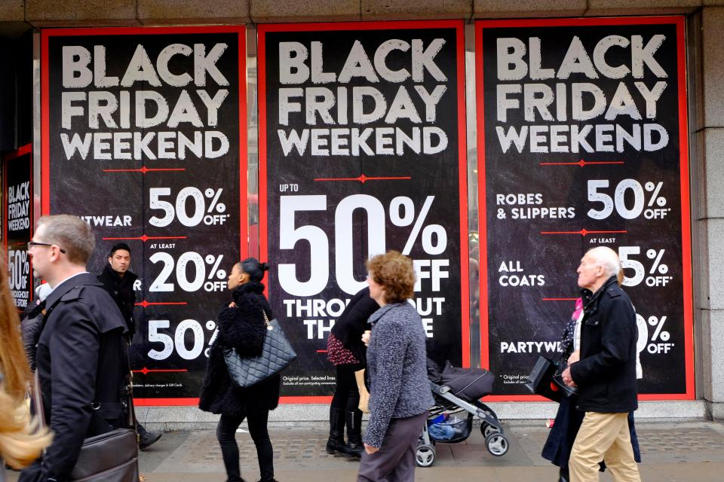

Slide 5
2. Why is it called Black Friday?
Because black refers to stores moving from the “red” to the “black”and black indicated a profit

Slide 6
3. When is Black Friday?
The Black Friday is 23 and 29 novembar, and is the day after Thanksgiving

Slide 8
4. What can you buy at the Black Friday?
At the Black Friday
people usually buy a Christmas present. The most shopped for items are electronics and popular toys.

