Slide 1
Barcelona & Catalonia
Yalina
Daniela
Liliana
Edwin

Slide 2
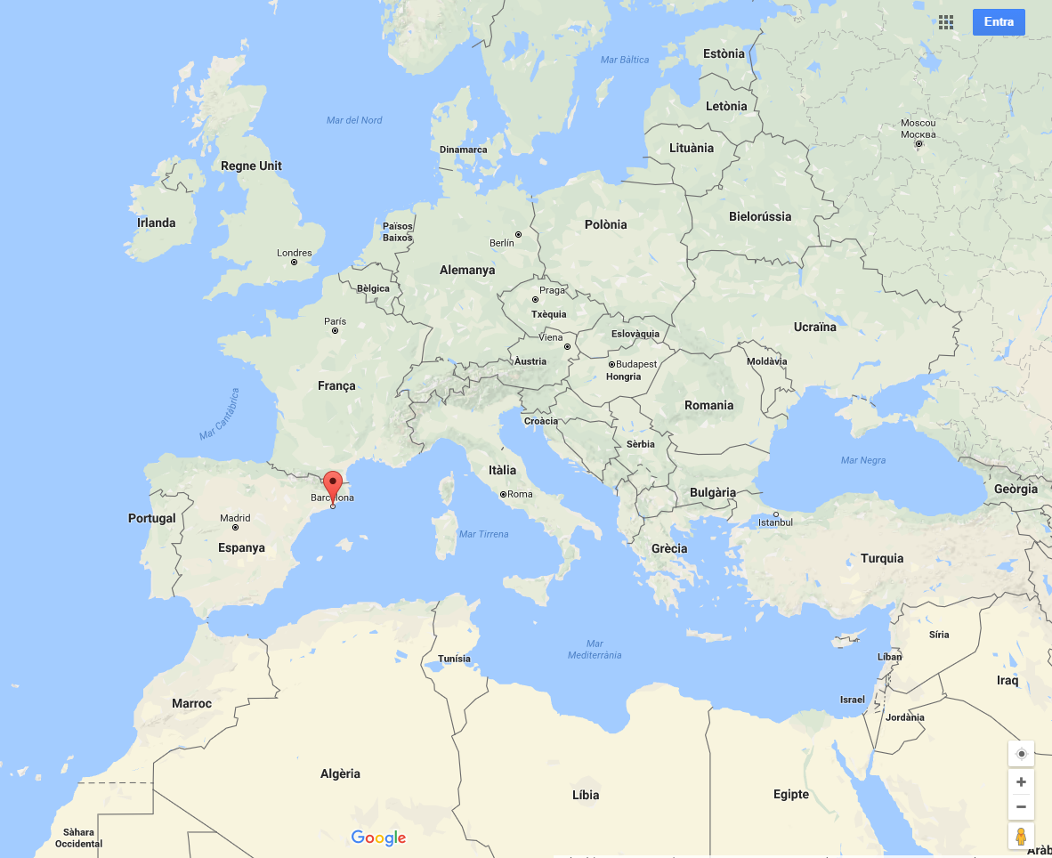
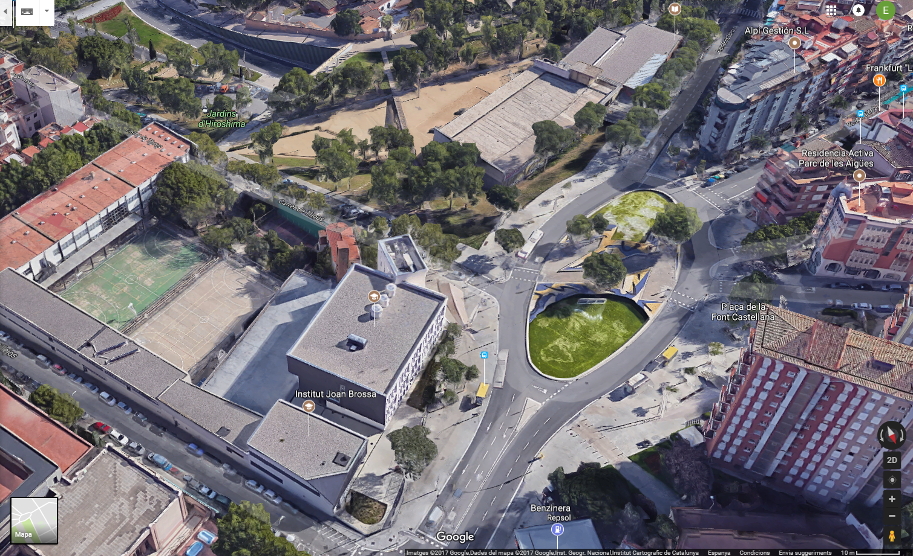
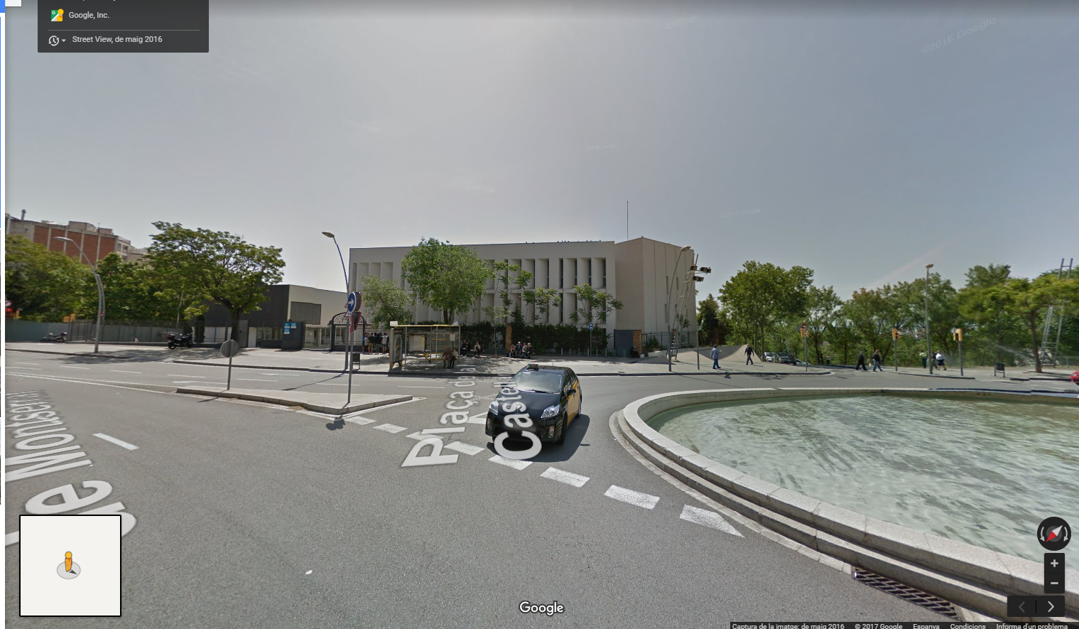
We are from Spain, we live in Barcelona, in catalonia
OUR SCHOOL IS IN A NEIGHBOURHOOD CALLED gUINARDÓ, METRO STATION alfoNS X

Slide 4
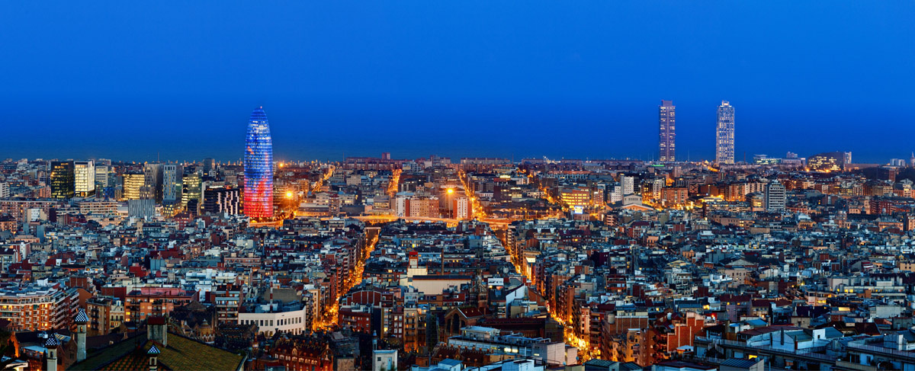
Barcelona
Barcelona is the capital and largest city of Catalonia, an autonomous community in Spain, and the country's second most populous municipality, with a population of 1.6 million within city limits.

Slide 5
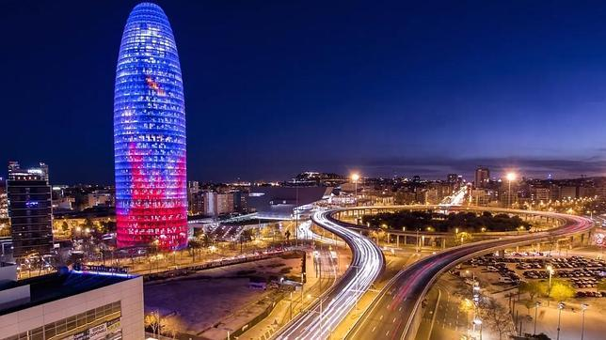
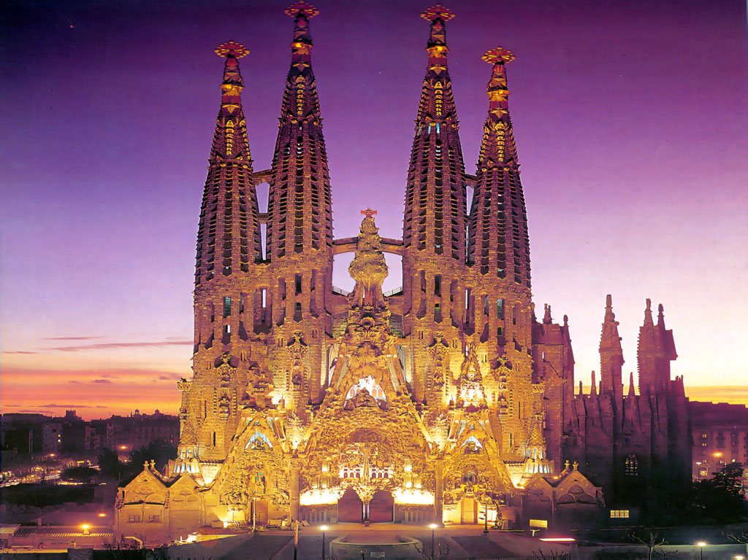
Monuments of Barcelona
The Glories Tower, formerly known as the Agbar Tower, is a skyscraper. Located in Plaça de les Glòries Catalanes, in the district of Sant Martí de Barcelona.
The Sagrada Família is a great Catalan churh in Barcelona, ​​Catalunya, Espanya.
It was designed by the Catalan architect Antoni Gaudí (1852-1926).

Slide 6
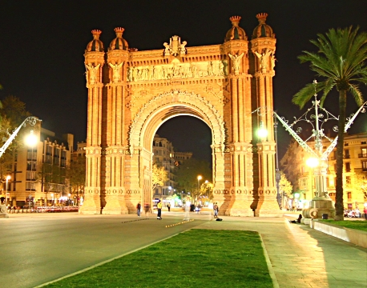
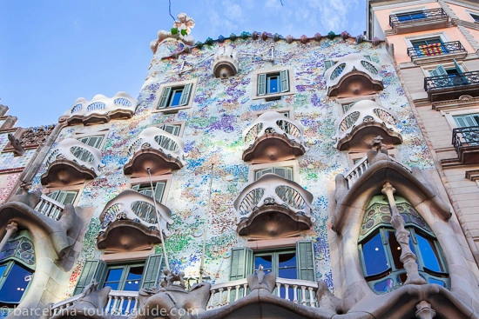
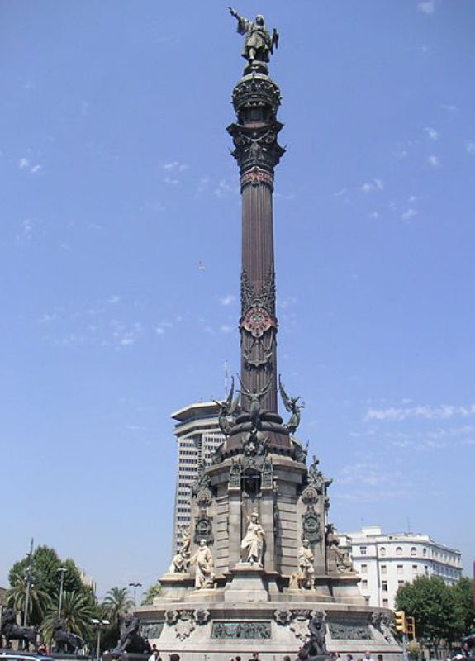
Casa Batlló It is a building designed by architect Antoni Gaudí, the highest representative of Catalan modernism. It is an integral remodeling of a building previously existing on the site.
Arc de Triomf It is a monument of Barcelona that is at the confluence between the Paseo de Lluís Companys (former Hall of San Juan), the Paseo de San Juan and the round of Sant Pere.
Monument Colón It is a sculptural complex located in the Plaça del Portal de la Pau in Barcelona, ​​in the Ciutat Vella district. Built in homage to the discoverer Cristóbal Colón

Slide 7
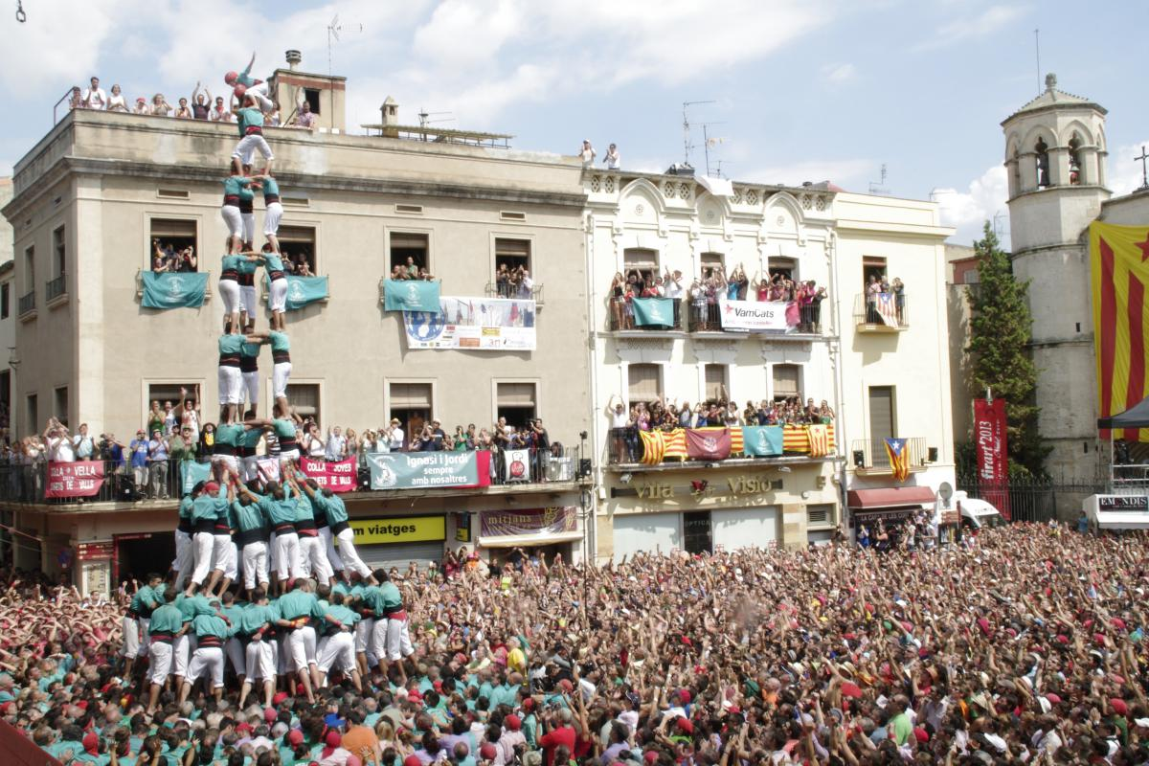
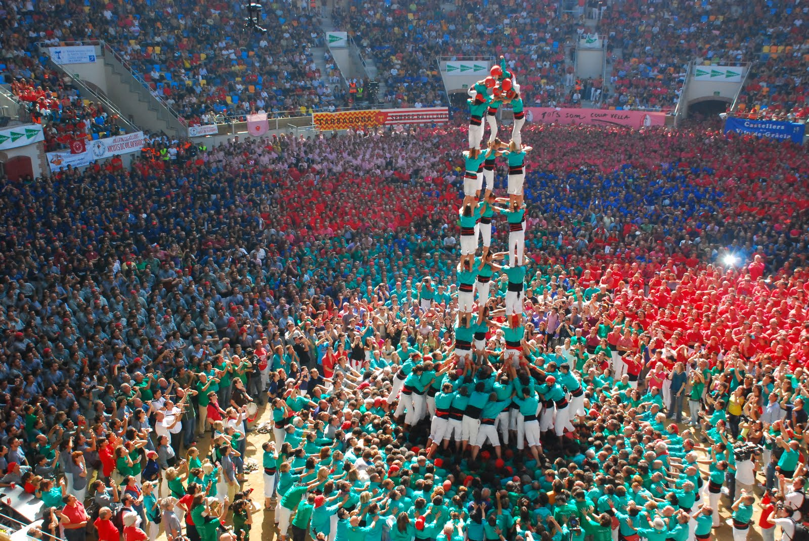
Castellers (Human Towers)
A castell is a human tower built traditionally in festivals at many locations within Catalonia. At these festivals, several colles castelleres (groups who construct towers) build their “castells”.
The tradition of building castells originated in the Ball dels Valencians, first documented in 1770s.
In the 1980s,the inclusion of women in the formerly male-only discipline inaugurated thegolden age) of castells permitting the construction of previously undreamed-of 9 and 10-storey castells.

Slide 8
*Thank you very much
*Muchas gracias
*Moltes gràcies
*Grazie mille
*Merci beaucoup

