Slide 1
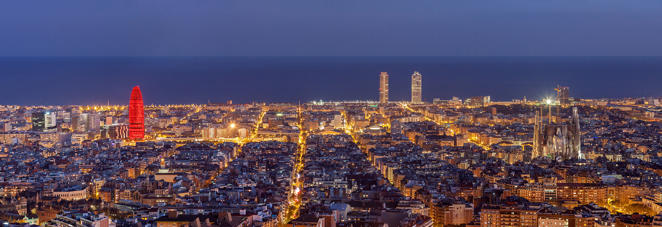
Christmas Markets

Slide 2
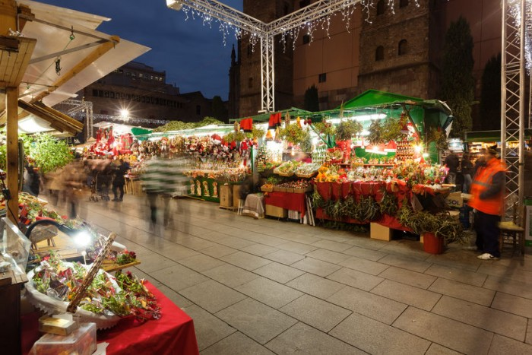
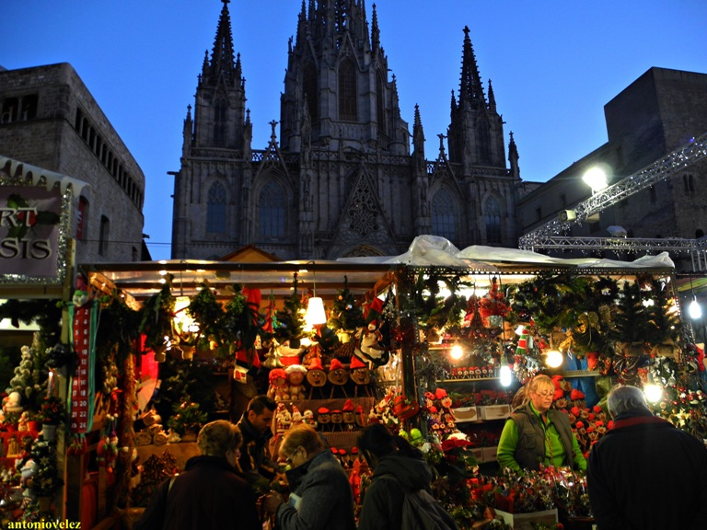
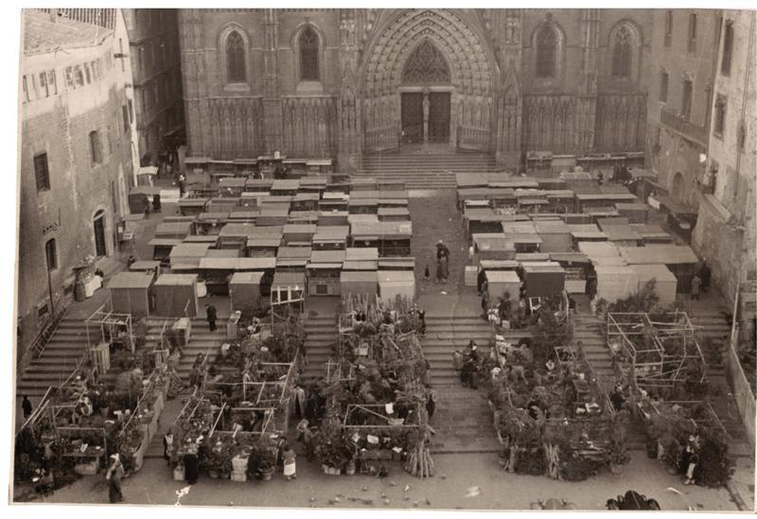
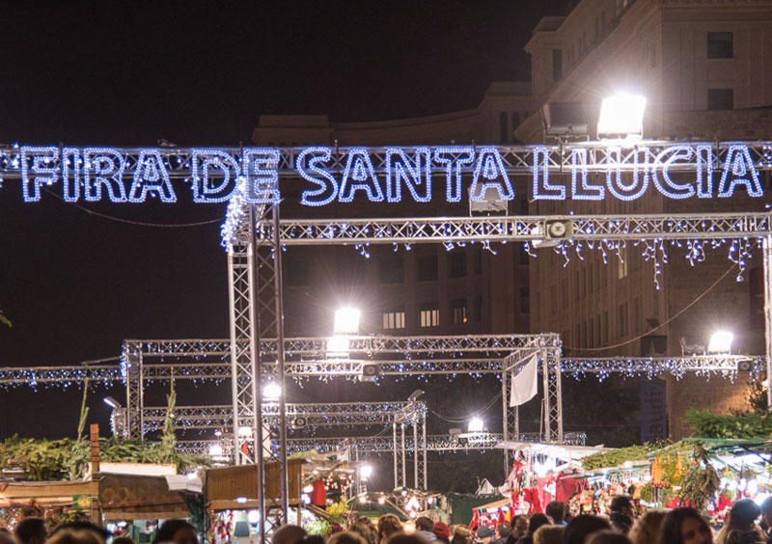
Feria de Santa Lucía “ Barrio Gótico
It is the main Christmas market in Barcelona and one of the oldest in the city. As every year, the Plaza de la Catedral, located in the Gothic Quarter of the city, gives its space to celebrate this traditional festival where you can find from very authentic cribs and unique Christmas trees to handmade Christmas decorations and classic sweets of these dates.
It opens its doors on November 23rd and closes the doors on November 24th. This year it celebrates the 231st anniversary (1786-2017)

Slide 3
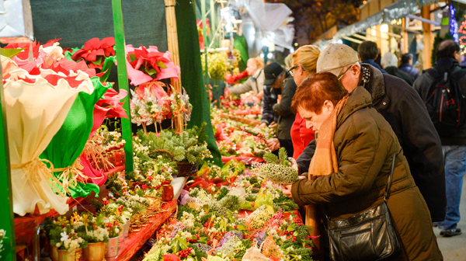
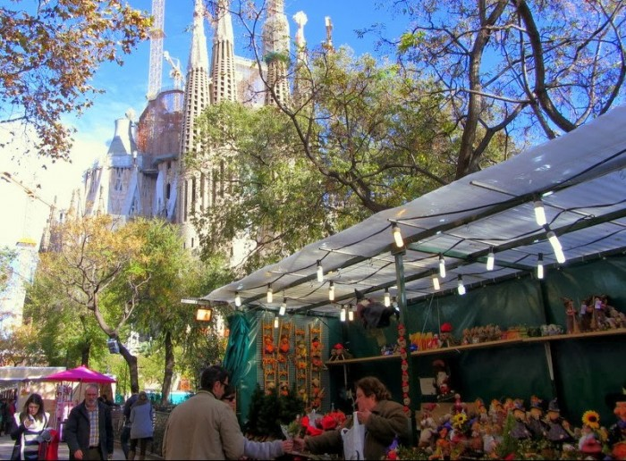
“Sagrada Familia” Christmas Market
It is located in front of the well-known church Sagrada Familia.
Artisans, artists and exhibitors offer the best of their works so that you can take home beautiful Christmas decorations and classic sweets of the season.
From November 28 to December 23

Slide 4
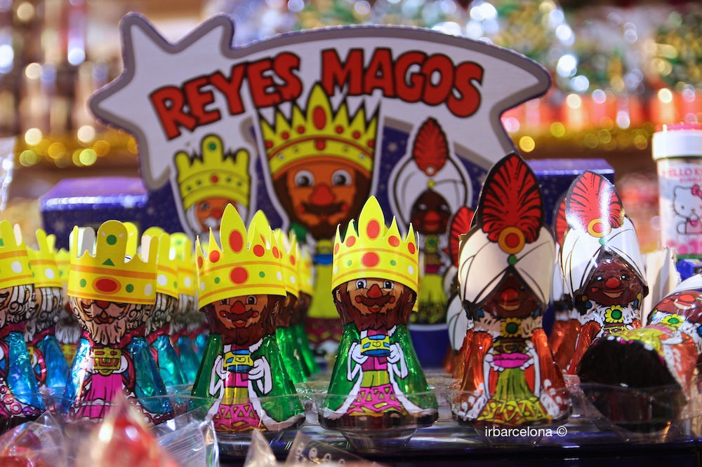
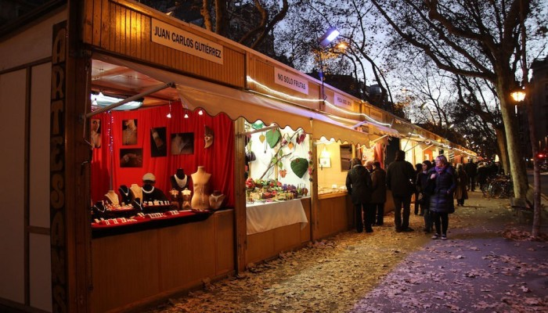
“Gran via” Christmas Market
It was held for the first time so that children could choose the toys they wanted for Christmas. The one dedicated to children is very close to the Plaza de Cataluña and another, the handicraft market, is located practically in Plaza España.
From December 18 and until January 6.

Slide 5
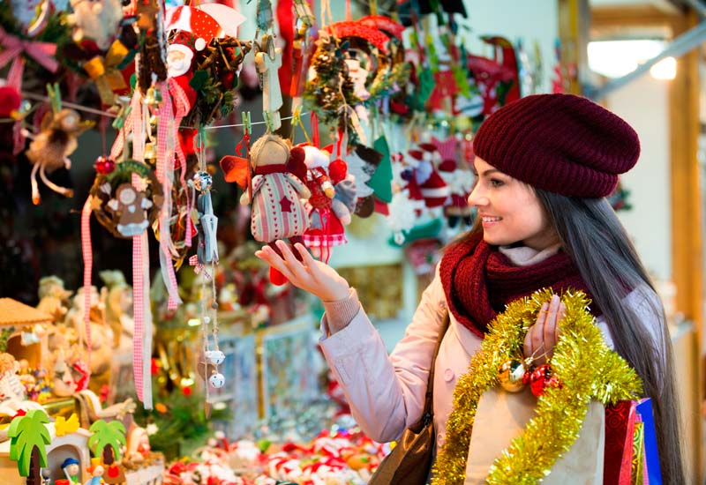
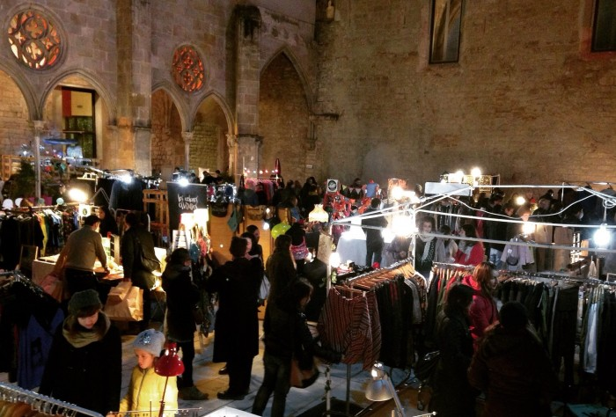
“El zapato rojo” Christmas Market
There we can find the best proposals of fashion designers, graphics and contemporary interiors.
The market has assigned an area for children where they can play at will and enjoy children's workshops, puppet theaters and music and dance shows.
It takes place on December 19 and 20 in the arches of the Convent of Sant Agustí.

Slide 6
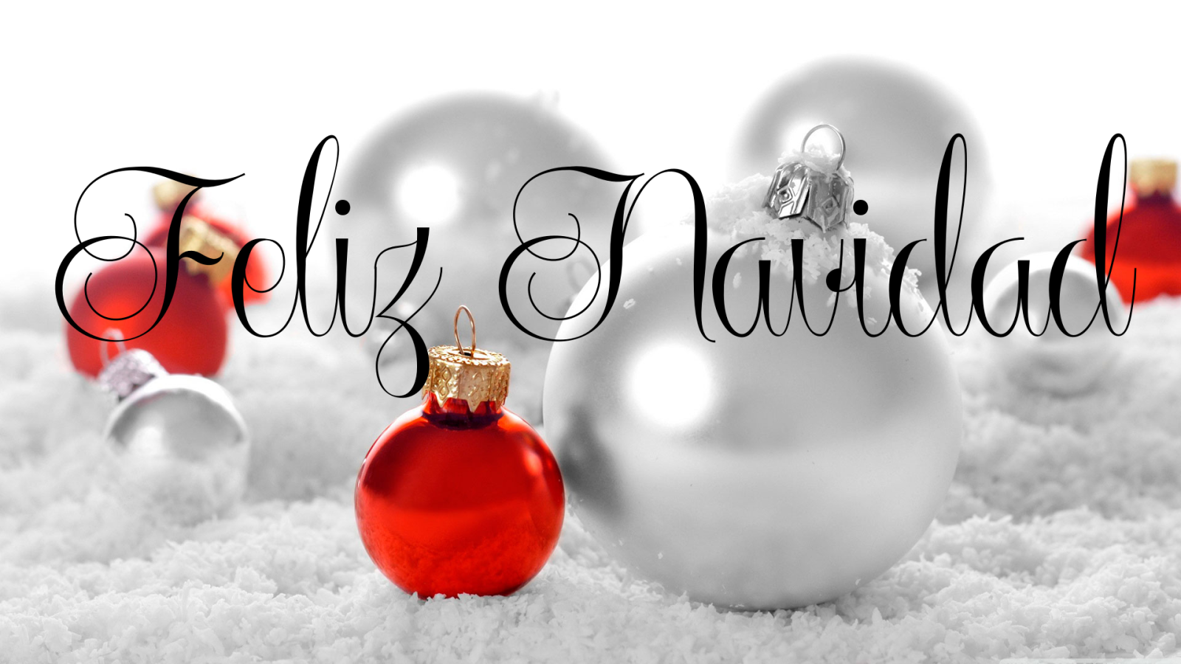
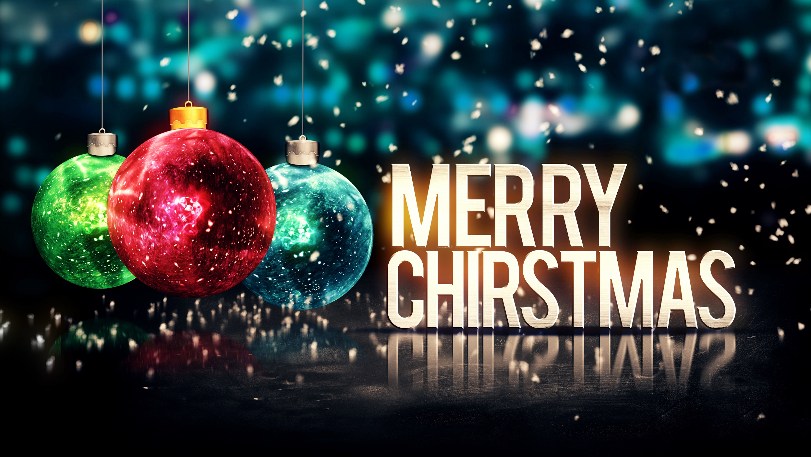
Yalina Rossis
Daniela Dominguez
Edwin Vargas

