Slide 1
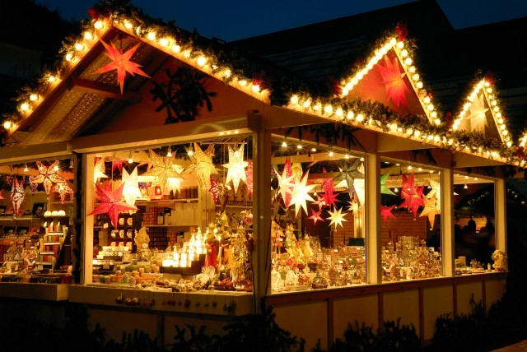
Christmas Markets
Jonatan Caballero
Ivan Zhou
Héctor Alvarenga

Slide 2
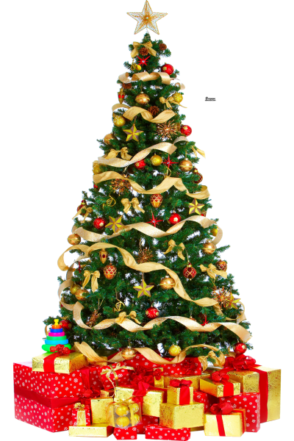
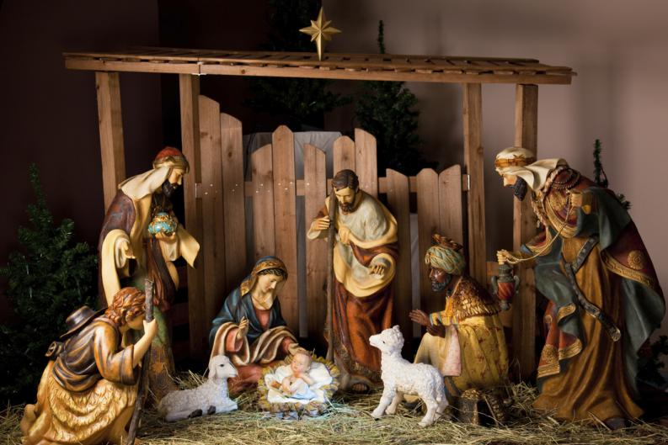
The Markets are open from November 24 to December 23
They sell Christmas products, to decorate Christmas trees, and pieces of Nativity.

Slide 3
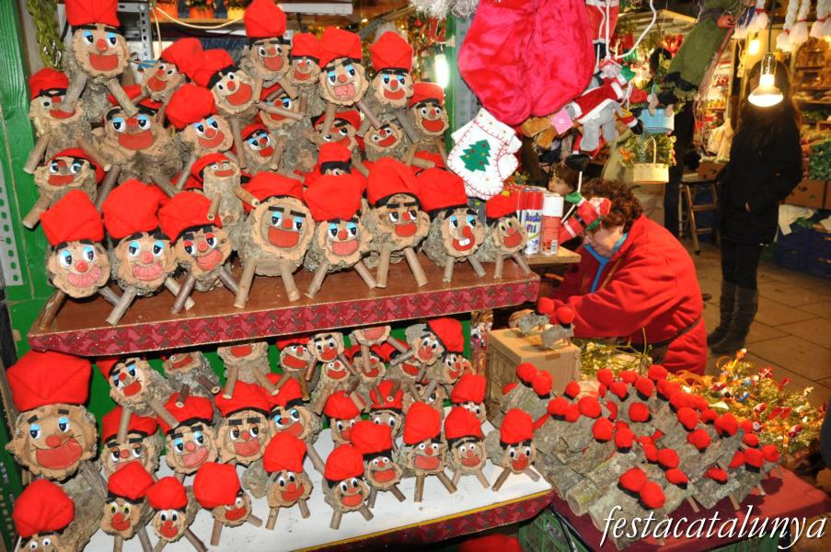
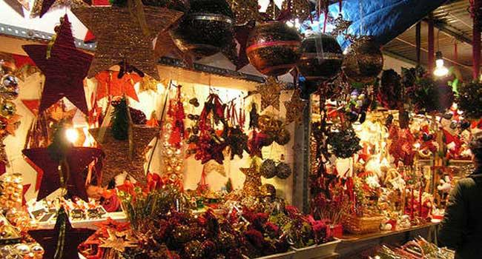
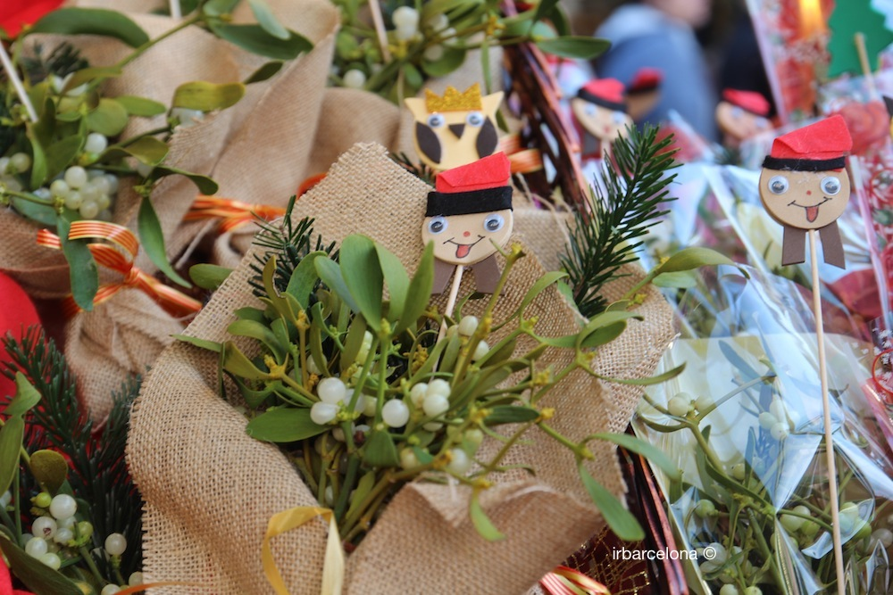
There are two markets in Barcelona: Cathedral of Barcelona and Sagrada Familia.
Here are some examples of the products they sell.

Slide 4
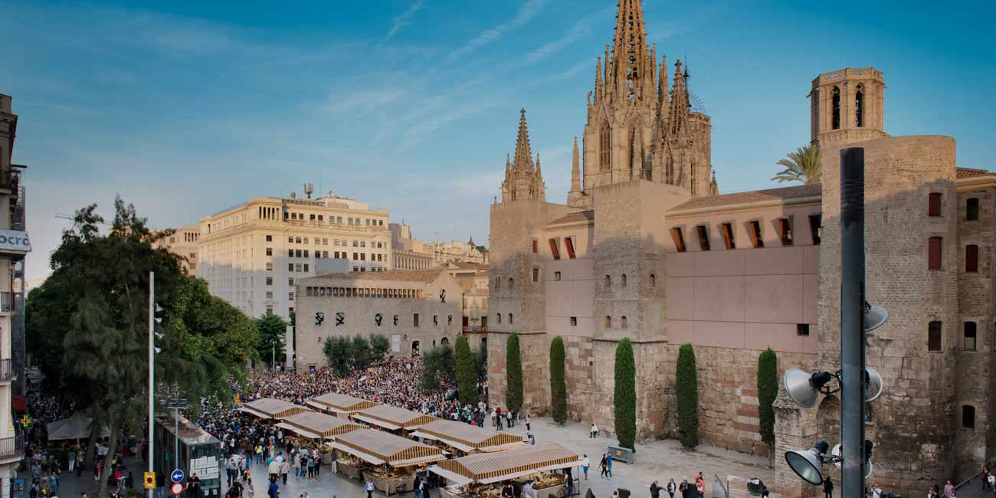
Christmas Market “Cathedral of Barcelona”

Slide 5
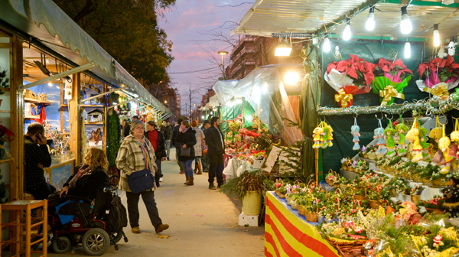
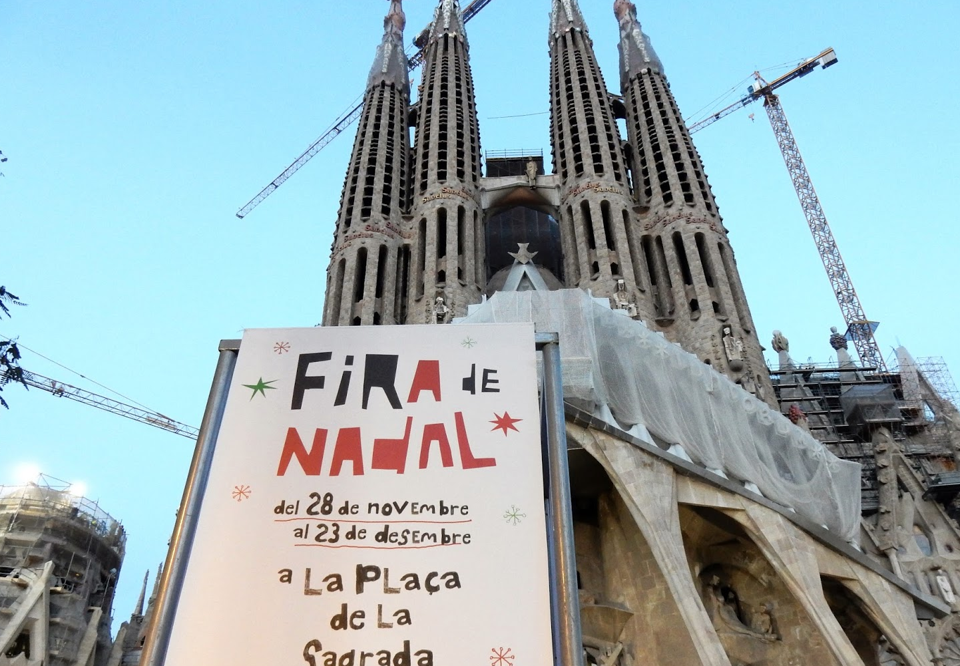
Christmas Market “Sagrada Família”

