Slide 1
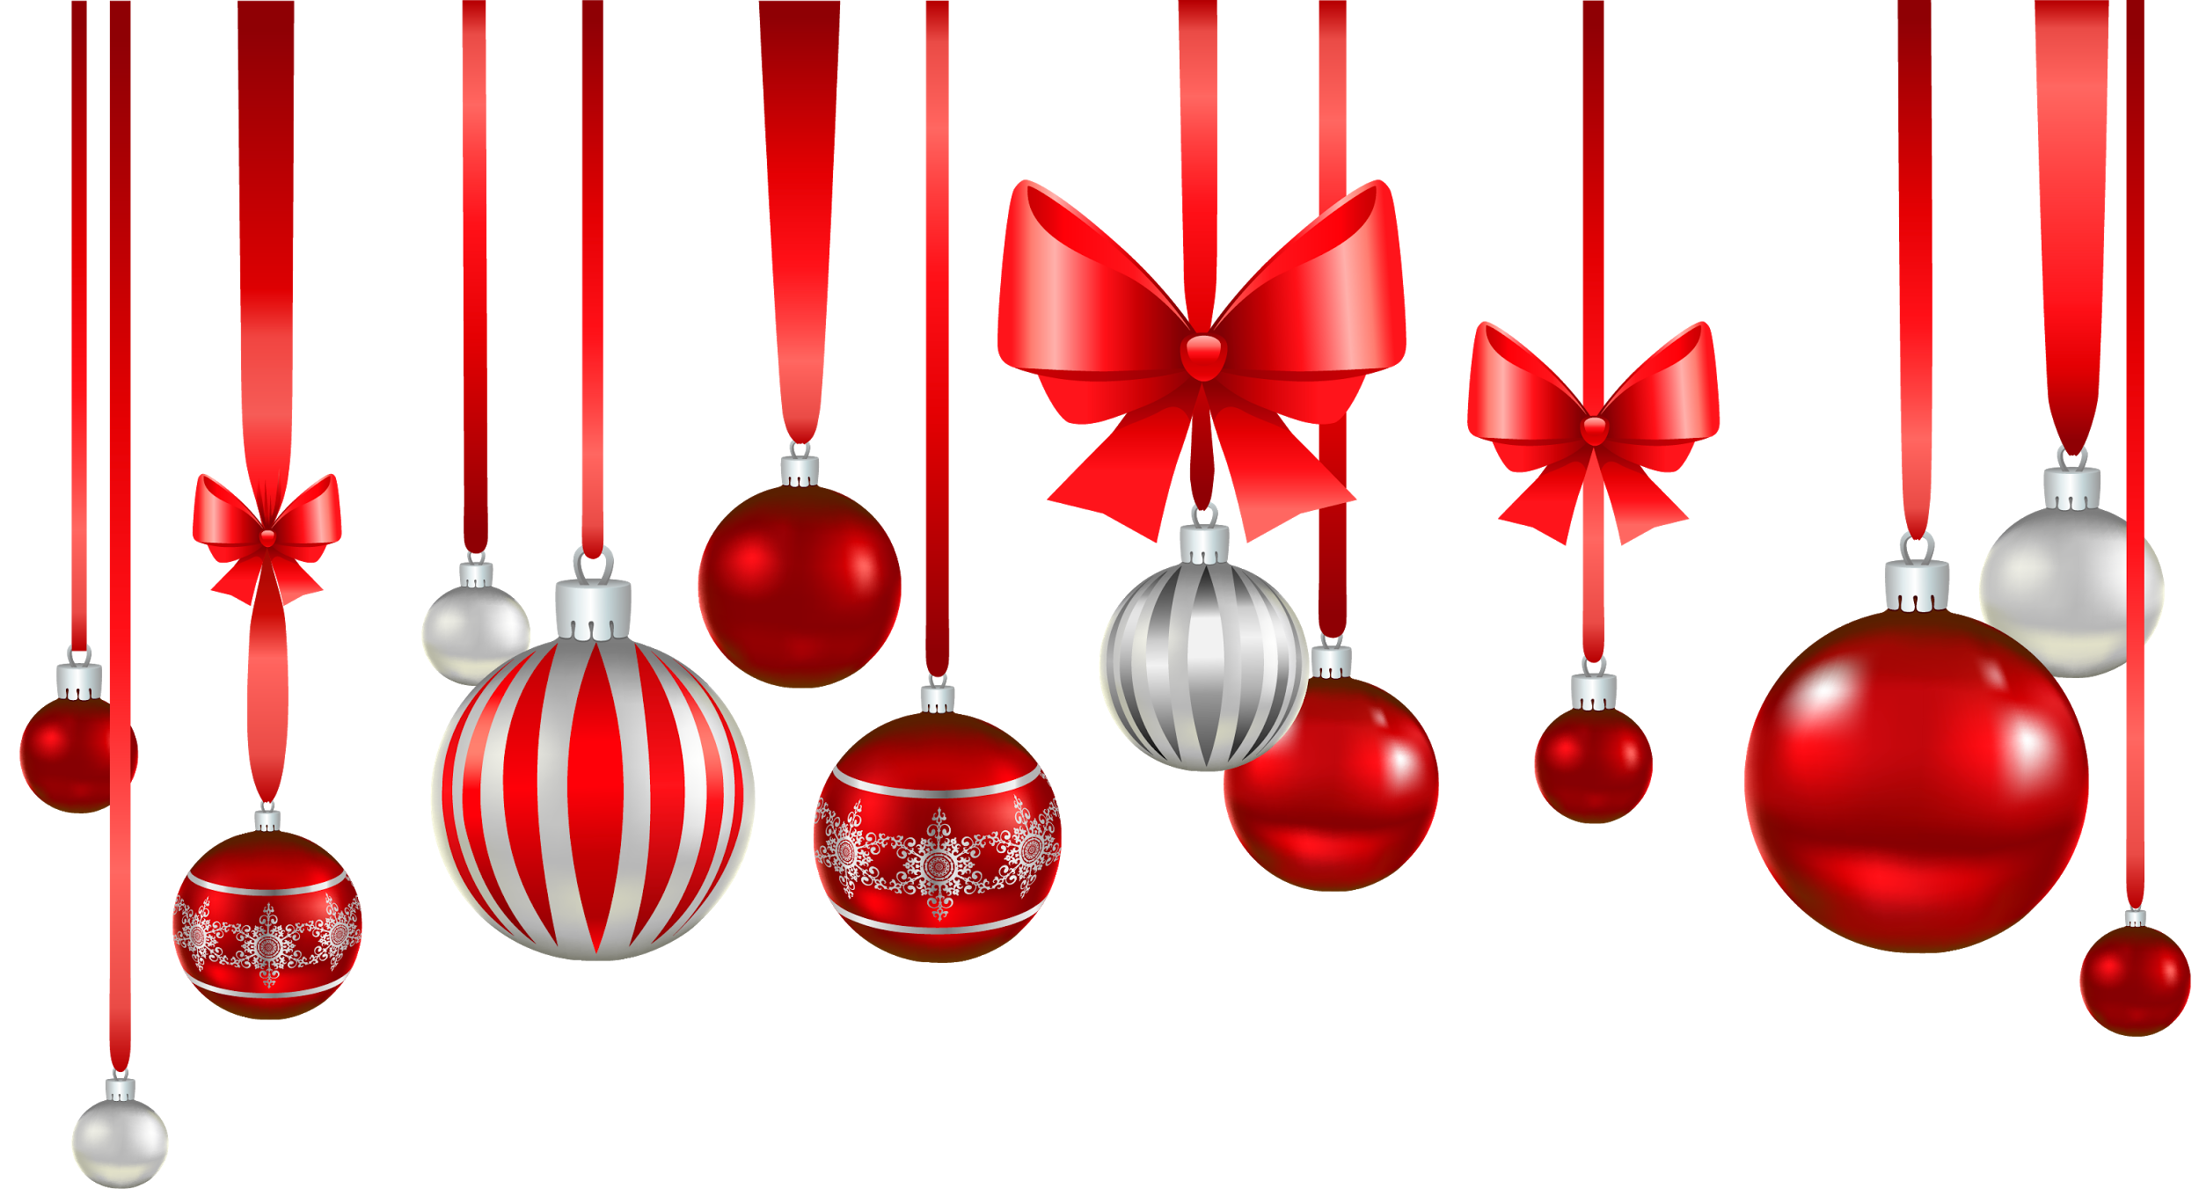
CHRISTMAS MARKETS
in Barcelona
Marta Santos
Nihad Hizoune

Slide 2
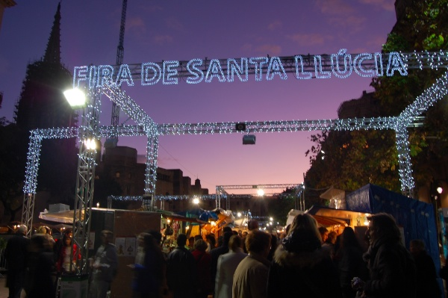
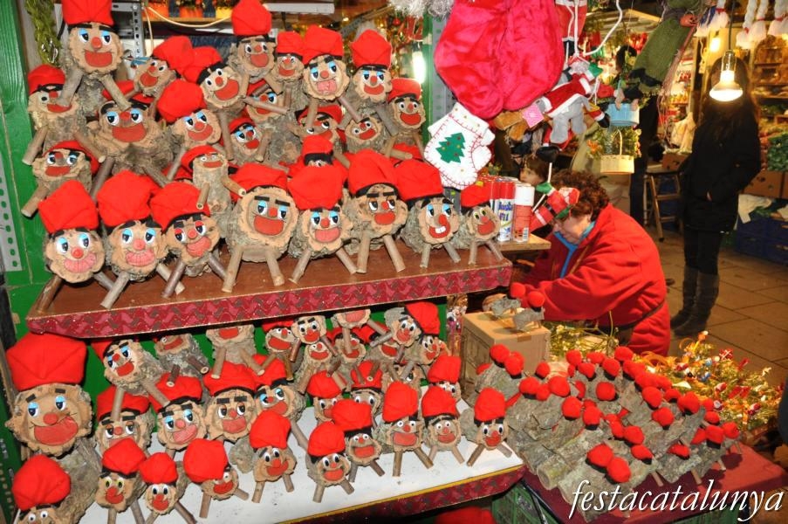
Fira de Santa Llúcia
It starts in November. It’s open from 10:30 to 20:30 (business days)and from 10:30 to 21:30 in holidays.
It’s the most popular in Barcelona because it opens every year from a long time ago. This market is located in Plà de la Seu in front of the Cathedral.

Slide 3
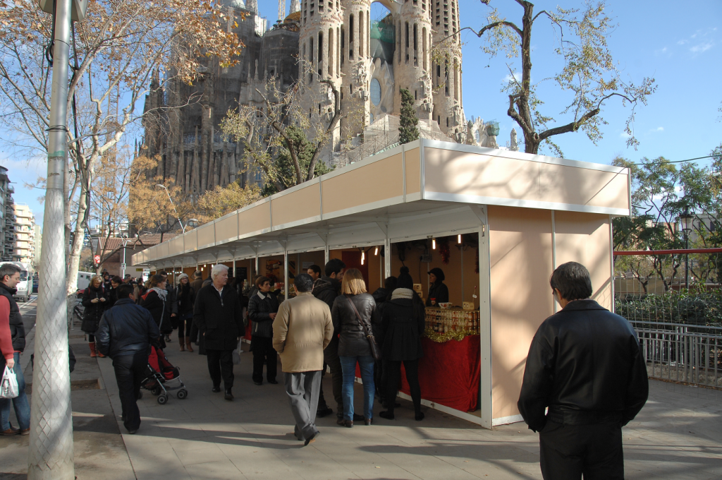
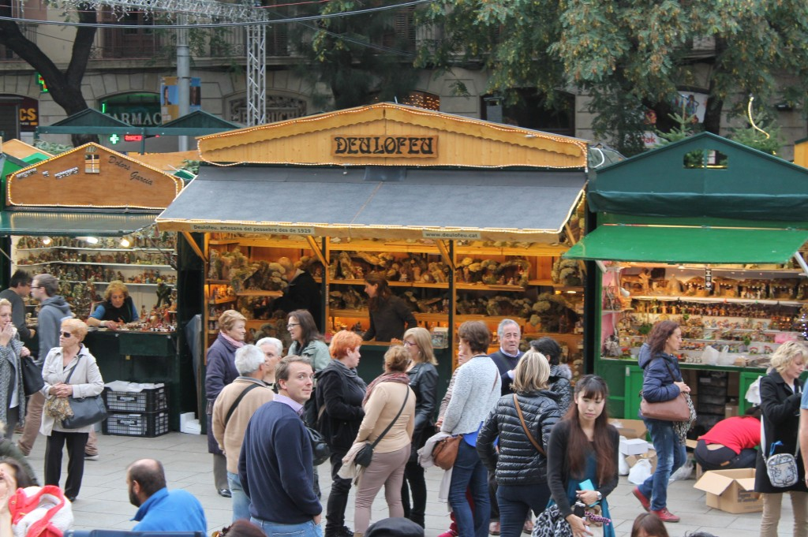
Fira de Nadal a la Sagrada Família de Barcelona
This Christmas market was born in the sixties and since then it opens every year next to La Sagrada Família which is a tourist location.

Slide 4
Sitges Christmas Festival
Here you can make Christmas crafts and they will sell for free during the holidays.

Slide 5
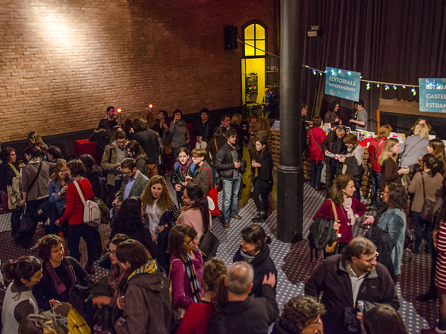
Mercat de Nadal del Llibre a Barcelona
The Mercat de Nadal del Llibre is one of the most important literary events of the year that has been consolidated as the Sant Jordi de Nadal. Different activities take place.
They bring together leading authors to make their work known in the near future and, if you wish, you can get signed and dedicated books.

Slide 6
MERRY CHRISTMAS EVERYONE!
Thank you for your attention and...

