Slide 1
ACTIVITATS COMERCIALS
Commerce and Sales
Alejandro Aponte
Emil Thiomirov
Marta Santos
Rosabel Soler
Nihad Hizoune

Slide 2
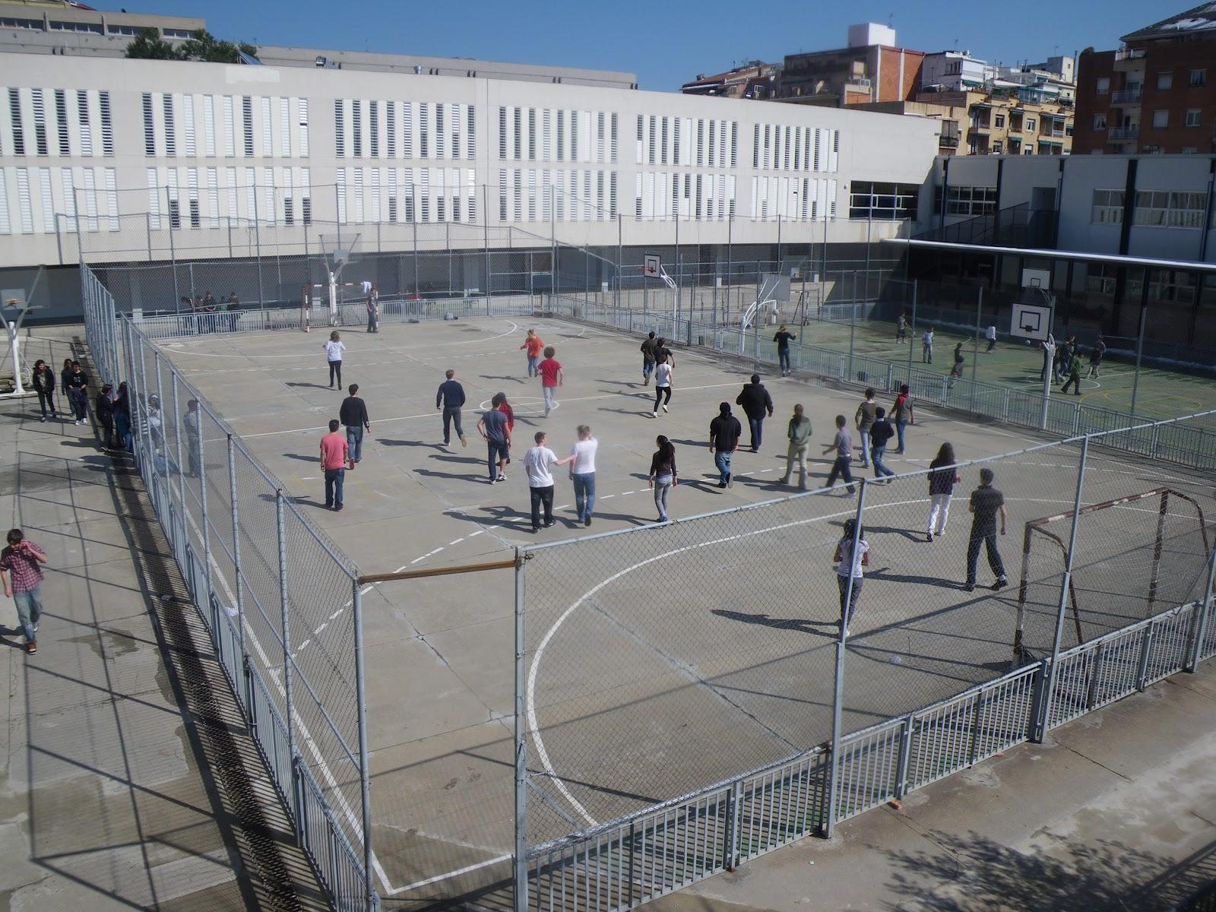
Vocational training
Lower degree
2 years: 2000 hours.
Commerce and marketing.
Schedule: 8am - 2:30pm.

Slide 3
Trainships
Where?
Desigual Corte Inglés
Decathlon InterKits
Casa Ametller Fnac
ETC. ETC.
DUAL
FCT

Slide 4
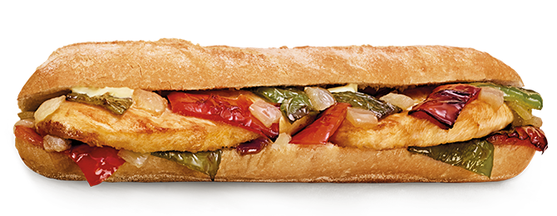
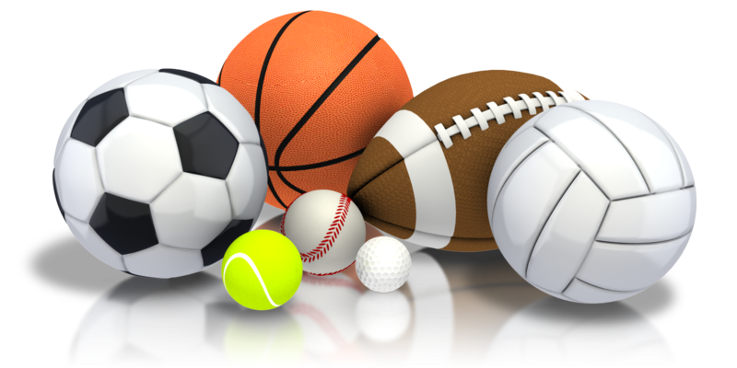
SCHEDULE
First Year (Monday - Friday)
Second Year (Monday, Tuesday, Wednesday and Friday)
8:00 - 9:00 | Class
9:00 - 10:00 | Class
10:00 - 10:20
10:20 - 11:15 | Class
11:15 - 12:10 | Class
12:10 - 12:40 | Cross Curricular Activities
12:40 - 13:35 | Class
13:35 - 14:30 | Class
9:00 - 10:00 | Class
10:00 - 10:20
10:20 - 11:15 | Class
11:15 - 12:10 (friday) | Class
12:10 - 12:40 (monday-wednesday) | Cross Curricular Activities
12:40 - 13:35 (monday-wednesday) | Class
13:35 - 14:30 (monday-wednesday) | Class

Slide 5
Modules of the intermediate level cycle of COMMERCIAL ACTIVITIES
Are there any issues that are very important to us?
Promotion of the point of sale
Purchasing management
Management of a small business
Sales processes
Commercial attention services
Warehouse techniques
Computer applications for commerce

Slide 6
Access conditions at an Intermediate Level
- Degree of E.S.O. (Compulsory Secondary Education) - Entry Exam to Intermediate Level - Degree of PFI with entry exam - Degree of PQPI

Slide 7
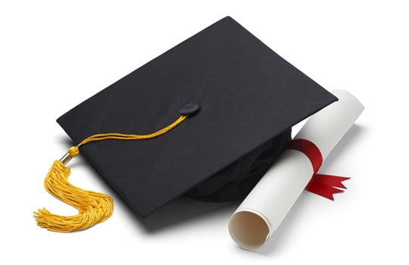
ACCESS TO HIGHER EDUCATION
Students who pass the training cycle obtain a technical degree, which allows access to:
The baccalaureate
A higher degree cycle (you have to pass the entrance exam).
The entrance exam can be taken by all students who are 19 years old. Otherwise they can do a specific course to access upper grade cycles ("bridge" course) that once passed, allows them to enroll in a higher grade cycle.

Slide 8
INFORMATION ABOUT AVERAGE AND HIGHER DEGREE
What to study?
Medium-grade training cycles CFGM Commercial Activities and Dual with Decathlon, Norauto or Casa Ametller CFGM Dual Fashion Commercial Activities with Desigual, Coshop and Quetglas
Medium-grade training cycles CFGM Commercial Activities and Dual with Decathlon, Norauto or Casa Ametller CFGM Dual Fashion Commercial Activities with Desigual, Coshop and Quetglas
https://vimeo.com/163742095
https://vimeo.com/163742095

Slide 9
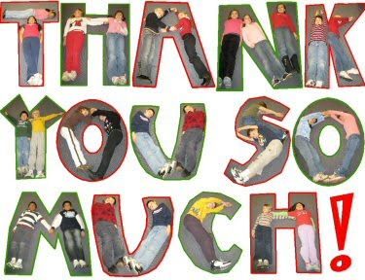
Thank you very much for your attention, we hope you liked it

