Slide 1
Carlos Almenara Jonatan Caballero
Ivan Zhou Héctor Alvarenga

Slide 2
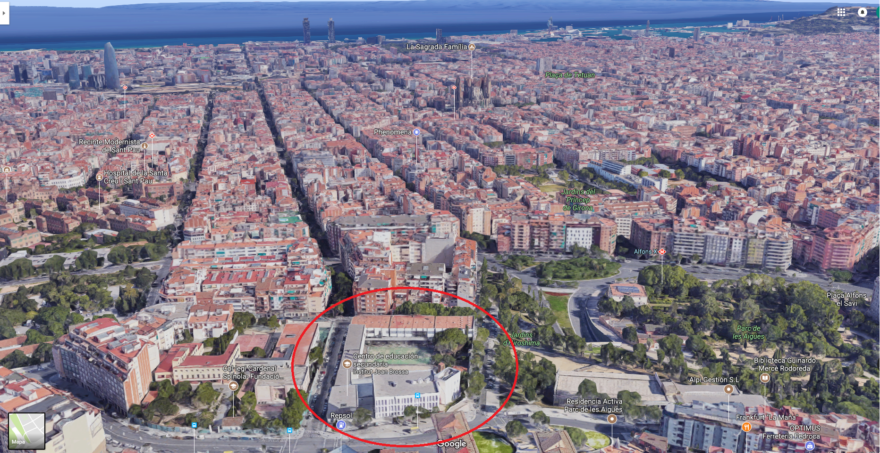
Where are we situated?
Address:
Av. Mare de Déu de Montserrat, 78
08024 Barcelona
Metro L4 Alfons X

Slide 3
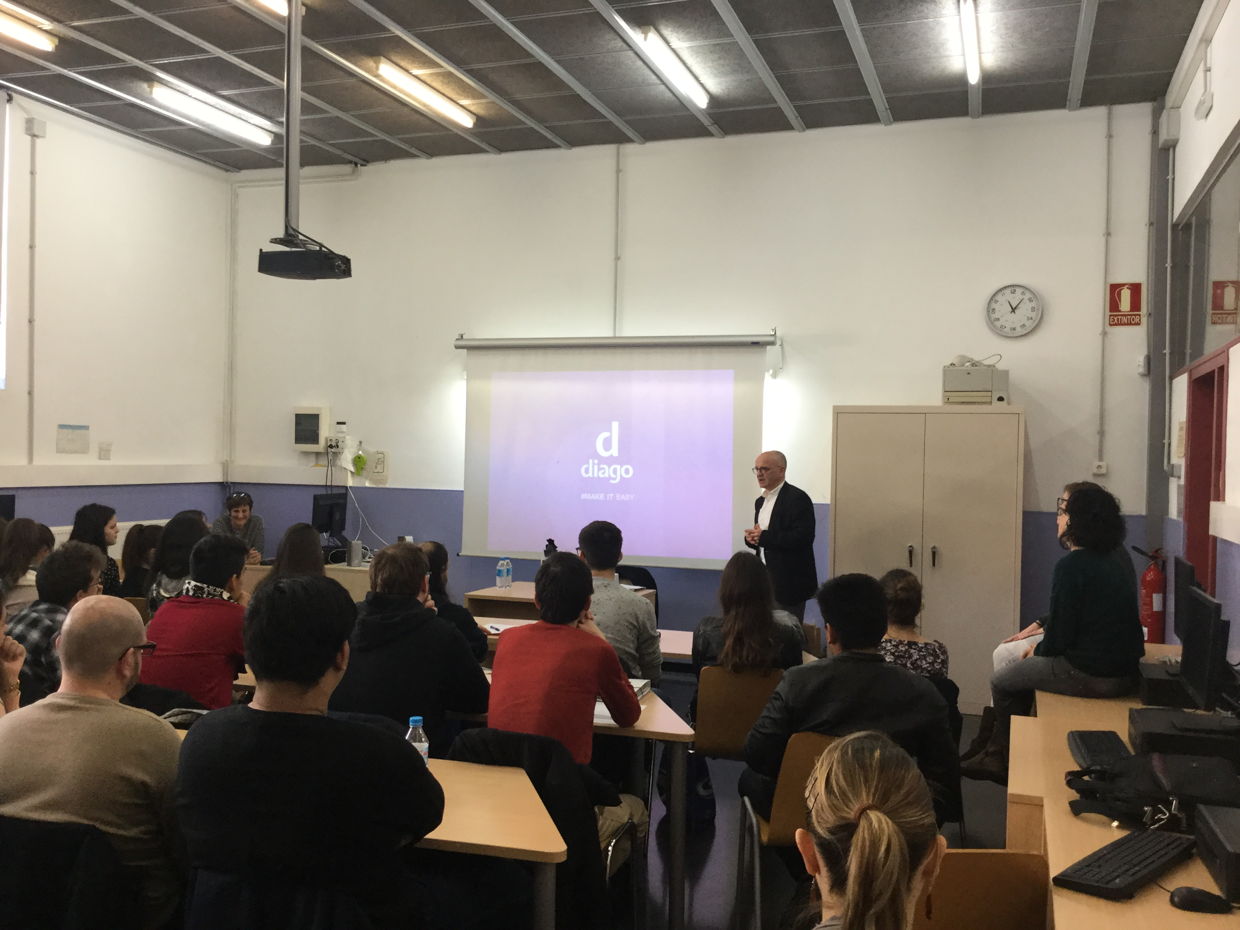
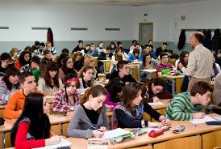
What can be studied ?
IES Joan Brossa is a public college located in Barcelona, not far from the city centre. This college provides secondary compulsory education and post-compulsory education.
The VET courses that this we are: Trade (intermediate course), International Trade (advanced course), Transport and logistics (advanced course), Sales Management and Marketing (advanced course) and Optical Lens (advanced course).

Slide 4
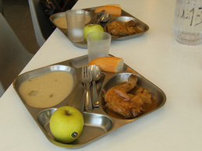
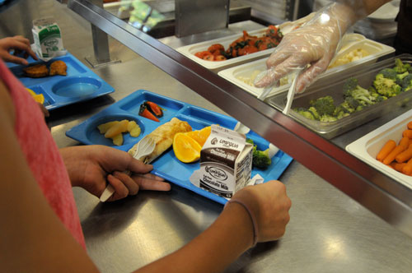
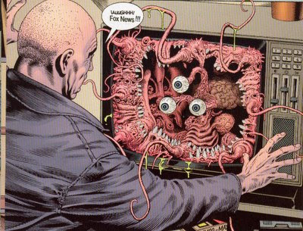
School canteen
If you want yo can eat in our school.
Prices vary according to the number of days you use this service. The sporadic ticket can be purchased early in the morning and its price is 7.70 euros.

Slide 5
STUDIES
In our school, from 12 to 16, pupils study ESO (compulsory secondary education). We try to plan and organize the groups and meet the needs of the students according to their academic career and with their aptitudes and attitudes.
When you finish the ESO you can choose to study, the baccalaureate or the VET
The baccalaureate are 2 years long, there are 2 modalities, technological scientist and the humanistic

Slide 6
Studies in Joan Brossa
ESO 4 Years.
Baccalaureate”Bachiller” 2 Years.
Training cicle “FP” 4 Years 2 Years (medium) and 2 Years (Superior grade).
If you are 16 years old and you do not have the ESO, you can choose to do PFI (Initial Professional Training) to have access to baccalaureate or Training cicle.

