Slide 1
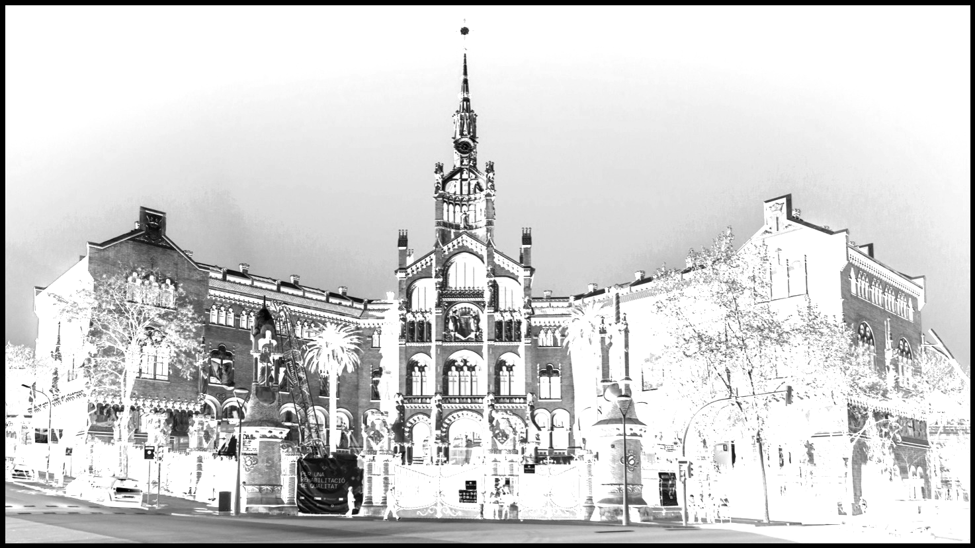
Our neighbourhood:
Guinardó
Alexis Escalante
Fiorella López
Saad Karimi
Conrad Cortinas

Slide 2
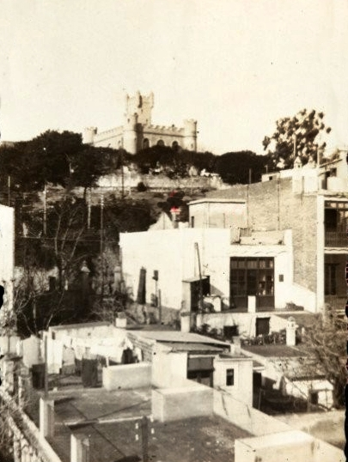
History
It begins in the old valley of Horta which is where the municipality of the same name developed until it was added, such as Gràcia, Sant Marti, etc…, Barcelona. It was a rural area and was urbanized mainly in the 50s of the 20th century, with an immigrant population from Catalonia and the rest of

Slide 3
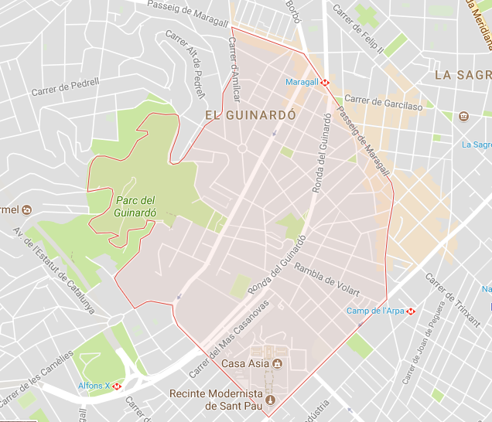
Location
The district of Horta-Guinardó, the third largest in the city, is located in the northeast of Barcelona, between those of Gràcia and Nou Barris, and is characterized by its rugged relief with mountains, hills and valleys.

Slide 4
Transport
Closest bus stops to Horta-Guinardó:
Alcalde De Móstoles - Guinardó is 28 m away, 1 minute walk
Guinardó-Parc De Les Aigües is 64 meters away, 1 minute walk
Lepant-Guinardó is 70 m away, 1 minute walk
Alfons X is 91 meters away, 2 minutes walk
Guinardó is located on L4, yellow line metro.
Between metro stations closest to the neighborhood guinardó include: Alfons X (L4), Guinardó i Hospital de Sant Pau (L4), Maragall (L4), Congrés (L5), Camp de l'Arpa (L5) ..
https://moovitapp.com/index/es/transporte_p%C3%BAblico-Horta_Guinard%C3%B3-Barcelona-efsite_5314c152e4b0d805d37b18de-362

Slide 5
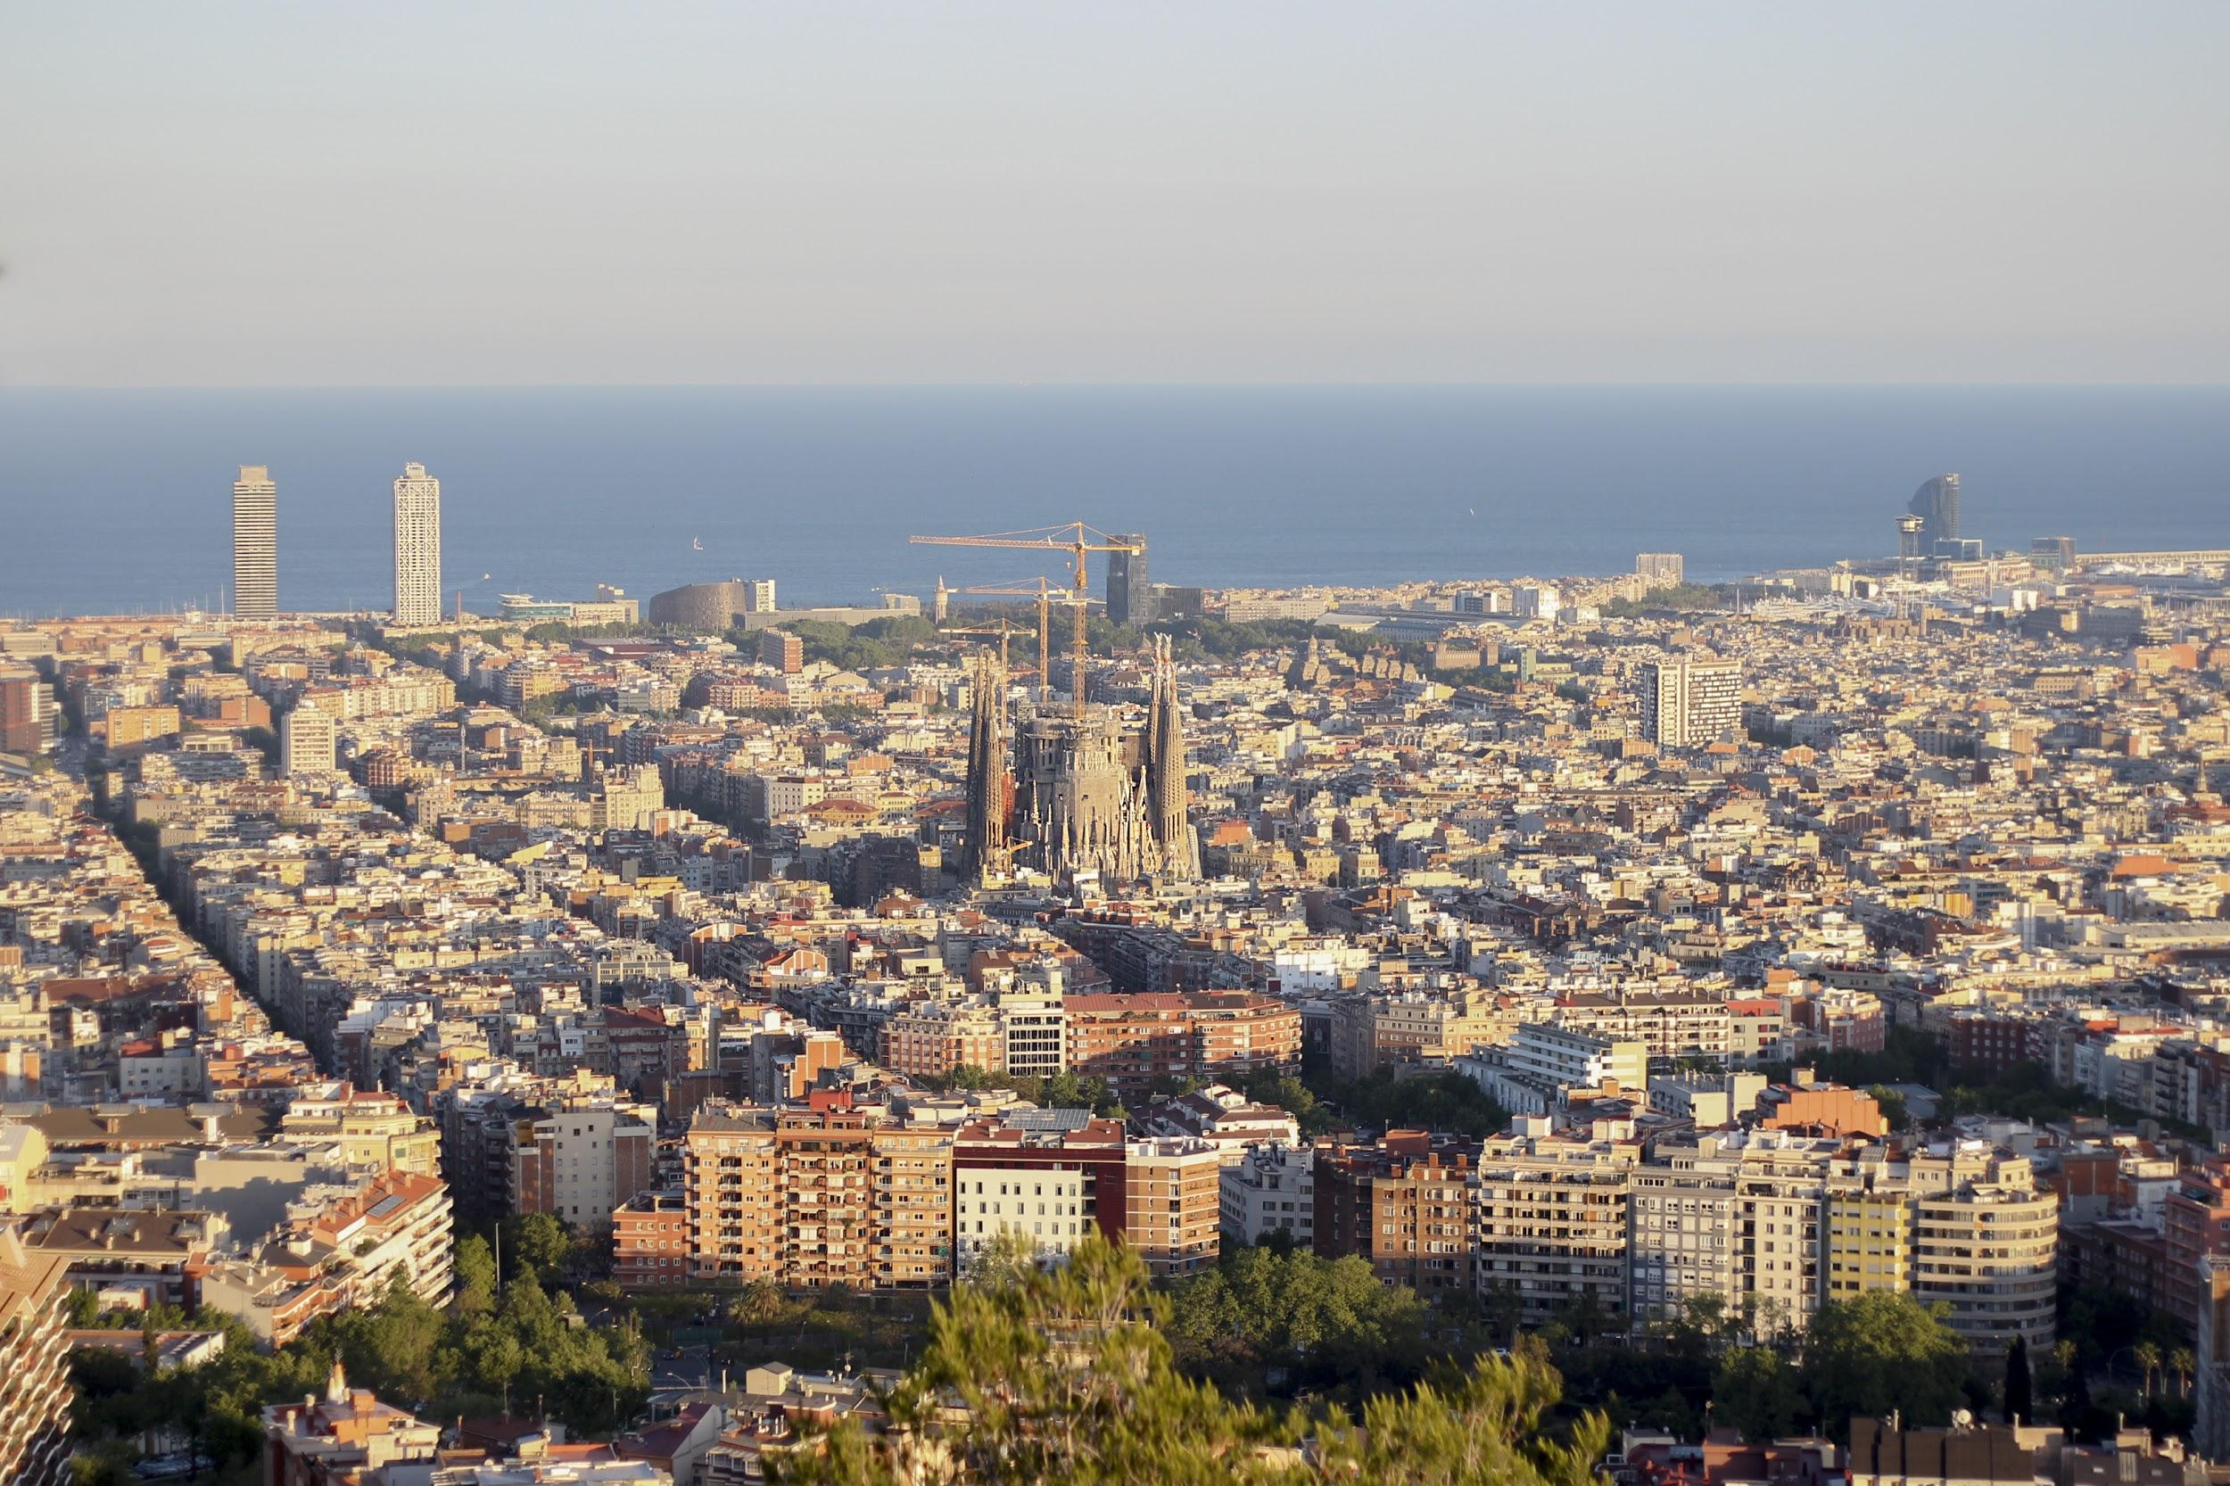
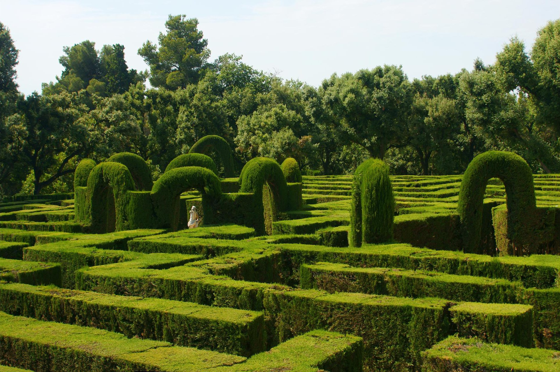
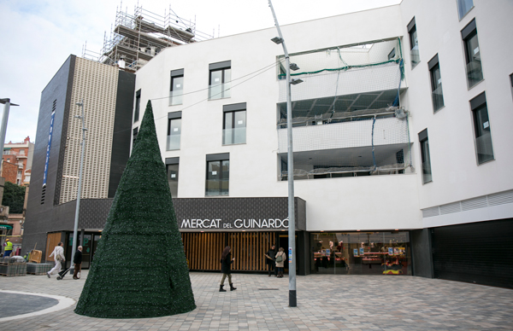
Equipments
The Guinardo neighborhood is a great viewpoint over the city. It is amazing.
It has one of the best viewpoints in the city, a library, a good food market, metro lines, bus, a large hospital, many types of bars, large parks and schools.

Slide 6
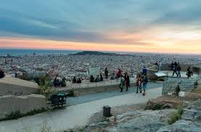
Tourist attractions
Its abundant green areas make it one of the most attractive spaces for those looking to enjoy the calm and the outdoors, a part of the park of Collserola, the park “dels Tres Turons”, with the spectacular Mirador del Turó de la Rovira.

Slide 7
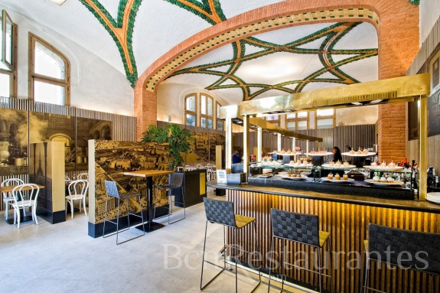
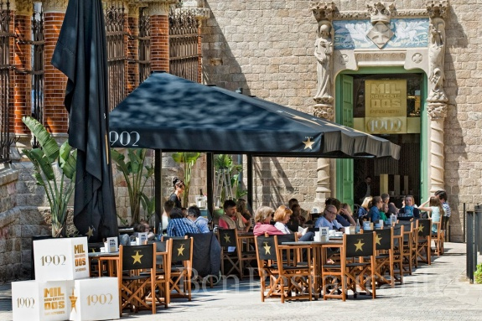
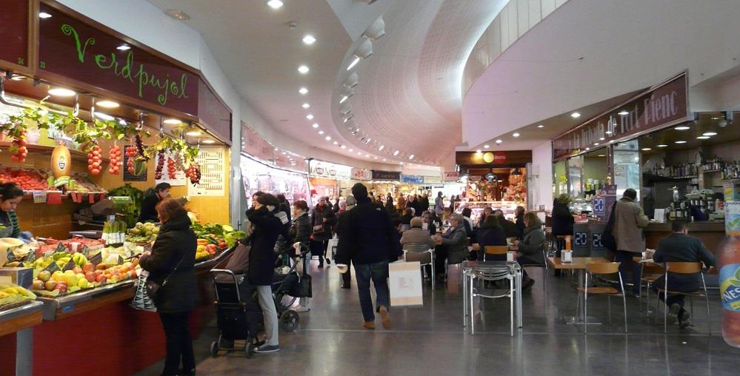
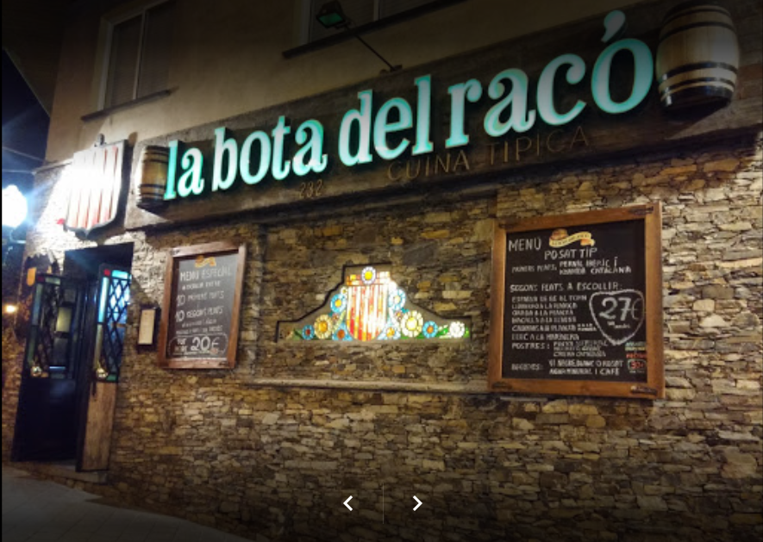
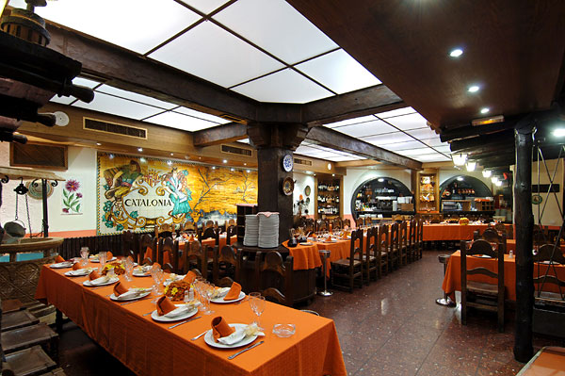
Commerce

Slide 8
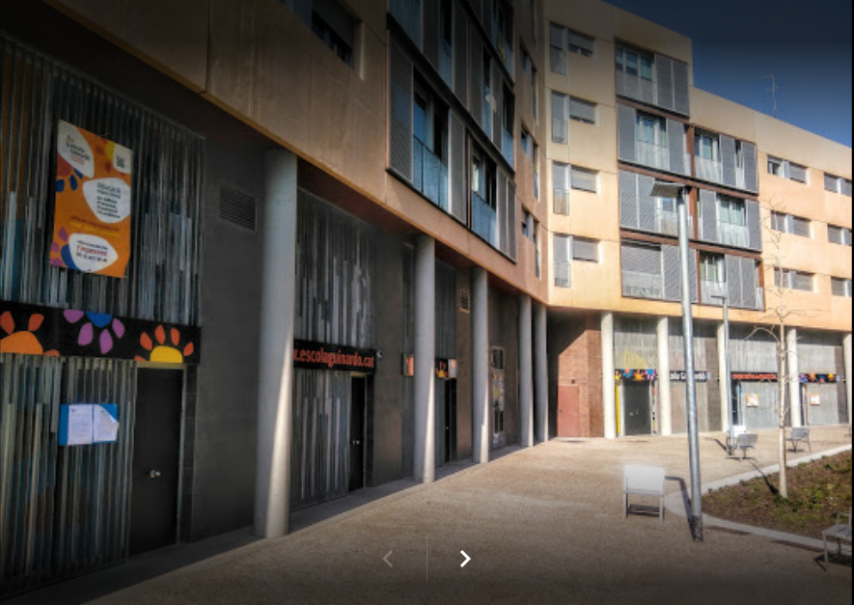
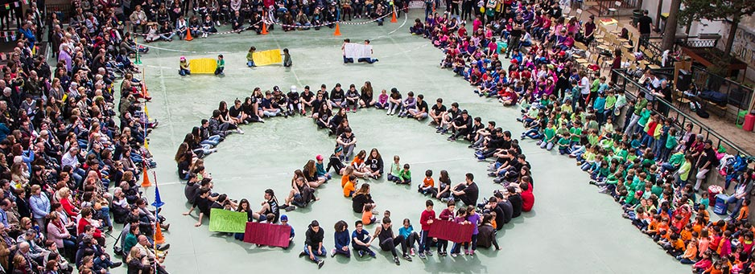
Guinardó School
The Guinardó School is in Barcelona, in the popular district of Guinardó. The school was born in 1927 and since 1986 is a cooperative of teachers. With 90 years of history.

Slide 9
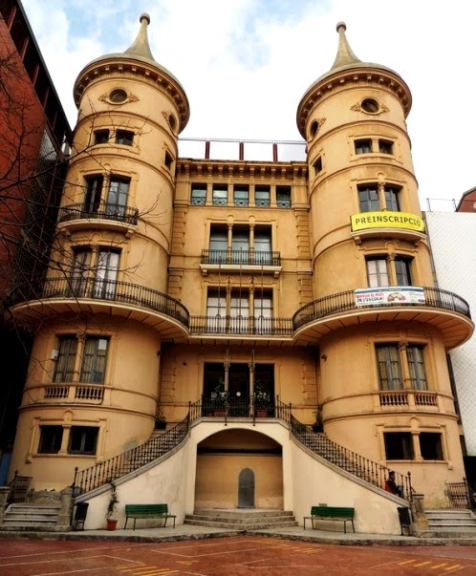
School Mas Casanovas
A school with a lot of history. At first, it was built as a luxury hotel with a medieval castle style. During the Civil War it was used as military barracks, and until 1950.
It is now a public elemmentary school in a building with more than one hundred years of history.

