Slide 1
Leisure time
Lukas Mihal and Jan Fikeis
10.12.2015

Slide 2
OUR FREE TIME
We like playing on computer or on mobile phone
We like going to the cinema
We like playing sports
We like hanging out with our friends
We like chating with our friends
We like watching videos on youtube
We like listening to music
We like watching films

Slide 3
Our favourite Computer games
Our favourite computer games are: Smite, League of Legends and Counter Strike : Global Offensive

Slide 4
Our favourite films
Our favourite films are: THG( The Hunger Games), The Hobbit,
X-men
Our favourite films are: THG (The Hunger Games),

Slide 5
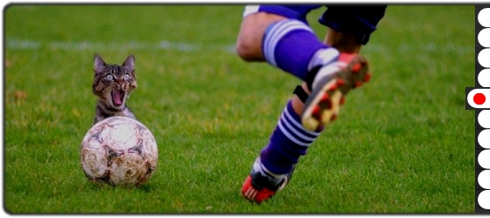
Our favourite sports
Our favourite sports are: Florball, Football, Ice Hockey
This is symbol of our favourite hockey club.

Slide 6
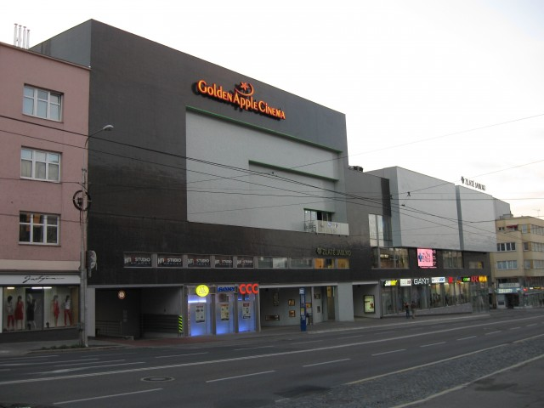
Hanging with friends
We sometimes go to KFC or to McDonald
We sometimes go to Golden Apple cinema
We sometimes go outside to play some sports
We never yet go to the disco party or to clubs
This is cinema in our city

Slide 7
Chating with Friends
To chatting with friends we using messenger (facebook), skype, instagram and snapchat
We chatting every day

Slide 8
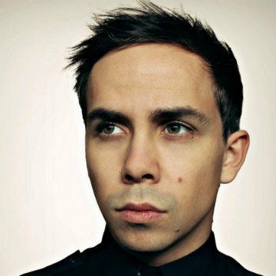
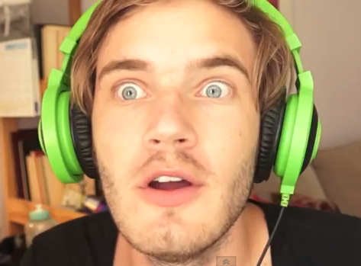
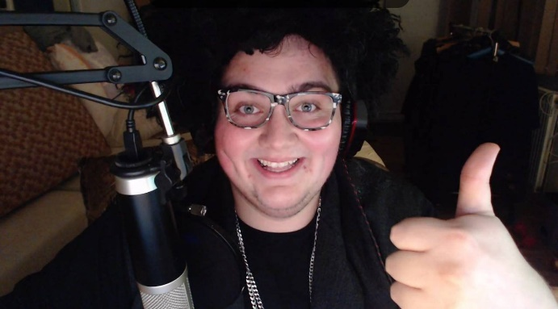
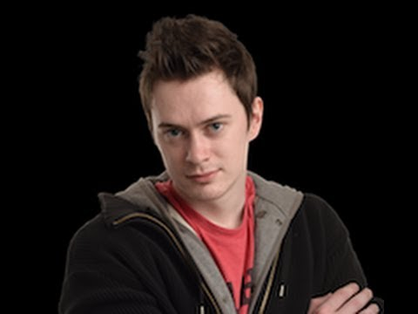
OUR favourite youtubers
Our favourite youtubers are: Hoggy, PewDiePie,FattyPillowTV , Herdyn
HOGGY
PewDiePie
FattyPillowTV
Herdyn

Slide 9
OUR favourite music
Our favourite music are : Europe: The Final Coundown, Nightcore: Runnin, Welcome to the world, Avicii: The Nights, AronChupa

Slide 10
THANKS FOR YOUR ATTENTION

