Slide 1
Tourist attractions
Michal Malinak and Filip Dolezel

Slide 2
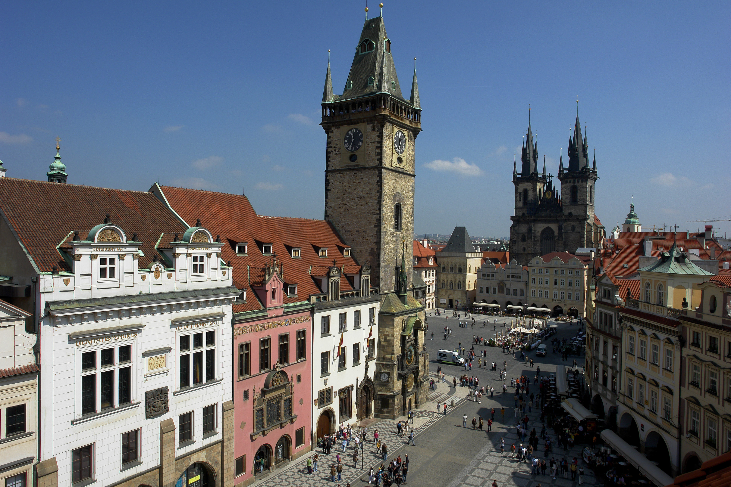
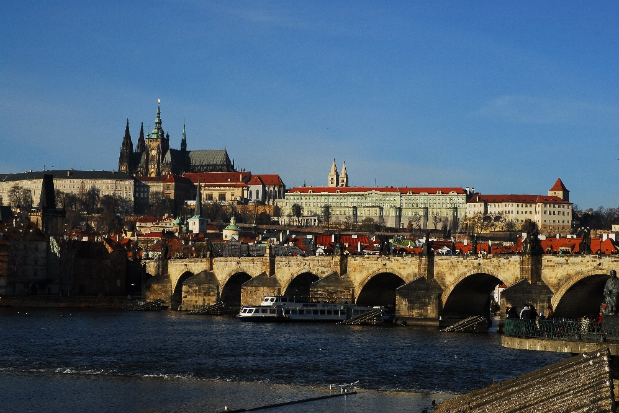
the Czech Republic
In the Czech Republic are many tourist attractions.
In Capital city, Prague are Prague castle, Charles bridge and Old town square with Astronomical Clock.

Slide 3
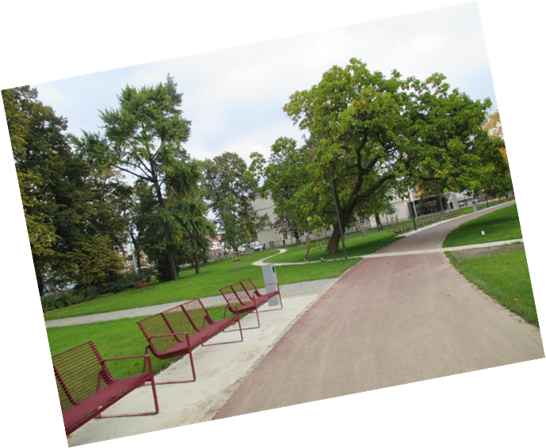
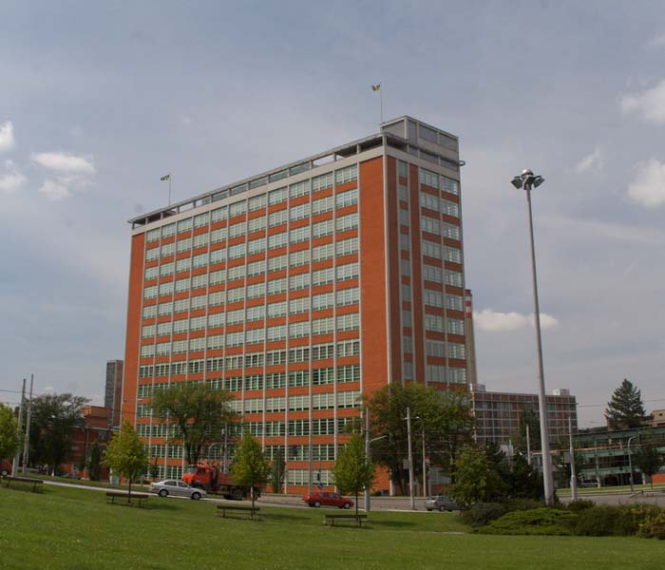
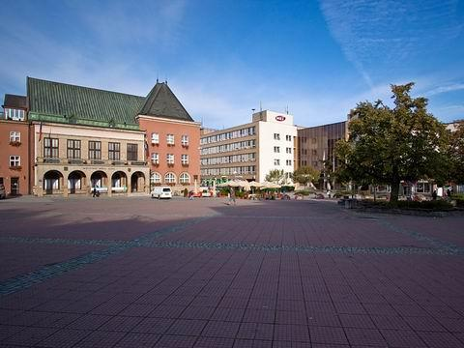
Zlin
In Zlin are Batas skyscraper, Zlin new castle, square with town hall and other.
There are many beautiful parks and big ZOO.

Slide 4
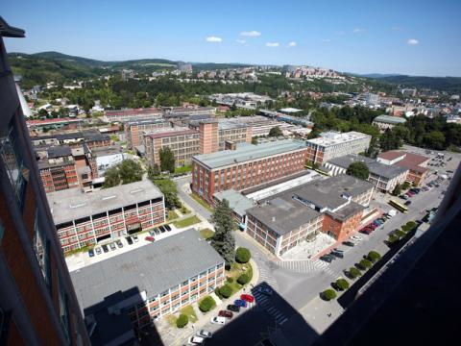
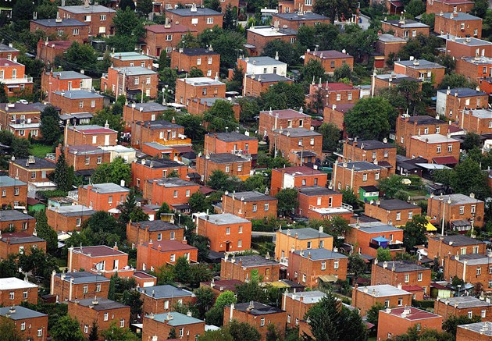
Tomas Bata
Tomas Bata was born 1876 and died 1932.
In Zlin is a big factory area Svit.
This area was founded by Tomas Bata in 1894.
There is a Shoe industry.
He founded also Batas Houses.

Slide 5
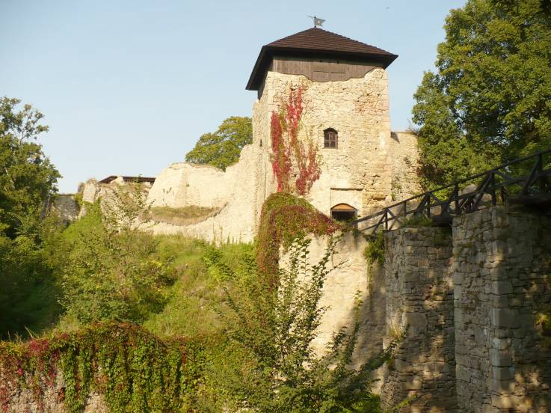
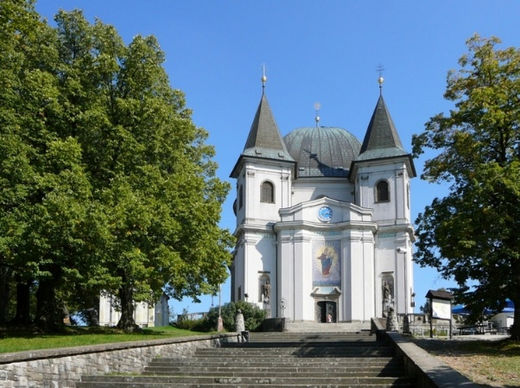
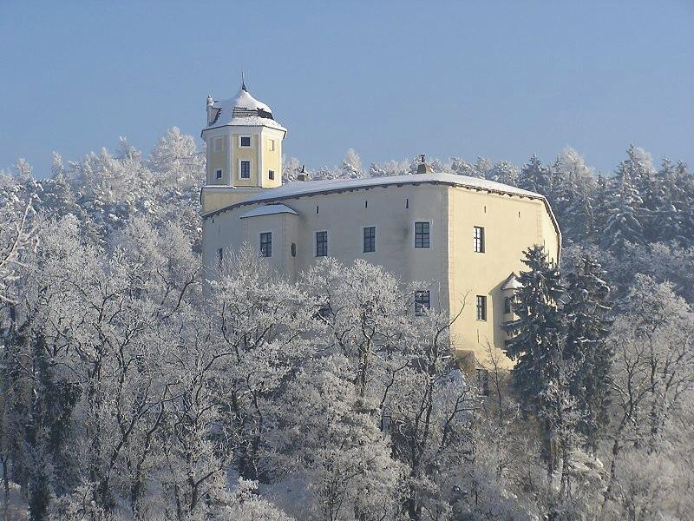
Zlin Region
Flower garden in Kromeriz
Castle Lukov
St. Hostyn Cathedral
Castle Malenovice

