Slide 1
Sports of teenagers
Borovec
Hartman

Slide 2
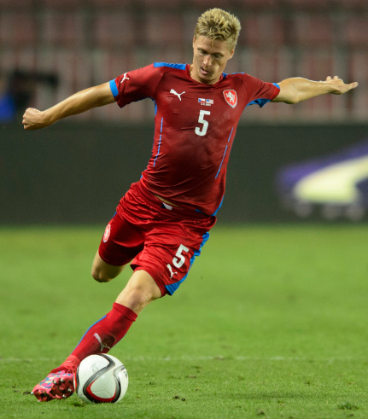
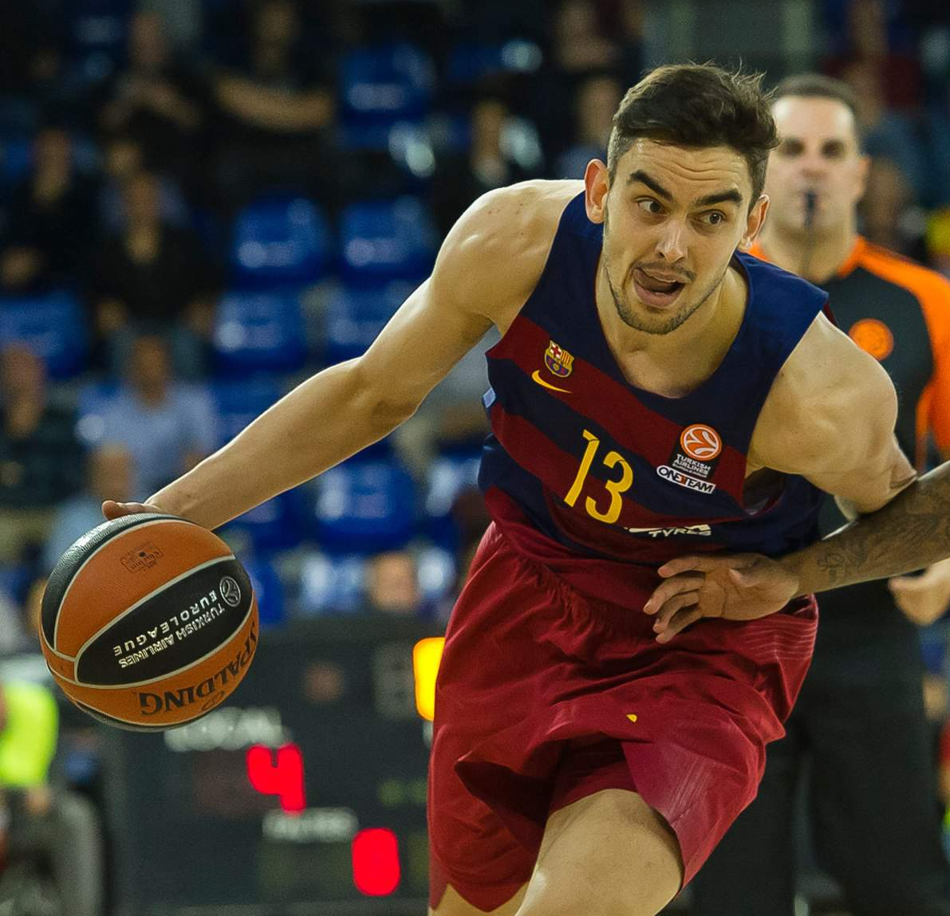
Popular sports in czech republic

Slide 3
IN ZLIN there are POPULAR THeSe SPORT CLUBs
Ice hockey:
PSG Zlín

Slide 4
IN ZLIN there are POPULAR THeSe SPORT CLUBs
FOOTBALL:
FC FASTAV ZLÍN

Slide 5
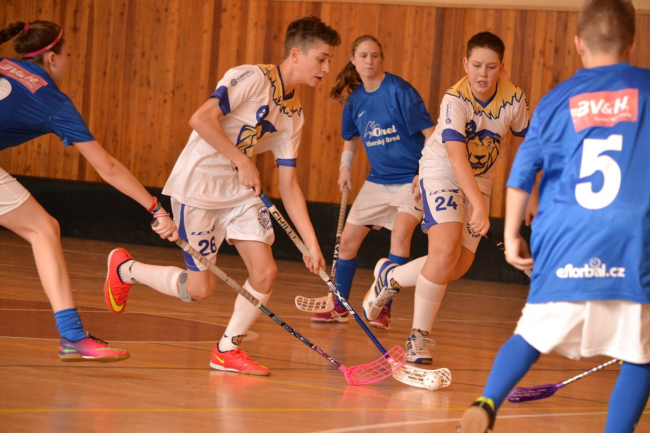
IN ZLIN there are POPULAR THese SPORT CLUBs
FLOORBALL:
LIONS ZLÍN

Slide 6
THE END

