Slide 1
Being a TEENAGERS
sports

Slide 2
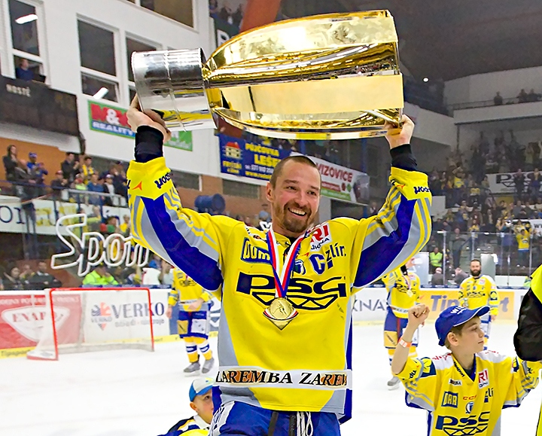
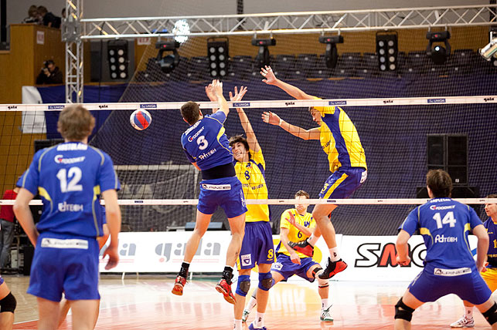
SPORTS
In zlín are lots of sport clubs: ice hockey, football, basketball, swimming and volleyball club … .

Slide 3
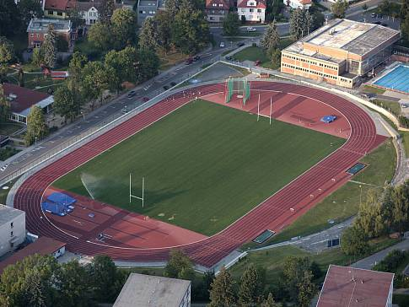
Athletic club
we go to the athetic club.
in older level there are 10-20 peoples, in younger level there are 20-30 peoples.
Trainings is every day.
coaches are good.

Slide 4
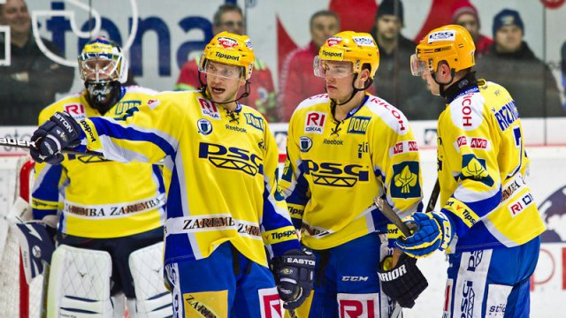
Ice hockey
Our ice hockey team is psg zlin.
They won in 2013/14 czech ice hockey league.

Slide 5
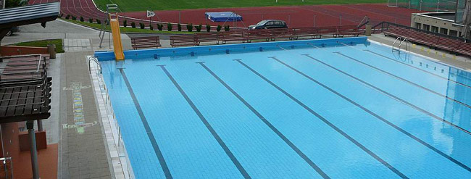
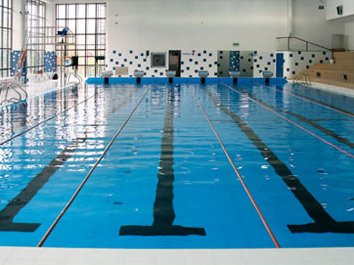
Swimming in zlin
Our swimming pool is in the big building next to the athletic stadium.

