Slide 1
Teenager‘s holiday

Slide 2
Holiday in Zlin
Our favourite places to spend time on holiday:
Zoo Zlin
Shopping centres
Cinema
Swimming pool
Park

Slide 3
Zoo Zlin
We sometimes go to zoo on holiday. It is so beautiful and big. It is the second most visited zoo in the Czech Republic. Our favourite animals are meerkats and rays. Other interesting thing in zoo is ice-cream.

Slide 4
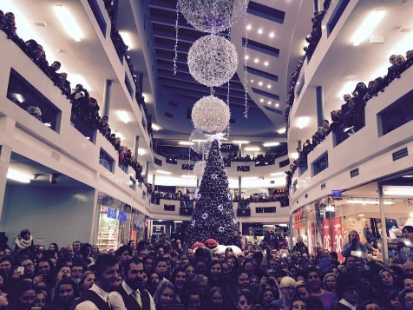
Shopping centres
In Zlin there are 3 shopping centres. Their names are Cepkov, Centro Zlin and Golden Apple. Biggest centre is Centro Zlin.
In Cepkov there are lots of shops. Clothes shops, supermarket, sports shops… Centro Zlin is in Malenovice. Malenovice is a part of Zlin. Golden Apple is our favourite shopping centre. There are cinemas (one is 2D and 3D and one is 5D), clothes shops (for example H&M) etc. In this centre are sometimes miniconcerts, autographing…
This photo is from autographing of czech group called Slza.

Slide 5
Cinema
There are 3 normal cinemas and 1 summer theater. Two of them are in Golden Apple. We like going to the cinema.
Films are sometimes for 50 crowns (almost 2 euros) and then we want to see them.
In cinemas there are sometimes public events, for example CineTube. CineTube is event with youtubers.

Slide 6
Swimming pool
We sometimes go swimming.
There are three types of pools, where we go: aquapark, sport spa and swimming pool like this one in backround.

Slide 7
Park
We go sometimes shopping and then buy some food like ice cream, fries or pizza. Then we go to park and eat it there.
Our park is new and it´s very nice.
In the park there is playground.

Slide 8
Holiday in abroad
Czech teenagers usually go abroad on holiday. The most popular destination are:
Croatia
Italy
Bulgaria
Greece
Spain

Slide 9
What we do on holiday? How long we go there?
Teenagers go shopping on holiday- we buy different kinds of souvenirs, food what we do not have in the Czech Republic.
Also we love going to the sea.
We take lots of photos and sometimes we give them on social networks.
On the holiday we are about 1 or 2 weeks.
We usually go by car or by the airplane.
Length of trips (by car)
To Croatia we go about 9 hours
To Italy we go about 15 hours
To Bulgaria we go about 16 hours
To Spain we go about 25 hours

