Slide 1
Being a teenager
MUSIC
Rakvicová Aneta, Vaďurová Kristýna, Vojáčková Karolina

Slide 2
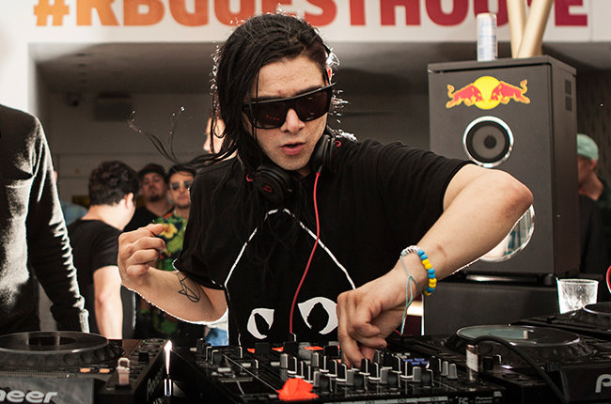
What do teenagers listen to?
Teenagers listen to many genres of music
In this age they mostly like pop and rap and techno
And how about you?

Slide 3
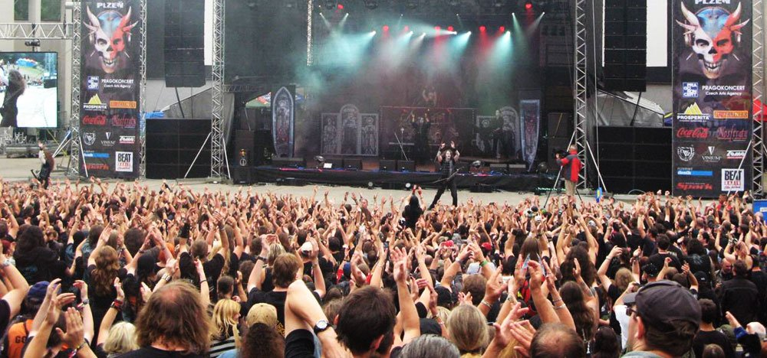
MUSIC CULTURE IN CZECH
WE HAVE GOT LOT OF DIFFERENT CONCERTS, BUT MOSTLY THEY‘RE IN PRAGUE, OUR CAPITAL.
THERE ARE SOME BIG MUSIC FESTIVALS NEAR PRAGUE.
WE‘VE ALSO GOT SOME GOOD BANDS HERE

Slide 4
MUSIC CULTURE IN OUR TOWN
OUR TOWN IS SMALL, BUT WE HAVE SOME CLUBS HERE. ALSO WE HAVE HERE VARIED FESTIVALS AT SUMMER. FOR EXAMPLE BIG FESTIVAL MASTERS OF ROCK. THERE WAS ALMOST 30 000 PEOPLE!
ZLIN IS CLOSE TO AUSTRIA AND SLOVAKIA, SO WE CAN JOIN CONCERTS AT VIENNA OR OTHER BIG CITIES.

Slide 5
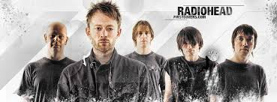
What do we listen to
Our group is different, because we like harder styles, like rock and metal

Slide 6
THANK YOU FOR YOUR ATTENTION ☺

