Slide 1
Teenagers
Tourist atractions

Slide 2
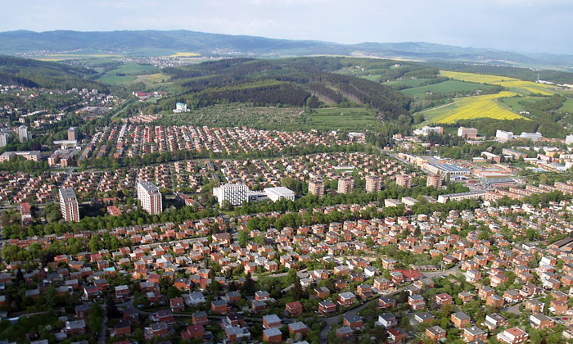
Introduction
The city of Zlin is located in the region of Central Moravia
The Zlin Region is an extremely interesting tourist destination offering many attractive natural, cultural and historical monuments
There‘s no other region in the Czech Republic where you could find everything you can think of: mountains, garden architecture and historically significant buildings as well as unique examples of modern architecture from the times of Tomas Bata

Slide 3
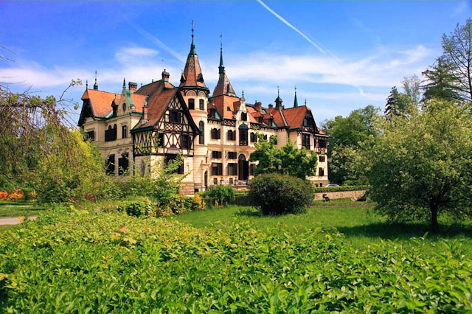
Chateau Lesna
The history of the chateau Lesna is closely associated with the history of earlier famous Moravian castle Lukov. In 1724 Lesna acquired the castle and the whole Lukov land Austrian count's family Seilern
Moravia however almost resided, the castle fell into disrepair and in 1793 it was already uninhabitable. Seilernons therefore started looking for space to build new headquarters. They chose a hill within sight of the original castle Lukov
A place called Lesna

Slide 4
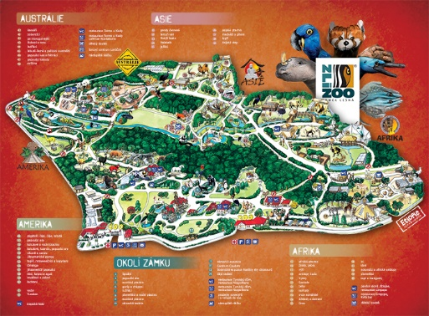
Zoo Zlin
Around the chateau Lesna there is a ZOO
The ZOO is the most visited tourist destination in all of Moravia
The ZOO is divided into separate continents
In attendance we are in the second place
In the ZOO there are many animals, for example stingrays, vultures, anteaters and red pandas

Slide 5
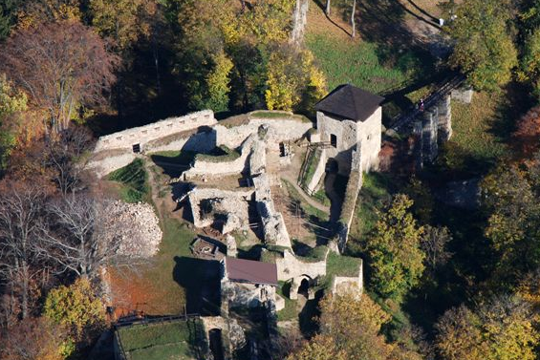
Ruin of castle Lukov
The famous romantic castle
Guild Castle offers many educational activities
Below the castle there are big stones
Before stones there was the fortification of the castle
Now they are only for tourist atraction

Slide 6
The End Katrušáková, Polášková, Kieu

