Slide 1
FOOD
In our country
Jan Dufek
Tomáš Strouhal

Slide 2
About food
1. About food
1,1
2. Food in city
3. Food at school canteen
4.Photos of our best food

Slide 3
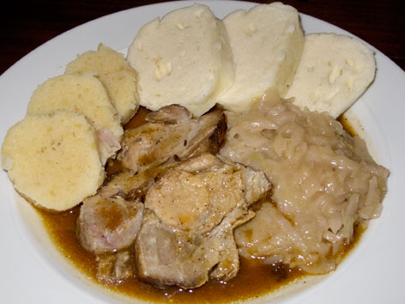
About food
Our national food is a „vepřo knedlo zelo“ = pork meat, cabbage with dumpling
Most teenagers love meat
But there are some teenagers (girls) who are vegetarians

Slide 4
Most teenagers eat in school canteen,
but some of them haven´t got lunch at school canteen
They go either home or to city.

Slide 5
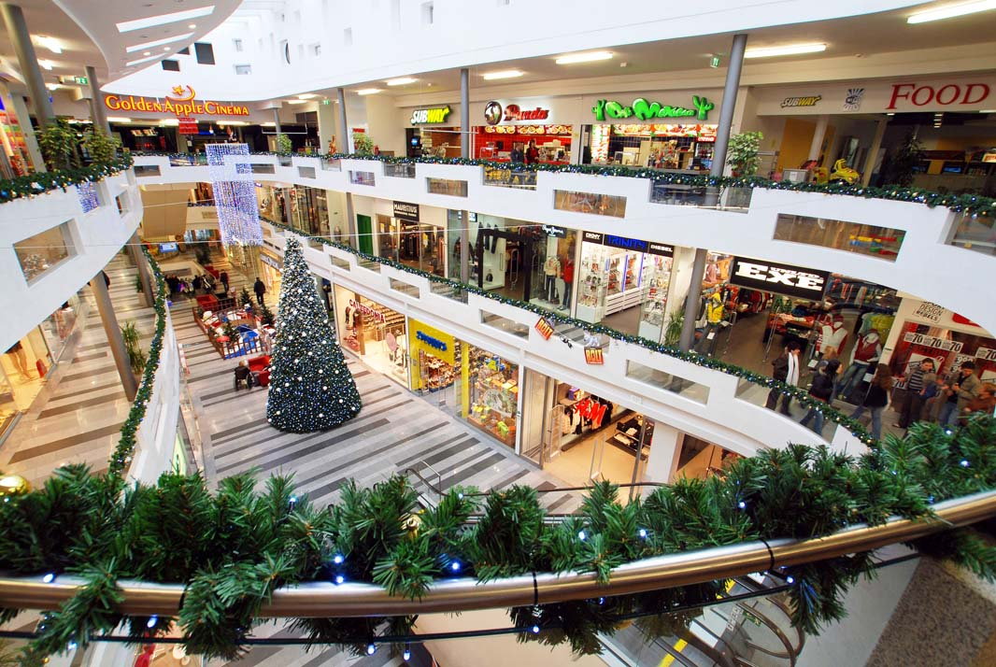
FOOD IN THE CITY
In the square there is a big mall Golden apple
There are many fastfoods:
KFC
Chinese restaurant
Thailand restaurant
we also have MCDonald‘s
And many cafees

Slide 6
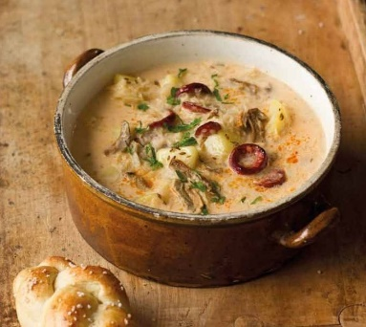
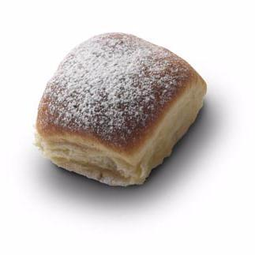
FoOd in School canteen
We have three courses. First one is soup. Best soup is „Kyselica“ = cabbage soup with sausages
Main food-1. hot salty food 2. sweet food 3. salat
Dessert-„buchta“- cake with jam or curd

Slide 7
Photos of our best food
„Guláš“
„Řízek“
Fried cheese
Pork meat with dumpling.
In the pepper sauce.
Chicken or pork meat with potatoes.
In a breadcrumps.
Cheese in a breadcrumps.

Slide 8
Photos of our best food in school canteen
Dumpling with poppy
Fish with masched potatoes
Ice salad
In dumpling there is a jam.
Fried fish.
Salad, carrot olives and cheese

