Slide 1
Welcome to our village

Slide 2
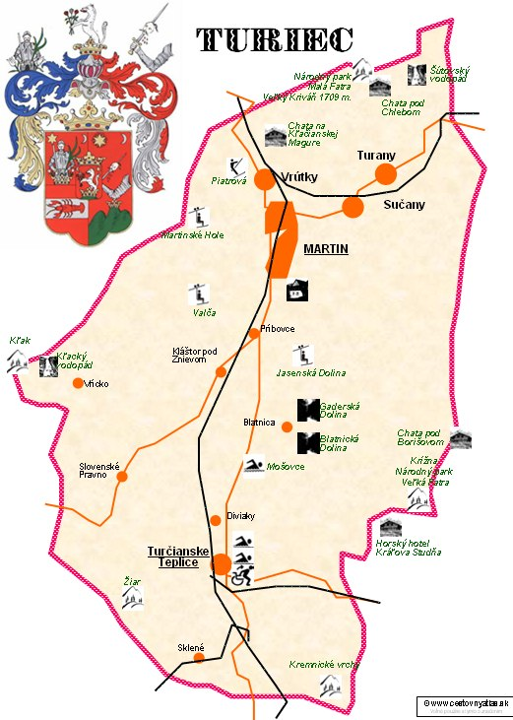
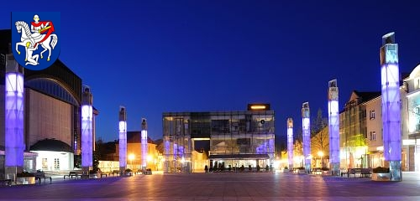
Region Turiec
Region Turiec is surrounded by beautiful mountains.,
Martin is the capital of this region

Slide 3
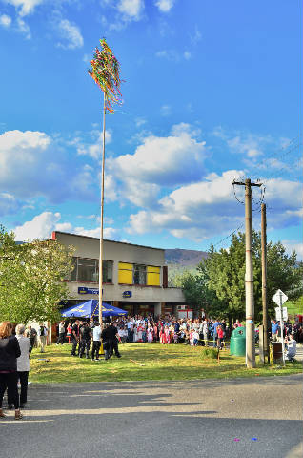
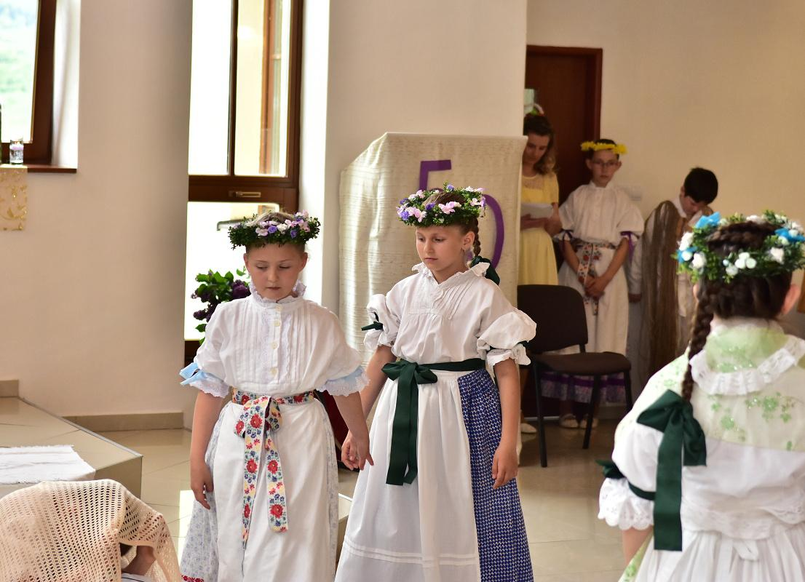
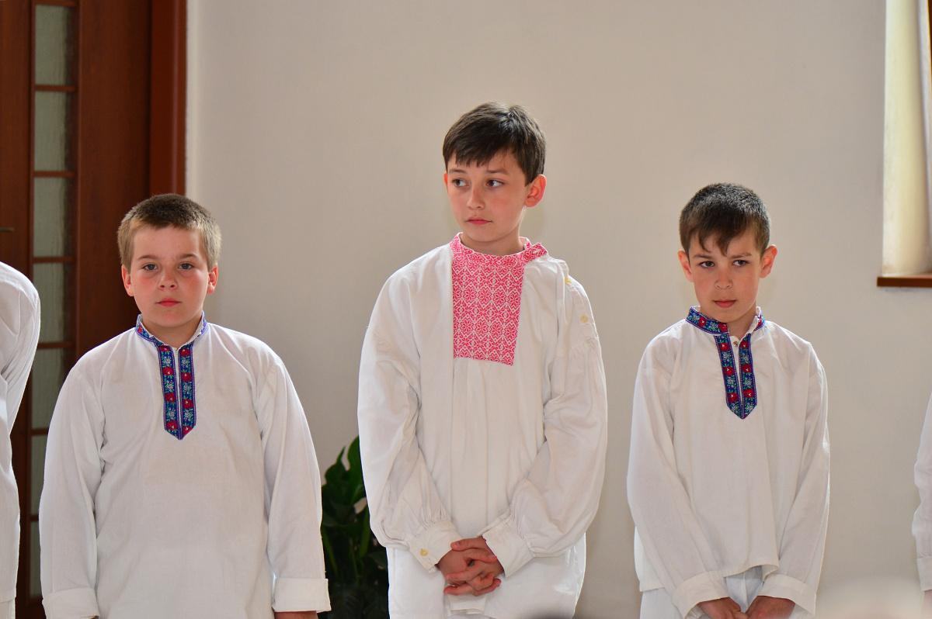
Traditions
50 výročie ZŠ v Krpeľanoch PV
We keep our traditions alive.We have a
choir:Old and children.We have a musical band old and children, too

Slide 4
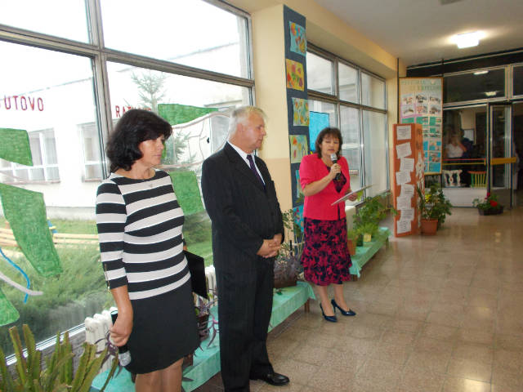
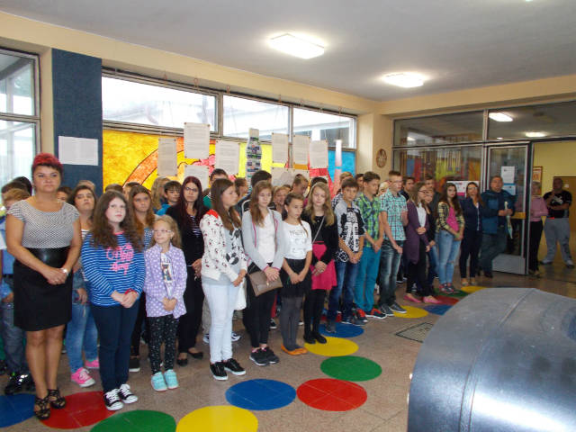
Our school

Slide 5
School
Our school is in the North of Slovakia, region Martin.
In our school we have 130 pupils and 20 teachers.
We have a dinning room,and we really miss a gymnastics room.
We have 5 interactive boards and a computer room for our project.

Slide 6
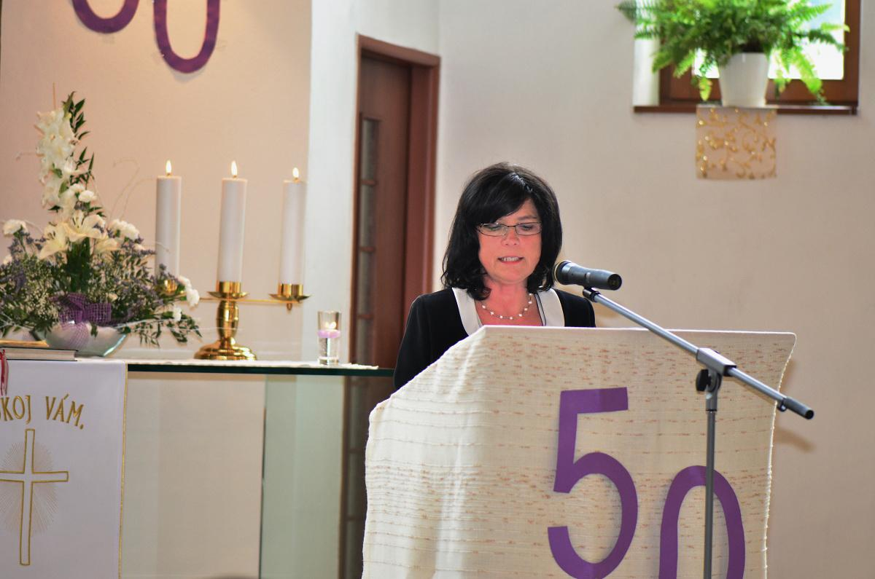
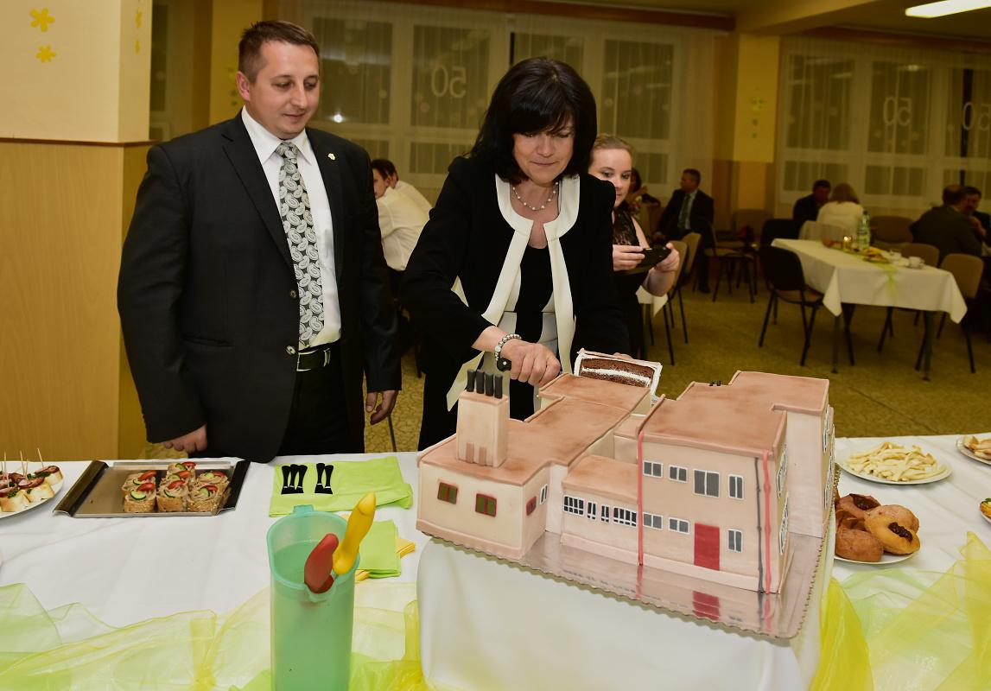
50th anniversary
v
We have celebrated 50 years of founding
this year. We had a big cake like our school.
Our headteacher

Slide 7
Thanks for watching class 7

