Slide 1
Tone Pavček Primary School Mirna Peč, Slovenia Recycling Club DECORATIVE TRAYS MADE OF NEWSPAPER

Slide 2
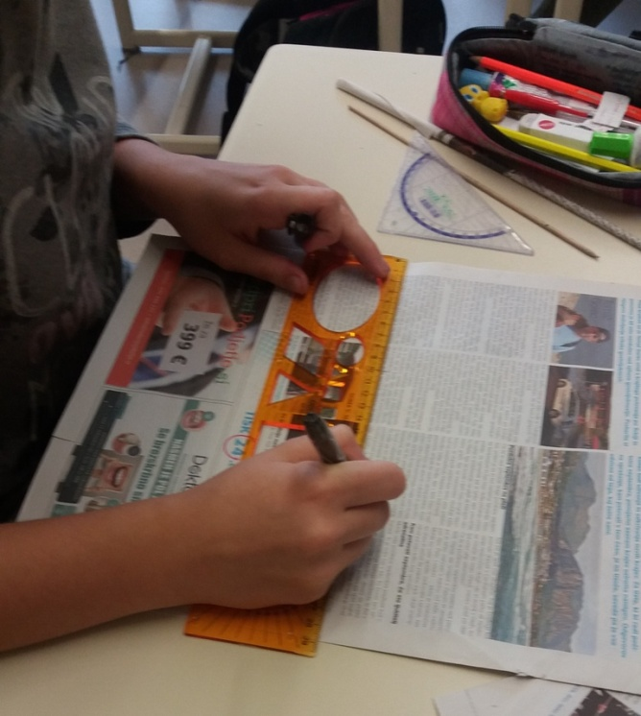
Cut 10 cm wide strips out of old newspapers. Use a small stick to shape them into tubes. At last, stick the paper together using glue.

Slide 3
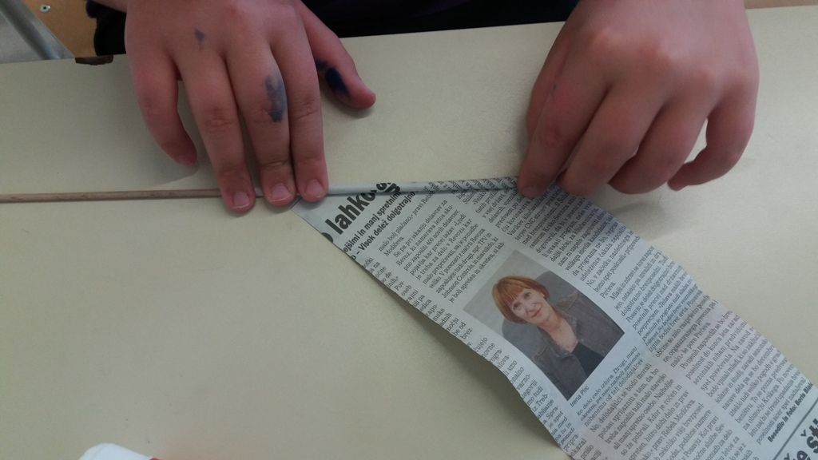
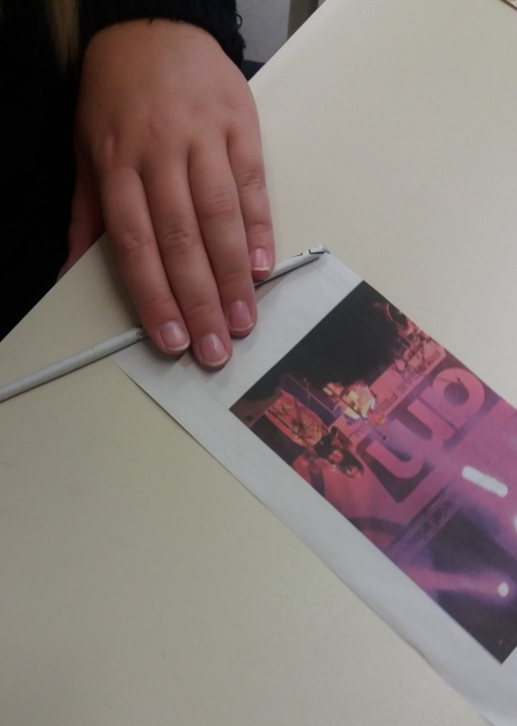
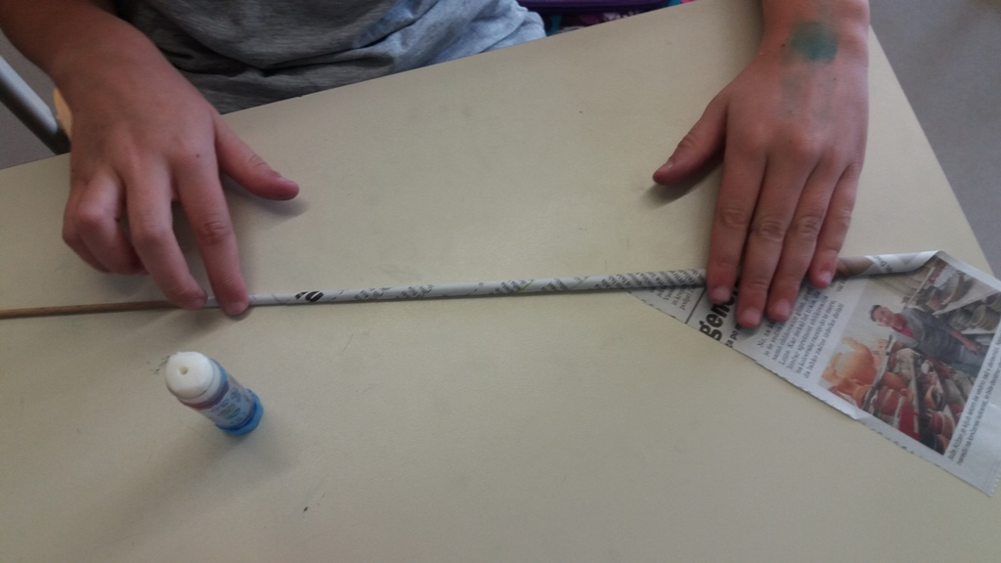

Slide 4
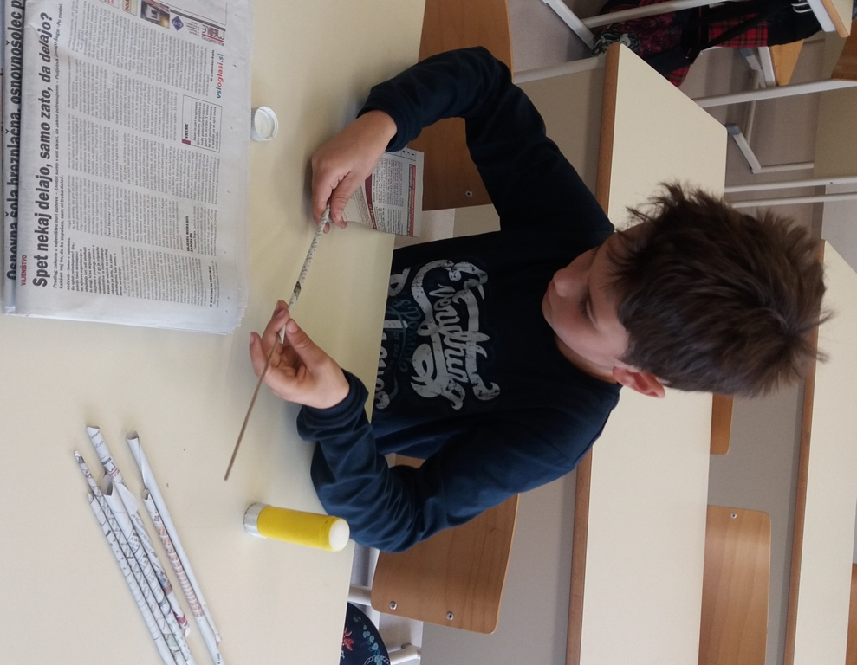
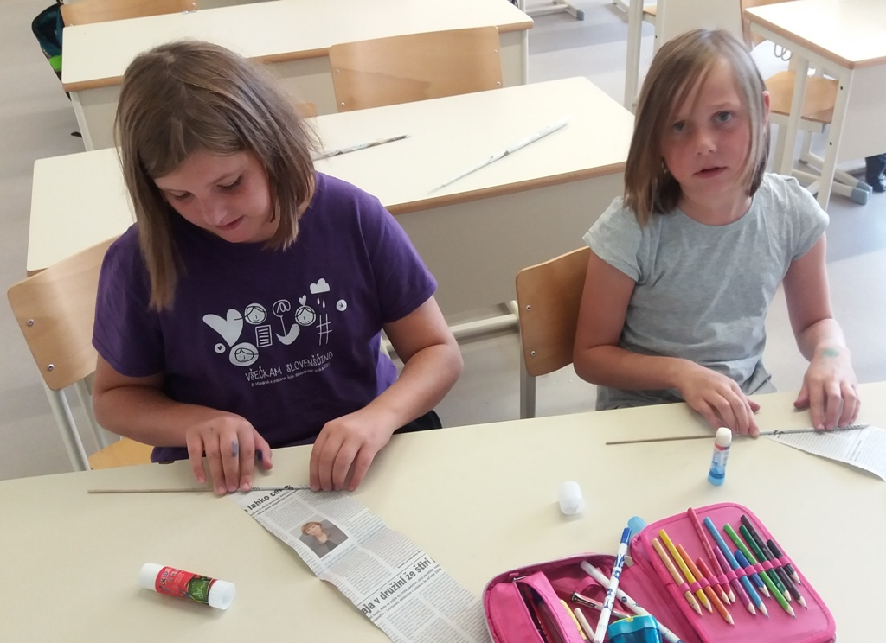
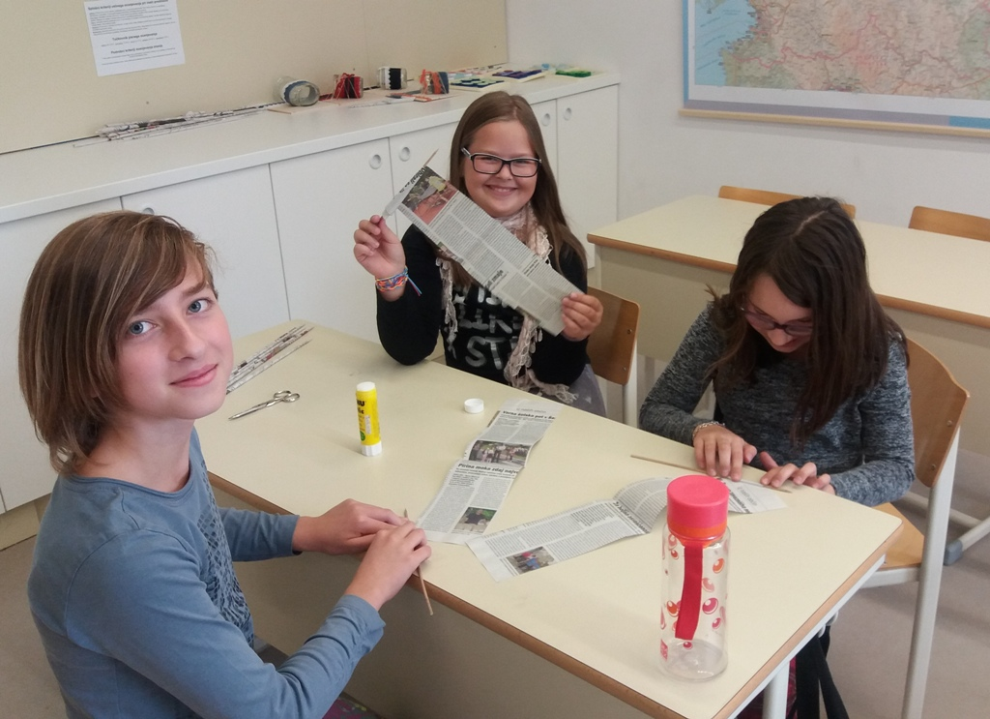

Slide 5
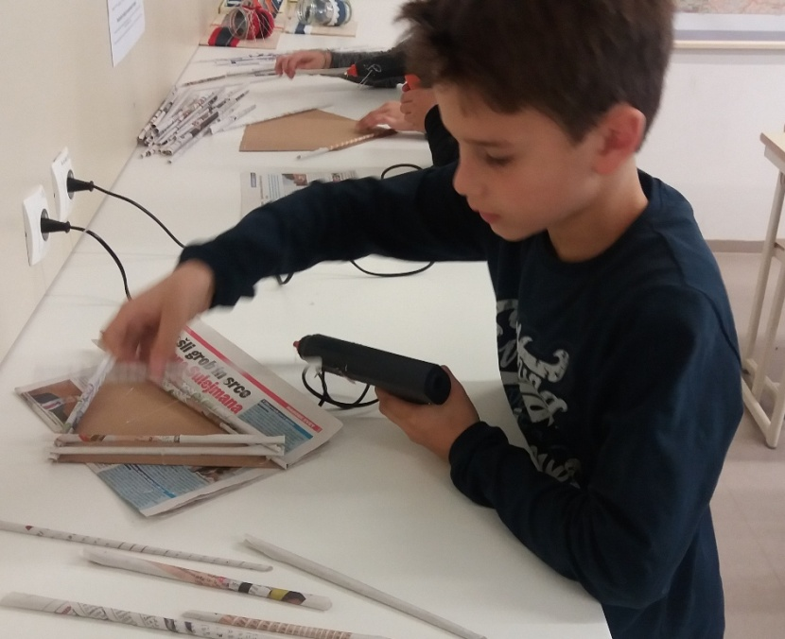
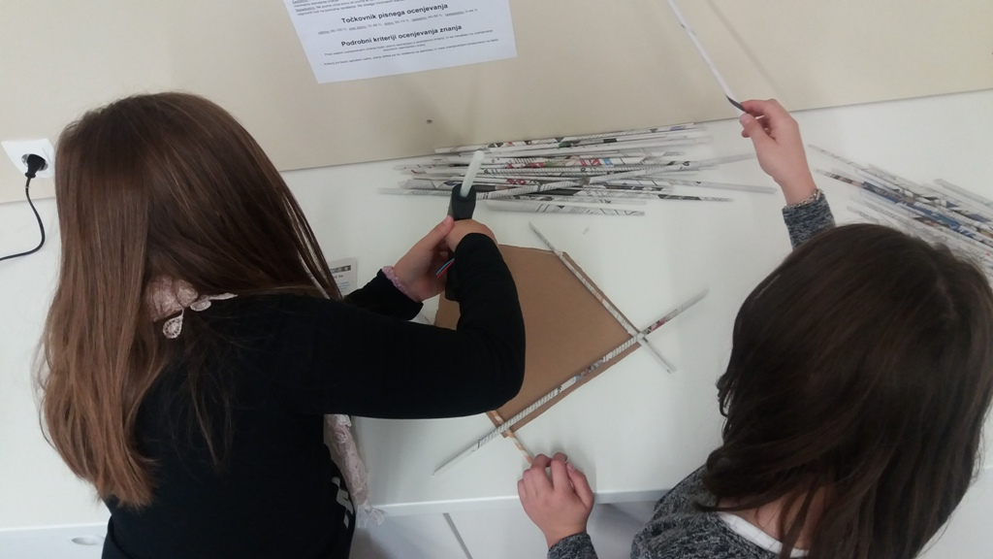
Cut a basis out of cardboard. Then use a glue gun to place the little fence made from newspaper tubes onto the basis.

Slide 6
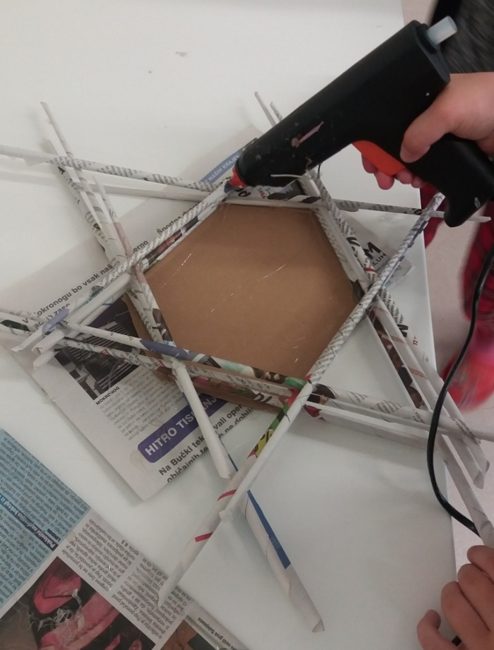
With scissors, cut off the edges of the tubes that stick out.

Slide 7
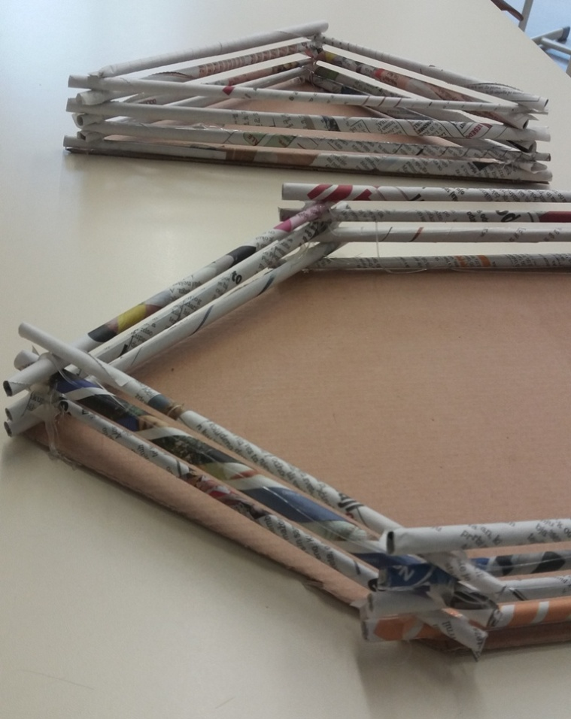
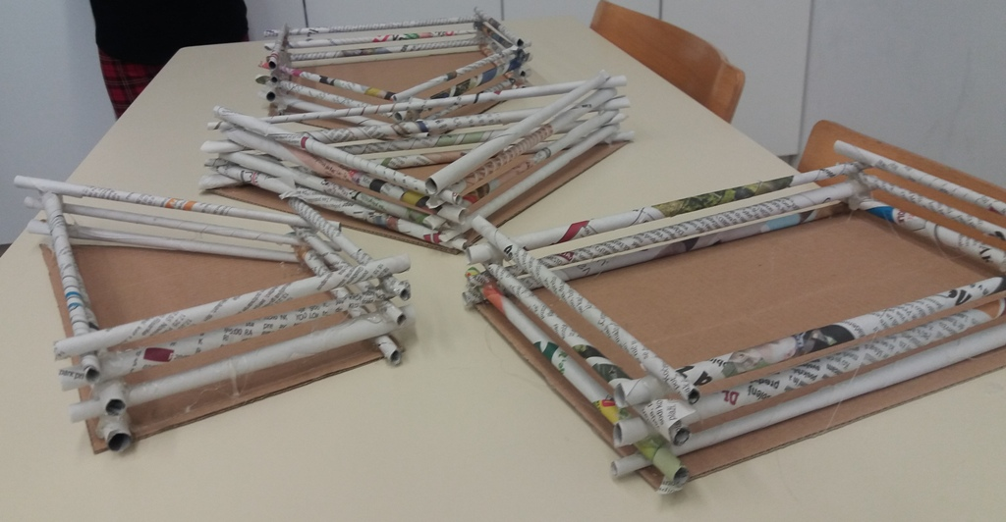

Slide 8
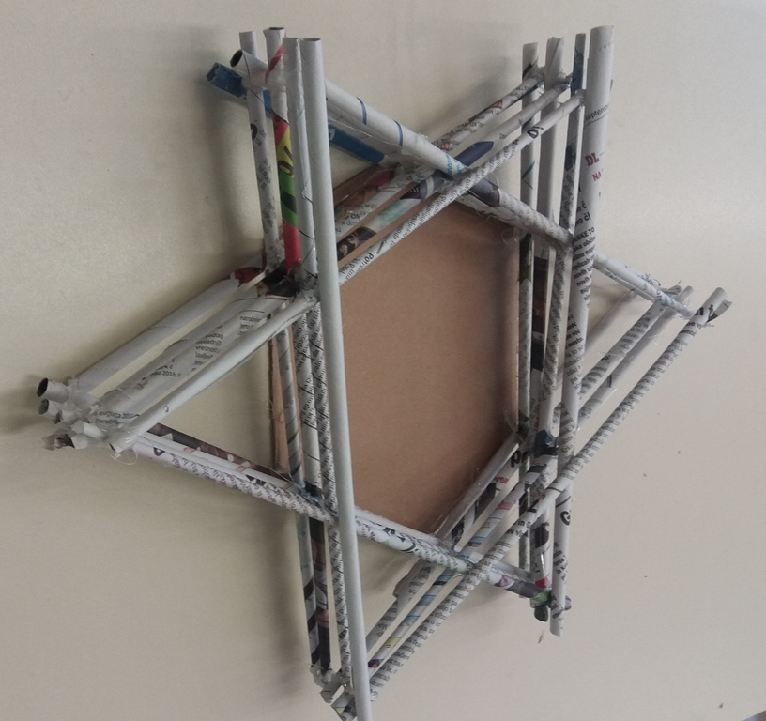

Slide 9
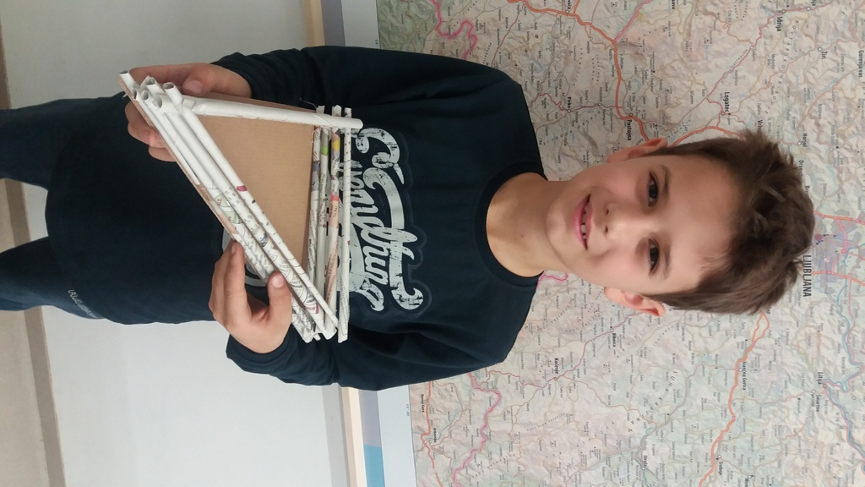
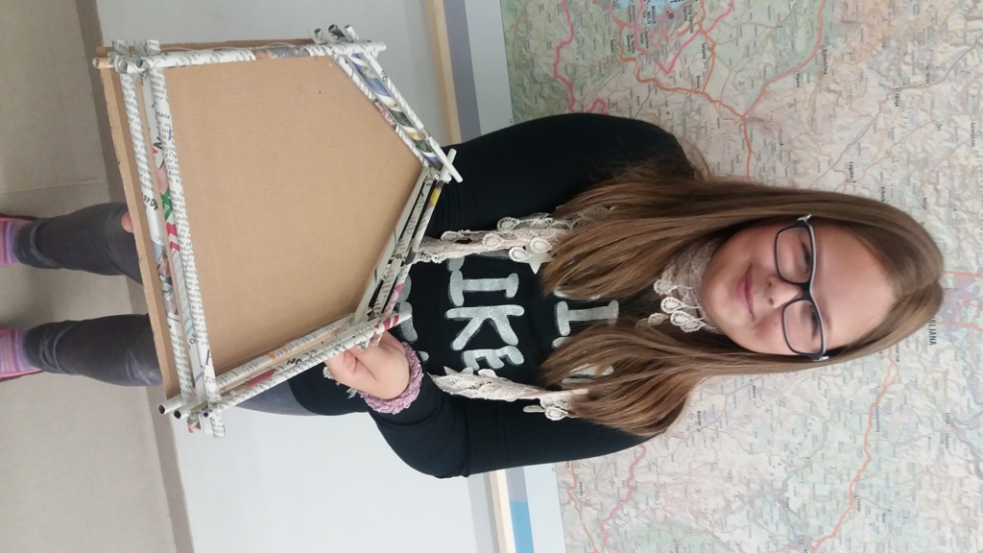

Slide 10
