Slide 1
HOW TO SAVE WATER:
Urh Bobnar
Bine Parkelj
5.a
Notes:
1

Slide 2
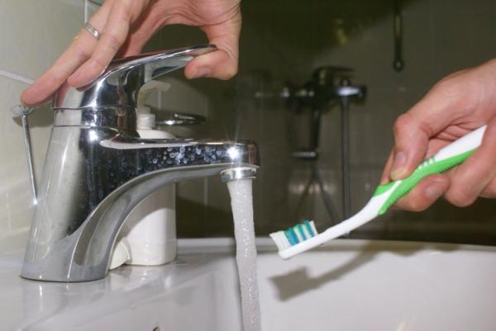
HOW TO SAVE WATER:
1. When you brush your teeth, close the water and save 13.5 litres of water per minute.
2. When you shampoo, close the water, too.

Slide 3
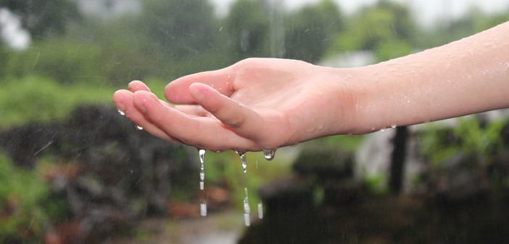
HOW TO SAVE WATER:
3. When you cook, try to use the right size bowls. With bigger bowls we use more water than we should.
4. When you shower or clean, try to save as much water as you can. You can use it for flushing the toilet.
5. Reuse the water that you use for cleaning vegetables, for watering flowers.

Slide 4
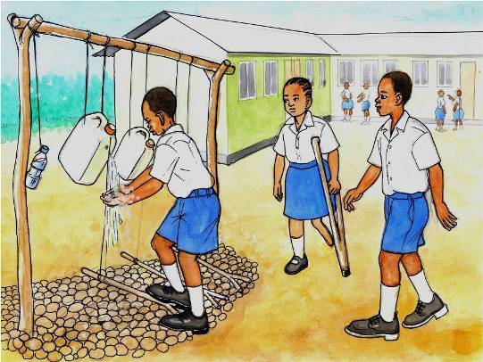
HOW TO SAVE WATER:
6. Close the water when you shampoo your hands.
7. Take a shower more often than a bath.
8. When you do the dishes, try
To open the water tap only to
Wash the soap away.

Slide 5
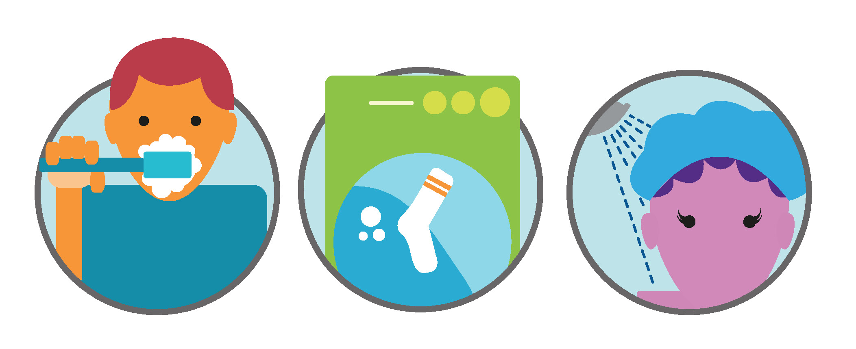
HOW TO SAVE WATER:
9. Don‘t use liquid water for unfrozing frozen food.
10. When you buy a new washing machine or dishwasher, choose the one that uses less water.
11. Close the tap tightly after you use it.

Slide 6
HOW TO SAVE WATER:
12. Wash the laundry when you can fill the whole
washing machine.
13. Instead of throwing the water away when you
Change it in the aquarium, you can water the flowers
With it.

Slide 7
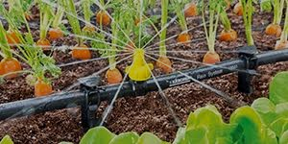
HOW TO SAVE WATER:
14. Install water meters to measure your water
Usage.
15. New toilets have start and end buttons to start
and stop flushing whenever we want.
16. Do not plant plants on dry land because they need plenty of water.

Slide 8
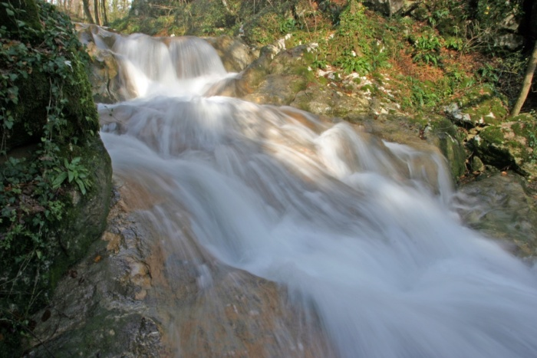
HOW TO SAVE WATER:
17. Forests are the
Best water keepers in
Nature.
18. Water the garden
early in the morning or
in the evening, when
the evaporation of water
is lower.

