Slide 1
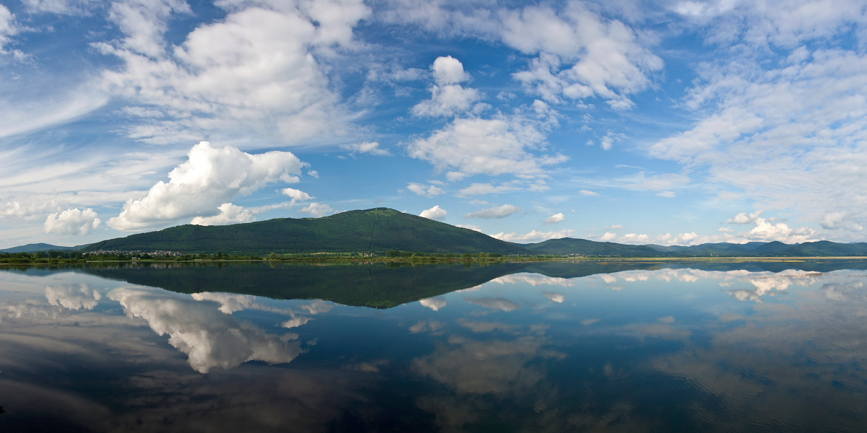
LAKE CERKNICA
Don‘t forget to write down the important parts of the presentation!
Nik Globokar, 5.b

Slide 2
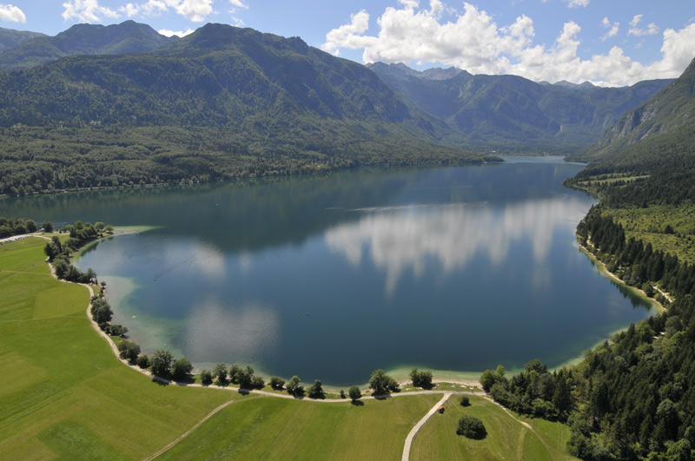
It‘s an intermittent lake in southwestern Slovenia.
It’s the greatest intermittent lake in the world.
It’s the largest lake in Slovenia.
SURFACE: 546 m
AVERAGE DEPTH: 10 m !!!

Slide 3
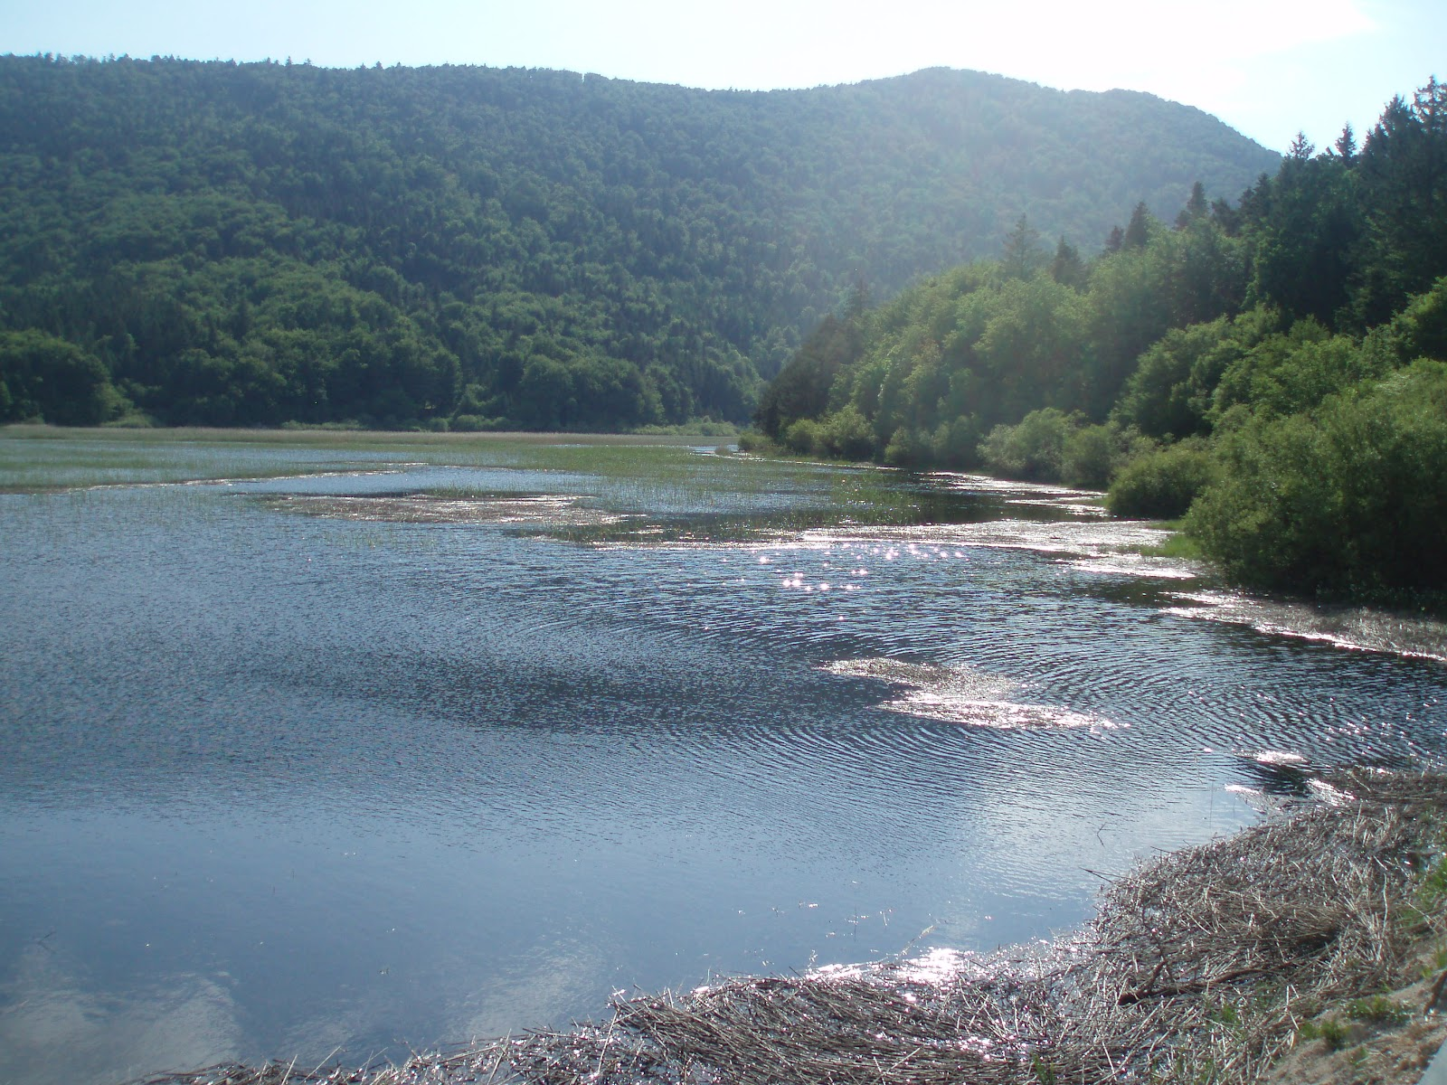
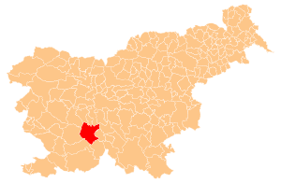
POSITION:
on the southern part of the Cerknica Field
to the southwest of Ljubljana
in the Dinaric Karst landscape

Slide 4
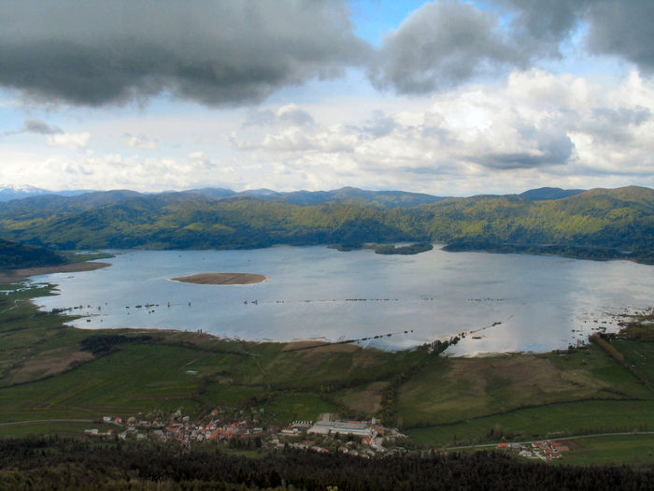
INFLOWS AND OUTFLOWS:
the Obrh stream disappears on Loški Field
it comes back to surface as a stream Stržen in Cerknica Field

Slide 5
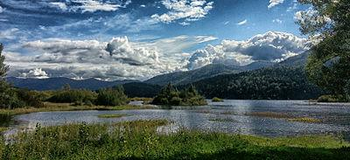
Lake Cerknica, empty lake Lake Cerknica, flood

Slide 6
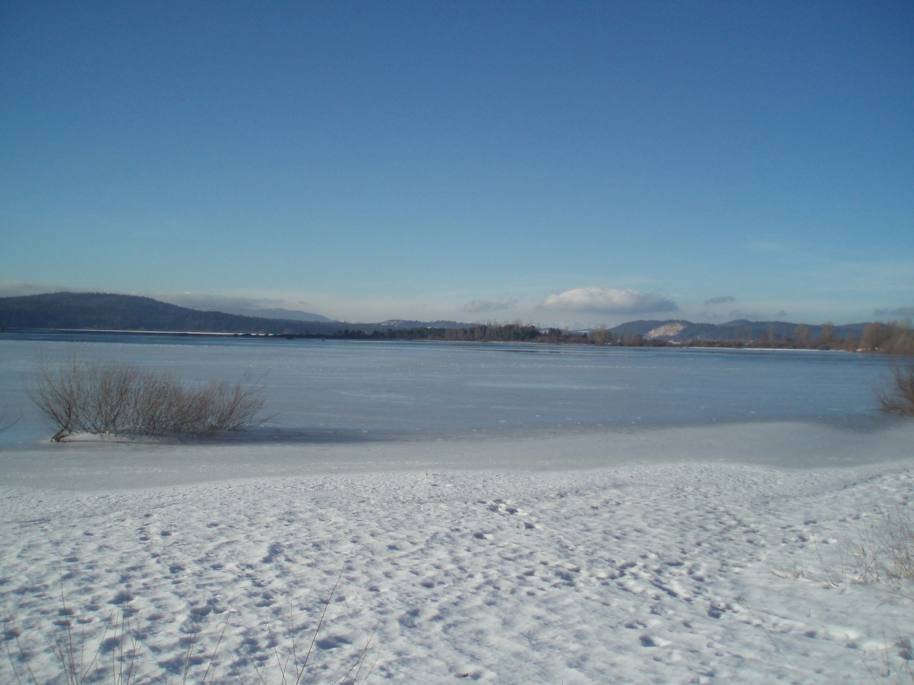
Lake Cerknica in winter

Slide 7
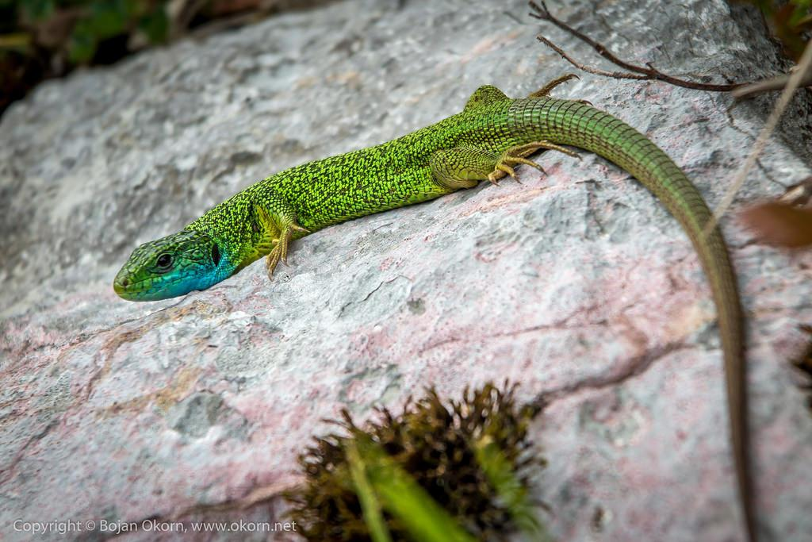
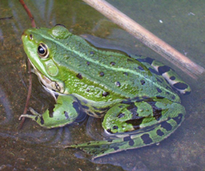
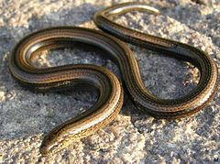
FAUNA:
REPTILES: green lizard, slowworm, smooth snake, etc.
AMPHIBIANS:
salamander,
newt, etc.

Slide 8
INTERESTING FACT:
-The formation of internal fields is associated with a large tectonic fault
-Janez Vajkard Valvasor tried, on the basis of Descartes's mechanical theory, to explain the interruption of Cerknica Lake
-Centuries ago Lake Cerknica was considered one of the most famous Karst phenomena in Europe.

Slide 9
QUESTIONS:
Where is Lake Cerknica?
In Dinaric Karst landscape. In southwestern Slovenia.
Is the Cerknica Lake the largest lake in Slovenia?
Yes, it is.
Which animal lives there?
REPTILES (green lizard, slowworm, smooth snake) and AMPHIBIANS (salamander, newt).

Slide 10
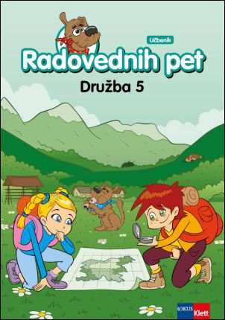
THANK YOU FOR YOUR ATTENTION!
SOURCES:
-Wikipedia,
-Book: A hundred natural attractions of Slovenia,
-Textbook Curious 5,
page 64
https://youtu.be/plRQXOD7fts

