Slide 1
Wind power plant

Slide 2
Wind Power Plant is a group of wind turbines interconnected to a common power provider system through a system of transformers, distribution lines, and (usually) one substation.

Slide 3
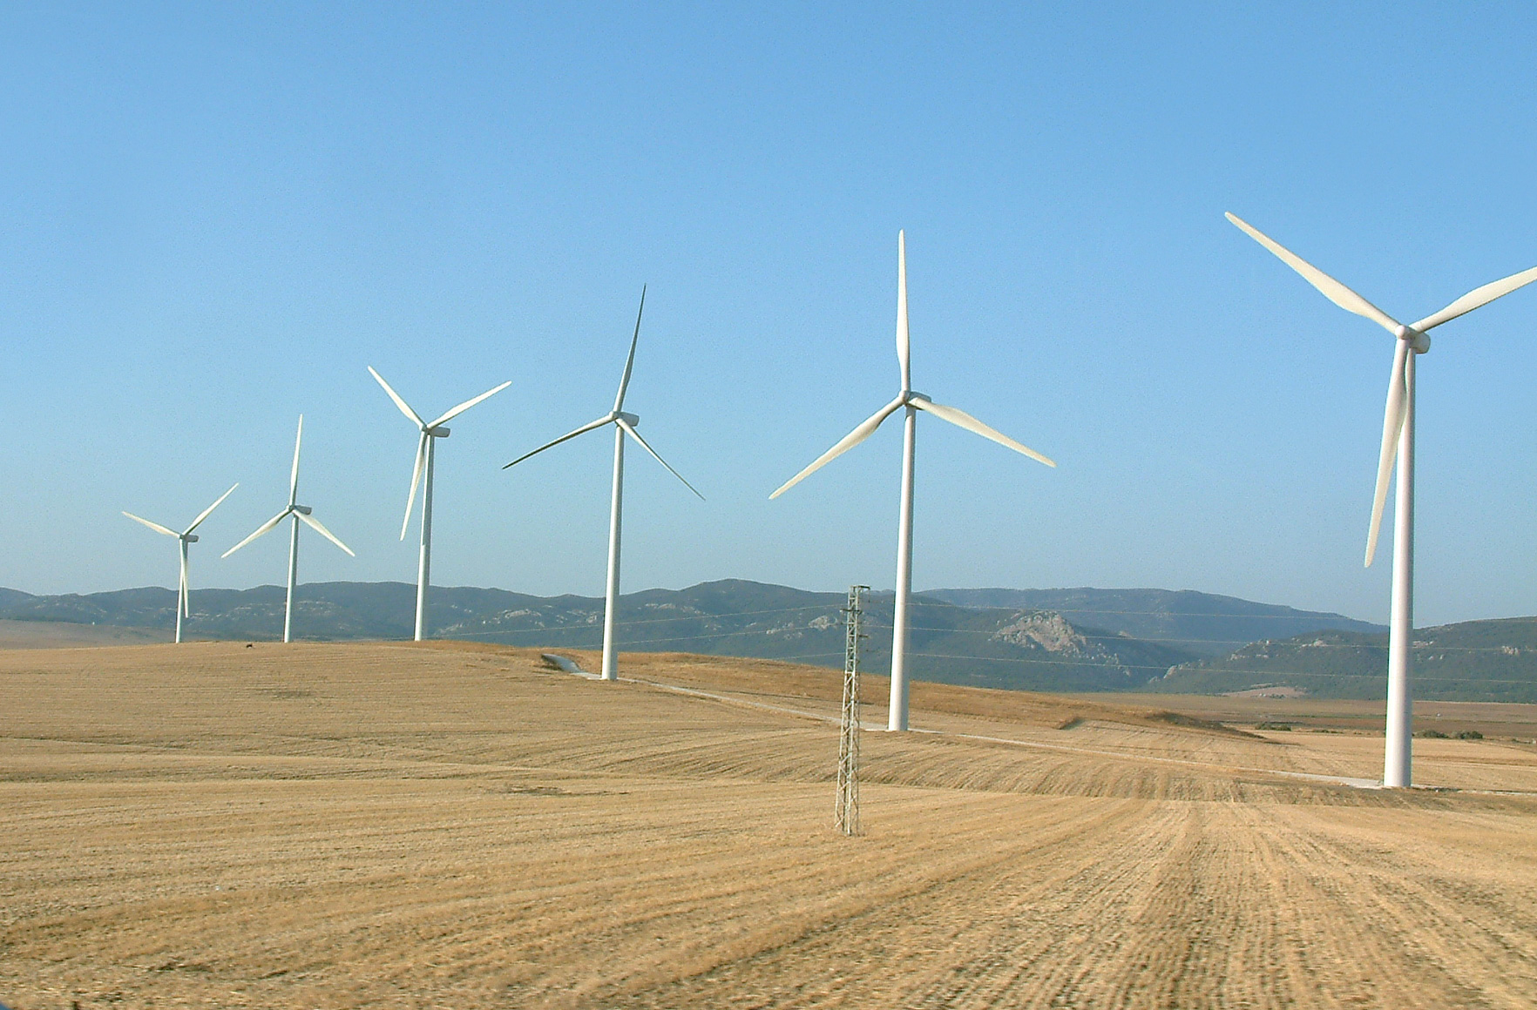
Wind turbines in Margonin

Slide 4
The stronger is the wind the more energy it can produce through the wind turbines
The biggest wind power plants in Poland are situated in Bełchatów
Wind farm is an area of land with a group of energy-producing windmills or wind turbines.In 2015 Poland had 1000 wind farms which altogether were able to produce 10 000 GWh of electricity.

Slide 5
Wind turbines vary vastly in size, shape, and orientation. Small turbines are used for a variety of rudimentary applications, while larger turbines are often found in wind farms and provide power to the electric grid
The maximum efficiency of a wind turbine can be up to 60%.

Slide 6
Glossary:
turbine: a machine that transforms the kinetic energy of the wind into mechanical or electrical energy.
TW: a unit of power equal to one trillion watts (1TW= 1 000 000 000 000W)

Slide 7
INTERESTING FACTS
The cost of one wind turbine is 400 000 pln
Wind turbines are mainly built on the coast due to stron winds
the heighest turbines are 250 metres high and can be found in Germany. The heighest wind turbine in Poland is 210 metres heigh and is situated in Nowy Tomyśl
the strongest wind was recorded in1990 roku, and its speed was 345km/h.

Slide 8
Presentation made by: Mateusz Kowalik i Damian Bronisz
resources: Wikipedia
Geography and science student books and work books.

