Slide 1
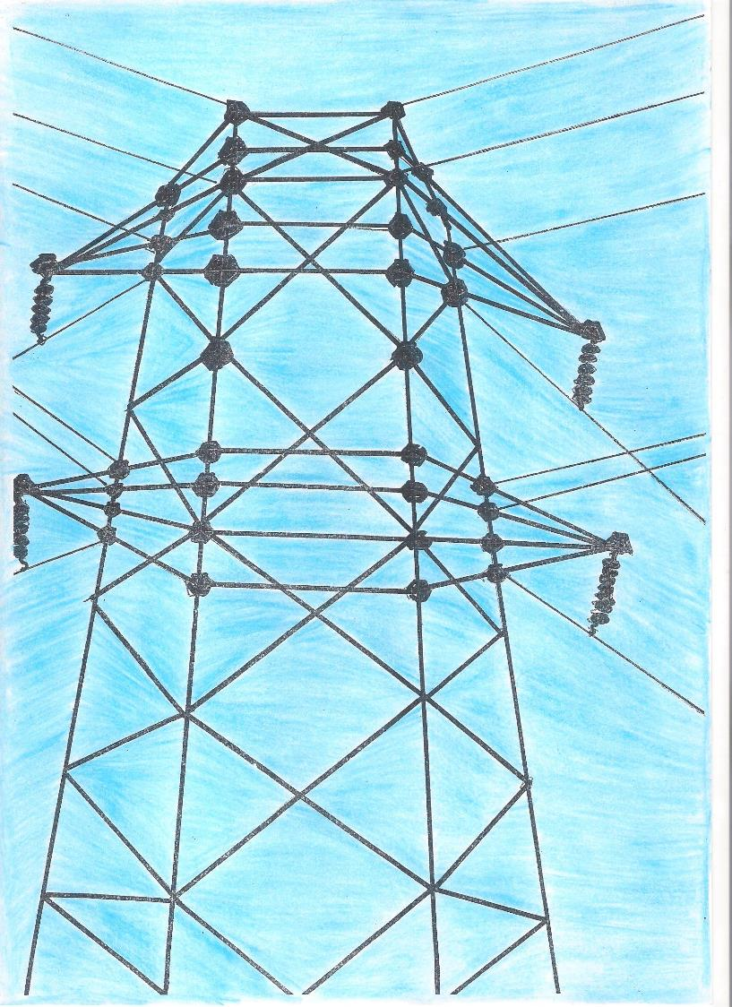
ENERGY

Slide 2
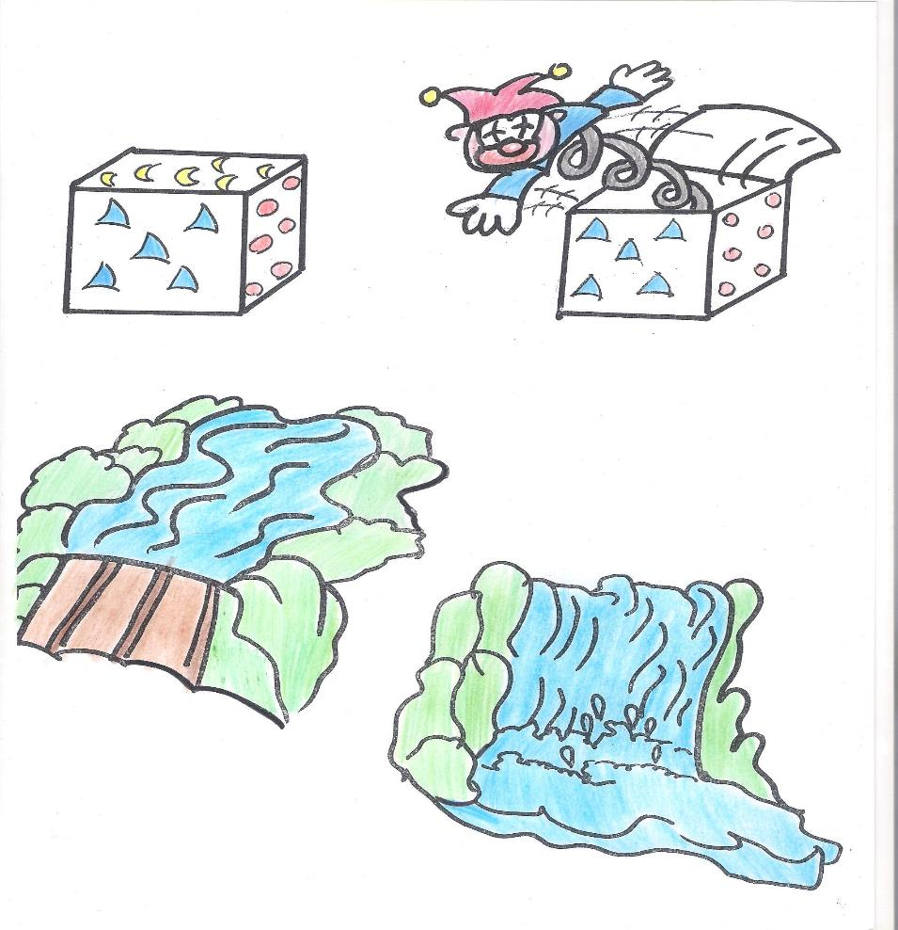
Energy is the capacity to do a job.

Slide 3
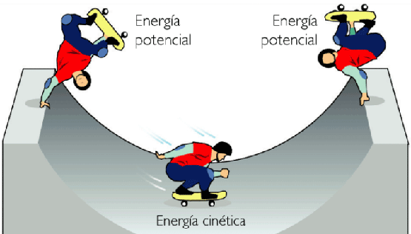
Potential
We cannot see it
Energy
Kinetics
movement
It is "hidden" in the bodies that possess it but do not exploit it
in relation to the earth's gravity
The energy that bodies
have in motion;

Slide 4
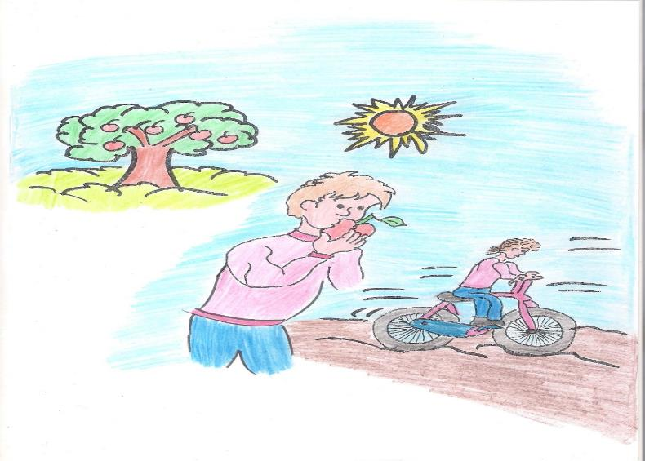
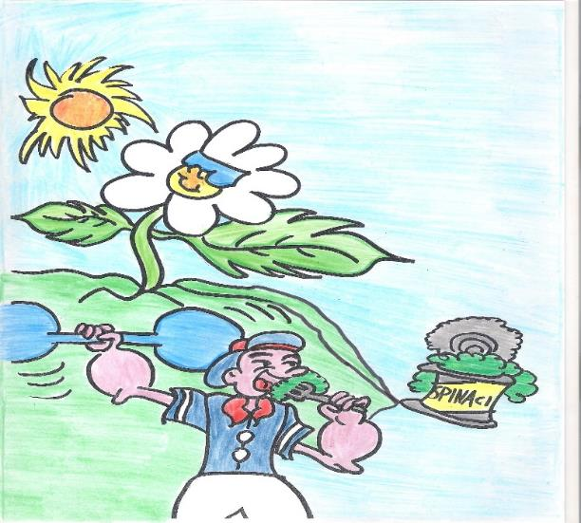
Energy transforms itself
Energy is never consumed, but is transformed from one
object to another.
For example: bike moves because the muscles energy is transformed into kinetic by the wheels.

Slide 5
Energy
Sources
Renewable
Non Renewable
they are in the subsoil and are highly polluting
(Fossil Energy)
they produce clean energy and are little or nothing polluting
Sun Wind Water Vapor
Biomass
Solar power
Carbon Oil Uranium Methane
wind power plant
hydroelectric power plant
geothermal power
plant
thermoelectric power plant
Biomass power plant

Slide 6
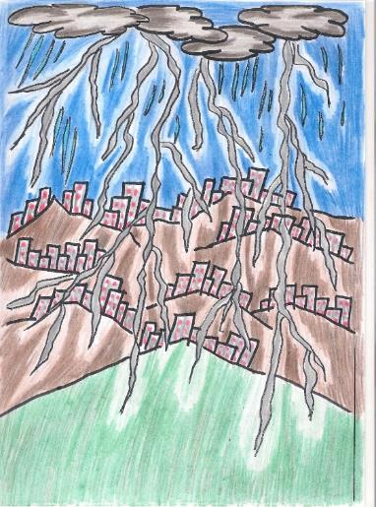
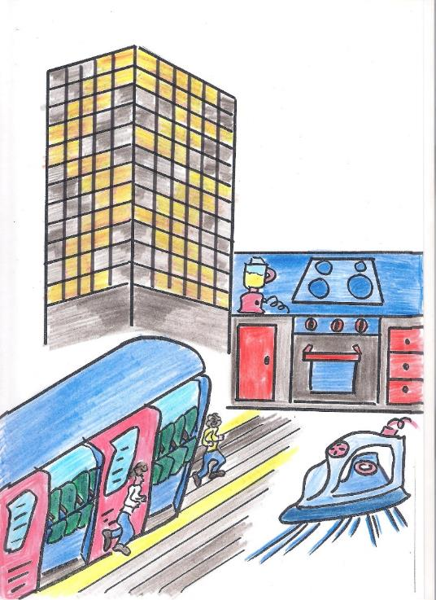
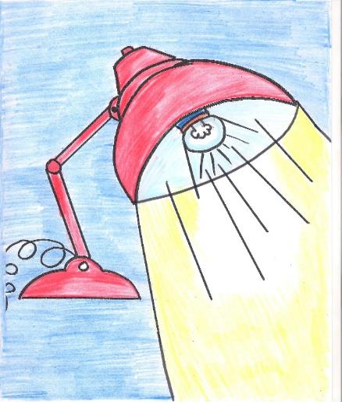
Electric energy
It can be produced from different sources
Electricity can be used to obtain: light energy, thermal energy, mechanical energy…….

Slide 7
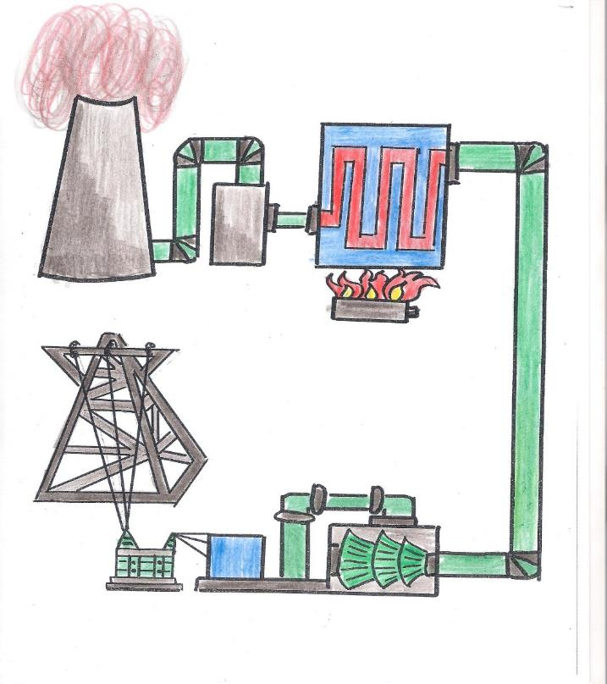
Thermoelectric power plant
Thermoelectric power plant: uses fossil fuel energy
The thermoelectric plant uses fossil fuels, which are also sources of exhaustible energy

Slide 8
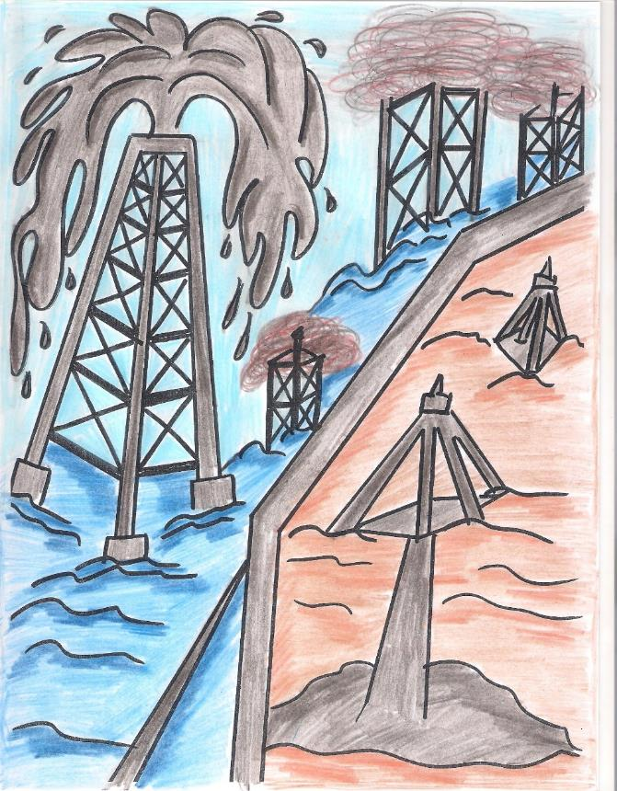
Fossil fuels
highly polluting:
Oil -Petroleum
Coal
Gas (natural)
Methane

Slide 9
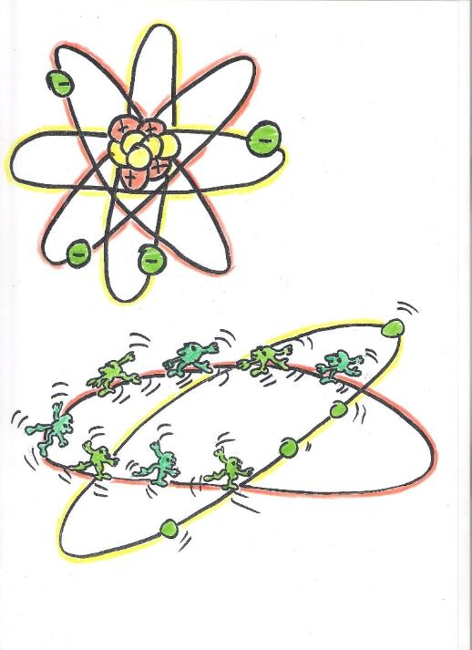
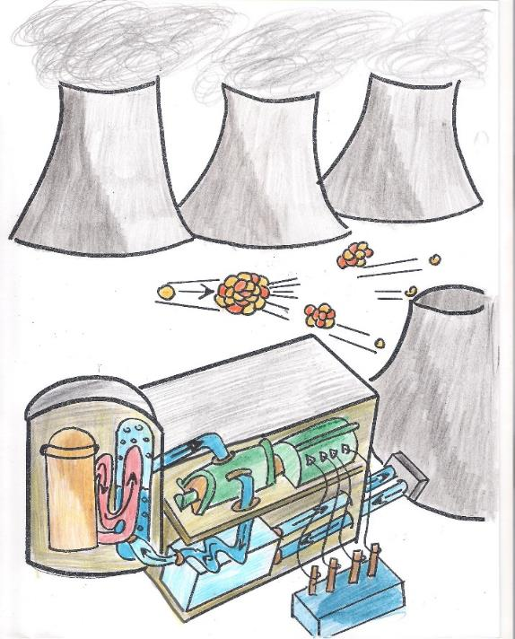
Nuclear power station
uses atomic Energy
Nuclear power plants are extremely dangerous due to the harmful radiation that can occur in case of breakdown or disposal of waste, radioactive waste.

Slide 10
CLEAN ENERGY TO SAVE THE WORLD
Solar energy
Wind energy
Hydroelettric energy
Geothermal energy
Biomass energy

Slide 11
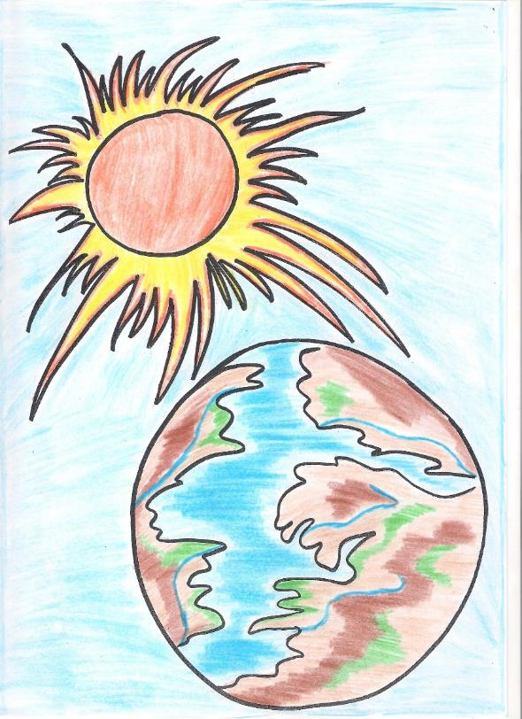
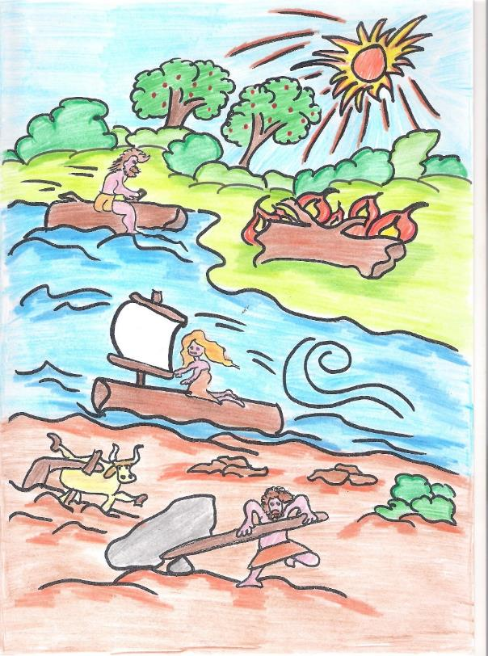
Solar Energy is the first form of energy used by man

Slide 12
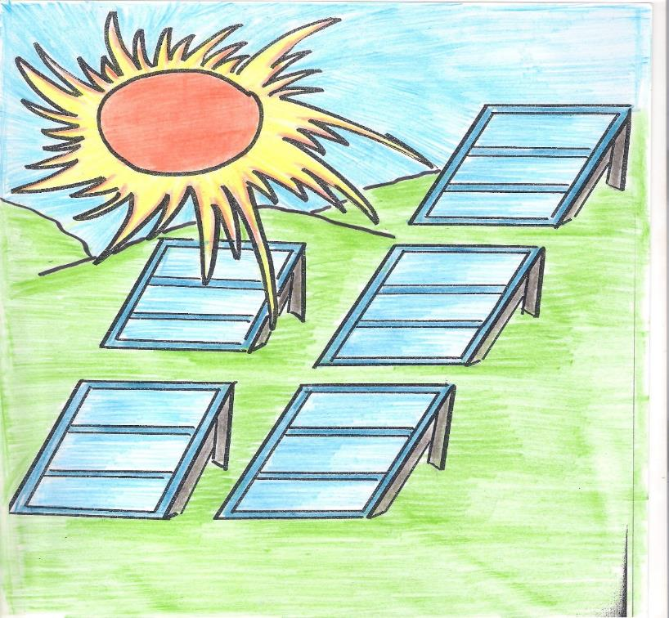
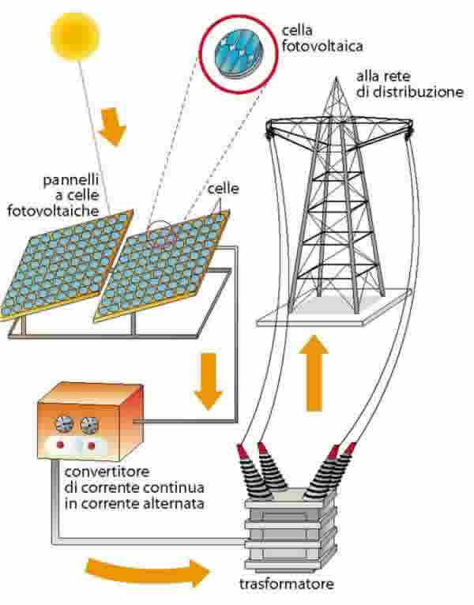
Solar energy is transformed into electricity from
solar and photovoltaic panels

Slide 13
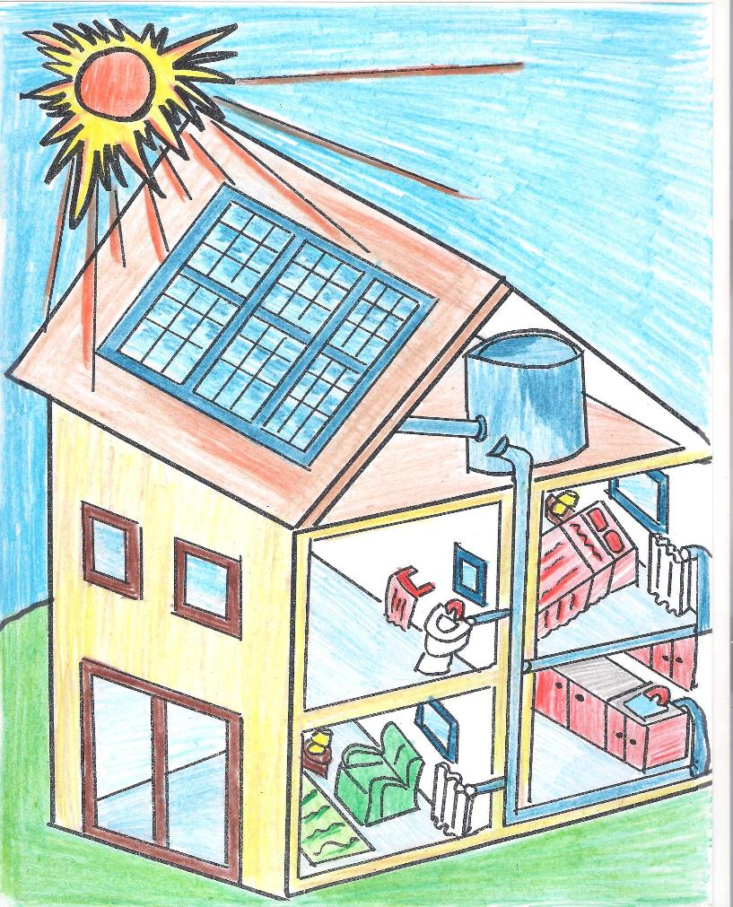

Slide 14
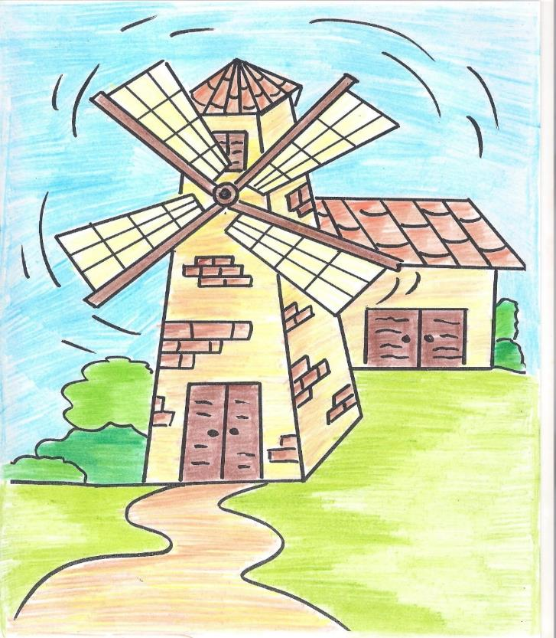
Wind Energy

Slide 15
A wind farm is a place with wind turbines that use the wind to make electricity
The energy of movement (kinetic) is transformed into electrical energy in the wind farm by aerogenerators

Slide 16
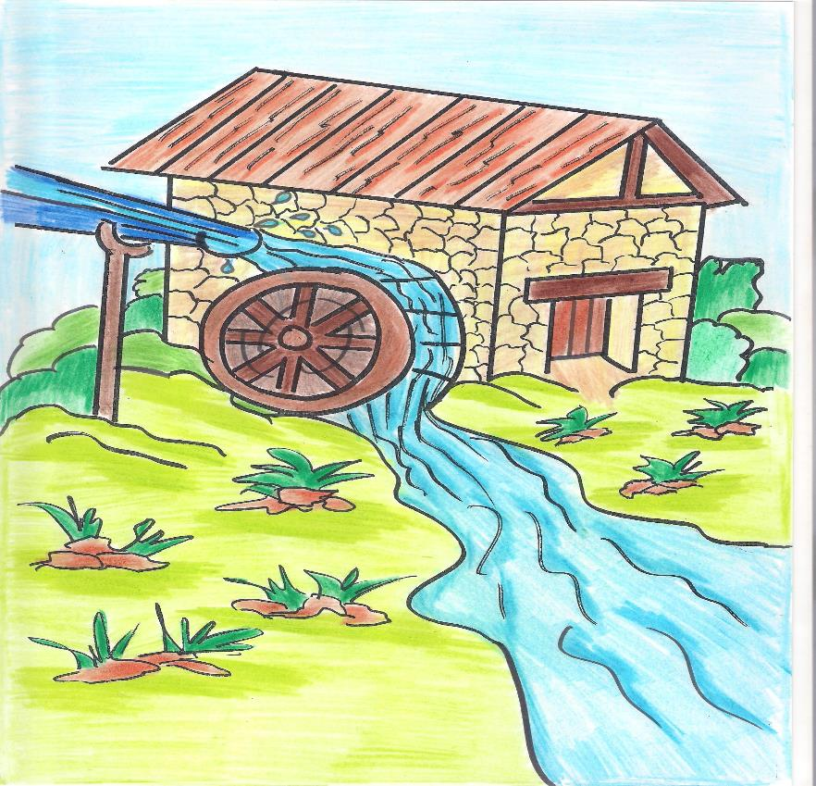
Hydroelectric energy

Slide 17
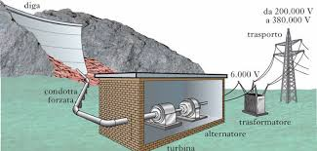
Hydroelectric plant uses the Energy of moving water.

Slide 18
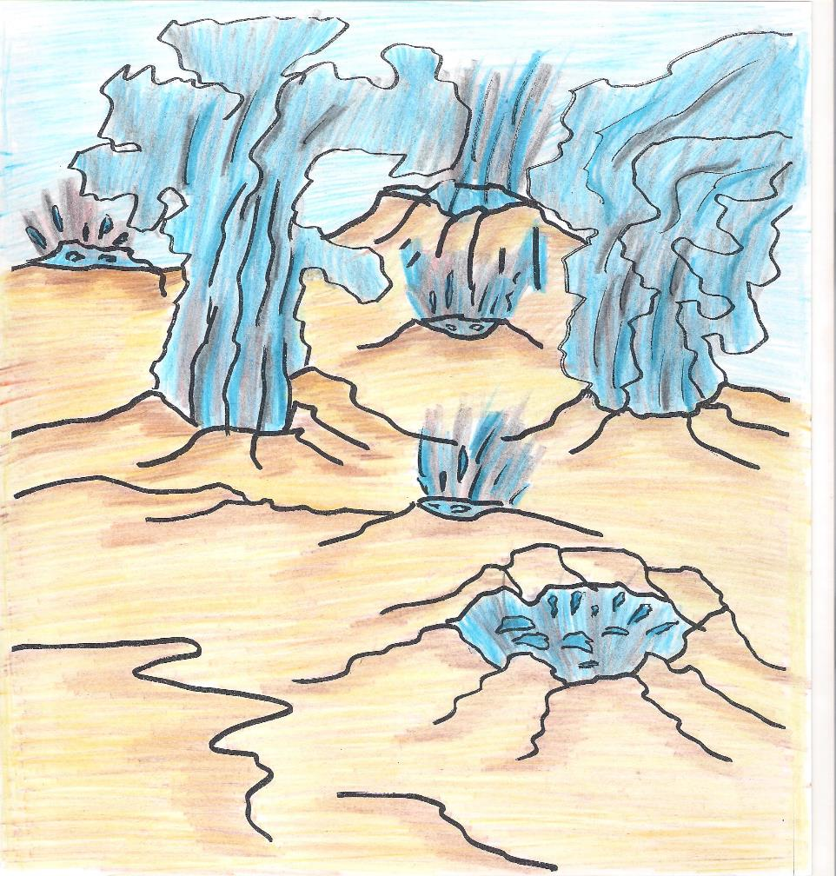
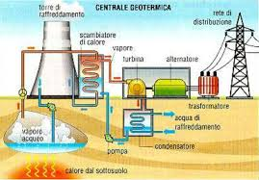
Geothermal energy
Geothermal power plant: uses the steam coming from the subsoil.

Slide 19
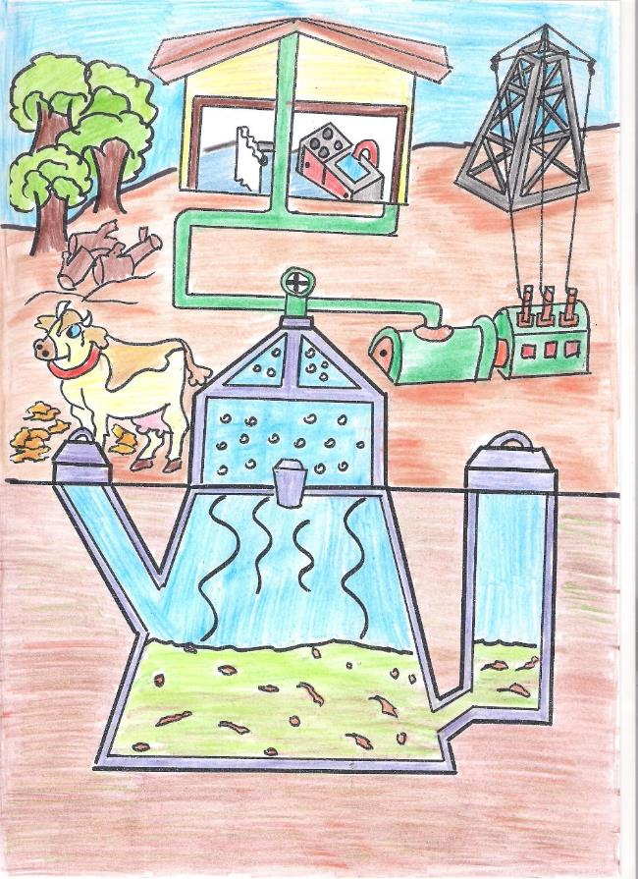
Biomassa energy:
cames from the organic waste

Slide 20
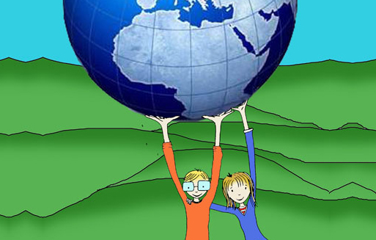
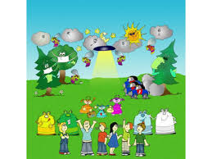
A message for you:
Help us to save our earth:
Recycle and
use green energy!

