Slide 1
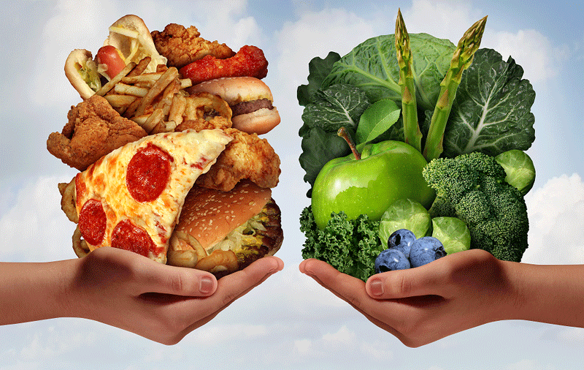
Healthy eating

Slide 2
Today we will talk about healthy lifestyle:
what to eat
to be healthy

Slide 3
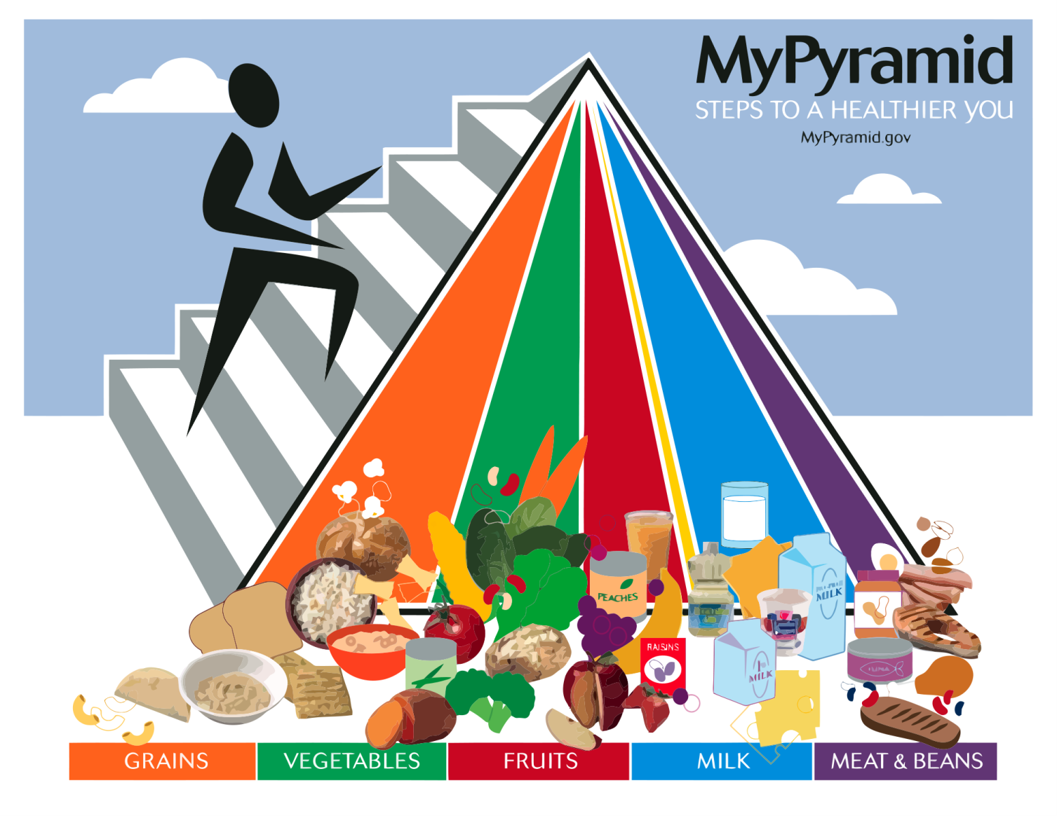
we will create a pyramid of healthy lifestyle

Slide 4
you will make a healthy lunchbox in groups

Slide 5
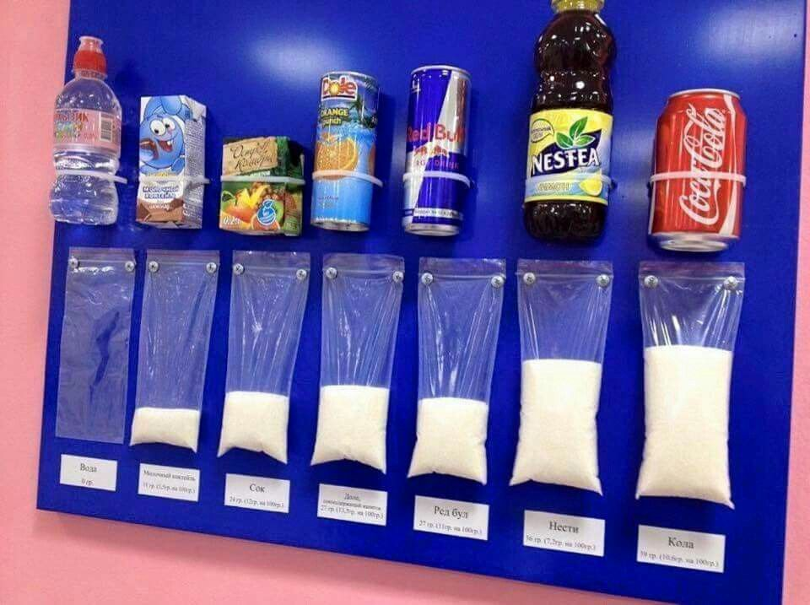
you will see how much sugar is found in popular products

Slide 6
HEALTHY
UNHEALTHY

Slide 7
https://www.youtube.com/watch?v=_VczK2zV2sE&t=93s

Slide 8
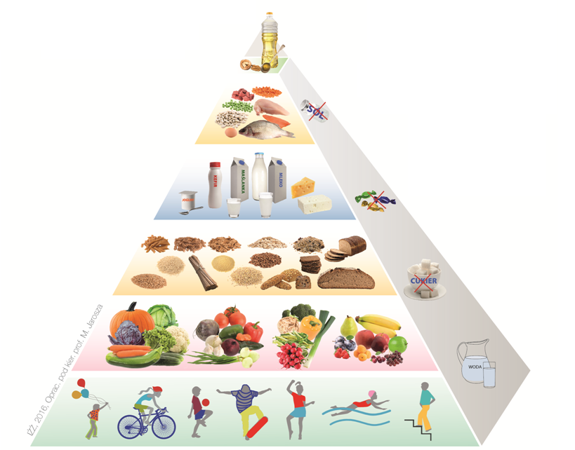

Slide 9
1. Be active every day

Slide 10
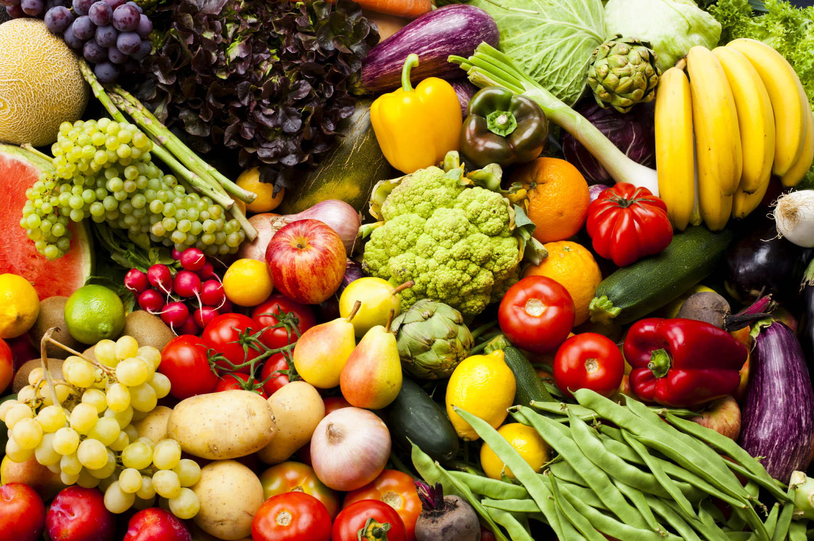
2. Eat vegetable and fruit as often as possible

Slide 11
3. Eat cereal products, especially whole grains products

Slide 12
4. Drink at least 3-4 glasses of milk every day. You can replace them with joghurt or cheese.

Slide 13
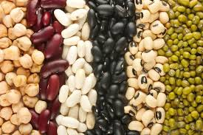
5. Eat fish, legume seeds, eggs and lean meat.

Slide 14
6. Limit the consumption of animal fats. Replace them with vegetable oils.

Slide 15
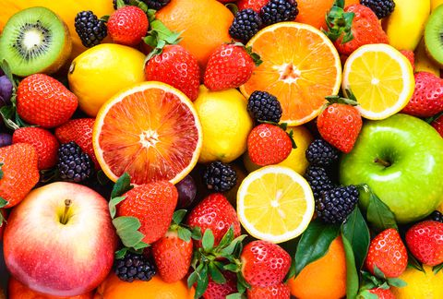
7. Avoid sugar, sweets and sweet drinks. Replace them with fruits and nuts.

Slide 16
8. Don’t salt a lot. Avoid salty snacks and junk food.

Slide 17
9. Remember to drink water.

Slide 18
10. Eat 5 regular meals
1. breakfast
2. lunch
3. dinner
4. afternoon snack
5. supper

Slide 20
One OREO cookie
1 sugar cube

Slide 21
Mars bar
7 sugar cubes

Slide 22
A can of Coca Cola
8 sugar cubes

Slide 23
100 g Milka chocolate
11 sugar cubes

Slide 24
Skittles
13 sugar cubes

Slide 25
Ketchup HEINZ
17 sugar cubes

Slide 26
Cappy apple juice
20 sugar cubes

Slide 27
https://www.youtube.com/watch?v=eFn4F4q5fIs

Slide 28
Summary
I found out that fruit juices contain a lot of sugar,
I know how to make a healthy lunch
I can identify healthy and unhealthy products

Slide 29
pear
apple
plum
strawberry
cherry
black currant
raspberry
blackberry

Slide 30
gooseberry blueberry apricot wild strawberry
banana orange lemon kiwi
Notes:
banana orange lemon kiwi

Slide 31
lime grapefruit pineapple grapes
peach watermelon pomegranate mango
fruit

