Slide 1
Destination – health !

Slide 2
If health were not so valuable, we would not have to read during Polish classes:
,,Na zdrowie’’ by Jan Kochanowski
,,Człowiek i zdrowie’’ by Ignacy Krasicki
,,Doktor i zdrowie’’ by Ignacy Krasicki

Slide 3
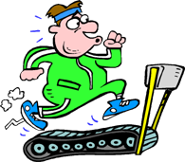
The first stop: physical activity!

Slide 4
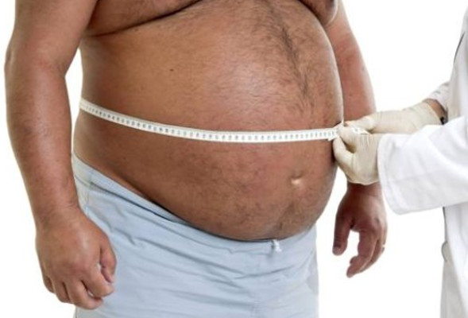
Doing physical exercises is very important for our health. Not enough physical activity is a common cause of diabetes, obesity, heart disease and cardiovascular system diseases, as well as changes in the spine and joints.

Slide 5
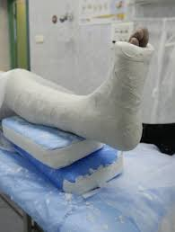
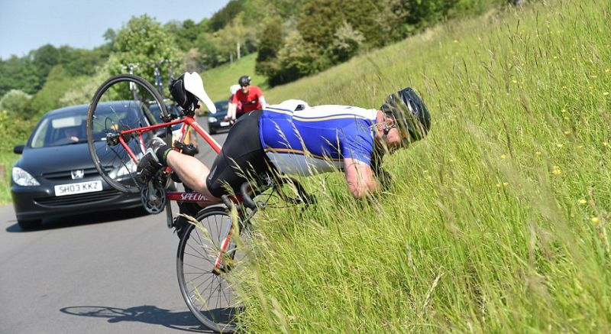
Doing sports is not so difficult!
Just ride a bike, run or walk to school.

Slide 6
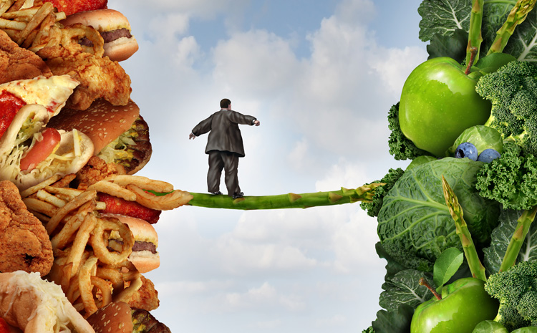
Our next stop - healthy diet!

Slide 7
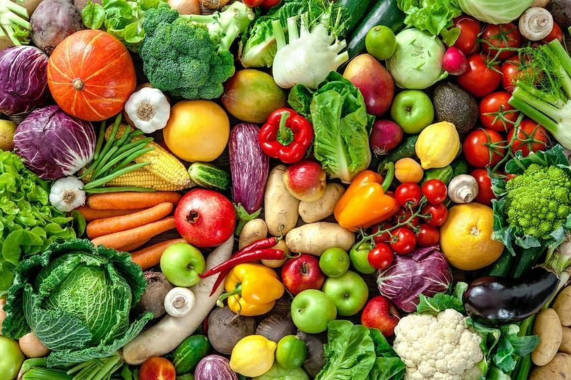
A healthy diet - a way of eating, based on the food that is beneficial to health.
Vegetables and fruit are essencial ingredients used in healthy diet. Drinking mineral water and avoiding sodas and fast foods helps keep our bodies in good condition and limits developing serious diseases.

Slide 8
Eating healthily is not so difficult!
All you need to do is to replace products containing a lot of sugar with those naturally sweet, for example: strawberries

Slide 9
Remember about the healthy nutrition pyramid

Slide 10
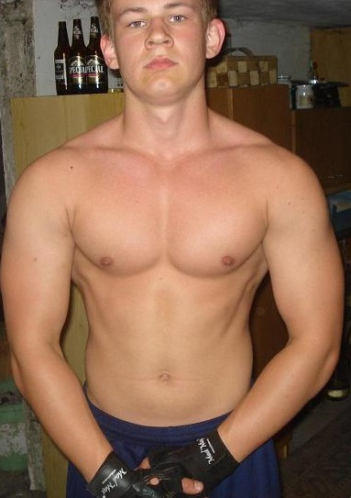
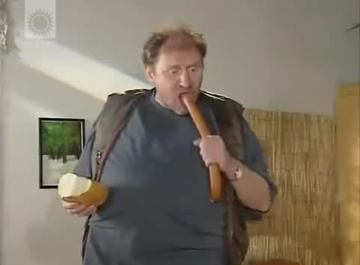
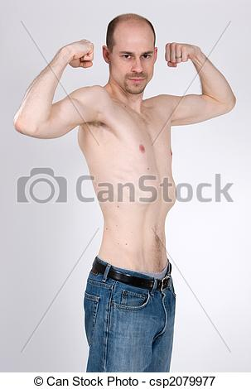
By following these rules, you can take a quick step forward.

Slide 11
Remember!
Laughter is also good for health!

Slide 12
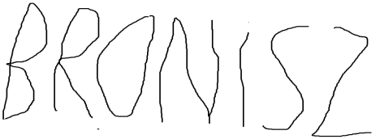
Made with a small sense of humor by: Hubert Sawa and hhh hhhhhh sources: http://zdrowie.gazeta.pl/Zdrowie/1,107103,16813075,Aktywnosc_fizyczna_jest_zdrowa__Czy_wiesz_dlaczego_.html https://pl.wikipedia.org/wiki/Zdrowe_od%C5%BCywianie

