Slide 1



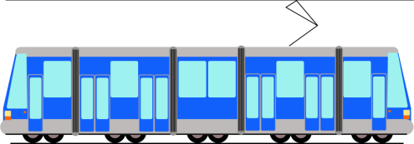


Saving Energy
- it’s our common concern !
Notes:
1

Slide 2

DYSKUSJA
?
?
?
What are the types of Energy?
?
?
Where is Energy acquired from?
?
?
?
What do we need Energy for?
?
Why do we have to save Energy?
?
?
?
How can we save Energy?
Notes:
What are the types of Energy?
Nowadays Energy occurs under many figures. The Energy that is used for devices and lightning in our houses, schools and offices is called electricity , so called electrical current. The Energy which makes our houses and work places warm and in faucets we have got warm water is called thermal energy. Furthermore each human and animal needs life-affecting energy, which results in our possibility to move, develop and height. To make it happen we need food.
Where is Energy acquired from? Sources of Energy
The Energy is acquired from many roots. The most used fuel to raise electricity and thermal energy in Poland is coal. It is burnt in electrical power and heating plants or in houses’ stoves. In electrical power and heating plants the warmth, that is made in the process of burning the coal is heated with water , which flows to our appartments through pipelines. Thanks to that we feel warm in our houses and in faucets we have hot water. Moreover the electrical current is acquired. Another energy fuel that is often used is natural gas. As a result of its burning in gassy caldrons the warmth obtained runs accross directly to our faucets and heaters. On the other hand the gas that is burnt in gas burner is used to prepare hot meals.
Both, gas and coal, are called non-renewable sources of energy , because we need hundreds of years to regenerate them in the nature.
Beacuse those gas supplies are shortened, people use renewable sources of energy (water, sunlight, biomass, wind, Earth warmth) to obtain the electricity.
What do we need Energy for?
The Energy makes the devices, which we use everyday, work. At homes energy is used for heating, preparing hot meals, lightening and using many domestic electrical appliances. Moreover, the energy makes cars and other vehicles move. It is essential for organism to live. We use it at work and games; it makes our bodies grow, and the brain is capable to think.
Why do we have to save Energy?
Saving the Energy fosters the environmental protection. Less energy consumption acts on better condition of the air, which we use for breathing. That makes us healthy. The additional benefit related to saving the Energy are cuts to the energy and warmth consumption bills. The saved money may be used on travelling- visiting zoo, museums or going to the cinema.
How can we save the Energy?
Turning off the lights in rooms when we go out
Unplugging electrical appliances when we aren’t using them
No running water from the faucet
Close the refrigerator
Turning off the heater when we open the windows during winter time
2

Slide 3
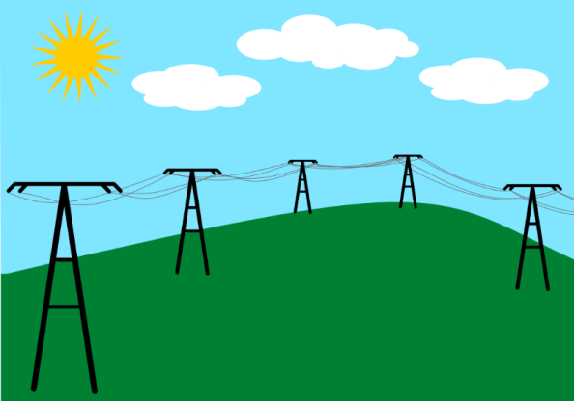
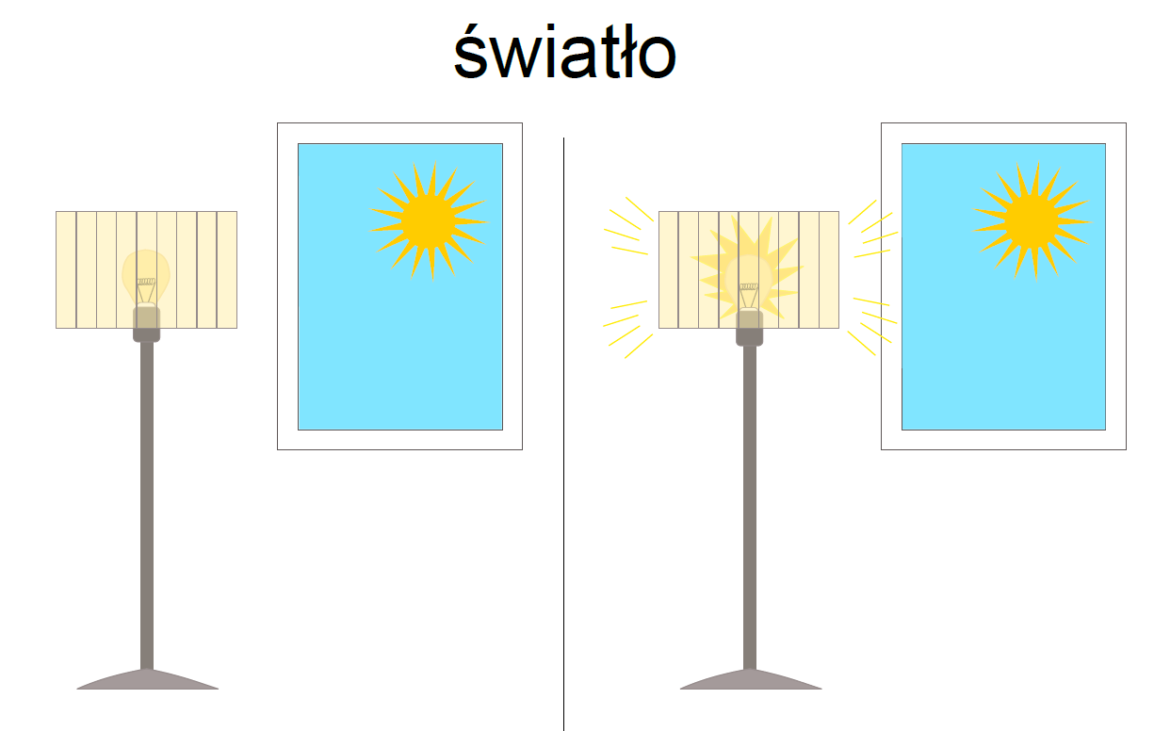
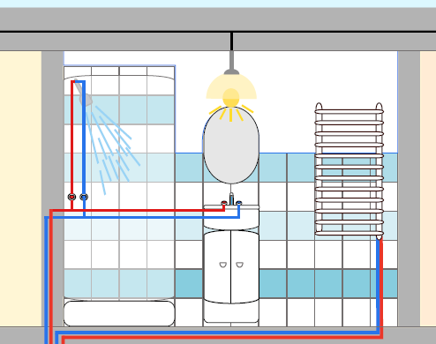
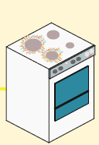

What are the types of the Energy?
Electrical
Thermal
Life-affecting
Notes:
Nowadays Energy occurs under many figures. The Energy that is used for devices and lightning in our houses, schools and offices is called electricity , so called electrical current. The Energy which makes our houses and work places warm and in faucets we have got warm water is called thermal energy. Furthermore each human and animal needs life-affecting energy, which results in our possibility to move, develop and height. To make it happen we need food.
3

Slide 4


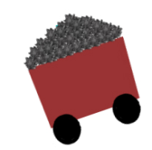




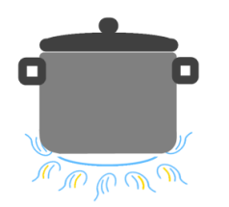

Where is Energy acquired from? Sources of Energy
Renewable
Non-renewable
biomass
warmth from the Earth’s inetrior
water
wind
Solar radiation
materials(brown and black coal
Mineral oil
Natural gas
Notes:
Renewable sources of energy are almost endless, f.ex. solar radiation, wind, the potency of water, the warmth from the Earth’s interior, biomass
Non-renewable sources of energy will end faster than their natural regenerating would be obtained. The process of rising raw materials(brown and black coal, mineral oil, natural gas) lasts for million years. Experts believe that mineral oil deposit will run out in 30 years, and natural gas deposit will suffice for another 100 years.
4

Slide 5
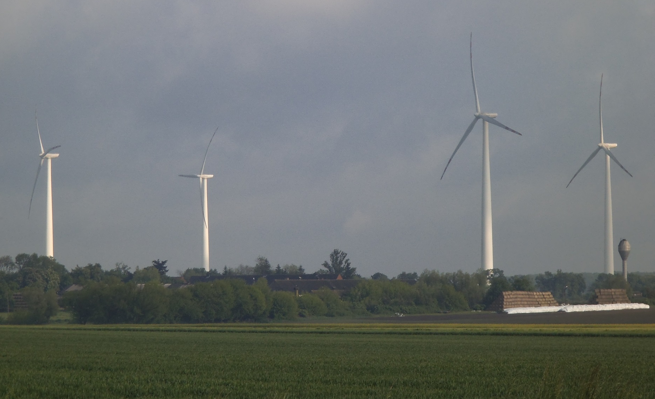

Where is Energy acquired from? Sources of Energy
Wind power station
Wind
Notes:
More often near Wrocław we can find wind power stations. The wind moves propellers and that’s why we receive the energy which then is sent through high voltage lines to houses, companies.
5

Slide 6
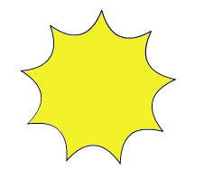


Where is Energy acquired from? Sources of Energy
Solar panels
Sun
Notes:
Solar radiation makes us feel warmer when we are on fresh air. Collected in photovoltaic pannels or solar thermal collectors, after transforming energy, electrical or thermal energy is received.
6

Slide 7

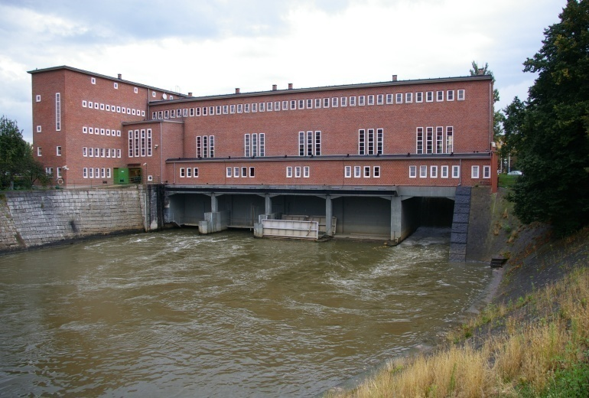

Where is Energy acquired from? Sources of Energy
Hydroelectric power station
Water
Notes:
Running water can be also the source of electrical energy. The Energy received because of water movement takes place in hydroelectric power station.
7

Slide 8
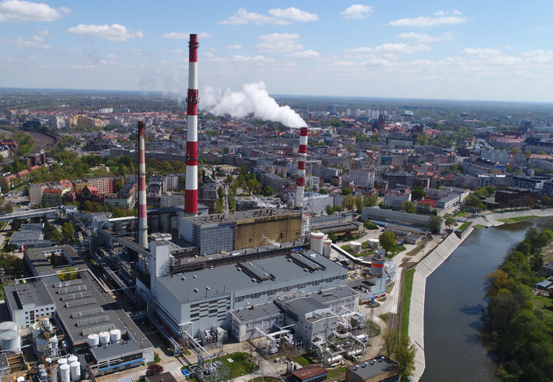
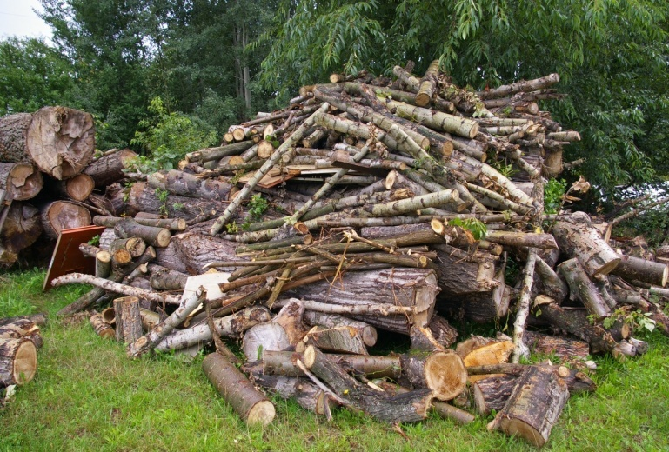
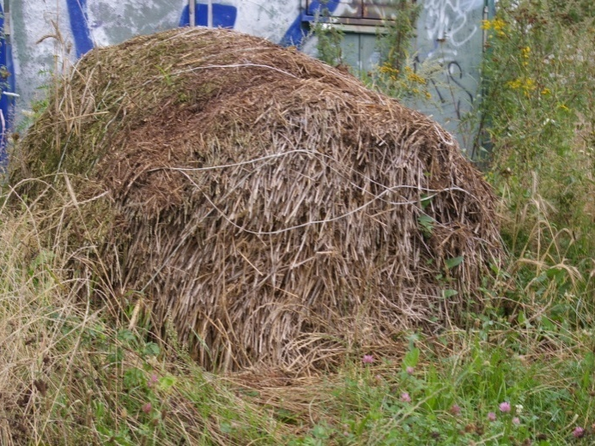
Where is Energy acquired from? Sources of Energy
Power Plant
Biomass
Notes:
Biomass is the oldest and most widely used renewable energy source today.
Biomass used in the energy sector is mainly straw, energy crops and wood.
It is often burned in combined heat and power plants as a fuel additional to coal.
8

Slide 9
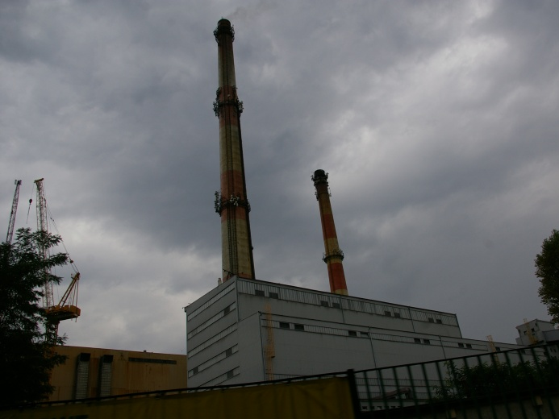
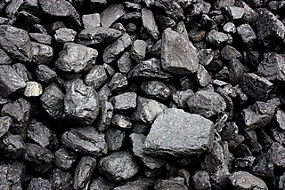
Where is Energy acquired from? Energy sources
Power Plant
https://www.wroclaw.pl/nieznany-wroclaw-jak-z-wody-i-wegla-robi-sie-cieplo-wideo-zdjecia
coal
Notes:
Coal is the most common energy raw material in Poland.
It is used to produce electricity and heat in combined heat and power plants, but also in stoves in homes and flats.
In combined heat and power plants, coal is burned in blast furnaces, where the turbines move to produce electricity.
It is processed there so that it can be used for our radiators and for heating the water in our taps.
Additionally, water is heated, which is transported by pipelines to residential buildings.
9

Slide 10
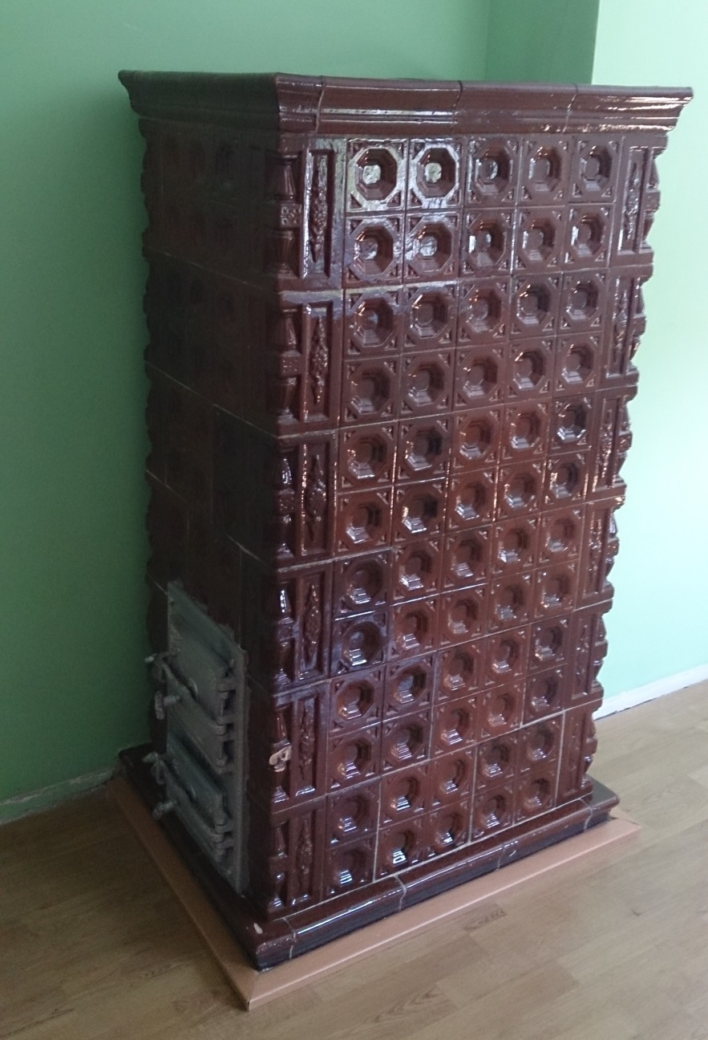
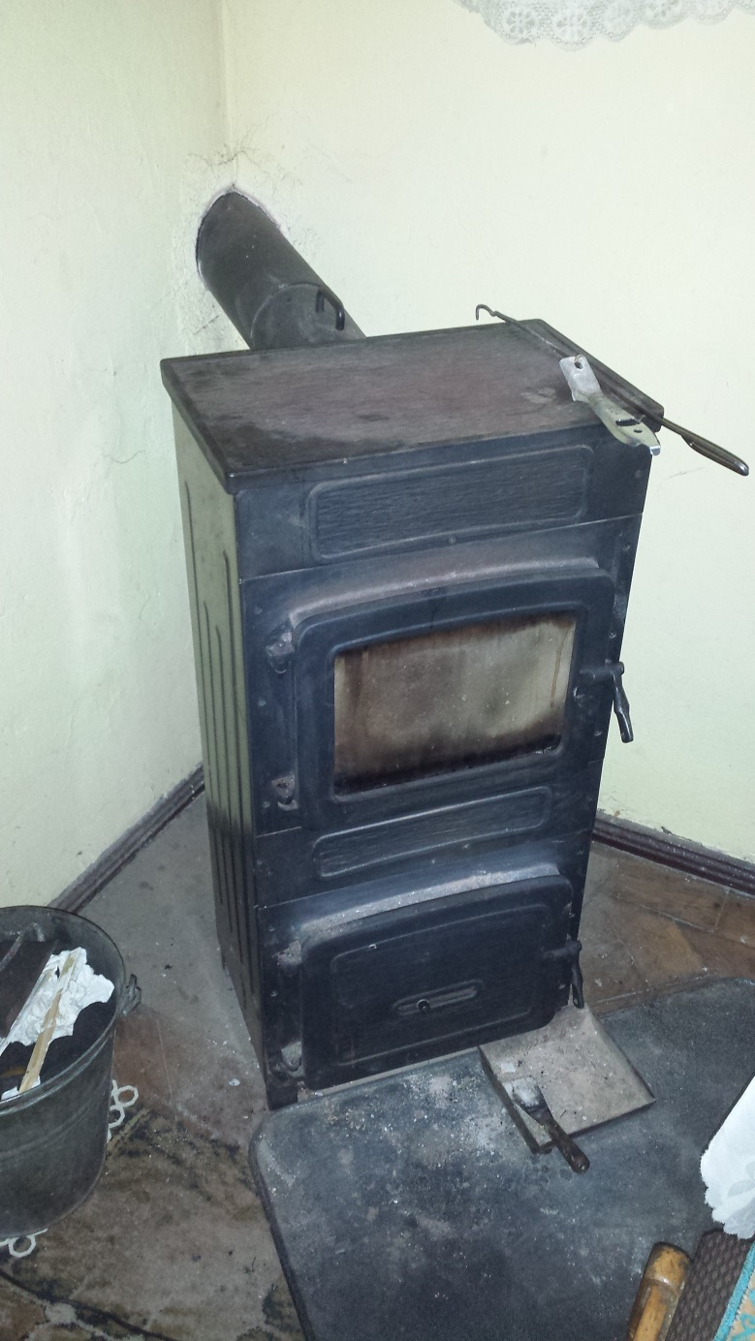
Where is Energy acquired from? Energy sources
Stoves in houses
https://www.wroclaw.pl/nieznany-wroclaw-jak-z-wody-i-wegla-robi-sie-cieplo-wideo-zdjecia
Coal
Notes:
Coal is the most common energy raw material in Poland.
The heating of dwellings by burning coal in stoves in homes causes high air pollution, so this form of heating is now being abandoned more and more often.
10

Slide 11
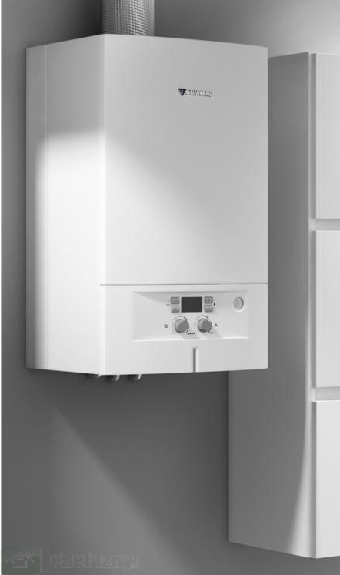
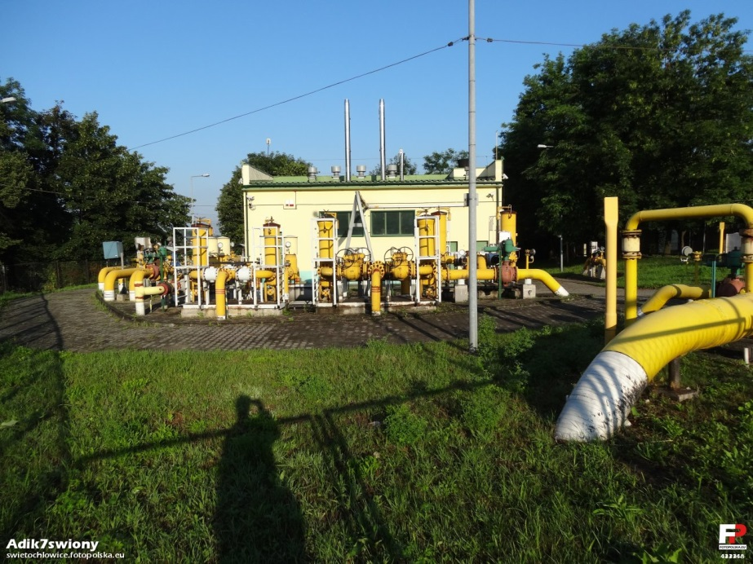
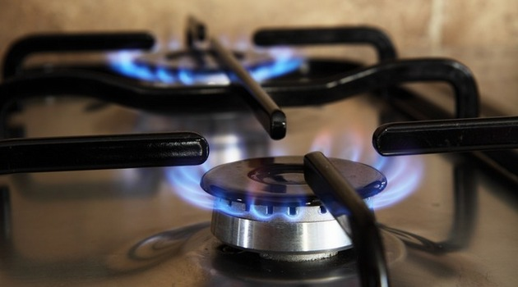
Where is Energy acquired from? Energy resources
gas station
gas boilers
Natural gas
gas range
Notes:
Natural gas, also called "blue fuel", is immediately after coal the most frequently used energy fuel in our country.
It is used primarily for heating the flats (with the use of gas boilers) and for preparing warm meals (gas cookers).
The emission of pollutants from gas combustion is much lower than in the case of coal.
11

Slide 12
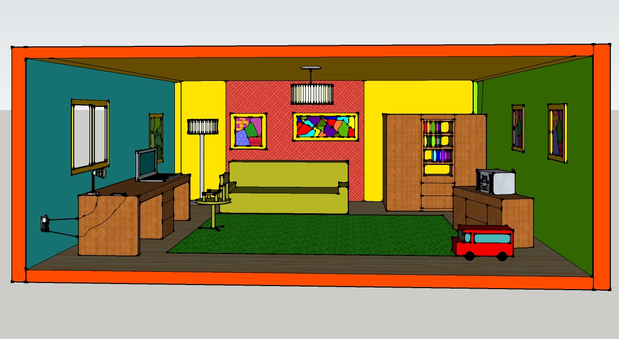

What do we need Energy for?
Children’s room
Notes:
Energy use in chilldren’s room: lightning, battery toys, radio, computer, heating
12

Slide 13
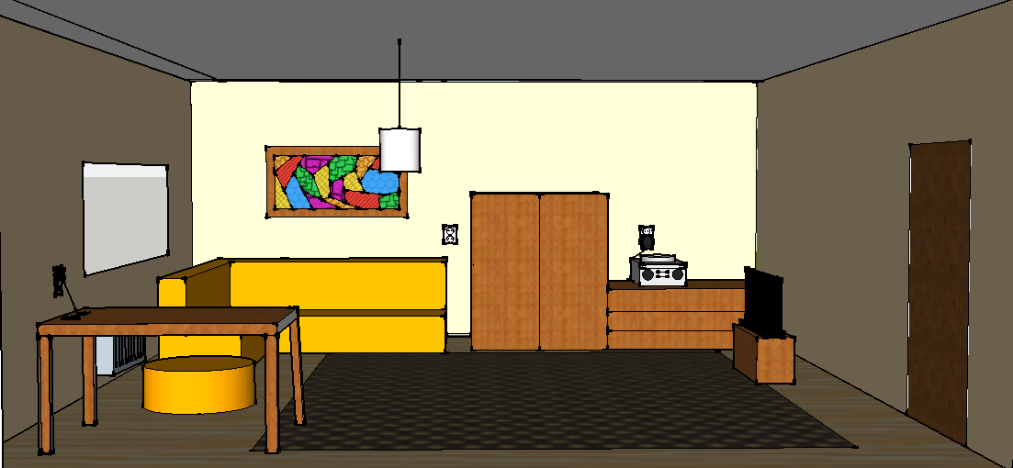
What do we need Energy for?
living room
Notes:
Energy use in living room: lighting, heating, television, radio, charger
13

Slide 14
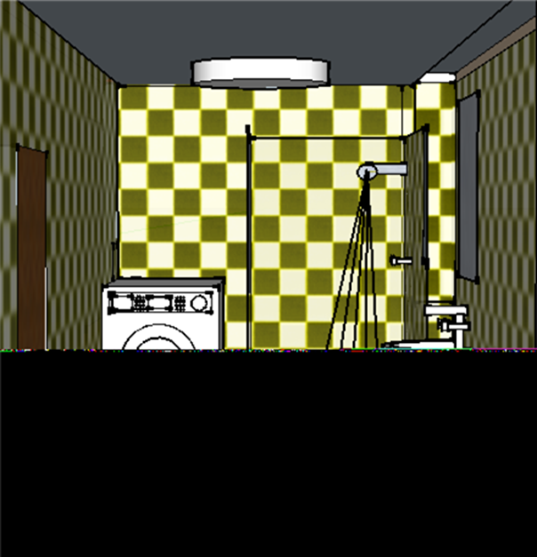
What do we need Energy for?
Bathroom
Notes:
Energy use in bathroom: lightning, heating, toillet, washbasin, shower, washing machine
14

Slide 15
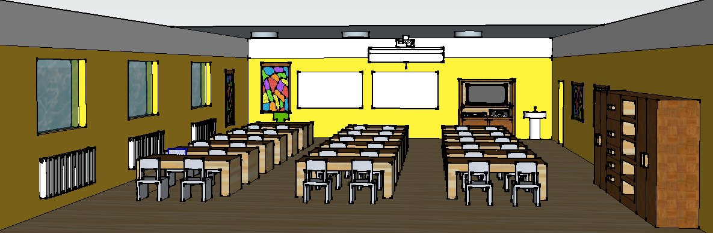

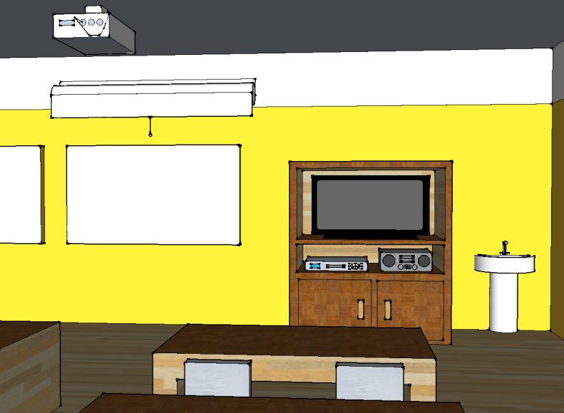
What do we need Energy for?
Classroom
Notes:
Energy use in school: lighting, heating, television, radio, overhead projector, washbasin, DVD player
15

Slide 16



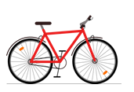
Quiz
about saving energy and water
Notes:
Test wiedzy o oszczędzaniu energii i wody – następne slajdy pokazują dwa możliwe postępowania przy korzystaniu z energii elektrycznej i cieplnej. Zadaniem uczniów/przedszkolaków jest wskazanie, która postepowanie jest zgodne z zasadami oszczędzania energii elektrycznej lub wody.
UWAGA!
Slajdy przygotowane w trybie „animacji niestandardowej”. Po kliknięciu myszą zaznaczana jest poprawna odpowiedź.
16

Slide 17
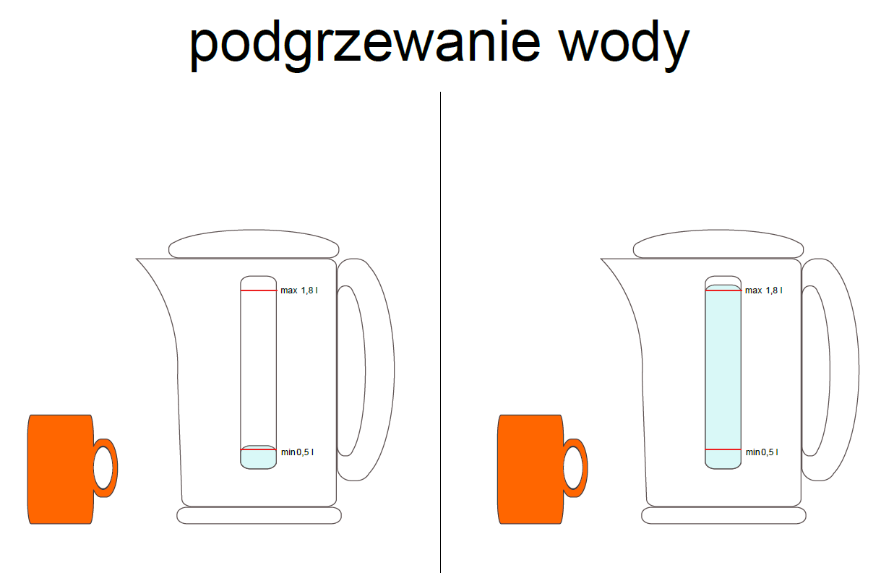
How can we save Energy?
Notes:
QUIZ ON SAVING ENERGY
When you heat water in an electric kettle to make a cup of tea or coffee don’t make it full. In order to save energy you should fill it with that amount of water you really need.
17

Slide 18
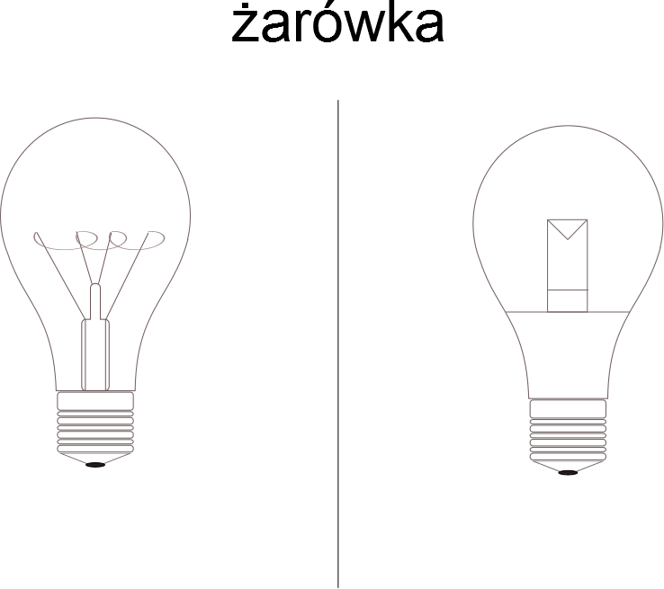

How can we save Energy?
LED
Notes:
To reduce electric energy consumption we should replace normal light-bulbs with energy-efficient light-bulbs.
18

Slide 19
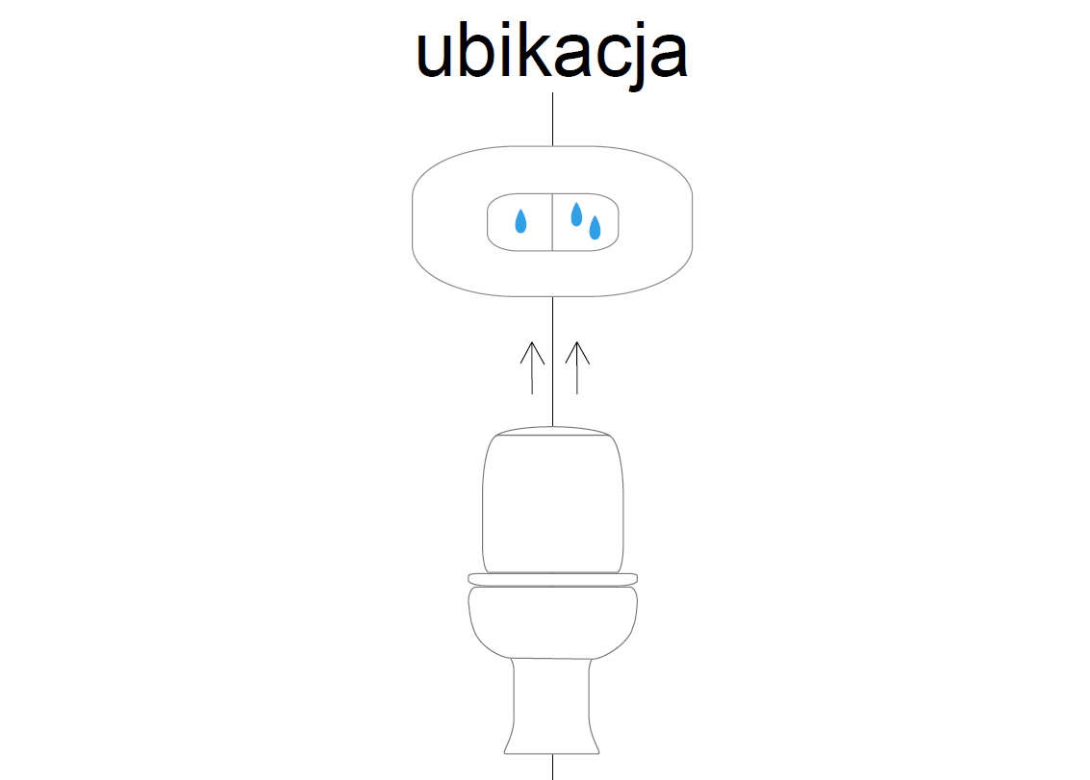
How can we save Energy?
Notes:
When you use toilets try to choose less water option.
19

Slide 20
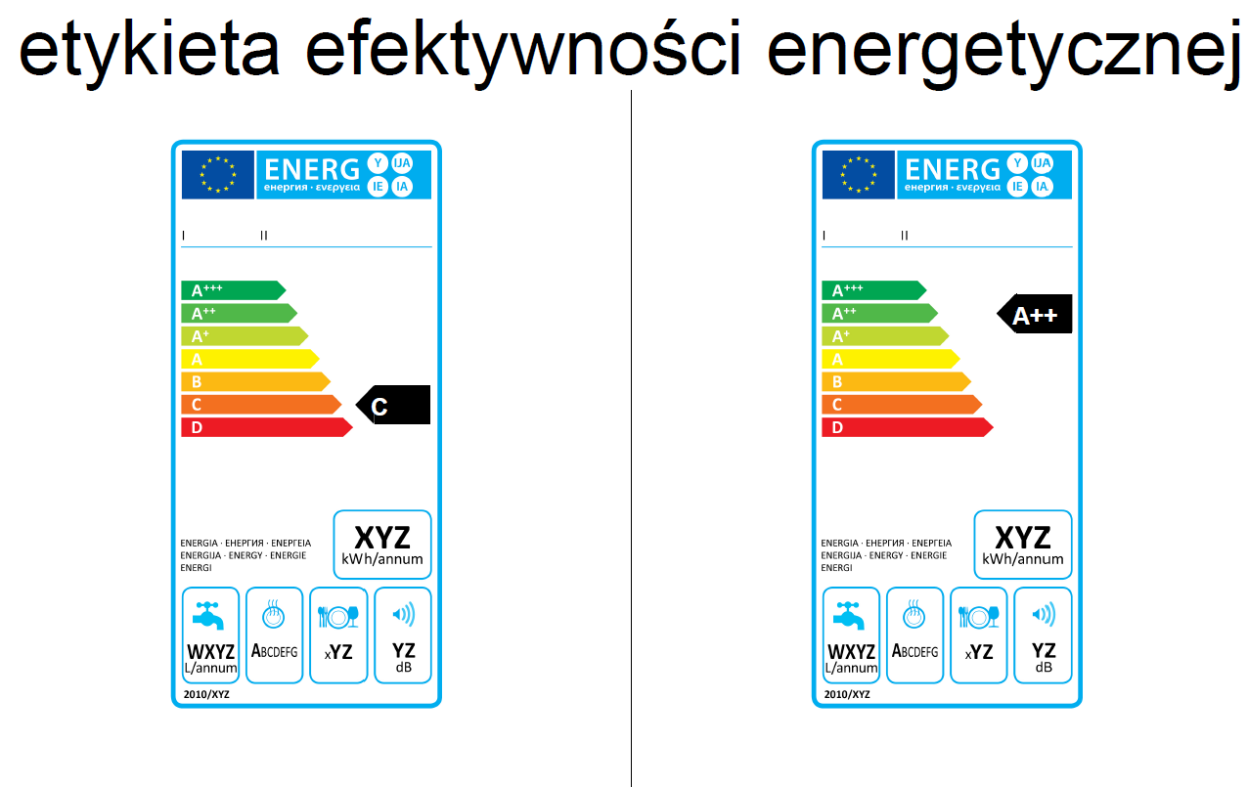
How can we save Energy?
A++
Notes:
When buying new electrical appliances check their energy label. The symbol A (A+,A++,A+++) informs you they are energy-efficient.
20

Slide 21
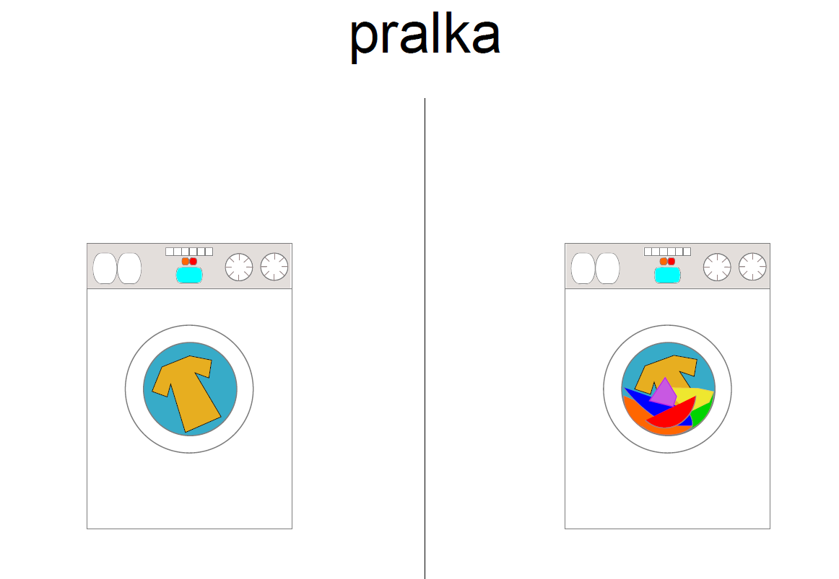
How can we save Energy?
Notes:
When doing the washing try to put as many clothes as you can.
21

Slide 22
How can we save Energy?
Notes:
When the sun is shining do not turn on the lights .
22

Slide 23
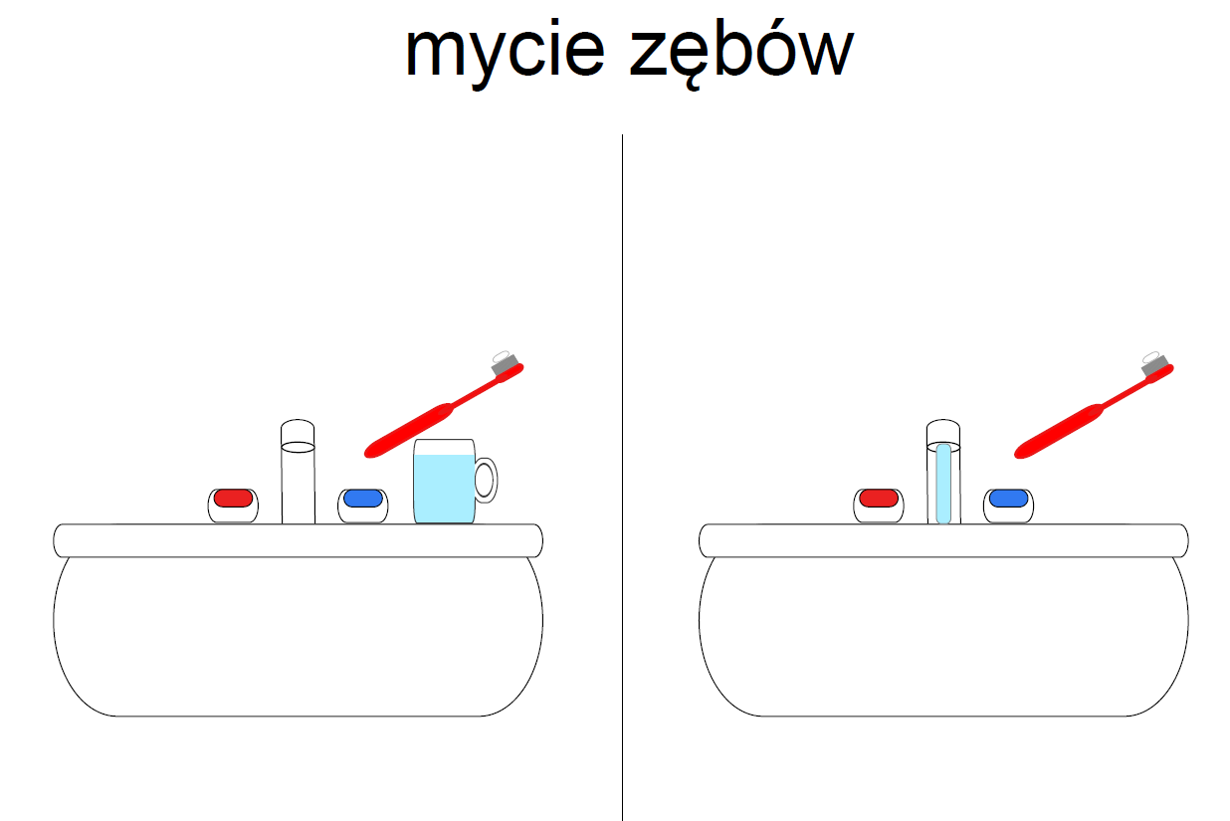
How can we save Energy?
Notes:
Gdy myjesz zęby, zamiast zostawiać włączoną wodę, która cieknie z kranu, nalej wodę do kubeczka. Pozwoli to na oszczędzenie wody.
23

Slide 24
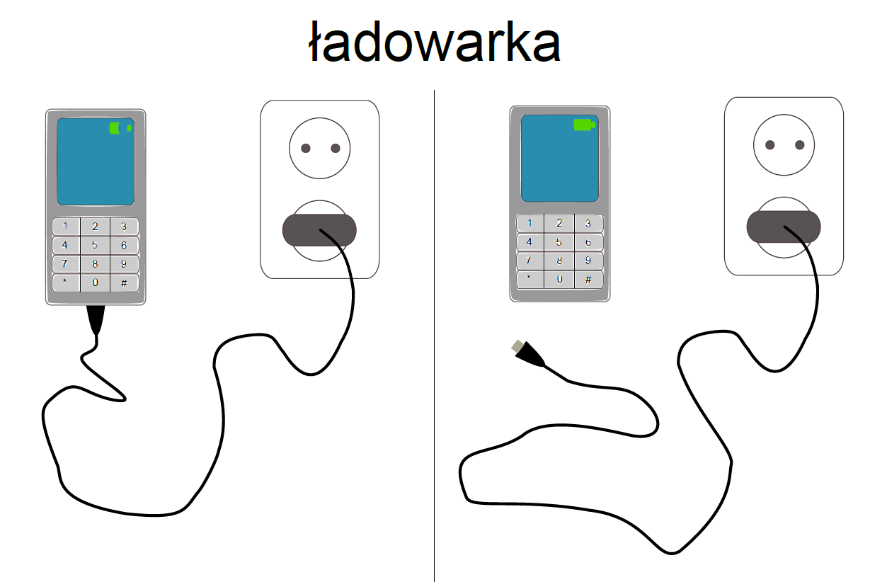
How can we save Energy?
Notes:
When the mobile is charged unplug the charger.
24

Slide 25
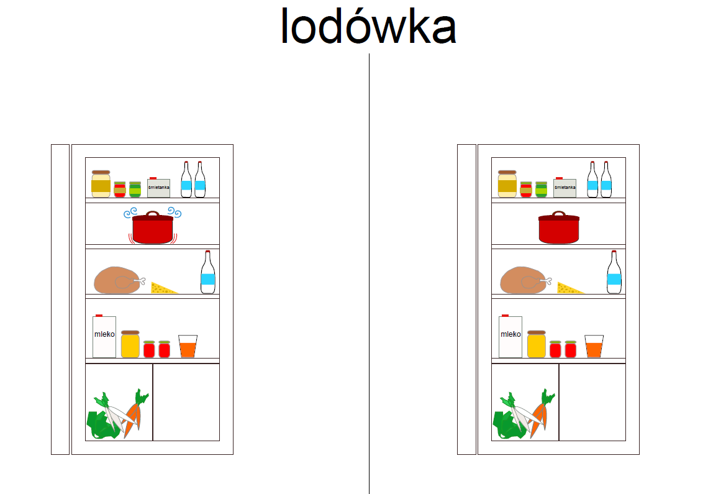
How can we save Energy?
Notes:
Wkładaj do lodówki tylko przestudzone potrawy i dbaj, aby lodówka nie była zbyt długo otwarta.
Pojawienie się lodu na tylnej ściance lodówki oznacza, że nie działa ona prawidłowo i zużywa znacznie więcej energii. Warto w takiej sytuacji oddać ją do naprawy.
25

Slide 26
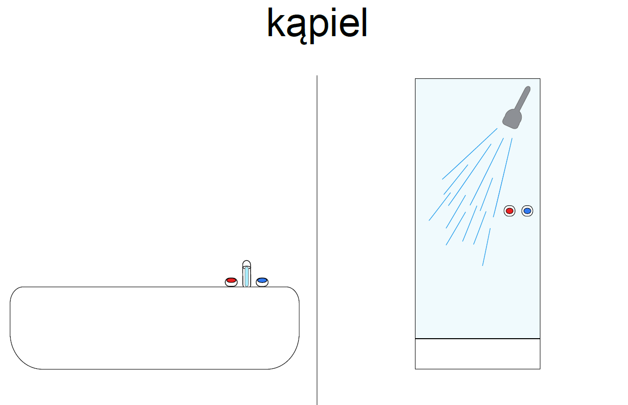
How can we save Energy?
Notes:
Try to have a short shower instead of having a bath.
26

Slide 27
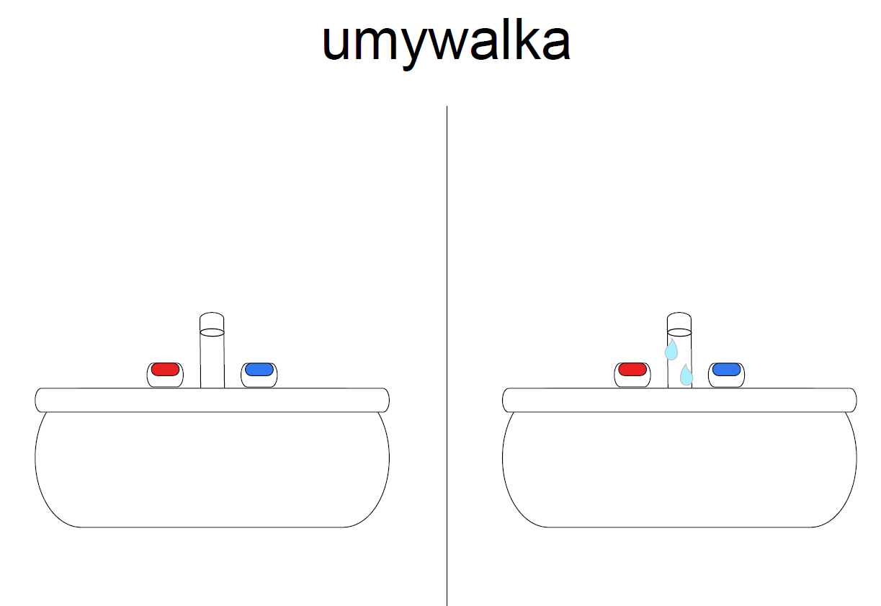
How can we save Energy?
Notes:
Dbaj, aby kran był zawsze dobrze dokręcony.
27

Slide 28
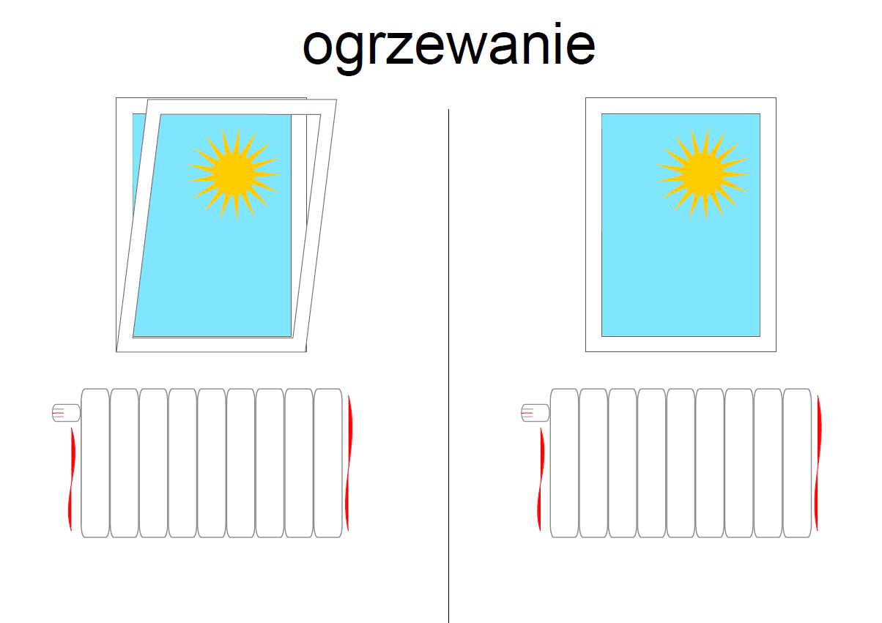
How can we save Energy?
Notes:
Do not open the windows when the heating is turned on. Close the radiator before opening the window.
28

Slide 29
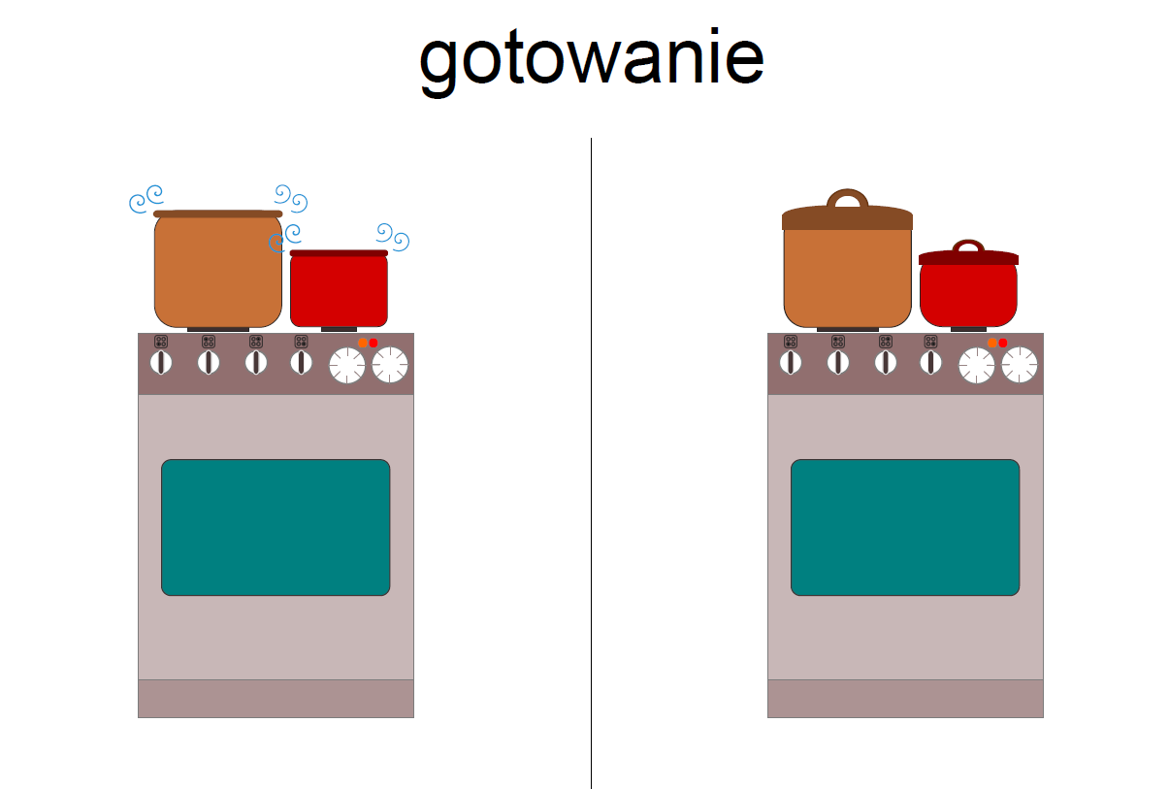
How can we save Energy?
Notes:
While cooking cover pots with a lid. Your food will be prepared faster and at the same time it will reduce energy consumption.
29

Slide 30



Each of us, every day has an impact on the energy consumption in the places where we are.
Saving energy means saving money
and reduction of pollutant emissions.
!
!
Let’s reduce
ENERGY CONSUMPTION IN THE WORLD
Notes:
30

Slide 31


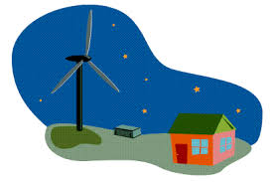


Slide 32

THE END
Translation:
Szymon Pilaszek 6b
Natalia Rządkowska 6b
The presentation was taken from the Inernet and modified by:
Alicja Tarczyńska 6b
Nina Sawczenko 6a
Zuzanna Gniot 6b
Natalia Rządkowska 6b
SP2 Puławy, POLAND 2018

