Slide 1
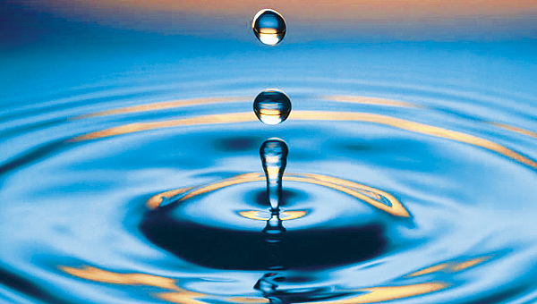
WATER
STUDENTS: NINA RAJŠELJ, ŽIVA BOBNAR

Slide 2
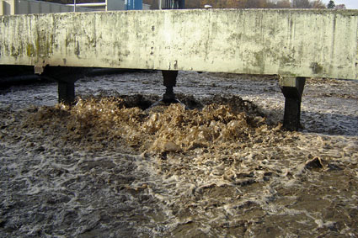
Polluted water
-Many developing countries don’t have clean water
-People often get sick because of polluted water
-In India majority of streams and rivers are polluted

Slide 3
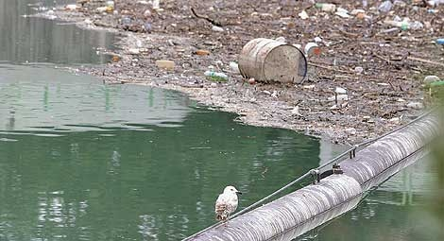
What pollutes the water?
inappropriate discharge of waste water in industry and households
inappropriate and excessive fertilizer and spray use
traffic
natural disasters (oil spills)
polluted air (acid rain)
illegal waste dumps

