Slide 1

windenergy
ECO ACTIVE

Slide 2
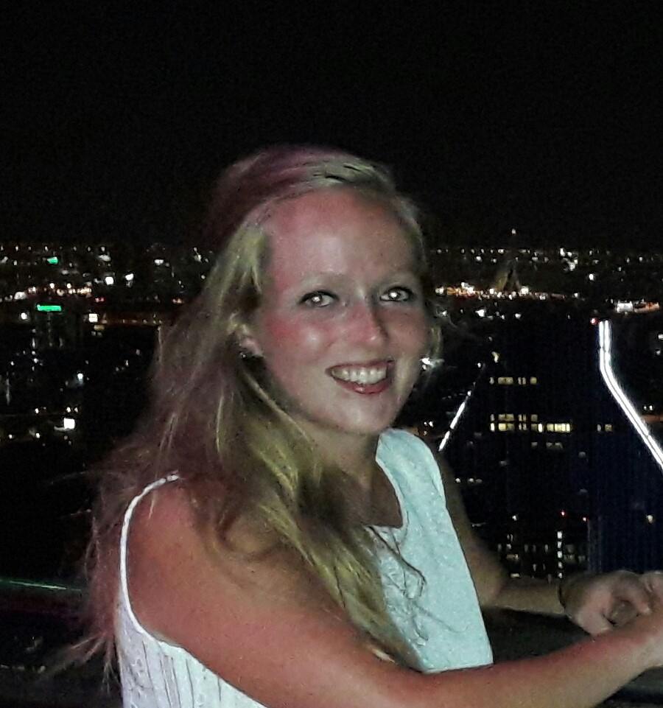
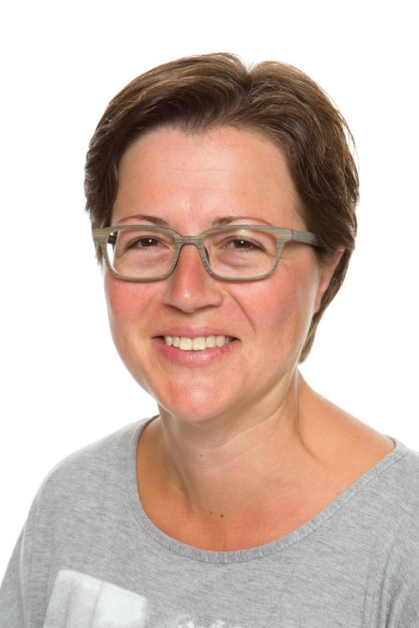
Introduction of the teachers
Imke Kosman
Carin Overbeek

Slide 3
Welcome
Hello students,
Today you learn something about windenergy.
We are going to make a windmill.
If you have any questions ask us for help.

Slide 4

Short movie energy
https://www.youtube.com/watch?v=wyVF6R9e6xE
Tell us in your own words:
What is energy?
What do we use it for?

Slide 5
Short movie windenergy
https://www.youtube.com/watch?v=Quy-b_ZOxBA
Now you’ve seen something about windenergy. We going to tell you how to make your own windmill.

Slide 6
How to make a windmill?
https://www.youtube.com/watch?v=jEhW6xFv49k

Slide 7
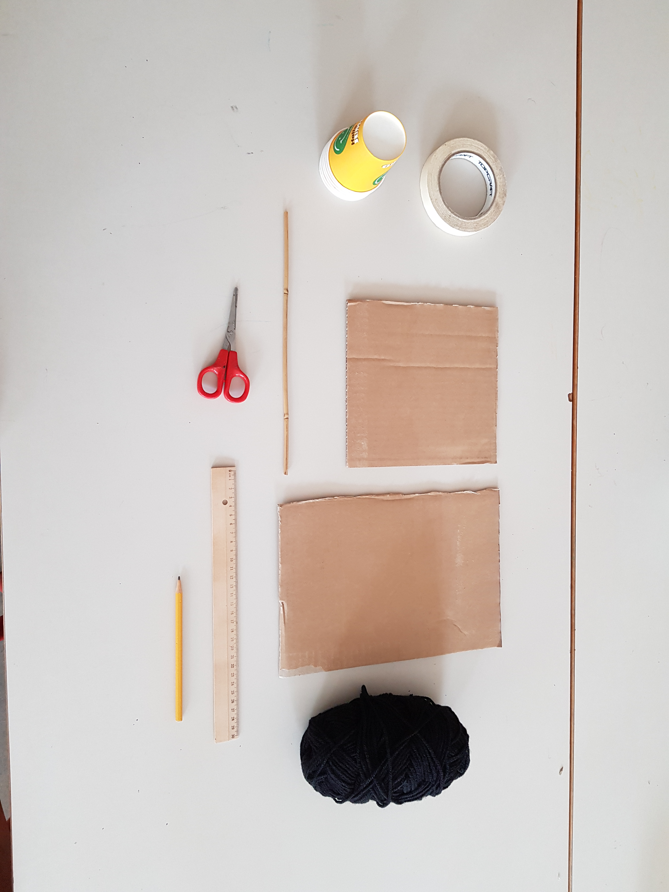
Materials

Slide 8

Materials (for 2 students)
piece of sturdy cardboard 20x20 centimeters
piece of sturdy cardboard (size does not matter)
ruler
pencil
6 paper cups (preferable without print)
scissors
stick 25 centimeters
painters tape
piece of rope
hairdryer / ventilator (not needed for every 2 students)
paint
brushes

Slide 9
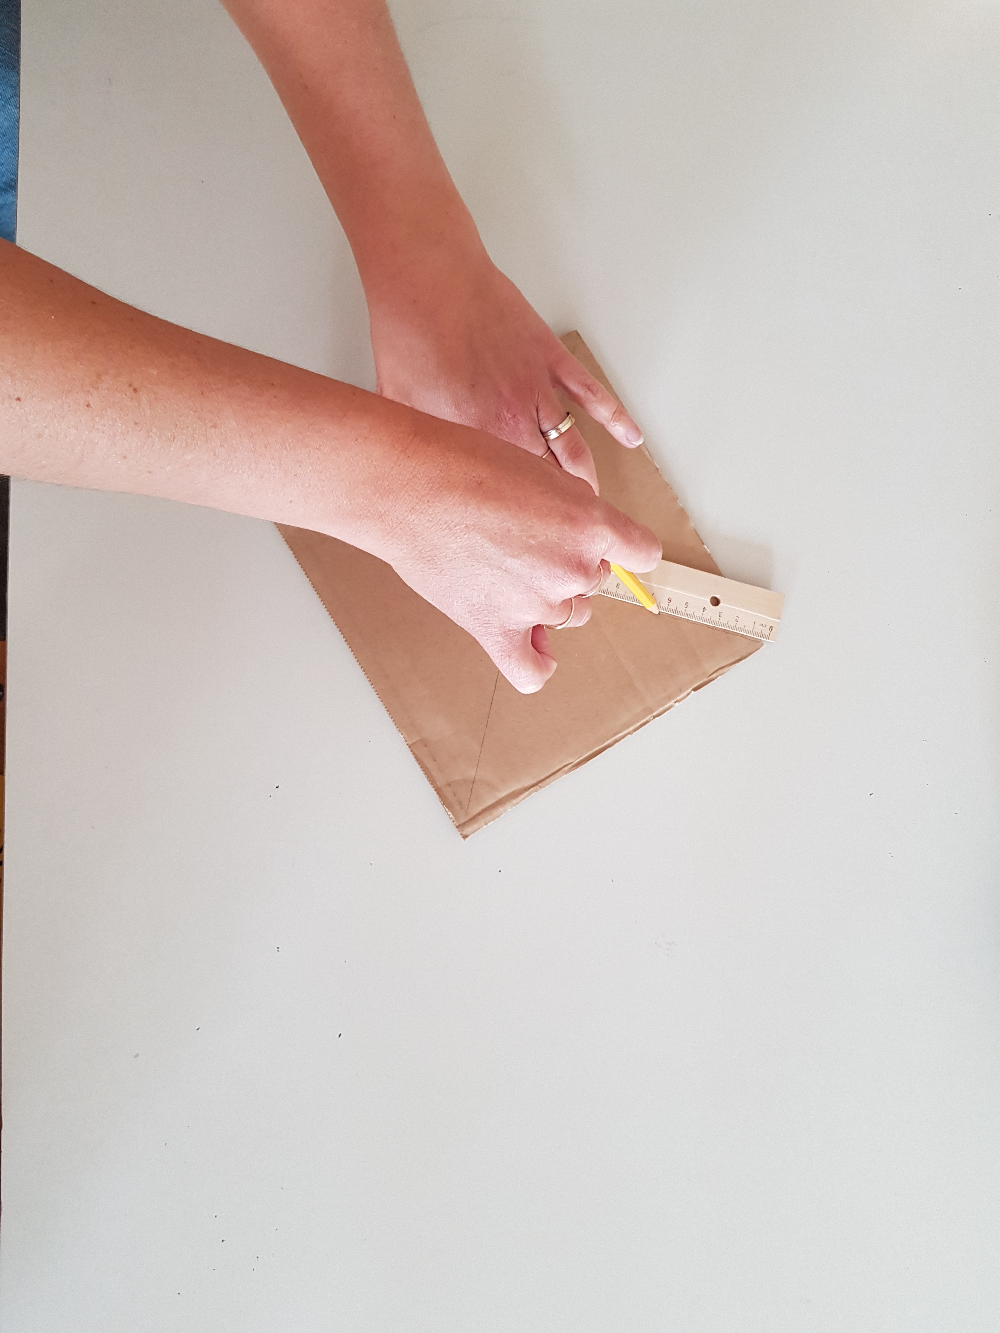
Explanation
Step by step
We’ll show you foto’s, of how to make the windmill step by step.

Slide 10
Show your results!

Slide 11

What did you learn?

