Slide 1
Waste recycle
How to do it?

Slide 2
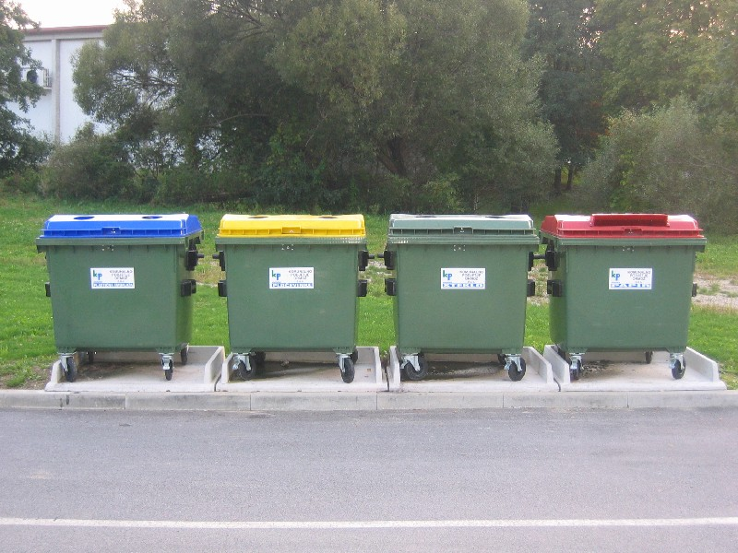
Some examples in our town:
Ecological islands
Recycling centres
Removal of bulky and hazardous waste
Separate collection of waste in specially marked containers in households

Slide 3
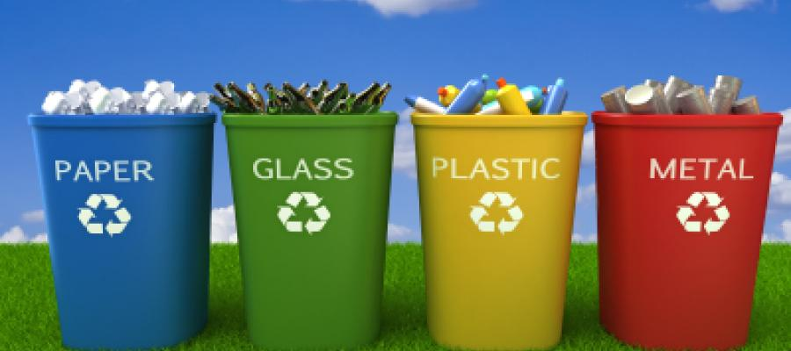
An ecological island
What's an ecological island?
Why recycling is important?
How materials are recycled?
Where can you recycle?
Why recycle?
How to recycle?
How to recycle at home?
Some useful websites:
http://www.recycling-guide.org.uk
https://www.komunala-nm.si
Vir:
https://www.google.si/search?q=ekolo%C5%A1ki+otok&source=lnms&tbm=isch&sa=X&ved=0ahUKEwie5KjFl9PSAhWGvRQKHezTAJIQ_AUIBigB&biw=1366&bih=662#tbm=isch&q=recycling&*&imgrc=EJJNYVVF477qCM:

Slide 4
Viri:
https://www.google.si/search?q=ekolo%C5%A1ki+otok&source=lnms&tbm=isch&sa=X&ved=0ahUKEwie5KjFl9PSAhWGvRQKHezTAJIQ_AUIBigB&biw=1366&bih=662#tbm=isch&q=recycling&*&imgrc=EJJNYVVF477qCM
http://www.recycling-guide.org.uk
https://www.komunala-nm.si

