Slide 1
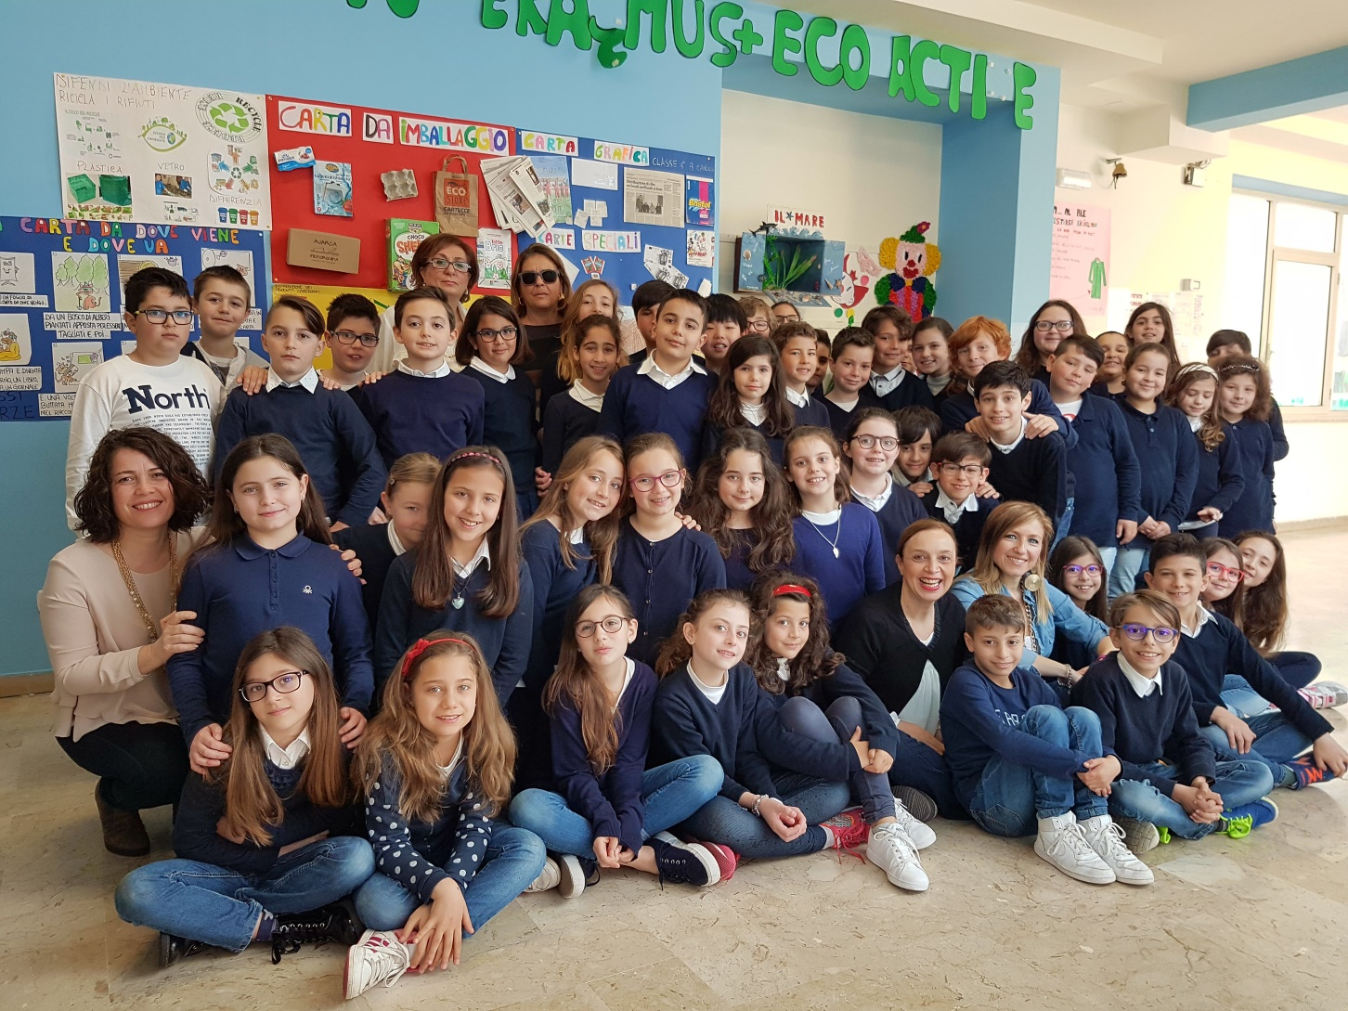
HELLO FRIENDS, ARE YOU READY?
LET’S GO!!!

Slide 2
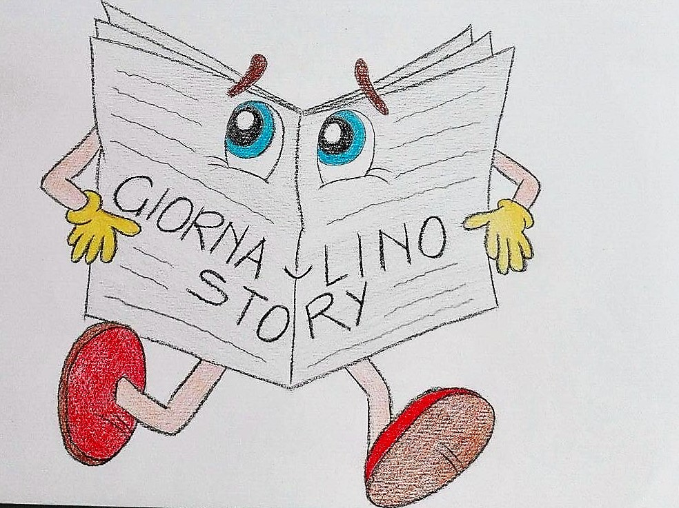
TODAY, WE TELL YOU
THE GIORNA-LINO STORY
LISTEN AND WATCH PLEASE!

Slide 3
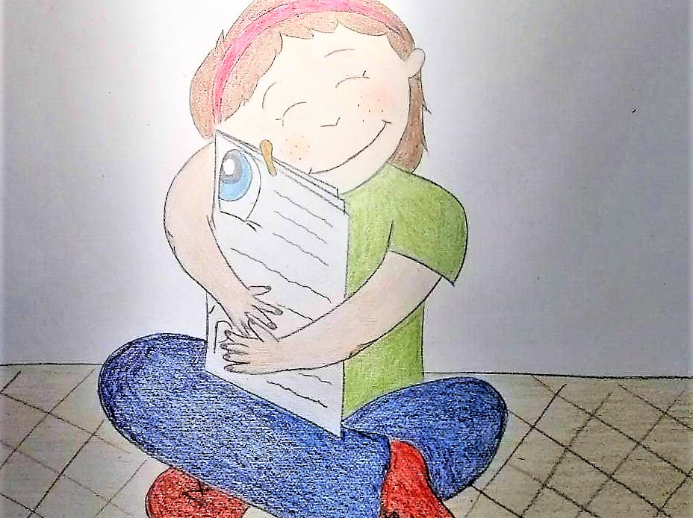
LITTLE TITTI RECEIVES, AS A GIFT,
GIORNA-LINO

Slide 4
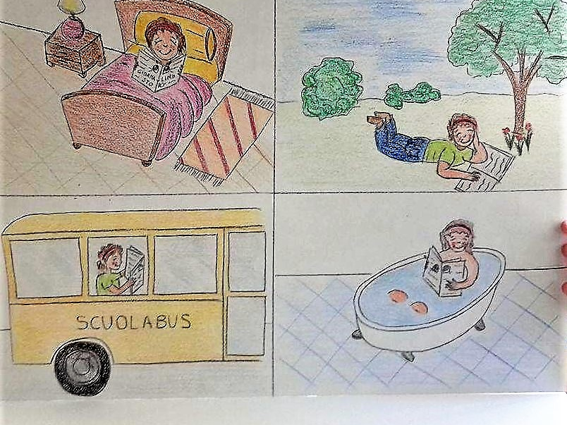
LITTLE TITTI IS VERY HAPPY,
GIORNA-LINO IS HER SPECIAL FRIEND

Slide 5
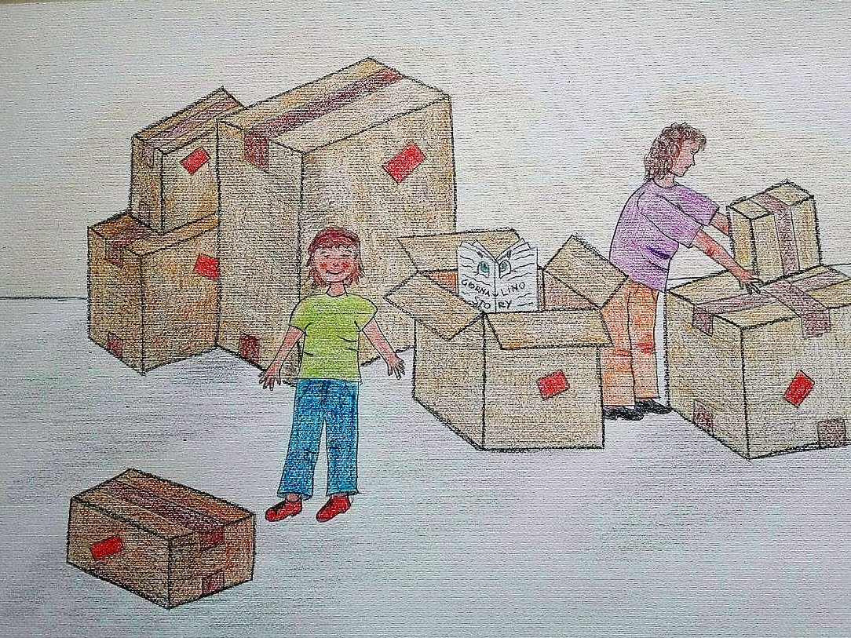
THE DAY OF MOVE, LITTLE TITTI PUTS GIORNA-LINO IN A BOX WITH OTHER SCHOOL BOOKS AND SHE WAITS FOR HIM IN THE NEW HOME

Slide 6
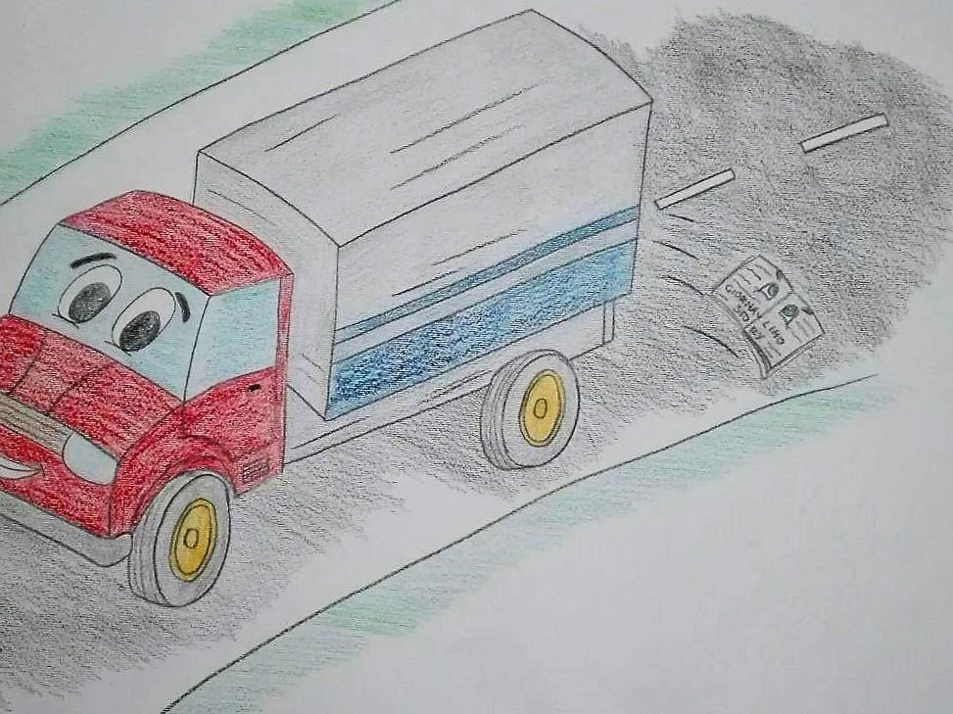
THE DRIVER RUNS FAST ON THE ROAD
ANDGIORNA-LINO FALLS DOWN

Slide 7
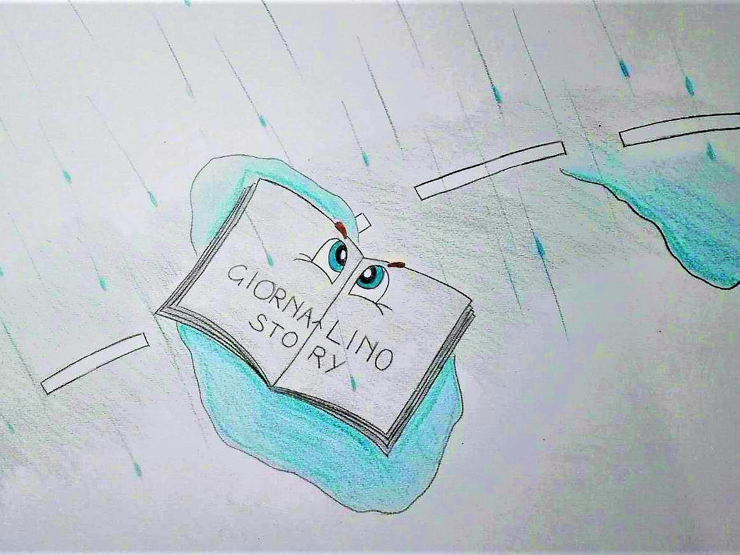
ALONE, WITHOUT LITTLE TITTI,
GIORNA-LINO IS IN THE STREET. HE BECOMES WET FOR RAIN. HE CRIES WAITING FOR HIS END

Slide 8
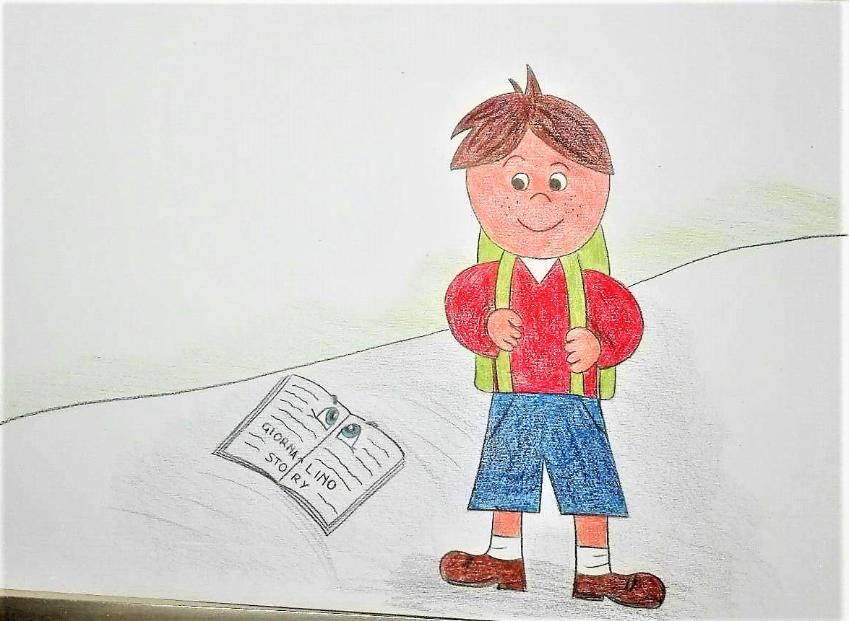
SUDDENLY, GIORNA-LINO HEARS SOME STEPS….
AND.. THINKS IT IS THE SWEEPER SWEEPING EVERYTHING AWAY
BUT…. IT IS NIKO

Slide 9
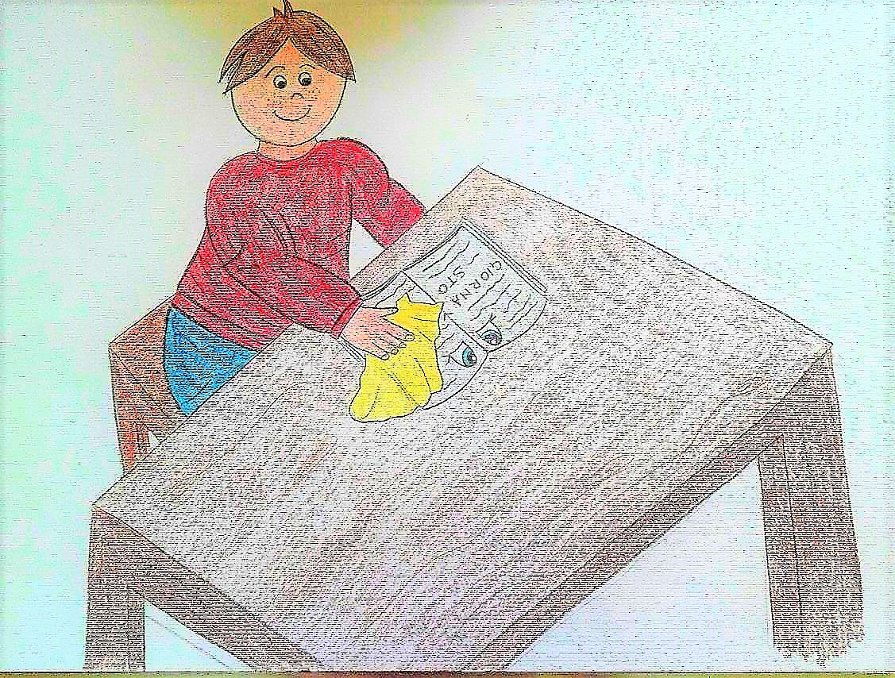
THE CHILD TAKES HIM, WELCOMES HIM, BRINGS HIM HOME AND DRY HIM, HOPING TO BRING HIM BACK TO LIFE.
BUT, EVERY ATTEMPT IS USELESS

Slide 10
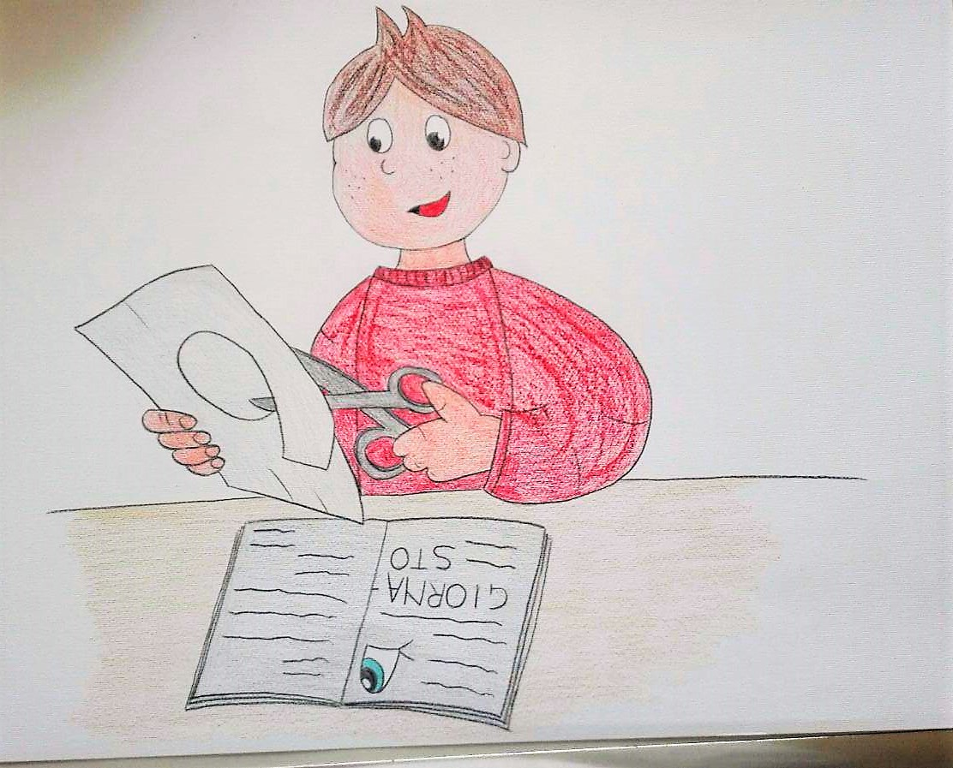
NIKO, THINKS AND RETHINKS
AND FINDS A SOLUTION NOT TO LOSE GIORNA-LINO AND THE BEAUTIFUL COLOURS OF ITS PAGES

Slide 11
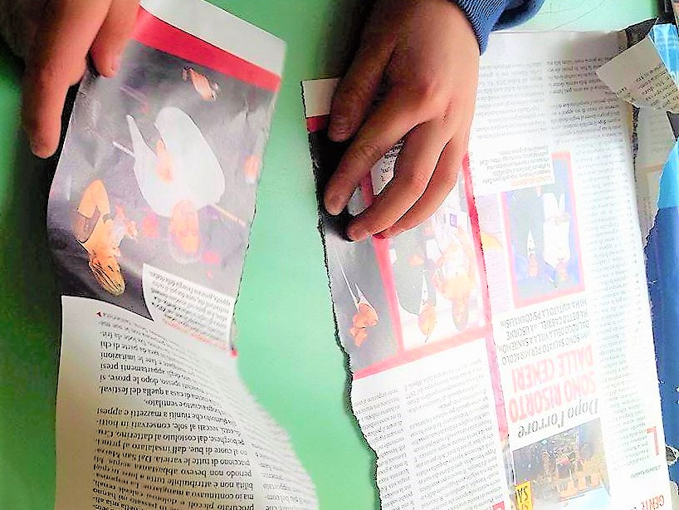
GET SOME PAPER, A PAIR OF SCISSORS AND BRUSHES AN WORK WITH NIKO AND US

Slide 12
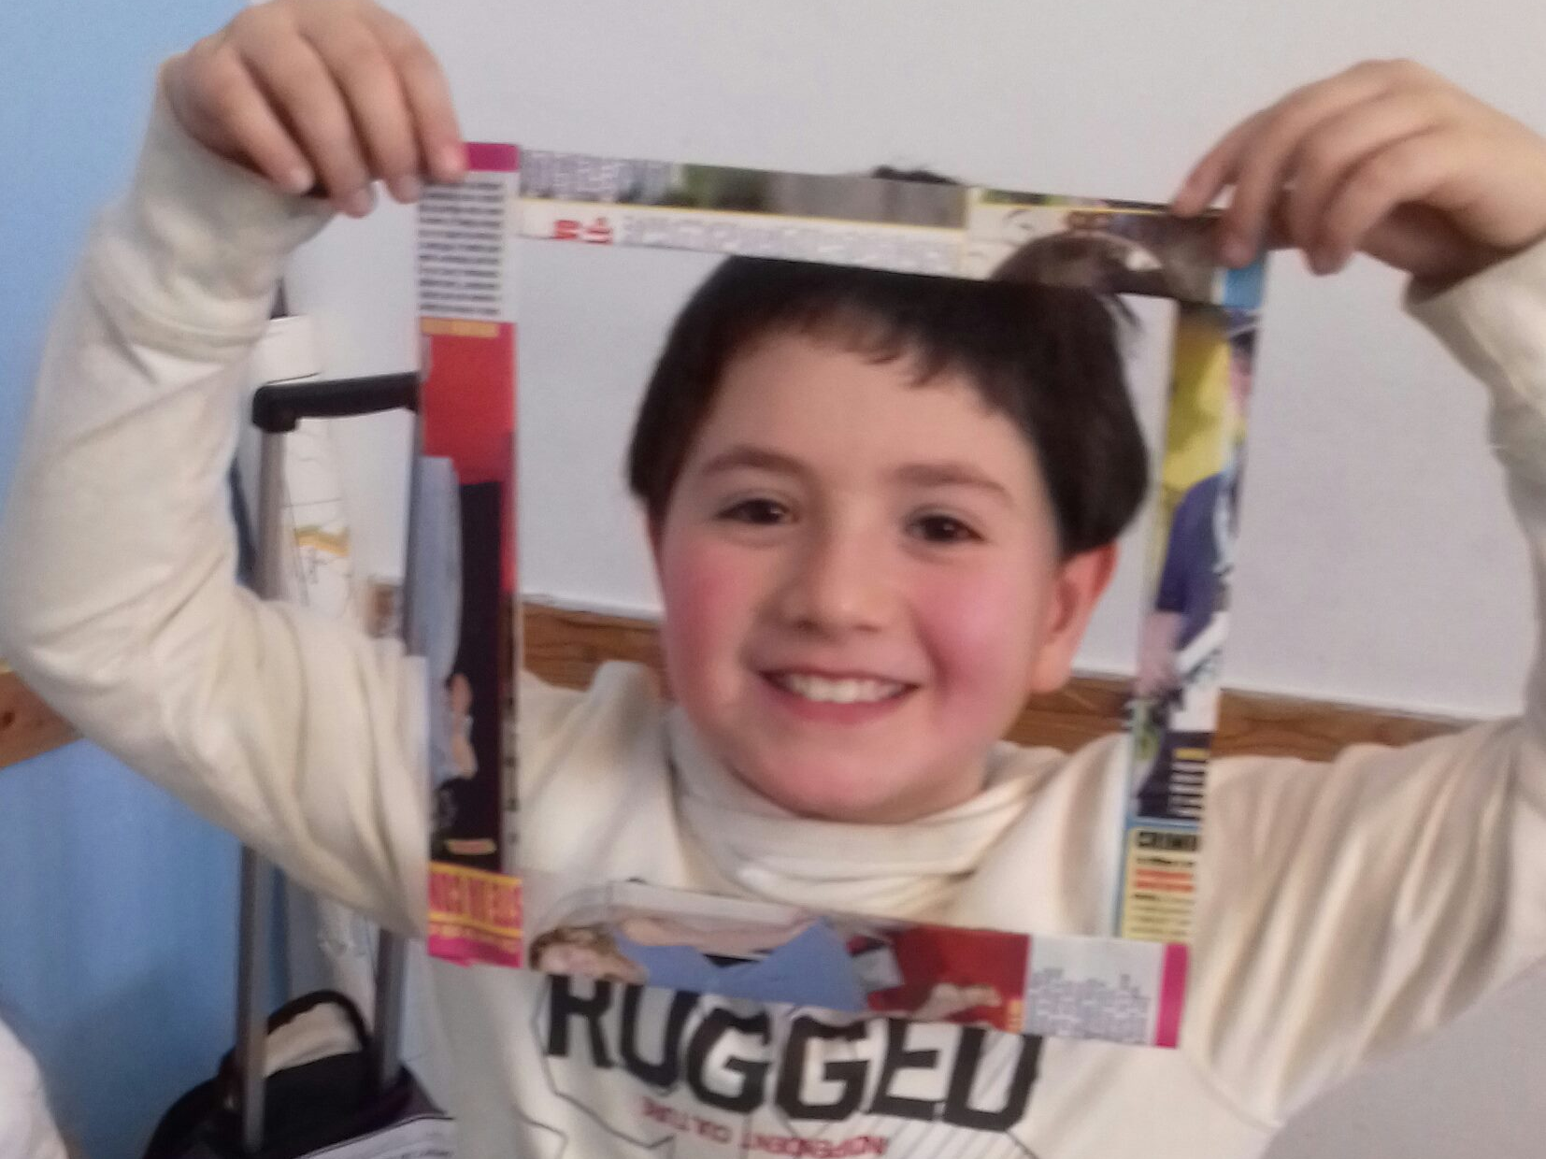
TO BEGIN WITH,
DO AS ENRICO

Slide 13
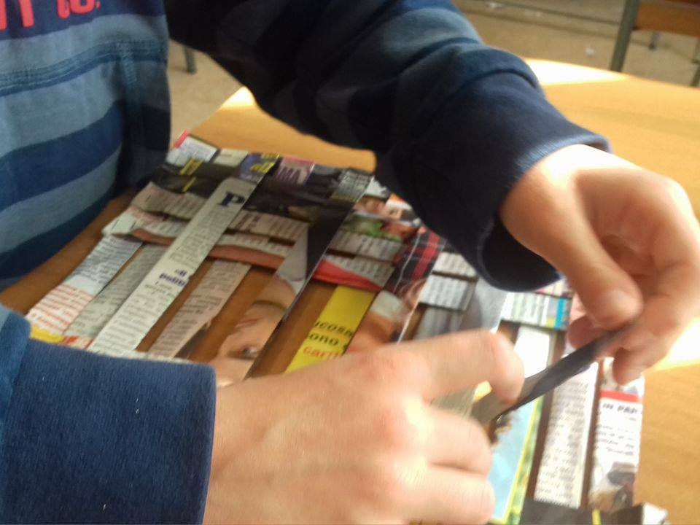
… AND THEN AS GIUSEPPE

Slide 14
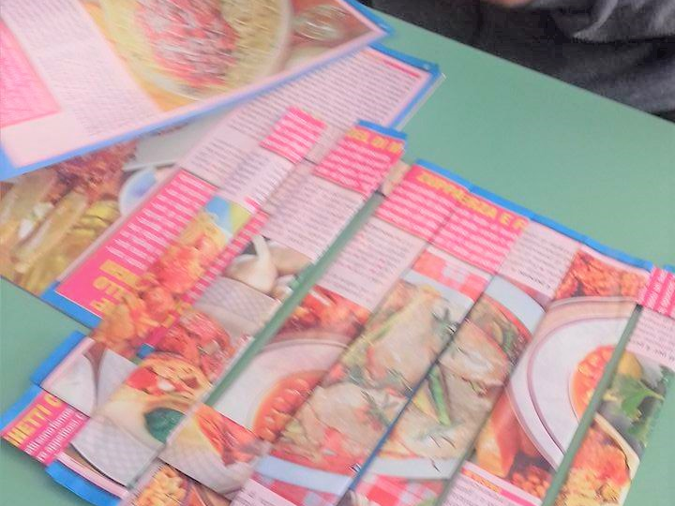
…GO ON..
YOU ARE THERE,
YOU CAN DO IT WELL

Slide 15
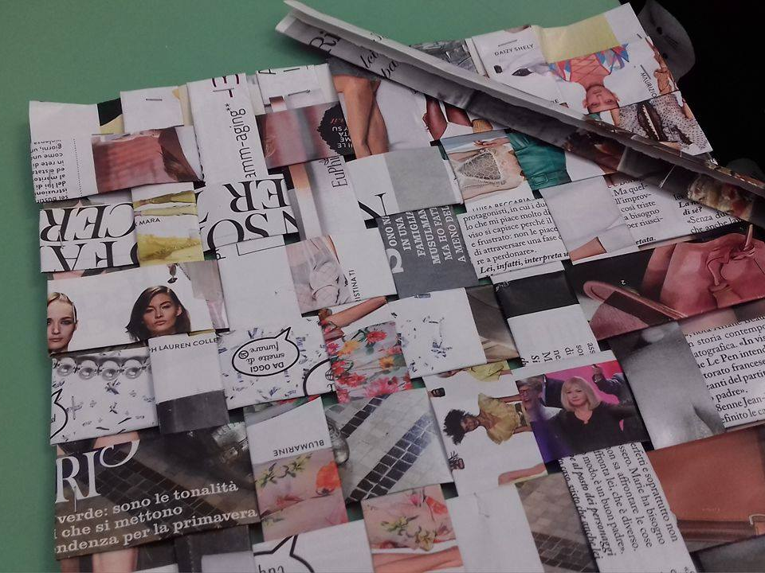
EXCELLENT!!!

Slide 16
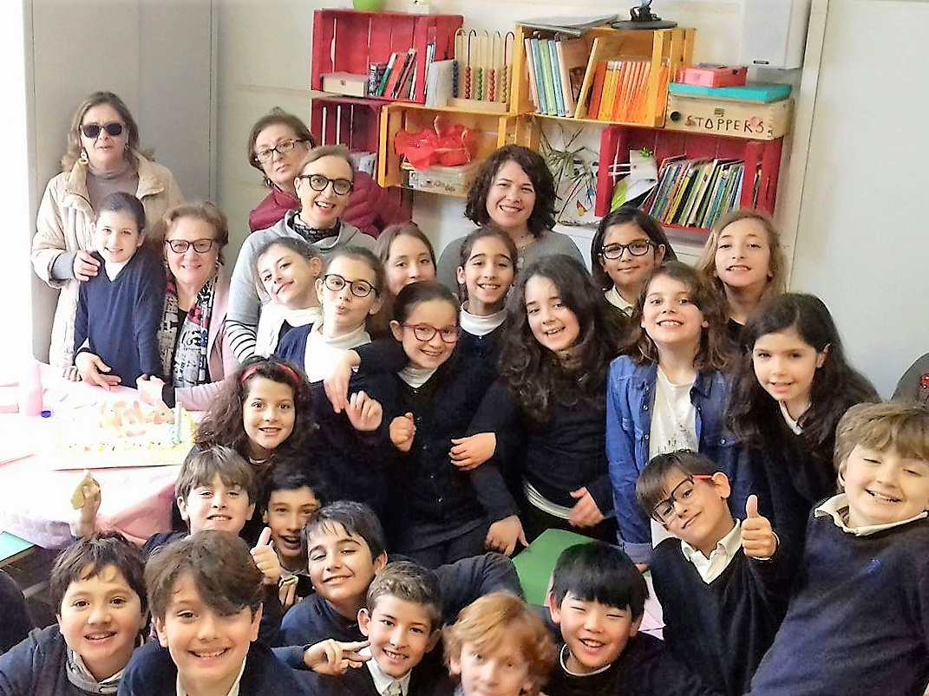
NOW, WE ARE..
SCHOOLFRIENDS FOREVER!

