Slide 1
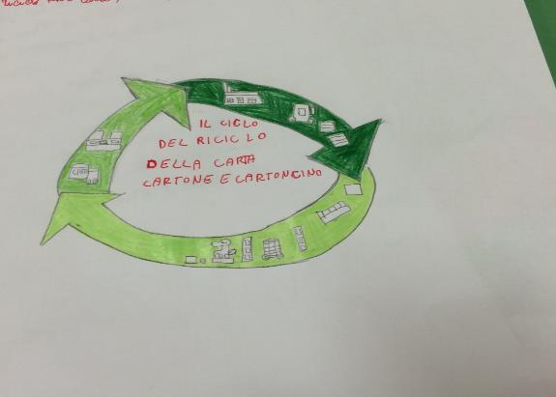
ECO ACTIVE PROJECT: THE PAPER
2° CIRCOLO DIDATTICO « CAVOUR» MARSALA

Slide 2
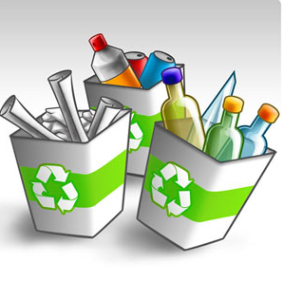
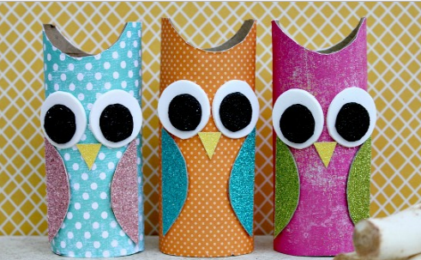
WHAT DOES RECYCLING MEANS?
Recycling means transforming waste into reusable materials.
It is an effective system to reduce the energy consumption of industries and to save on raw materials.

Slide 3
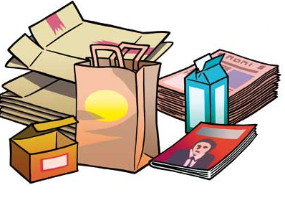
PAPER What is paper?
The paper is a thin layer of cellulose fibers woven from various additional substances such as glues, dyes and mineral substances.
Did you know that it takes from 2.0 to 2.5 tons of wood to produce 1 ton of paper?
Paper features:
resistant, wrapping paper;
fragile, printing;
filtering, tea bag;
oiled or waxed, for food;
soft, th tissues of paper;
absorbent, for diapers.

Slide 5
HOW DOES THE PAPER IS PRODUCED ?

Slide 6
How does the paper is produced?
The most used material for making paper is wood pulp or cellulose coming from a soft wood such as fir or poplar.
You can also use other fibers such as cotton, linen, hemp and recycled paper.
The card creation process involves 5 stages:
Fiber preparation: pulping.
Whitening
Sheet formation and pressing.
Surface treatments
Drying

Slide 7
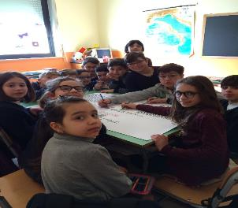
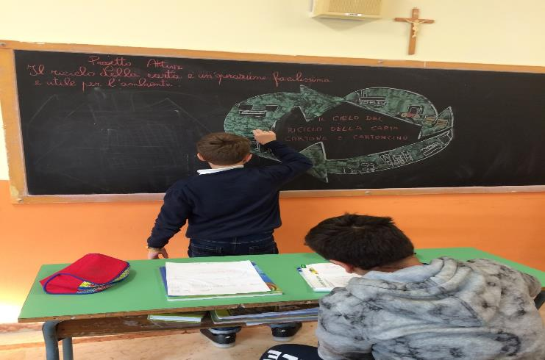
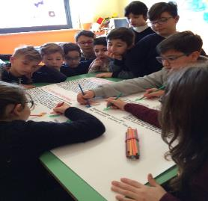
At work to realize a billboard on the importance of recycling

Slide 8
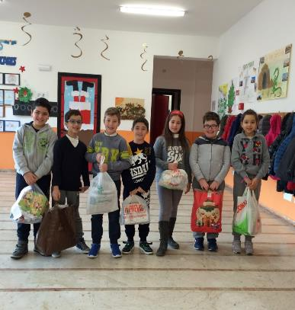
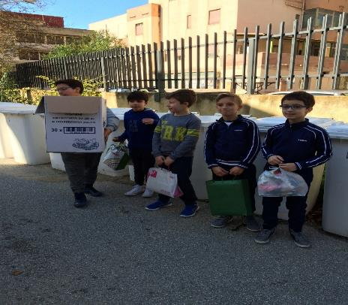
We are ready to supply the waste paper in the appropriate containers

Slide 9
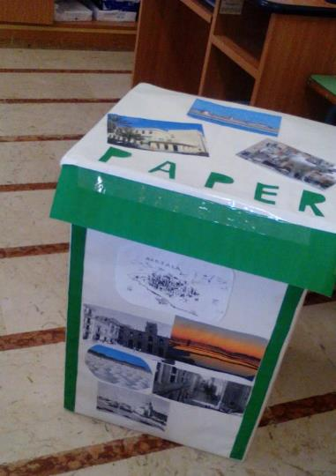

Slide 10
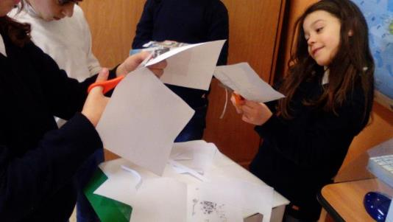
Laboratory of recycled paper

Slide 11
LABORATORIO
IN
ALLEGRIA

Slide 12
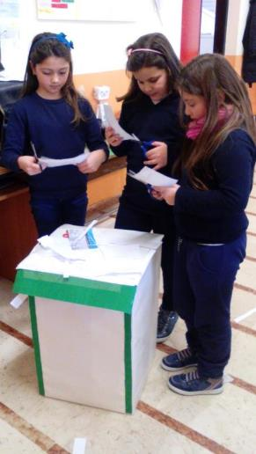

Slide 13
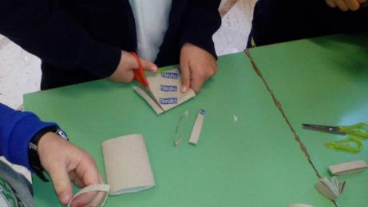
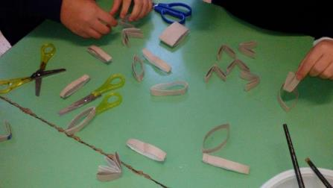
LAVORETTI NATALIZI CON CARTA E CARTONE RICICLATO

Slide 14
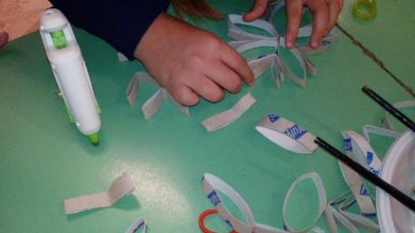
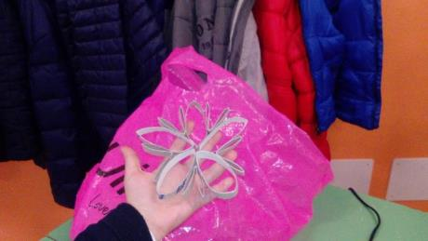

Slide 15
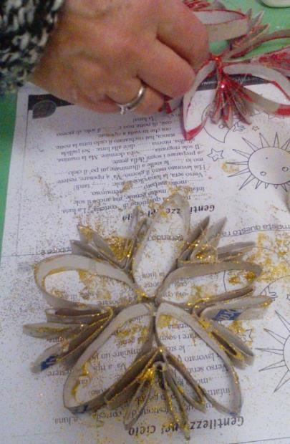
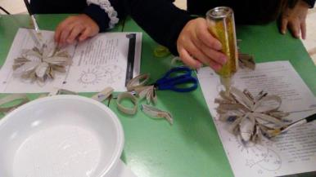

Slide 16
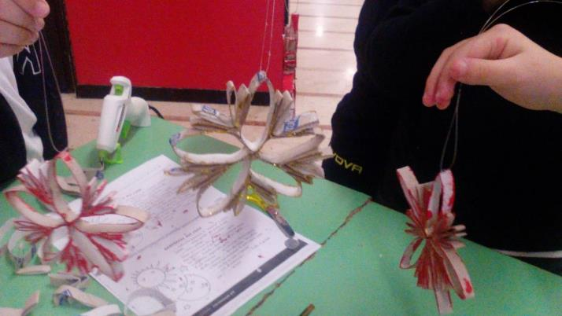

Slide 18
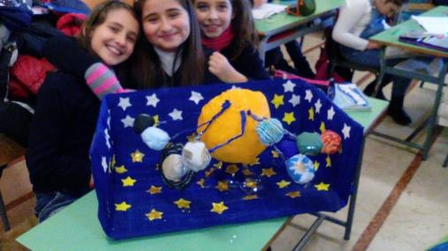

Slide 20
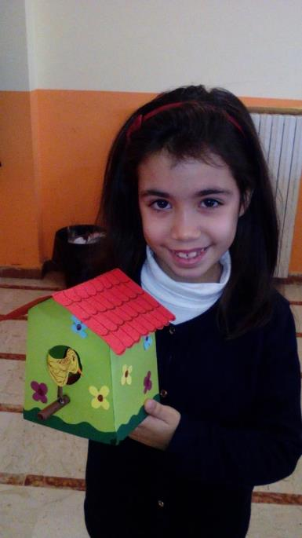

Slide 21
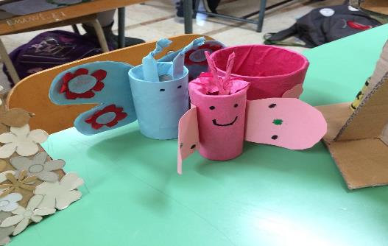
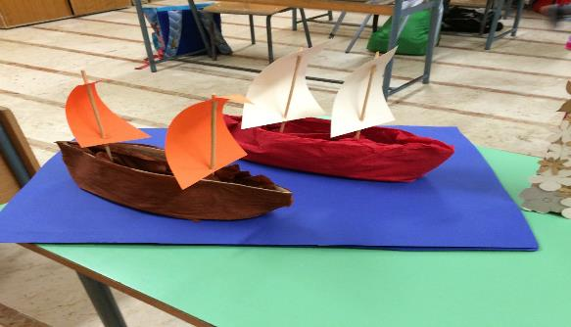
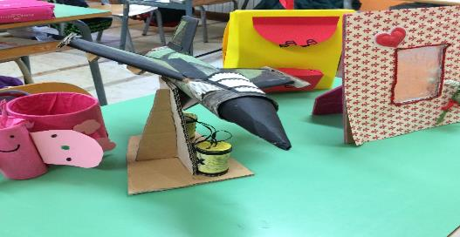
Work made with recycled paper

