Slide 1
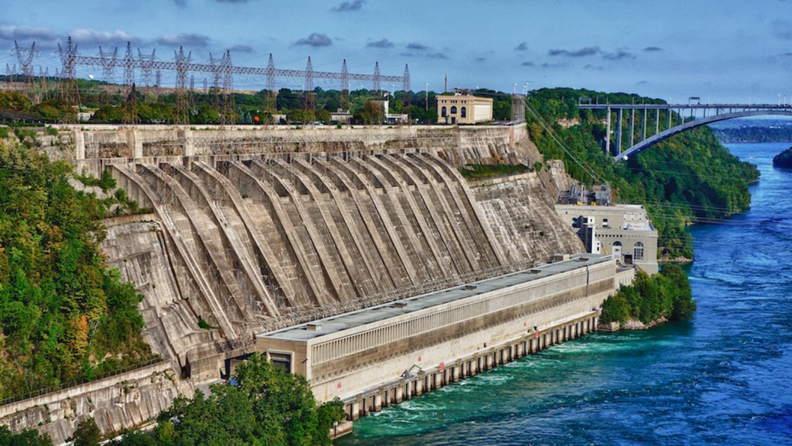
Hydroelectric power plant:
Hydroelectricity is produced by harnessing the gravitational force of flowing water. Compared to fossil fuel-powered energy plants, hydroelectric power plants emit lesser amounts of greenhouse gases.

Slide 2
Types of hydroelectric power plants
Pumped- storage power plant
Run- of-the-river hydro power station
Tidal power station
Impoundment
Small hydroelectric power plants

Slide 3
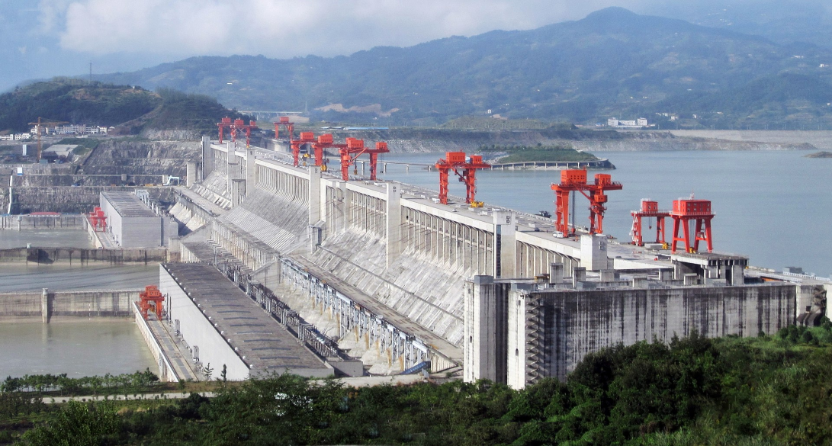
Pumped- storage power plant

Slide 4
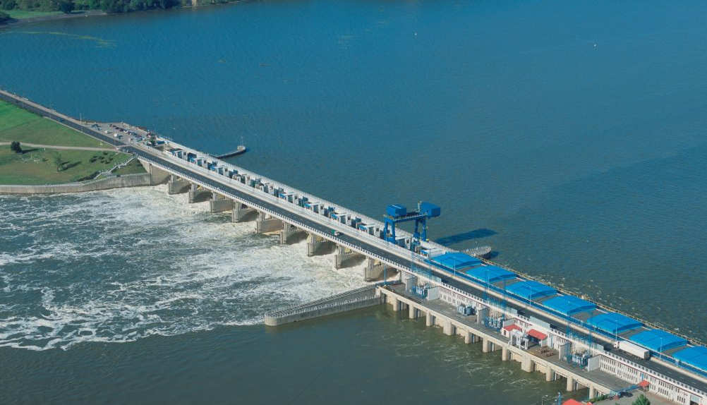
Run- of-the-river hydro power station

Slide 5
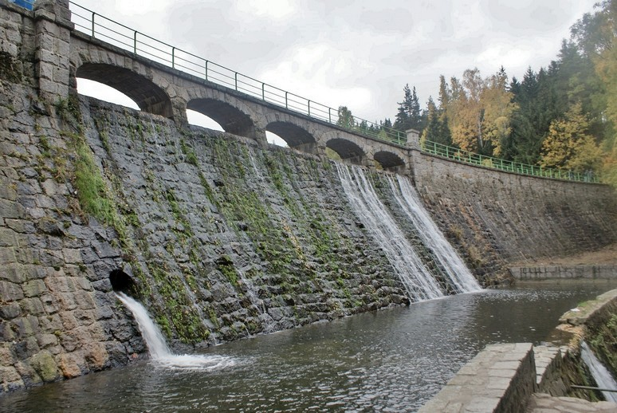
Impoundment

Slide 6
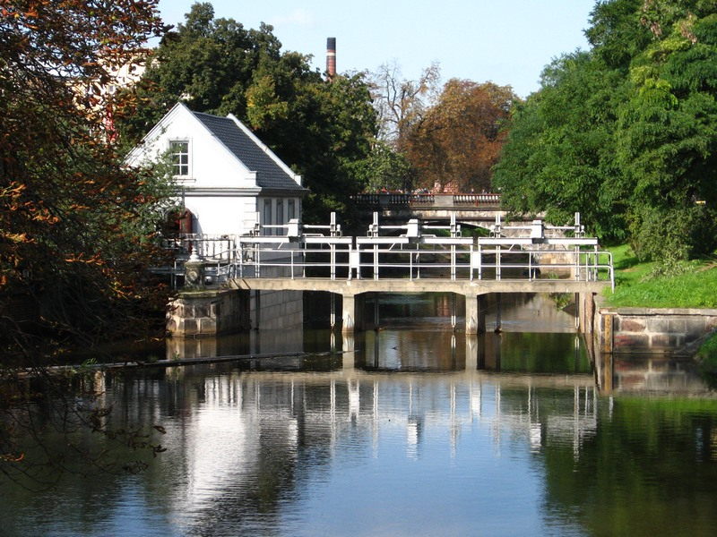
Small hydroelectric power plants

Slide 7
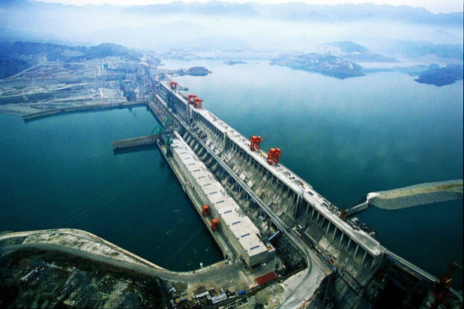
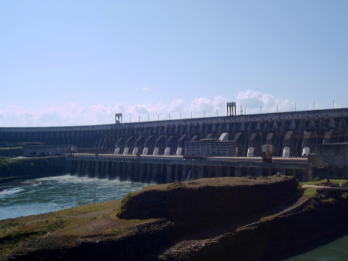
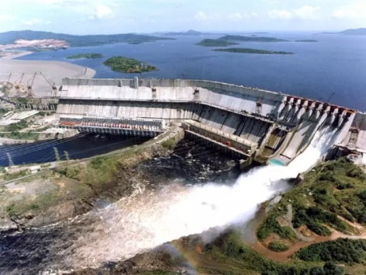
The biggest hydroelectric power plants in the world
The Three Gorges Dam in Hubei, China – power (20 300 MW)
Itaipu, Brazil & Paraguay– power (14 000 MW)
Guri – Venezuela – power (10 200 MW)

Slide 8
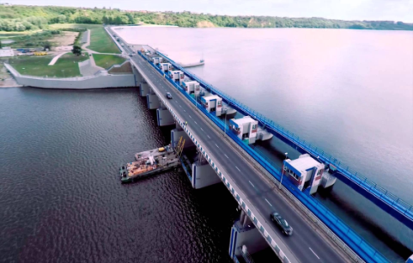
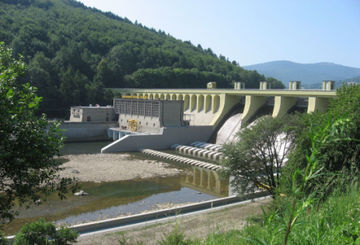
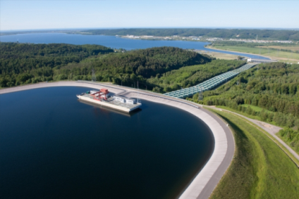
The biggest hydroelectric power plants in Poland
Hydroelectric power plant in Włocławek– power (160 MW)
Hydroelectric power plant in Włocławek Porąbcka– power (6,1 MW)
Hydroelectric power plant in Włocławek Żarnowiec – power (716 MW)

Slide 9
The advantages
Hydroelectric energy is renewable. This means that we cannot use up. However, there’s only a limited number of suitable reservoirs where hydroelectric power plants can be built and even less places where such projects are profitable.
Generating electricity with hydro energy is not polluting itself. The only pollution occurs during the construction of these massive power plants.
Hydroelectricity is very reliable energy. There are very little fluctuations in terms of the electric power that is being by the plants, unless a different output is desired. Countries that have large resources of hydropower use hydroelectricity as a base load energy source. As long as there is water in the magazines electricity can be generated.
Adjusting water flow and output of electricity is easy. At times where power consumption is low, water flow is reduced and the magazine levels are being conserved for times when the power consumption is high.

Slide 10
The disadvantages
The environmental consequences of hydropower are related to interventions in nature due to damming of water, changed water flow and the construction of roads and power lines.
Building power plants in general is expensive. Hydroelectric power plants are not an exception to this. On the other hand, these plants do not require a lot of workers and maintenance costs are usually low.
Electricity generation and energy prices are directly related to how much water is available. A drought could potentially affect this.
We have already started using up suitable reservoirs for hydroelectric power plants. There are currently about 30 major power plants that are expected to generate more than 2.000 MW under construction.

Slide 11
The end
The presentation made by
Agata Zając 7b
Ola Kołtońska 7b
Sources: Wikipedia, Geography student book

