Slide 1
MERENDA NEWS

Slide 2
Hello,
Today we talk
about snacks

Slide 3
Snacks cover 6-7 percent of the daily food needs

Slide 4
MA, COSA MANGIA UN BAMBINO A MERENDA??
What does a child eat for a snack ?

Slide 5
We would like to know more about this, so we speak with our experts

Slide 6
LA MERENDA IDEALE Ideal snack:
.
Kcal 90
Carbohydrates 12,4 gr.
of which sugars 3,4 gr.
Total fat 3 gr.
Salt 0,14 gr.
MERENDA IDEALE
Kcal 90
Proteine 1,6 gr
Carboidrati 12.4 gr di cui zuccheri 3.4 gr
Grassi totali 3 gr
Sale 0,14 gr

Slide 7
We have a snack Yes, but which one?

Slide 8
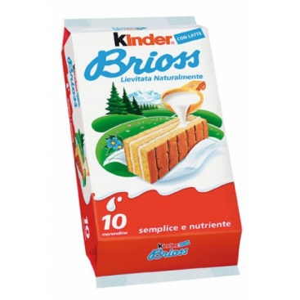
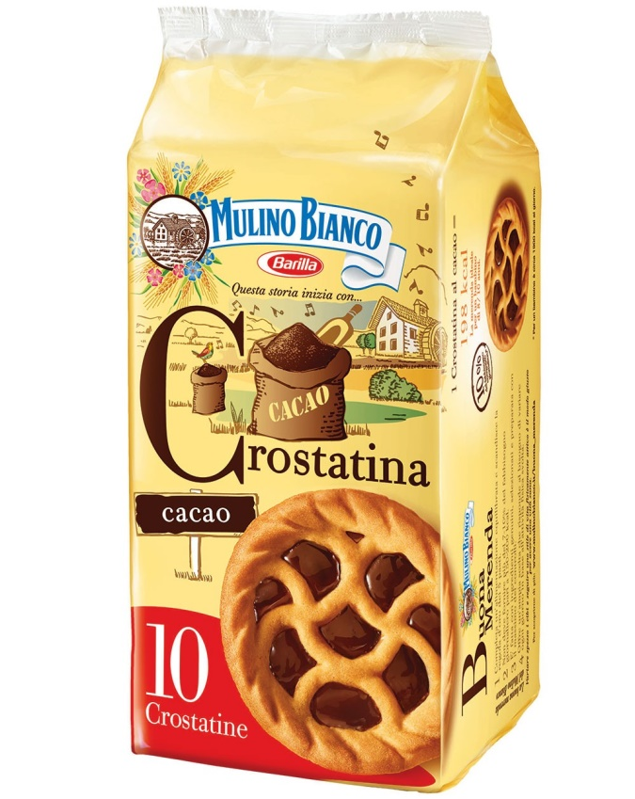
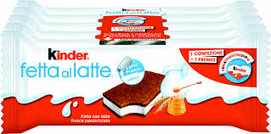

Slide 9
Read together the labels!!

Slide 10
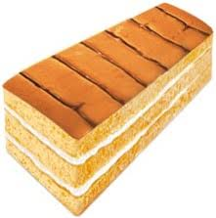
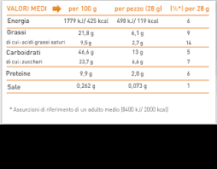
Energy
Fat
Carbohydrates
Protein
salt

Slide 11
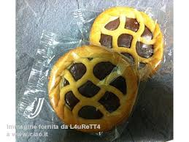

Slide 12
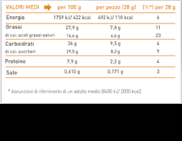
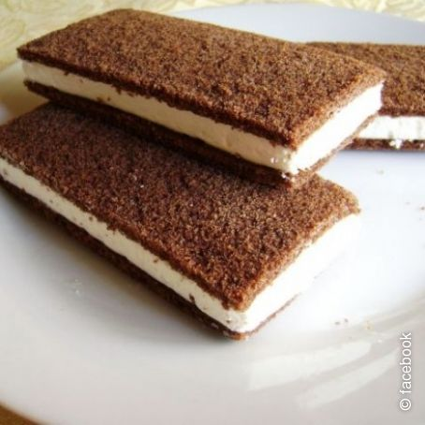

Slide 13
Summary: That is, when we eat ready snacks for a snack

Slide 14
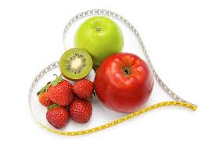
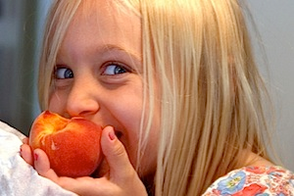
For a snack
We suggest you:
Avoid: chips, ready snacks, chewing gum, sparkling sodas
Limit:Sandwiches, pizza crackers, cookies, candies, chocolate, fruit juices
Prefer: dried fruit, vegetables, yogurt

