Slide 1
Recycable materials

Slide 2
-waste paper -scrap -plastic -glass

Slide 3
How source them?

Slide 4
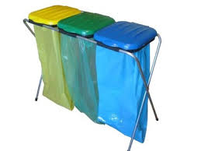
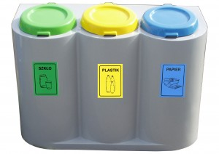
Segregate at home & school

Slide 5
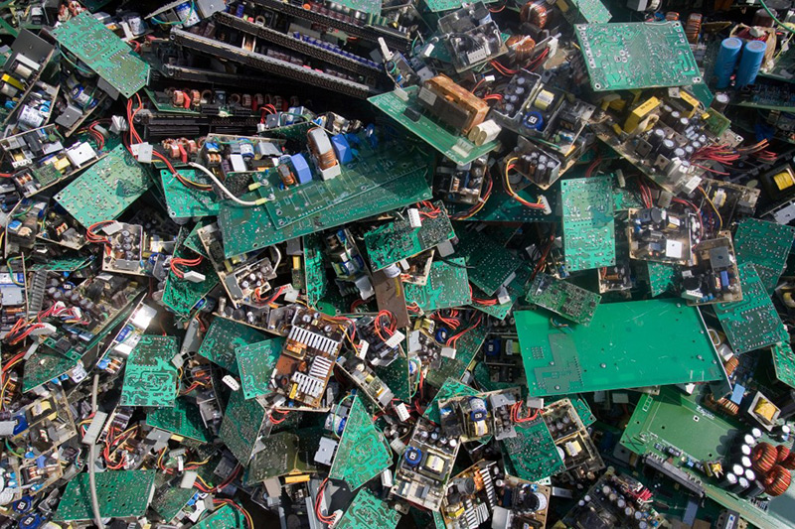
Give to junkyard
-waste paper
-scrap

Slide 6
Recycling

Slide 7
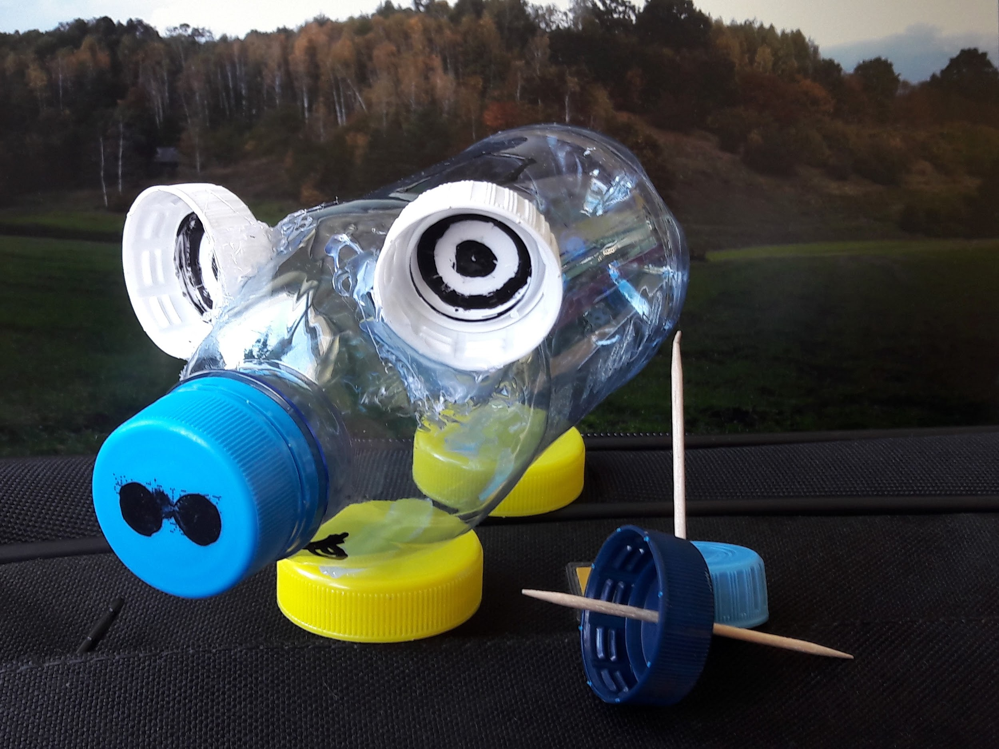
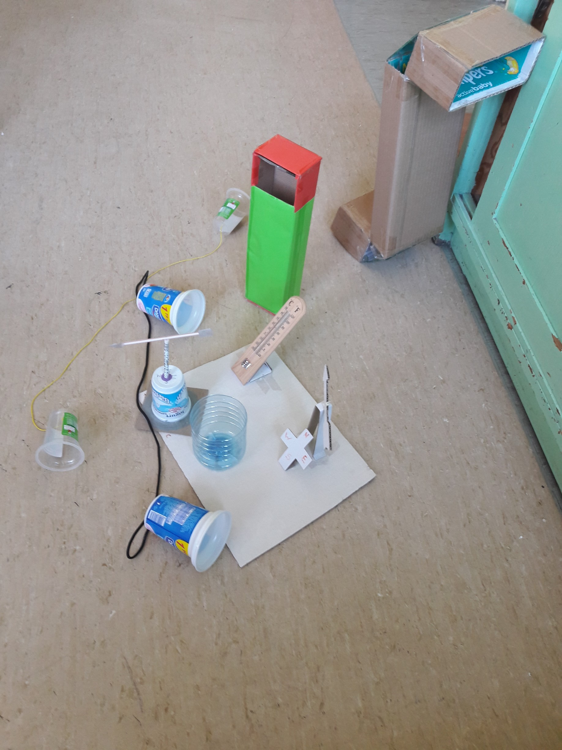
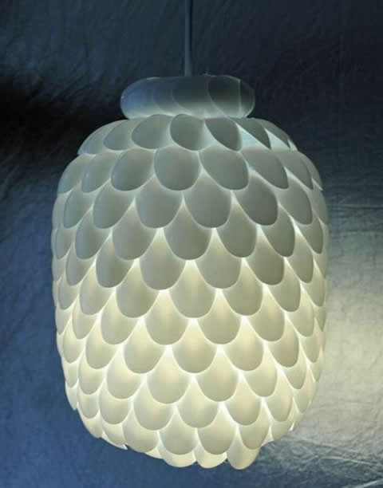
Plastic
-Teaching aids
-Eco toys
-Lampshades made of plastic teaspoons

Slide 8
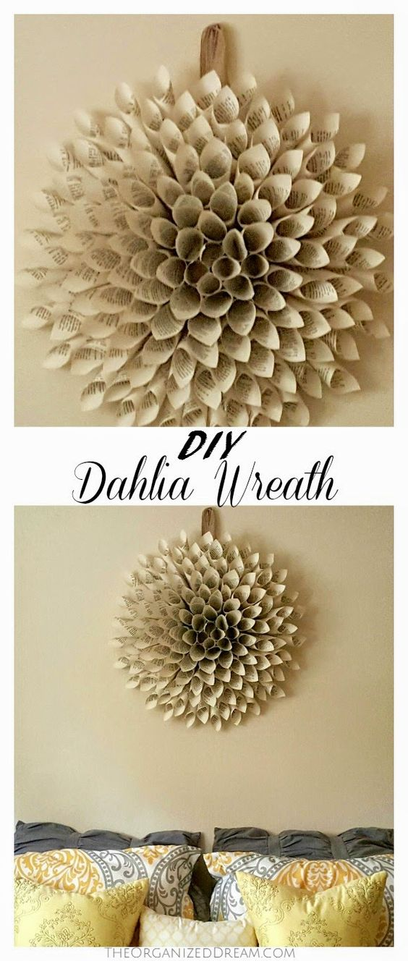
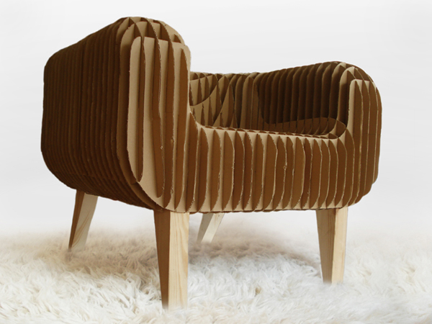
Wastepaper
-Paper decorations
-Eco notebooks
-Cardboard armchairs
-Paper wallet

Slide 9
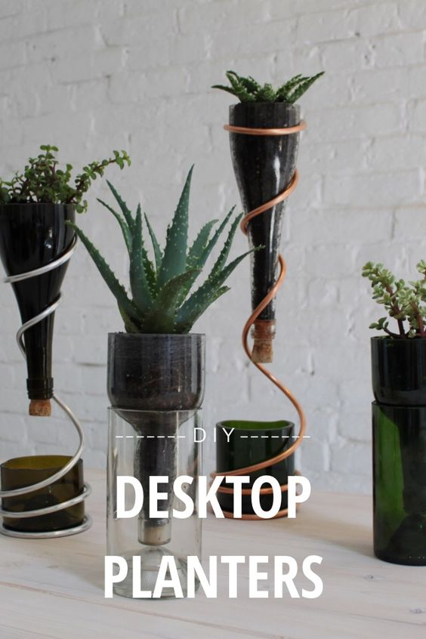
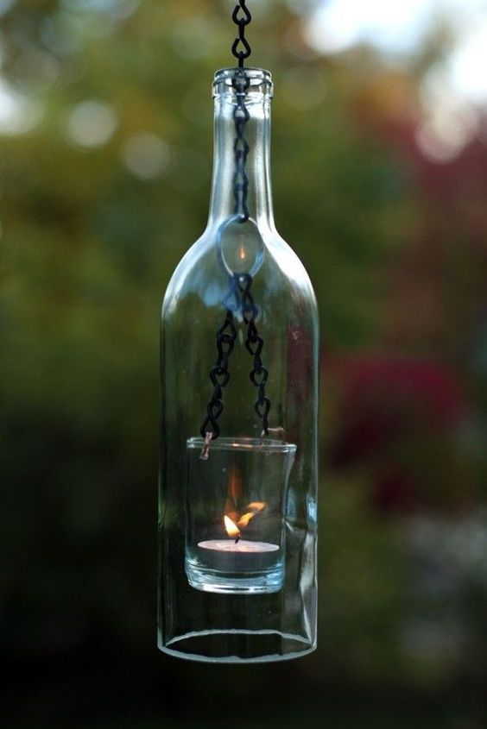
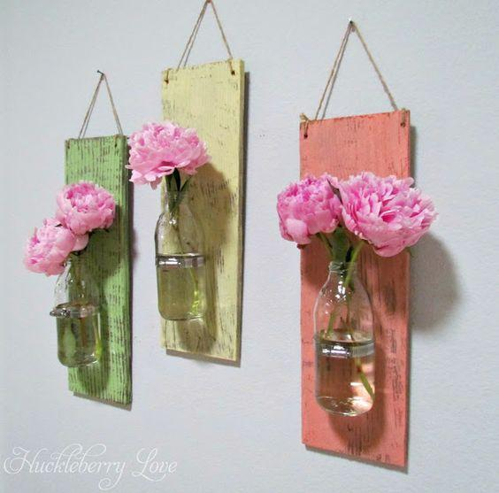
Glass
-Vase
-Candlesticks
-Pots

Slide 10
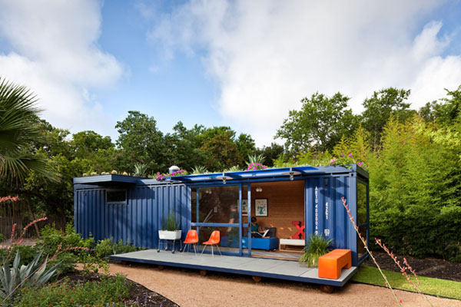
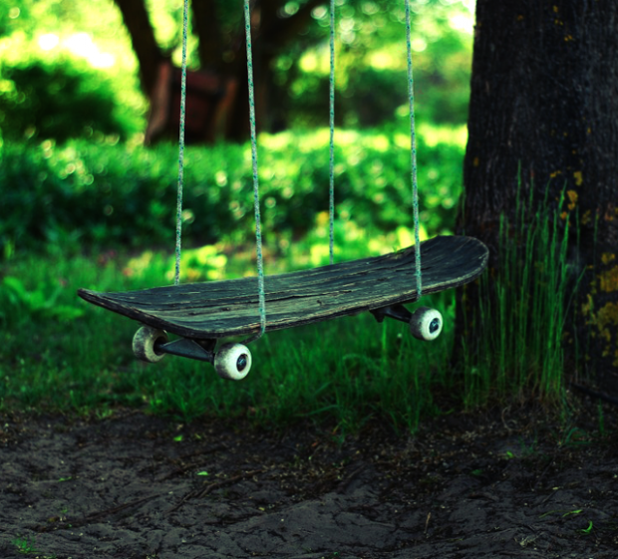
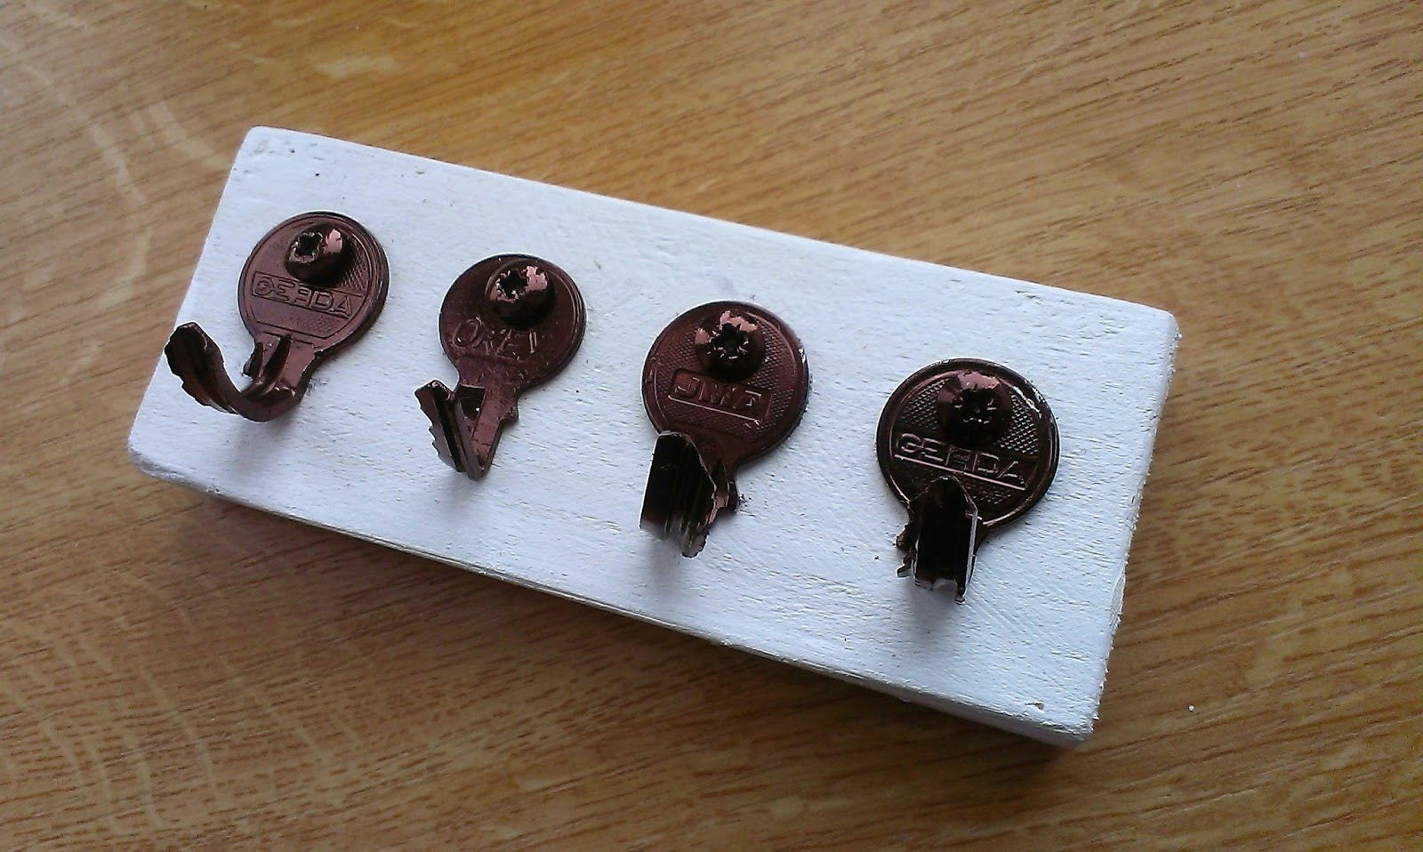
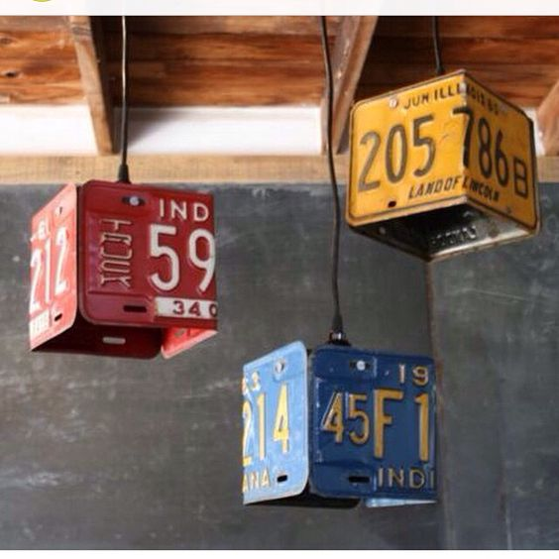
Scrap
-Container house
-Skateboard swings
-Key hanger
-Registration plate lampshade

Slide 11
Recycling is how you can look after enviroment (OR recycling is a simple way in which every person can contribute to making a better world)
Made by Igor Wróbel 6b
pictures: pintererst & private album

