Slide 1
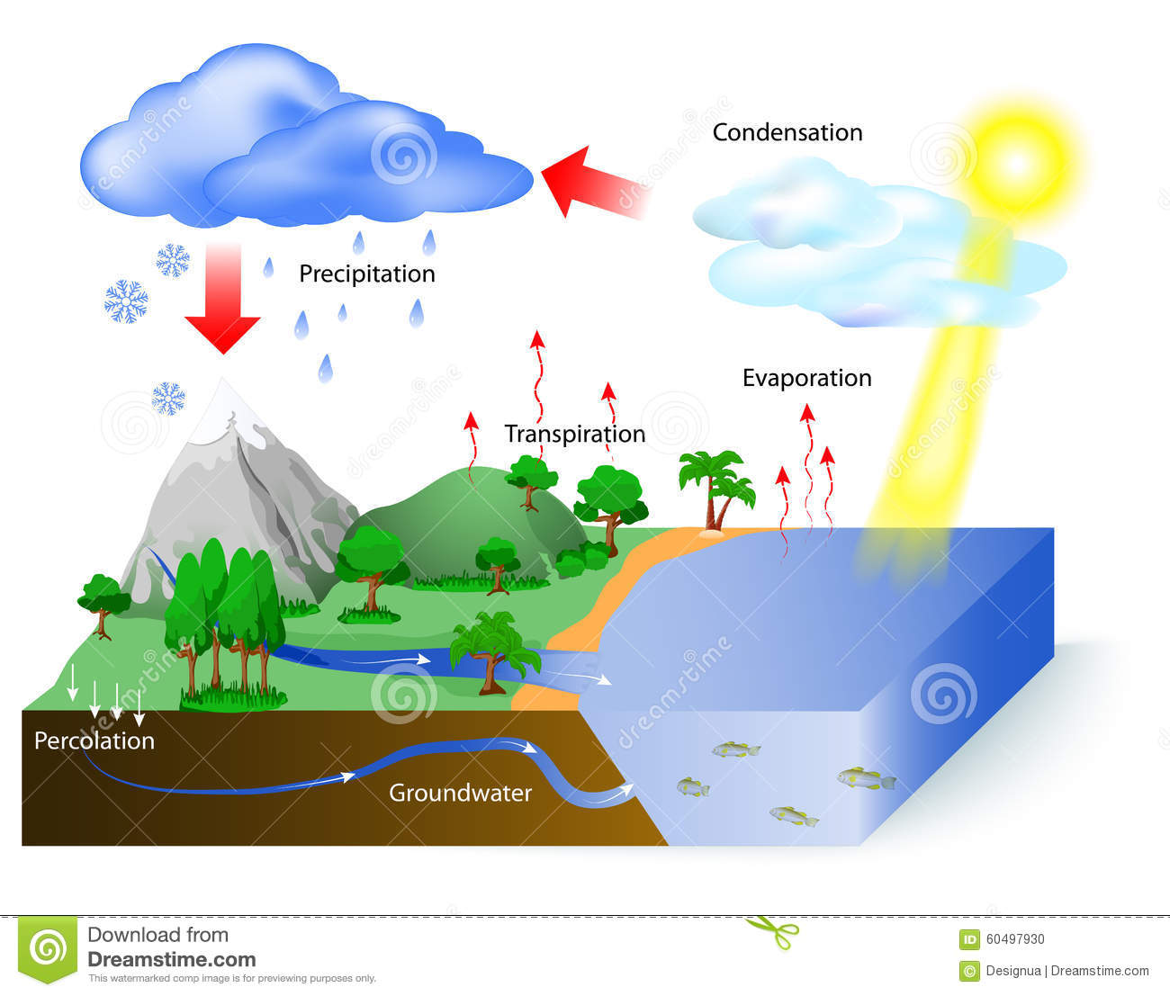
THE WATER CYCLE
IL CICLO DELL’ACQUA

Slide 2
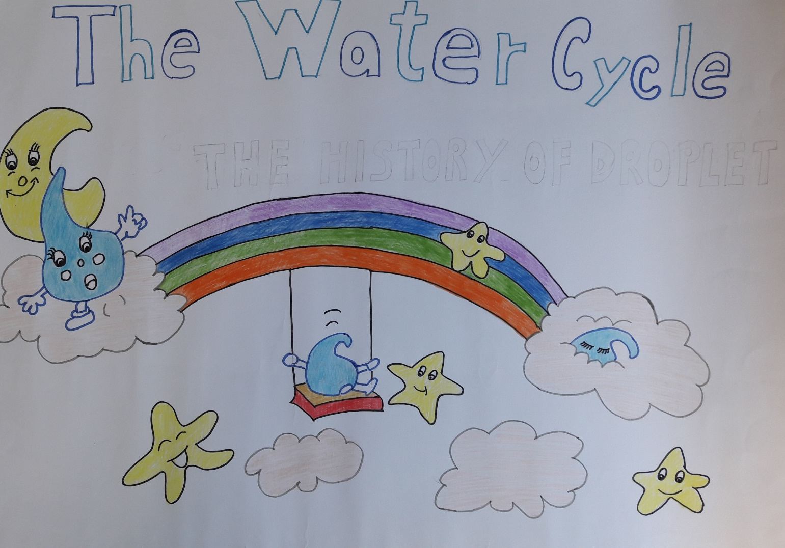
THE STORY OF DROPLET

Slide 3
A SWEET AND NICE WATER DROPLET LIVES IN THE DEEP AND DARK SEA, WITH OTHER little SISTERS.

Slide 4
ONE DAY, while PLAYING ON THE SURFACES, THE SUN KIDNAPS HER, AND ...

Slide 5
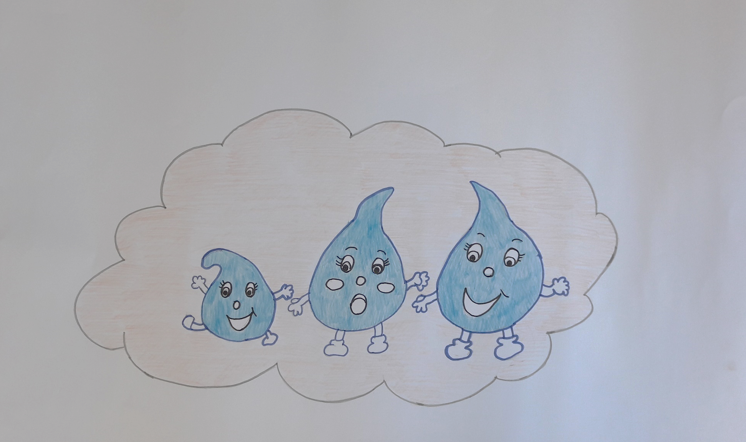
MAKES HER GO UP THE SKY AND PUT HER ON A CLOUD. HERE DROPLET BECOMES FRIEND WITH OTHER DROPS OF WATER

Slide 6
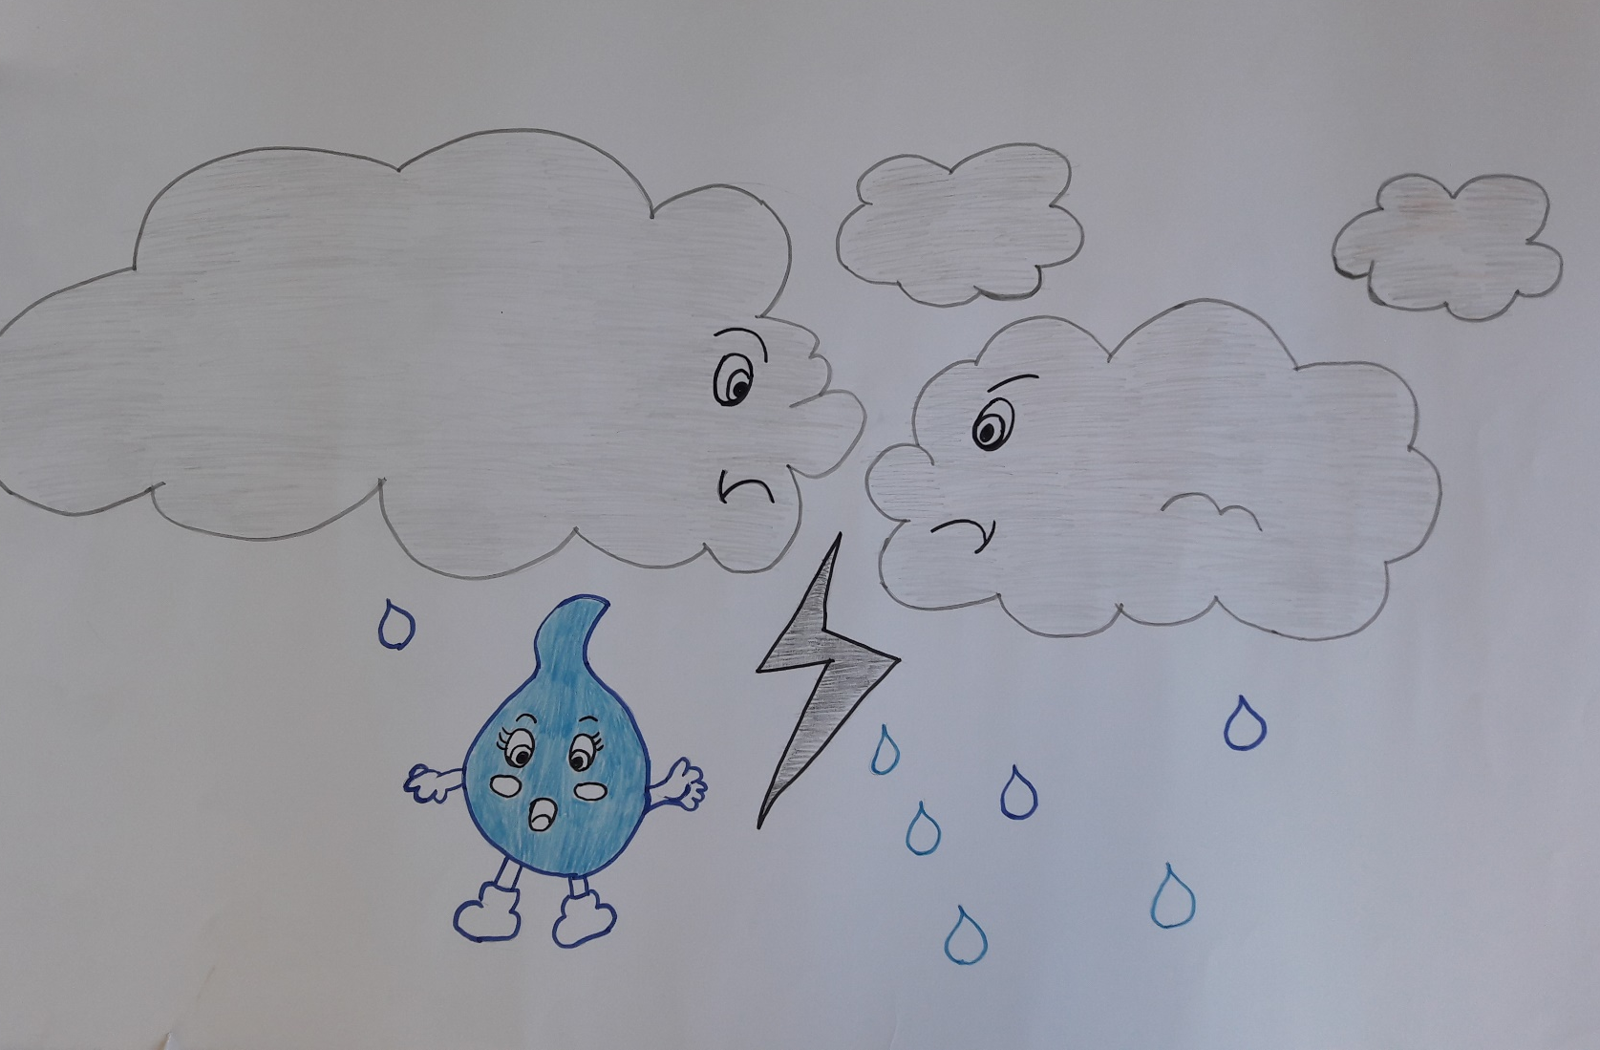
BUT ONE DAY TWO CLOUDS COLLIDE AND SO ....

Slide 7
DROPLET ENDS ON THE GROUND IN A MEADOW..

Slide 8
BEING COURIOUS, SHE ENTERS IN A TUBE.

Slide 9
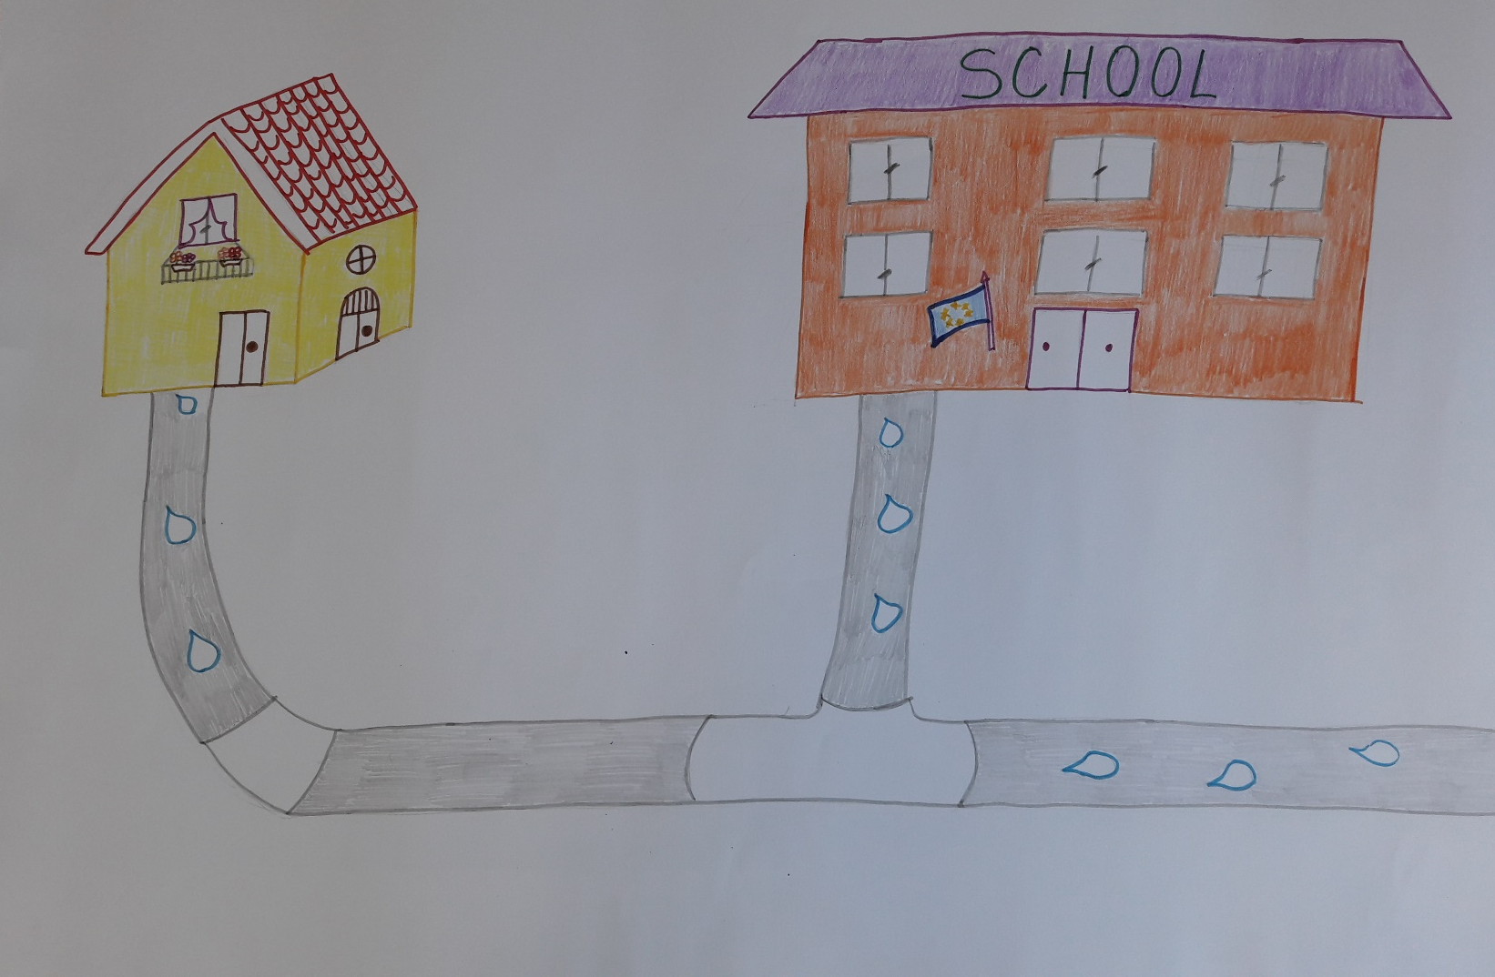
THE TUBE LEADS HER HOME AND TO SCHOOL

Slide 10
WHEN YOU DRINK WATER, THINK ABOUT DROPLET!

Slide 12
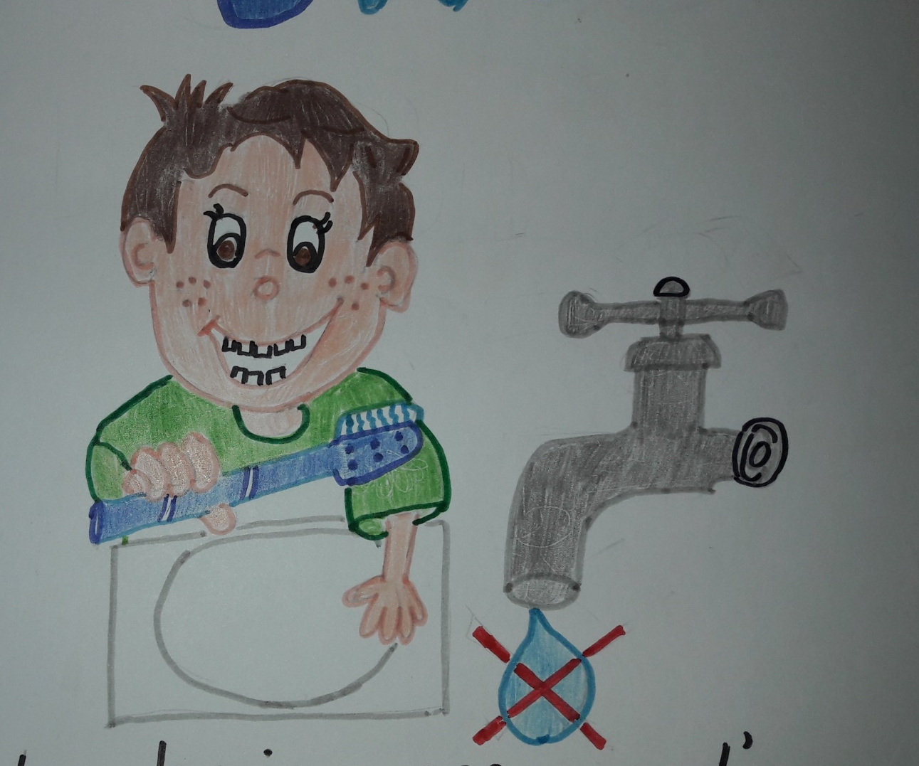
DO NOT LET THE WATER RUNNING WHEN BRUSHING YOUR TEETH

Slide 13
WASH THE FOOD LEAVING IT SOAKING

Slide 14
WASH YOURSELF USING THE SHOWER

Slide 15
WATER THE PLANTS IN THE EVENING: WHEN THE SUN SETS, THE WATER EVAPORATES MORE SLOWLY.

Slide 16
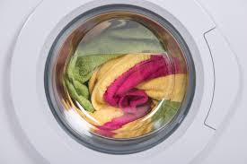
AVOID LOADING THE WASHING MACHINE ONLY HALF

Slide 17
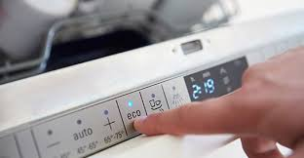
Tell mum to turn the wash to economy.

Slide 18
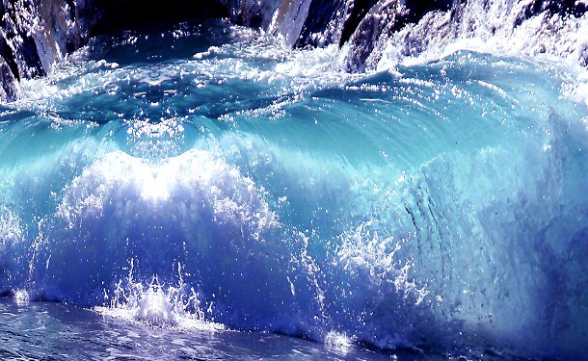
AND YOU, ….. HOW DO YOU SAVE WATER?

Slide 19
WATER FOR EVERYONE AND EVERYONE FOR WATER

Slide 20
WATER IS PRECIOUS AND INDISPENSABLE FOR LIFE

Slide 21
IT MUST BE SAVED BUT ALSO PROTECTED FROM POLLUTION:

Slide 22
DO NOT THROW NON-BIODEGRADABLE WASTE INTO THE WATER DO NOT USE CHEMICAL FERTILIZERS AND PESTICIDES IN AGRICULTURE

Slide 23
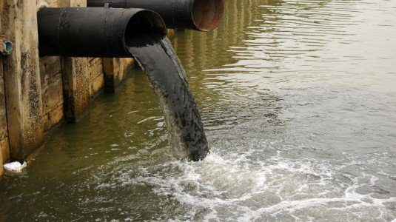
DO NOT DISCHARGE POISONOUS SUBSTANCES FROM THE SEWER BUT USE THE PURIFIERS

Slide 24
WATER IS NOT INFINITE, DO NOT WASTE IT

Slide 25
WATER IS LIFE "THERE IS NO LIFE WITHOUT WATER" "WATER IS A PRECIOUS ASSET" "WATER IS A COMMON HERITAGE: EACH HAS THE DUTY TO SAVE IT AND TO USE IT WITH CARE" KEEP THIS IN MIND

