Slide 1
Waste containers
"Ecoactive„
2016-2019

Slide 2
Waste containers in Italy
"Ecoactive„
2016-2019

Slide 3
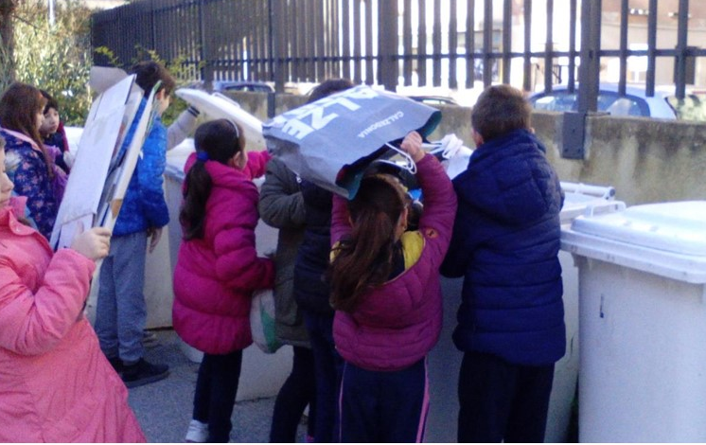
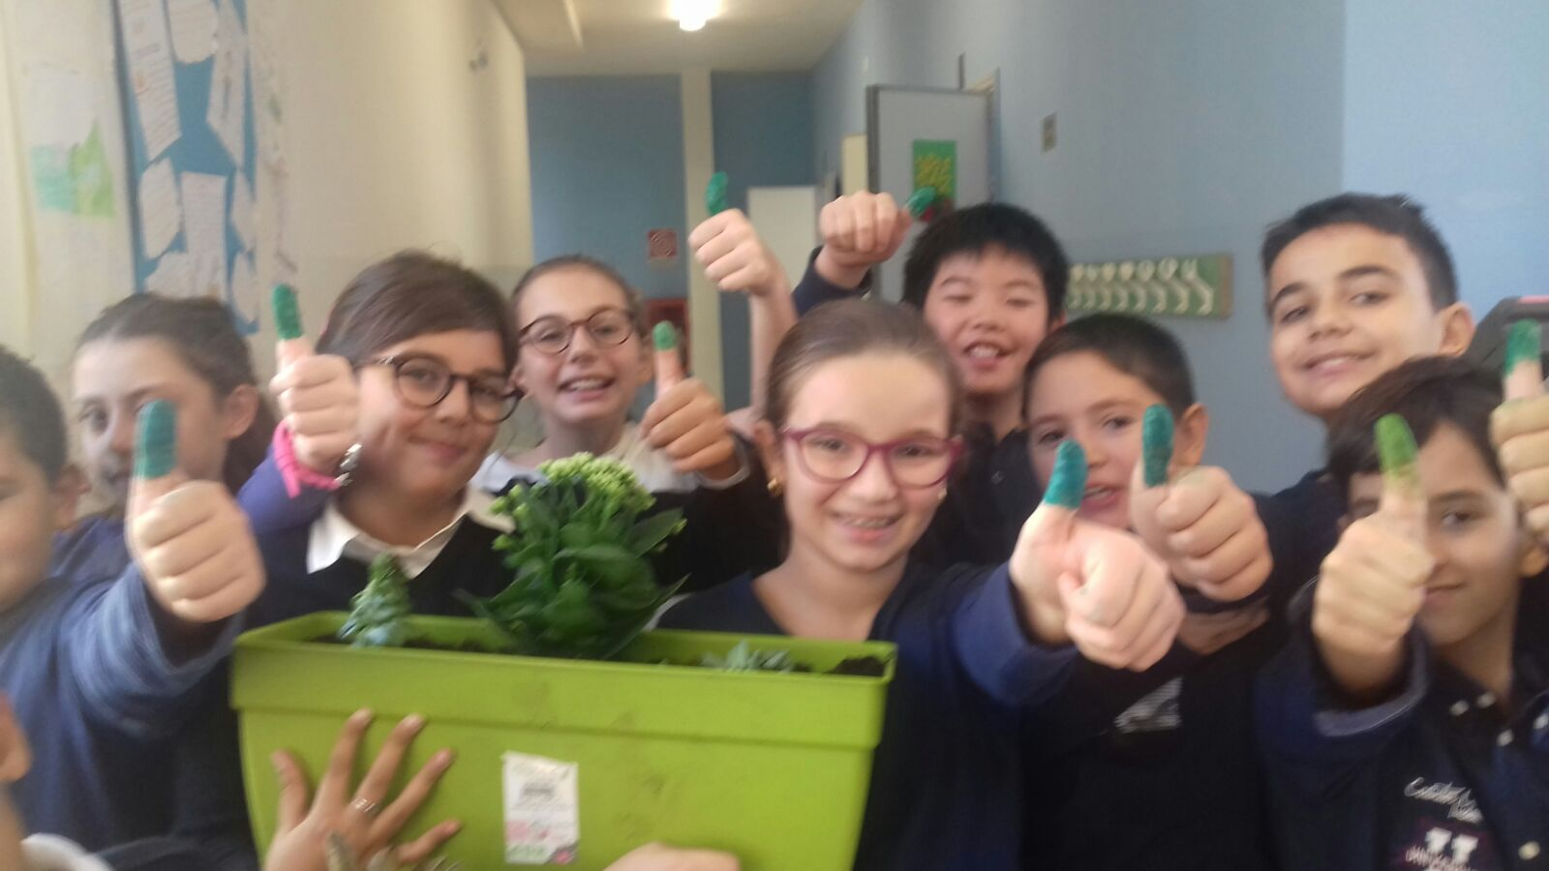
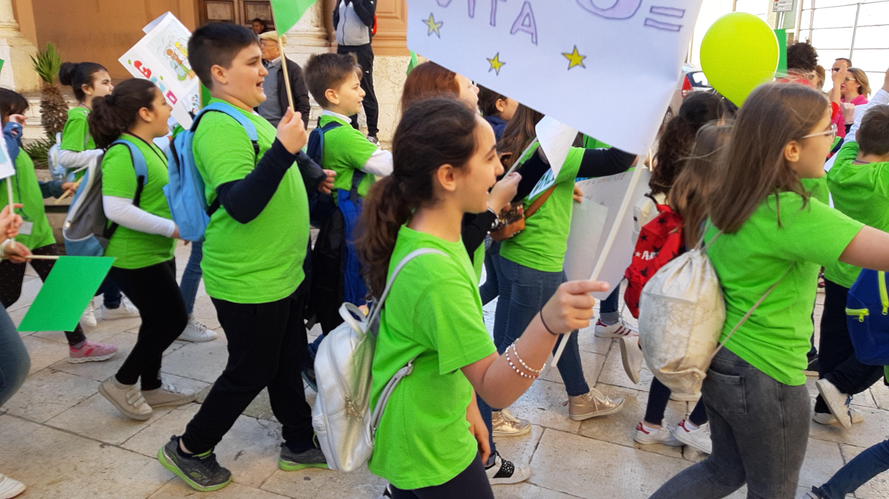
We love our EARTH
We recycle
Scuola Cavour Marsala Sicily Italy
We plant flowers and trees
We fight for our environment

Slide 4
Waste containers in Latvia
"Ecoactive„
2016-2019

Slide 5
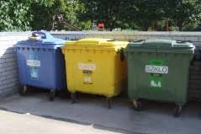
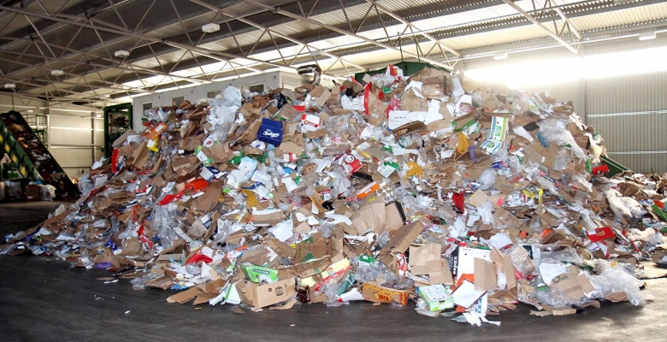
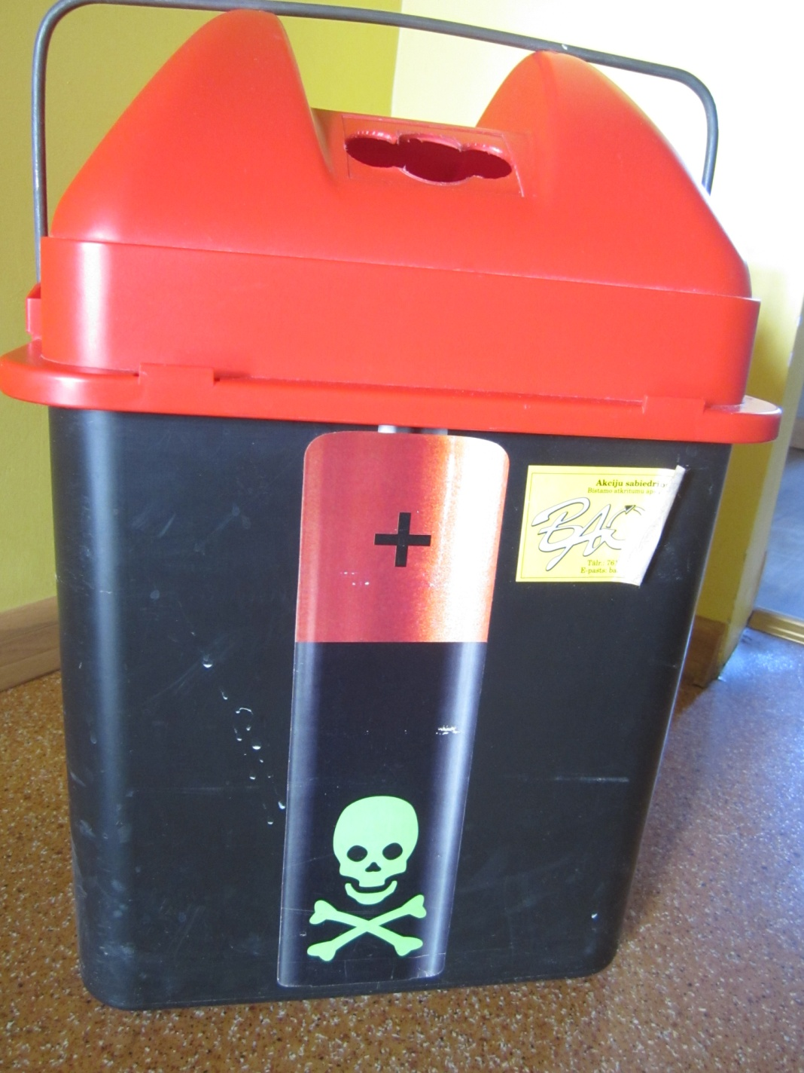
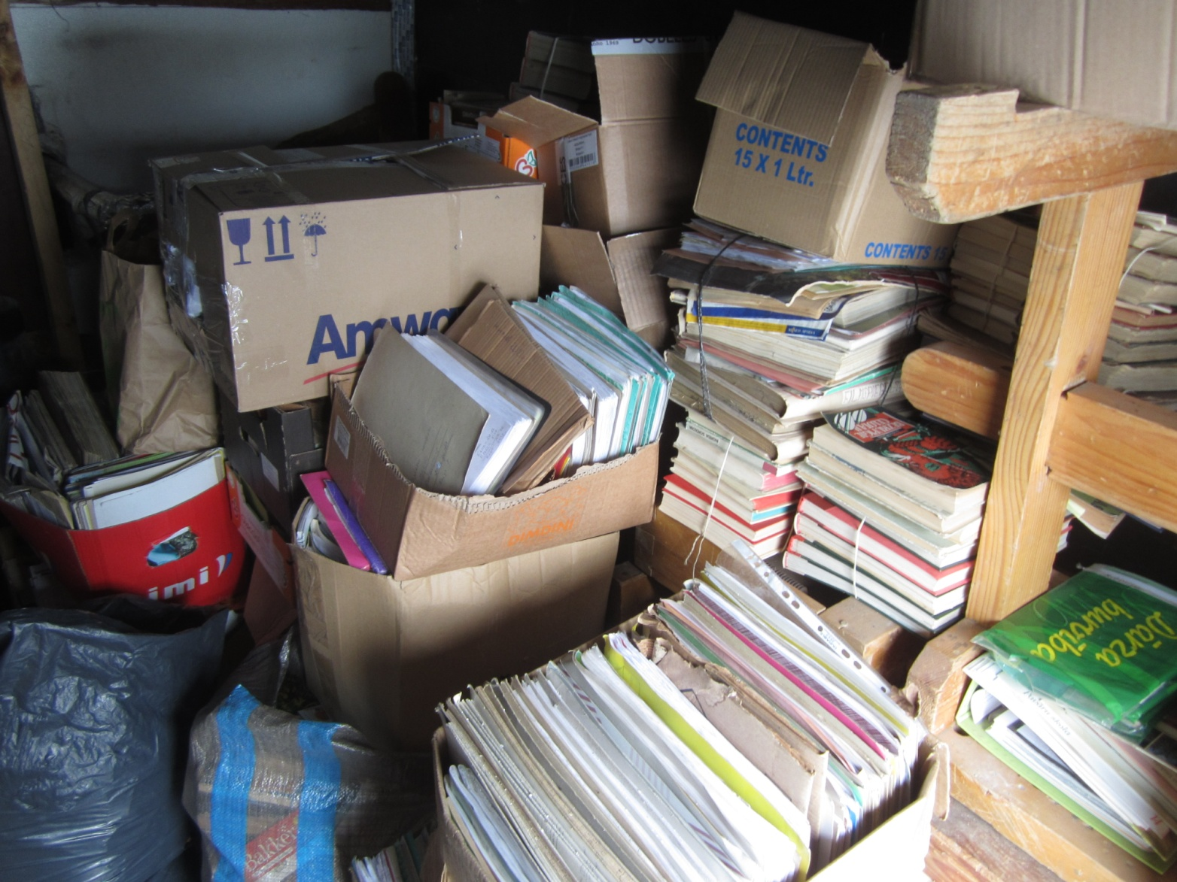
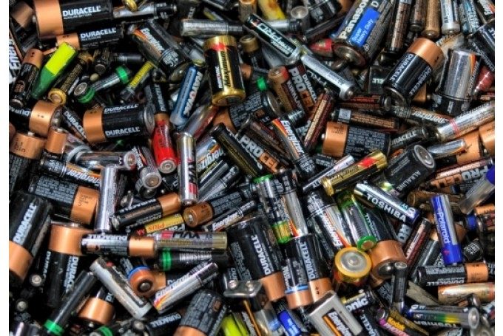
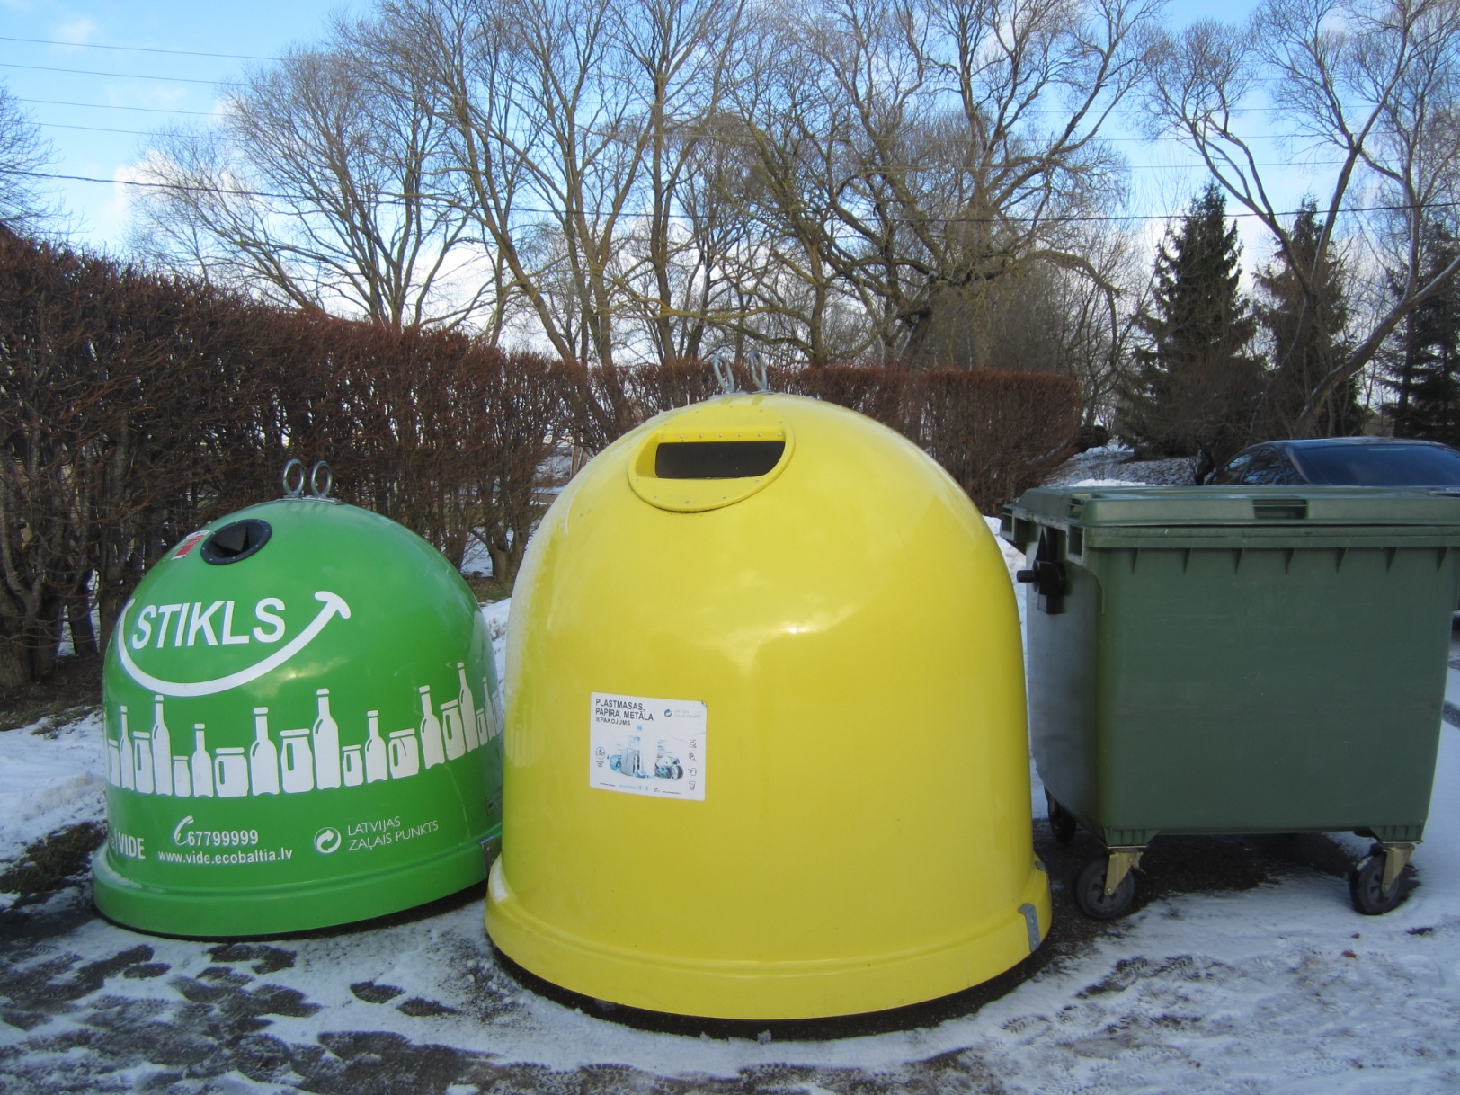
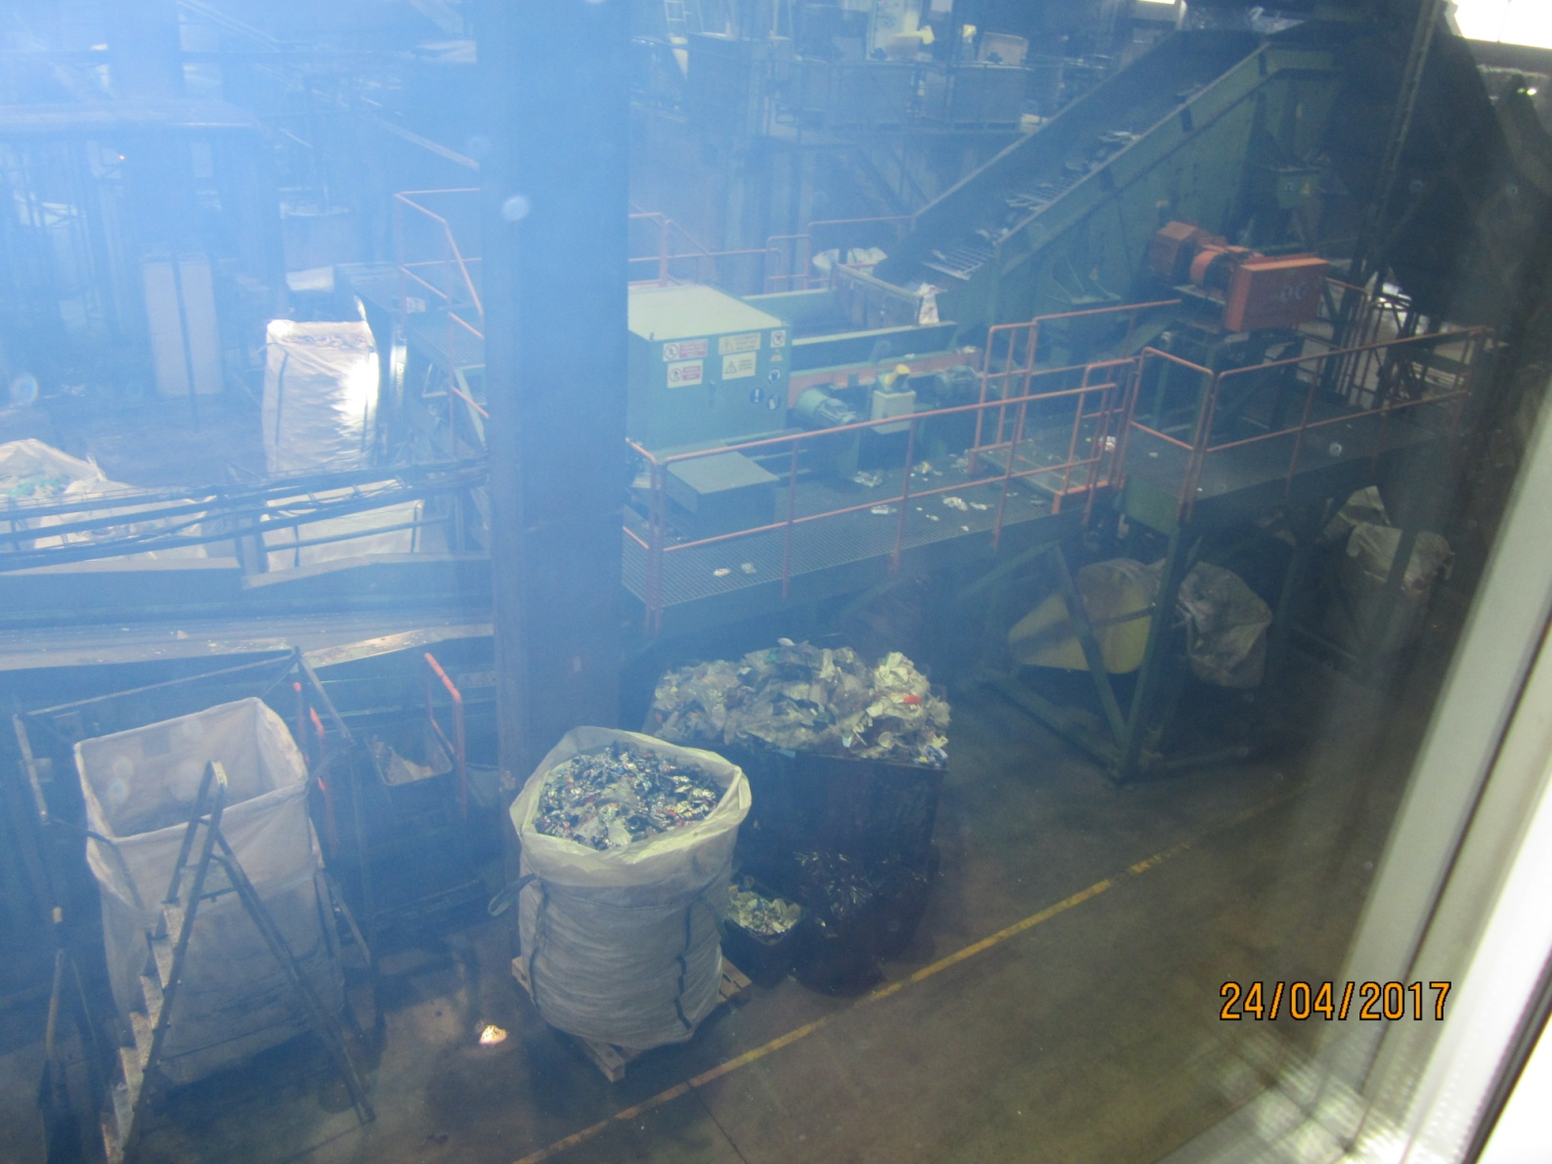

Slide 6
Waste containers in the netherlands

Slide 7
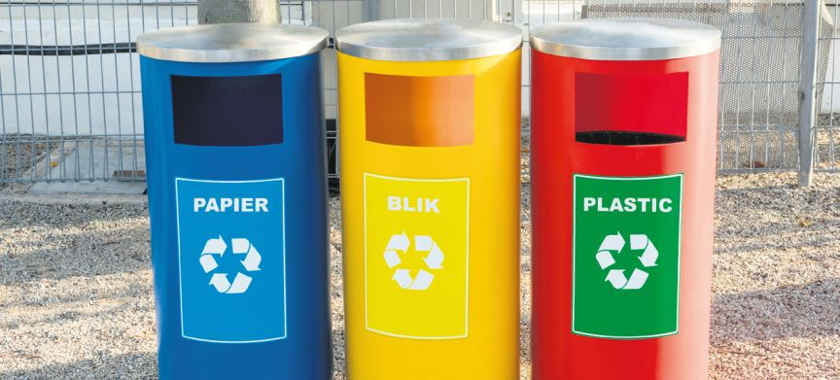
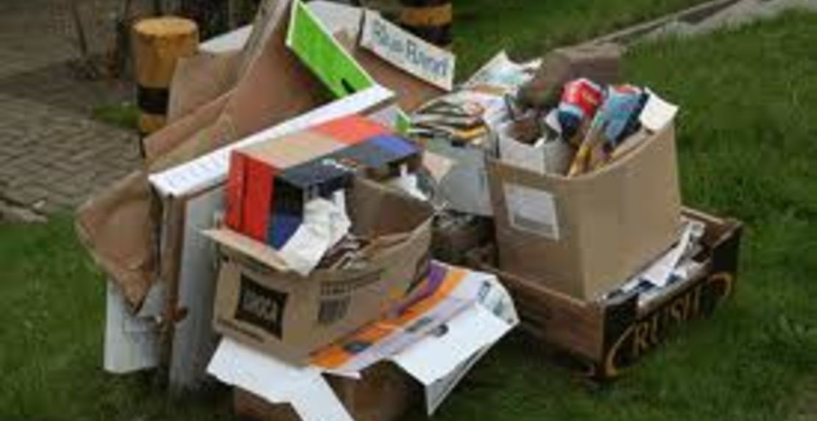
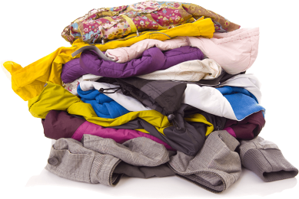
RECYCLE
The Netherlands
batteries
Clothes
glass
Clothes

Slide 8
Waste containers in Poland
"Ecoactive„
2016-2019

Slide 10
Waste containers in Slovenia
"Ecoactive„
2016-2019

Slide 11
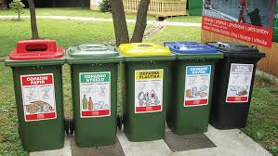
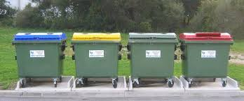
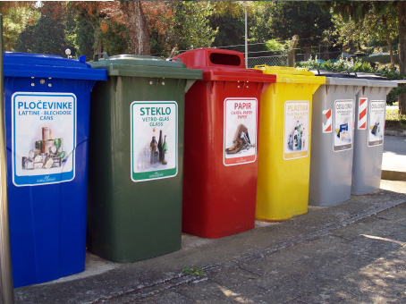
locevanjeodpadkov.si
jkp-log.si
cistomesto.si

