Slide 1
Under the same sky
“Europe in numbers”
Amazing records in the EU

Slide 2
Europe in numbers
How to “play” this presentation?
Go to the next page (a lot of questions)
Click on a question.
You will see three answers
Choose one
If the answer is right, click “Home” for the next question.
If the answer is qwrong, click “Home” for a second, or even third, answer.
Enjoy it! Good luck!

Slide 3
Europe in numbers
The biggest country in the EU is..
The smallest EU-country is….
The country with the largest number of inhabitants….
And the smallest number of inhabitants is …..
The country with the highest density of population….
And the lowest density of population is in…
The longest river in the EU is ….
The biggest lake in the EU…
The country with the shortest border…
The EU-country with the longest coast line…
And the shortest coast line has…
The highest building in the EU…
The biggest capital in the EU..
The capital with the lowest number of inhabitants is…
The highest point in the EU…
The longest bridge in the EU is…
The biggest football stadium in the EU…
The country with the largest number of bicycles is….

Slide 4
Europe in numbers
The biggest country in the EU is…..
A: France
B: Norway
C: Germany

Slide 5
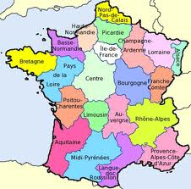
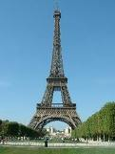
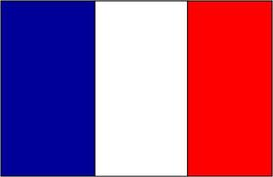
Under the same sky Europe in numbers
France: 544.000 km². This is the correct answer. Click “Home”for the next question.
Capital: Paris
Home

Slide 6
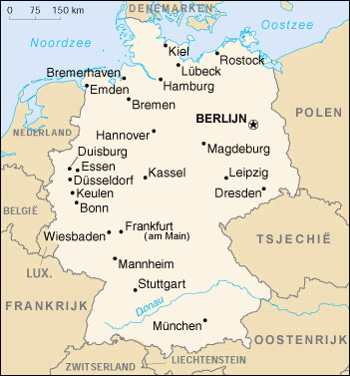
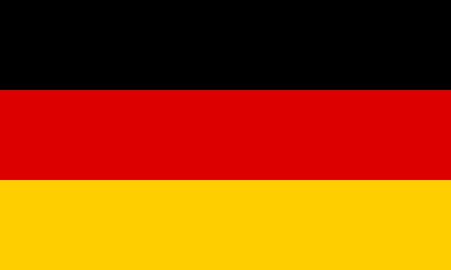
Europe in numbers
Germany is a big country, 357.022 km², capital Berlin, German name Bundesrepublik Deutschland but not the biggest country in the EU! So, try again!
HOME
Coat of arms
Flag
Country

Slide 7
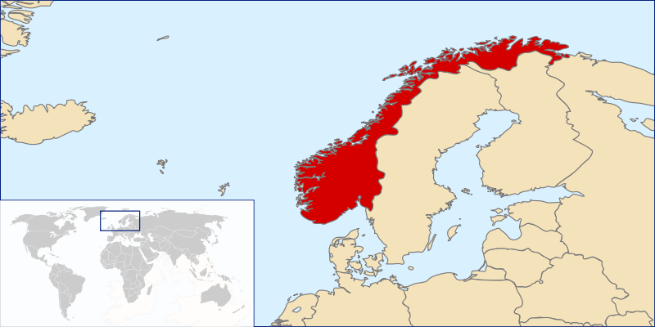
Europe in numbers
Norway could be one of the longest countries in Europe. The capital is Oslo. It is in the north of Europe, but.. Not the biggest country in the EU. So, try another one.
HOME

Slide 8
Europe in numbers
The smallest country in the EU is…
A: Luxemburg
B: Malta
C: Belgium

Slide 9
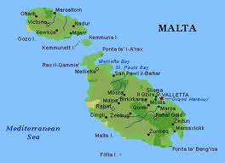
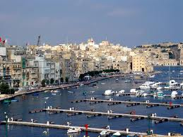
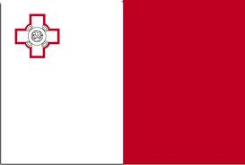
Under the same sky Europe in numbers
Malta 315 km². Correct! Click “Home” for the next question.
Capital: La Valetta
Home

Slide 10
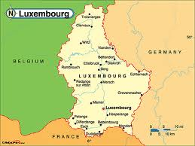
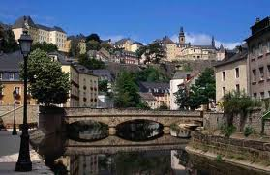
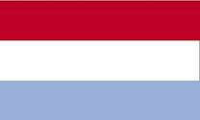
Europe in numbers
Luxemburg is a small country, next to Belgium, France and Germany. It has almost 500.000 inhabitant, it’s surface is 2586 km^{2.} The capital is called Luxemburg too. But… there are smaller countries in the EU! Try again.
Home
Capital

Slide 11
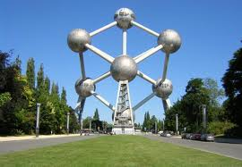
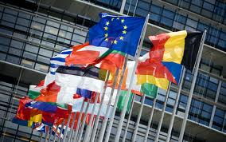
Europe in numbers
Belgium borders to The Netherlands, Germany, Luxemburg and the North sea. The capital Brussels is the residence of the European parliament. But the smalles country? No no!
Home
The famous Atomium in Brussels

Slide 12
Europe in numbers
The country with the largest number of inhabitants is ….
A: France
B. Italy
C: Germany

Slide 13
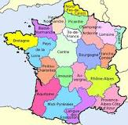
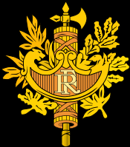
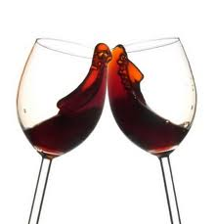
Europe in numbers
France has 62.150.775 inhabitants. A lot! They love to drink wine! And Paris is their capital. Do you know the famous tower Eiffel? But it is NOT the country with the most inhabitants. Try again.
HOME

Slide 14
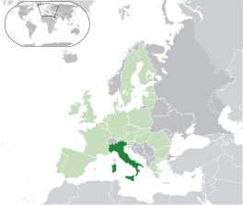
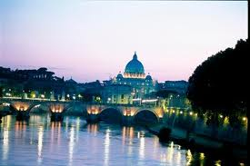
Europe in numbers
Italy has got 57.110.144 inhabitants. But it is not the largest number in the EU. Do you know which country? Try it.
HOME
Skyline Rome
Italy looks like a boot

Slide 15
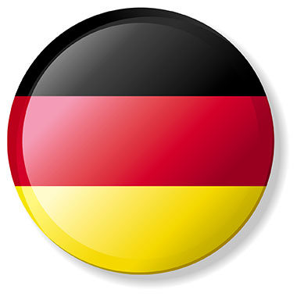
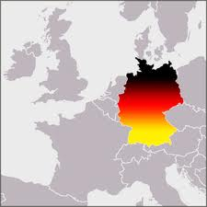
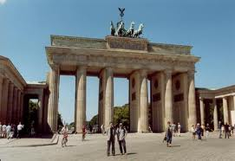
Under the same sky Europe in numbers
Germany has got the most inhabitants of all the EU-countries: 82.398.000. Right! “Home” for next question.
Capital: Berlin
Home

Slide 16
Europe in numbers
The country which has the smallest number of inhabitants is……
A: Malta
B: Finland
C: Denmark

Slide 17
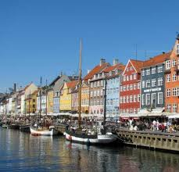
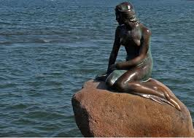
Europe in numbers
Denmark? The number of inhabitants is 5.500.510 what is almost the same as Finland. There is country which has less inhabitants in the EU! Find it.
HOME
Copenhagen
The famous statue

Slide 18
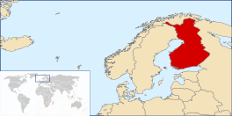
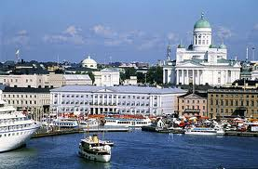
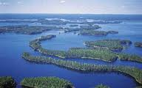
Europe in numbers
Finland is in the north of the EU. It has got not so much inhabitants: 5.250.275. Finland is very famous because of the large number of lakes. Helsinki is the capital. But….the answer is not correct!!!
HOME
Helsinki

Slide 19
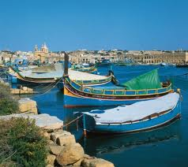
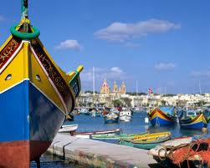
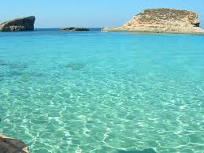
Under the same sky Europe in numbers
Malta 405.165 This answer is correct. “Home”for next question.
Malta has got 365 churches, one for every day of the year.
Home

Slide 20
Europe in numbers
The country with the highest density of
population is….
A: The Netherlands
B: Luxembourg
C: Latvia

Slide 21
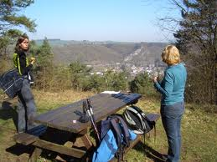
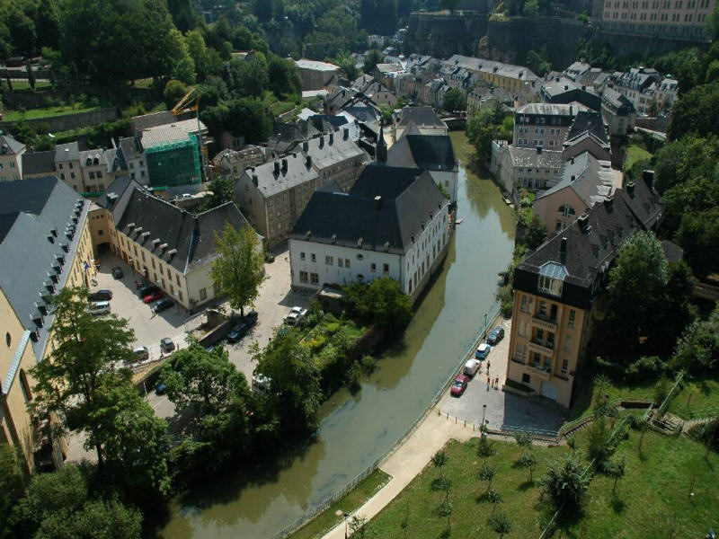
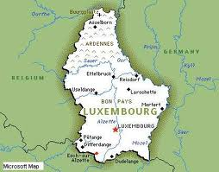
Europe in numbers
Luxembourg has about 500.000 inhabitants. It’s
capital is Luxembourg too. The flag is the same
as the Dutch one. The population density is 190
per km². Unfortunately this is not the highest in
the EU, so try again!
HOME

Slide 22
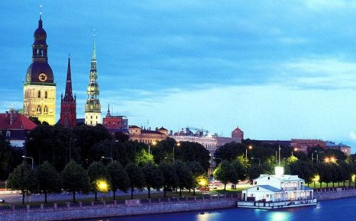
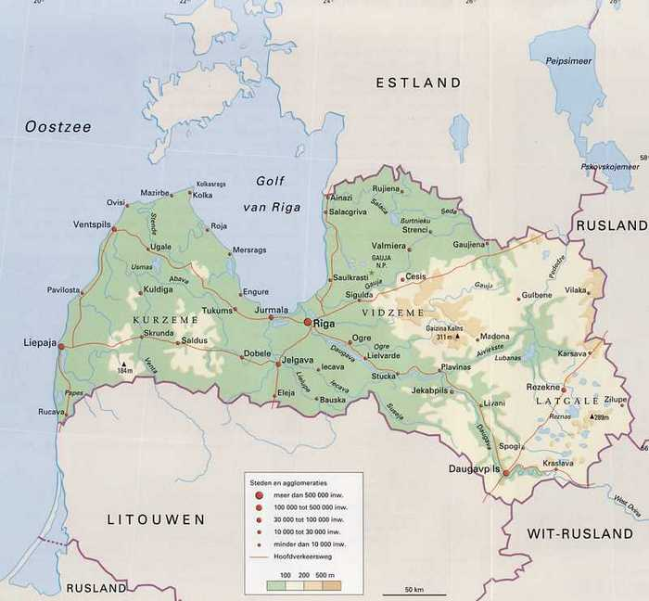
Europe in numbers
Latvia is one of the Baltic states. The capital is
Riga. It’s density of population is 34 persons
each km². It is NOT the country with the highest
density of population.
HOME

Slide 23
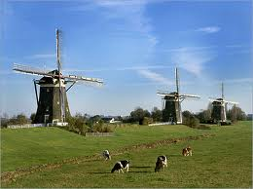
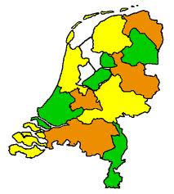
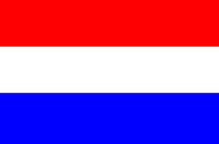
Under the same sky Europe in numbers
The Netherlands. Correct. The population density is 401/km^{2.} “Home” for next question.
^{Home}

Slide 24
Europe in numbers
And the lowest density of population is in…
A: Finland
B: Norway
C: Austria

Slide 25
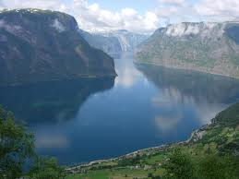
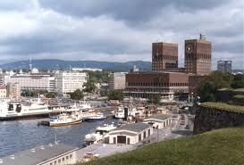
Europe in numbers
Norway!! It’s density of population is only 12,1/km². The capital is Oslo. The coast of Norway is famous for it’s fjords. Correct answer so “Home” for next question.
HOME
fjord
Oslo

Slide 26
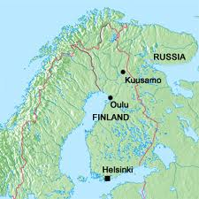
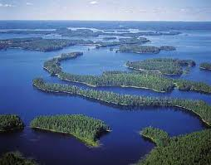
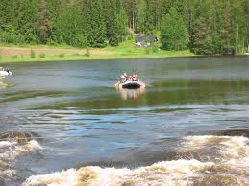
Under the same sky Europe in numbers
Finland has 15 inhabitants every km^{2.} But…not Correct. Click “Home” for a new answer.
^{Home}
Lots of lakes and free places for everybody.

Slide 27
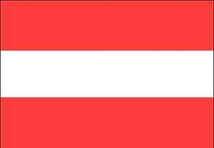
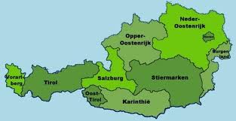
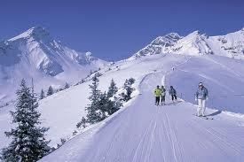
Europe in numbers
Austria, in the Alps, has got 97,9 inhabitants each km². This is a lot for a country in the mountains! Austrians are very good in skiing. But…your answer is not correct. Try “Home” for another answer.
Home

Slide 28
Under the same sky Europe in numbers
The longest river in the EU is ….
A: The Wolga?
B: The river Rhine?
C: The Danube?

Slide 29
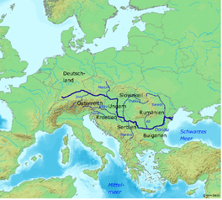
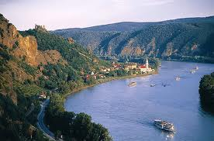
Under the same sky Europe in numbers
The Danube (Dutch “Donau”) is the longest river in the EU, 2860 km. The well is in Germany in the Black Forest, the estuary in the Black Sea. “An der schönen blauen Donau” is also a very famous walz, composed by Johann Strauss. So, your answer is RIGHT!
Home

Slide 30
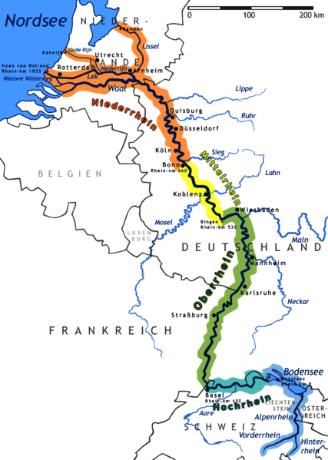
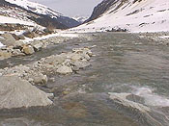
Europe in numbers
The Rhine flows from Grisons in the eastern Swiss Alps to the North Sea coast in the Netherlands and is one of the longest and most important rivers in Europe, at about 1,233 km.
The initial source of the Rhine
But…the longest river in the EU???? NO!
HOME

Slide 31
Europe in numbers
The Volga is the longest river in Europe, 3692 km. It flows through central Russia, and is widely viewed as the national river of Russia. But it is not the longest river in the EU, because Russia does not belong to the EU!!! So try again!
HOME

Slide 32
Europe in numbers
The biggest lake in the EU is…
A: Bodensee Germany/Austria/Switzerland
B: Balatonmeer Hungary
C: Lake Vänern Sweden

Slide 33
Europe in numbers
Lake Constance (in German: Bodensee) is a lake on the Rhine at the northern foot of the Alps, 536 km². It is a great area for water tourisme, but NOT the biggest lake in Europe. Click “Home” for another try.
HOME

Slide 34
Europe in numbers
Lake Balaton is a freshwater lake in Hungary. It is the largest lake in Central Europe, surface 592 km². But there are bigger ones in the EU, so, click “Home” and try again.
Home

Slide 35
Under the same sky Europe in numbers
The biggest lake in the EU is Vänern (Zweden) 5.584 km². So this is the correct answer. “Home”for the next question.
Home

Slide 36
Under the same sky Europe in numbers
The country with the shortest border is …
A: Slovakia
B: Malta
C: Switzerland

Slide 37
Under the same sky Europe in numbers
Malta.
The border of Malta is also the coast line, because Malta is a country which consist of two islands. This coast line is 252 km. So your answer is OK. Click “Home” for next question.
Home
Capital La Valetta

Slide 38
Under the same sky Europe in numbers
Switzerland is a republic consisting of 26 cantons, with Bern as the seat of the gouvernment. The country is situated in Western Europe, where it is bordered by Germany, France, Italy, Austria and Liechtenstein. It is famous for the mountains, The Alps. Swiss people are very good at skiing. But…the border is longer then in some other countries. And…it is not an EU-country! So, “Home” and try again.
HOME

Slide 39
Under the same sky Europe in numbers
Slovakia is a landlocked state in Central Europe, population about five million and an area of about 49.000 km². Slovakia is bordered by the Czech Republic and Austria to the west, Poland to the north, Ukraine to the east and Hungary to the south. The capital is Bratislava, famous are the mountains of the high Tatra. But…. it has a longer border then some other countries.So, “Home” for another try.
HOME

Slide 40
Under the same sky Europe in numbers
The country which has the longest coast line is….
A: Greece
B: Norway
C: Italy

Slide 41
Under the same sky Europe in numbers
Greece: 13 676 km coast line. Greece has a lot of islands, these all have a coast line! Correct answer!! Go “Home”
A lot of islands
Home

Slide 42
Under the same sky Europe in numbers
Italy??? It’s a form like a boot in the Mediterranian See. Coast line is 7600 km. Very long! But the longest??? NO, so “Home” for a better answer!
HOME
Italy

Slide 43
Under the same sky Europe in numbers
Maybe Norway? Very long country in the north of Europe! It’s coastline is over 25.000 km!!! The longest in Europe, but…little problem: Norway is not an EU-member!! So “Home” for another try.
HOME
One of the famous Norwegian fjords.

Slide 44
Under the same sky Europe in numbers
And the shortest coast line has…
A: Hungary
B: Belgium
C: Poland

Slide 45
Under the same sky Europe in numbers
Maybe Belgium? It has a short coastline as you can see. It borders the North Sea, the length of the coastline is 67 km. Correct answer! Next question.
Home
The most famous statue in Belgium, in Brussels.

Slide 46
Under the same sky Europe in numbers
Hungary. False answer!
Hungary even does not have a coastline, the country is in the middle of Europe. Try again.
Home

Slide 47
Under the same sky Europe in numbers
Poland? It has a coastline next to the Baltc Sea and it’s lenght is 524 km. So, there are shorter coastlines in the EU! Try again.
Home
Capital Warsaw
Gdansk

Slide 48
Under the same sky Europe in numbers
The highest building in the EU…
A: The Commerzbank Tower in Frankfurt
Germany.
B: The Eiffel Tower in Paris France
C: The Torre de Cristal in Madrid Spain

Slide 49
Under the same sky Europe in numbers
The Commerzbank Tower is a tower in
Frankfurt am Main, 259 m. high. The tower is
NOT the highest one in the EU. The three
highest buildings in the EU are in
Moskow. So try again.
Home
“City of Capitals” in Moskou
Commerzbank Tower

Slide 50
Under the same sky Europe in numbers
The Eiffel Tower, nickname La dame de fer, the iron lady) is an iron lattice tower located in Paris. Built in 1889, it has become icon of France. The tower is named after its designer, engineer Gustave Eiffel, the tower was built as the entrance arch to the 1889 World's Fair.
The tower stands 324 metres high. Your answer is correct, the tower is the highest in the EU. “Home” for next question.
HOME

Slide 51
Under the same sky Europe in numbers
The Torre de Cristal (Spanish for Tower of Glass) is a skyscraper in Madrid, completed in 2008, 249.5 metres high. It is NOT the highest building in the EU, it is the second highest building in Spain.
SO, go “Home” for a new try.
HOME

Slide 52
Europe in numbers
The biggest football stadium in the Eu is …
A: The Wembley stadium London
B: Camp Nou in Barcelona
C: The Amsterdam Arena

Slide 53
Under the same sky Europe in numbers
Camp Nou – Barcelona/Spanje – 98.772 seats. So, your answer is right! This is the biggest one in the EU! Go to the next question!
Home

Slide 54
Europe in numbers
The Amsterdam Arena is the first in Europe covered with a retractable roof. Number of spectators: 52.960. So, a lot, but…not the biggest one in the EU!!! So try again!
Home

Slide 55
Europe in numbers
The Wembley stadium in London is brandnew build. The number of spectators is 90.000. That’s much more then the Amsterdam Arena. But the biggest in the EU? NO no! Have another try!
Home

Slide 56
Under the same sky Europe in numbers
The biggest capital in the EU is…
A: Paris?
B: Rome?
C: London?

Slide 57
Under the same sky Europe in numbers
London? This is a very big city, but NOT the biggest one in the EU. London has got about 7.500.000 inhabitants. Try another answer!
Home
The skyline of London

Slide 58
Under the same sky Europe in numbers
Rome? Rome is very famous because of all the history, the ancient Romans, it’s famouis buildings. The city has got almost 3.000.000 inhabitants and it is not the biggest capital in the EU. So, try again.
Home
The skyline of Rome

Slide 59
Under the same sky Europe in numbers
Paris in France: 11.175.000 inhabitants. CORRECT answer! Very good! Click “Home” for next question.
Home

Slide 60
Europe in numbers
The smallest capital in the EU is…
A: La Valetta
B: Bratislava
C: Luxembourg

Slide 61
Under the same sky Europe in numbers
La Valetta in Malta: 7000 inhabitants
The skyline of La Valetta
Home

Slide 62
Europe in numbers
Luxembourg? This is the capital of the country Luxembourg. Number of inhabitants? 92.342. It is NOT the lowest number in the EU, for capitals. So, another try!
HOME
Skyline of Luxembourg

Slide 63
Europe in numbers
Maybe Bratislava? Itis the capital of Slovakia and, with a population of about 431.000, also the country's largest city. Bratislava is in southwestern Slovakia on both banks of the Danube River, bordering Austria and Hungary. But in the EU there are smaller capitals! Try again.
Home
Skyline of Bratislava

Slide 64
Under the same sky Europe in numbers
Lowest point in the EU: Zuidplaspolder, The Netherlands
-6,76 meter below sea level
Home
How people built a polder

Slide 65
Europe in numbers
The highest point in the EU is…
A: The Mont Blanc in France
B: The Grossglockner in Austria
C: The Matterhorn in Switzerland

Slide 66
Europe in numbers
The “Matterhorn” is one of the most famous mountains in Switzerland. It is situated near Zermatt, 4478 m. high. Whymper (England) was the first who klimbed this mountain, in 1865. But…is this the highest mountain in the EU? No, it is not! So try again.
HOME

Slide 67
Under the same sky Europe in numbers
The Mont Blanc (French), meaning "White Mountain", is the highest mountain in the Alps and in the European Union. It’s height is 4810,9 m. CORRECT answer! Click “Home”.
Home

Slide 68
Europe in numbers
The “Grossglockner” is the most famous mountain in Austria, 3798 m. high. Very famous is the road called “Grossglockner Hochalpenstrasse”. But…..this mountain is not the highest mountain in the EU! So, try again!
HOME
Grossglockner Hochalpenstrasse

Slide 69
Europe in numbers
The longest bridge in the EU is…
A: De Ponte Vasco Di Gama Lissabon
B: The “Zeelandbrug” in The Netherlands
C: Øresundsbron Denmark-Sweden

Slide 70
Europe in numbers
De Ponte Vasco Di Gama Lissabon, 17.2 Km long
This is the longest bridge in the EU. It is in Lissabon in Portugal and it crosses the river Tague. So: correct answer! “Home” for next question.
HOME

Slide 71
Europe in numbers
The Zeeland Bridge is the longest bridge in the Netherlands. It connects the islands of Schouwen-Duiveland and Noord-Beveland in the province of Zeeland.
The Zeeland Bridge was built between 1963 and 1965. At the time of its completion, it was the longest bridge of Europe. It has a total length of 5022 metres.
But it is not the longest bridge in the EU! So try again (“Home”)
HOME

Slide 72
Europe in numbers
Oresund Bridge (Øresundsbron) – Connecting Denmark and Sweden – is 7845 m long, but NOT the longest bridge in the EU! Go “Home” for another try.
HOME

Slide 73
Europe in numbers
In which country people use bicycles most of the time?
A: The Netherlands
B: Belgium
C: Cyprus

Slide 74
Europe in numbers
Belgium? The like to ride a bicycle, but espacially for sports and cyclocross. But the biggest number of bicycles? NO, try again.
By the way: did you know that the inventor of the first
bicycle was Drais von Sauerbron (Germany)? He created
The “Laufmaschine”, or velocipede, the earliest form
of a bicycle, yet without pedals (1871).
It was called “The draisine”,
Home

Slide 75
Europe in numbers
Cyprus? No, almost nobody uses a bike. They all go by car! So, wrong answer! Try again (“Home”)
Home
Aphrodite’s rock
No bicycles in Limassol…

Slide 76
Under the same sky Europe in numbers
The average number of bicycles in som Eu-countries:?
In the Netherlands 1,1 p.p. all together about 17.600.000
(more bicycles then inhabitants!)
Denmark 0,8 in all 4.500.000
Germany 0,8 in all 65.000.000, so here are the most bicycles!!!!!!
Belgium 0,5 in all 5.000.000
Italy 0,5 in all 30.000.000
Austria 0,4 in all 3.000.000
Great Brittain 0,4 in all 25.000.000
Spain 0,2 in 9.000.000
Concerning the little surface and the high average the Dutch are the champions in Europe in cycling!
Home

Slide 77
Under the same sky Europe in numbers
Some interesting facts in the EU. Did you like it? Pupils of form 8 in Primary School
“De Weijerhof”
in Boxmeer examined the EU with great enthousiasme.
Home

