Slide 1
Hats made of leftover wool
Tone Pavček Primary School
Mirna Peč, Slovenia Class 4. b

Slide 2
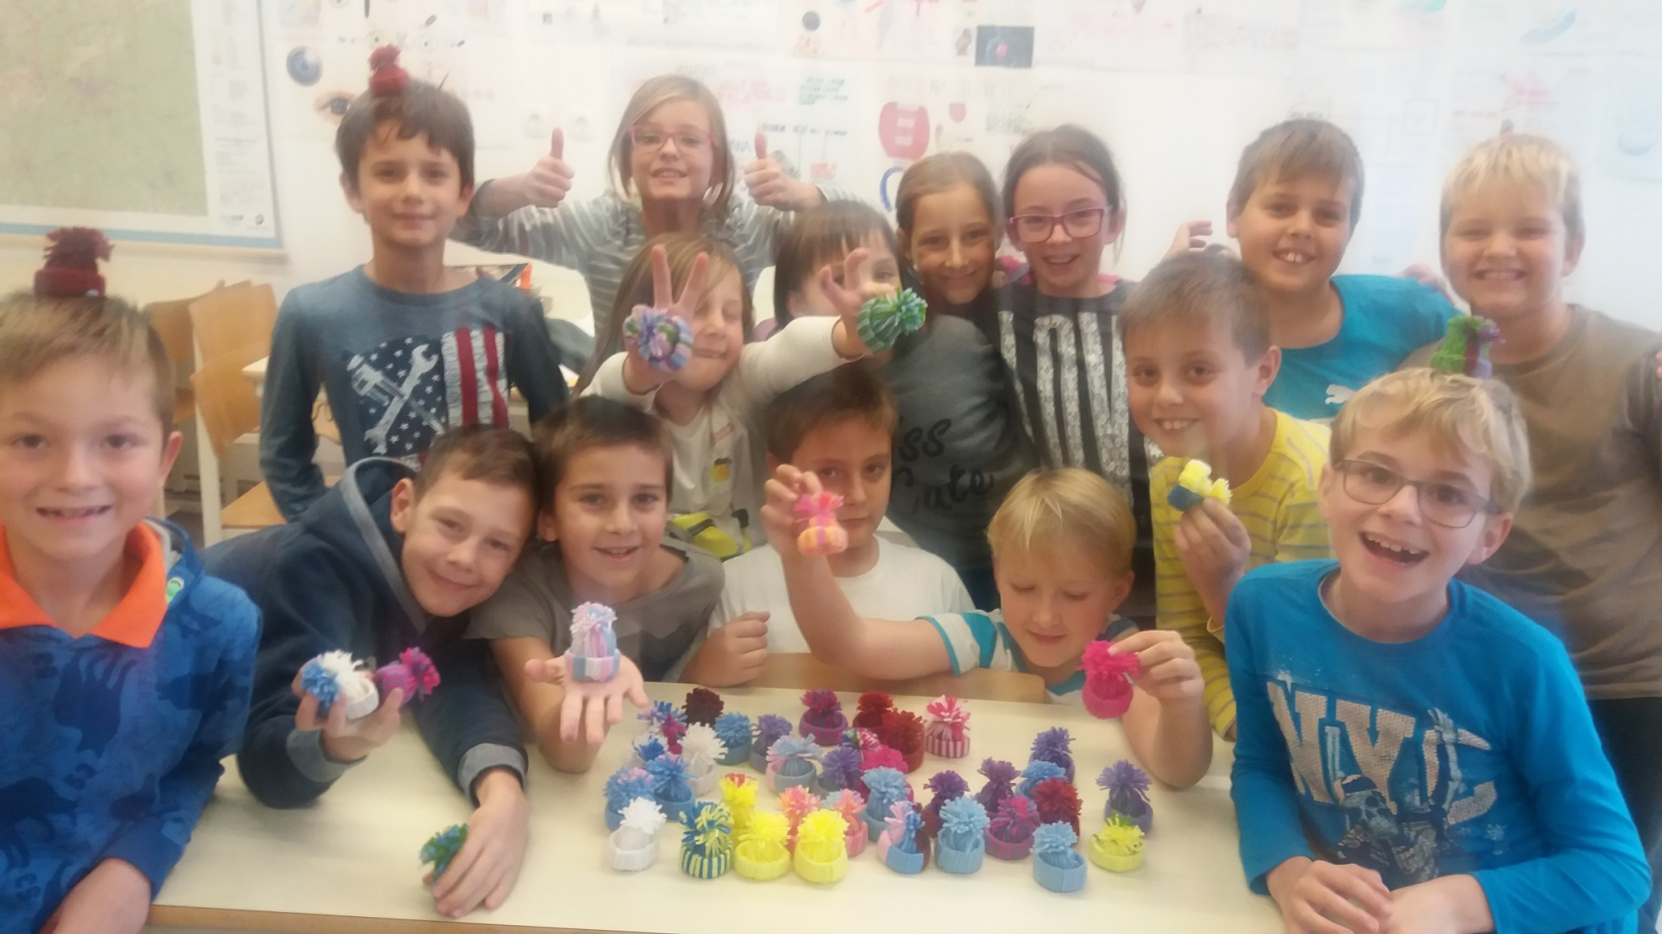
We were creating at art using scrap wool. We made decorative hats which we gave to elderly people in Mirna Peč.

Slide 3
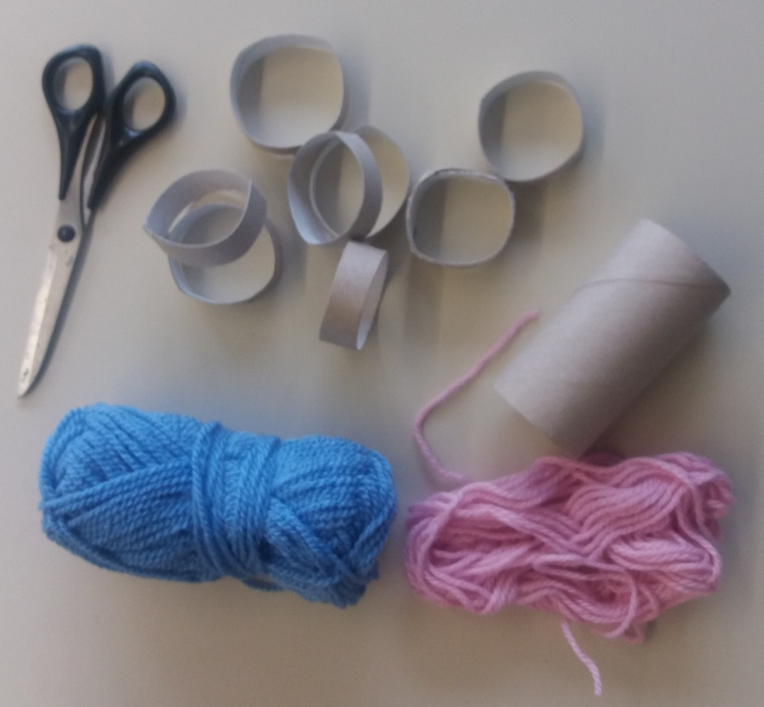
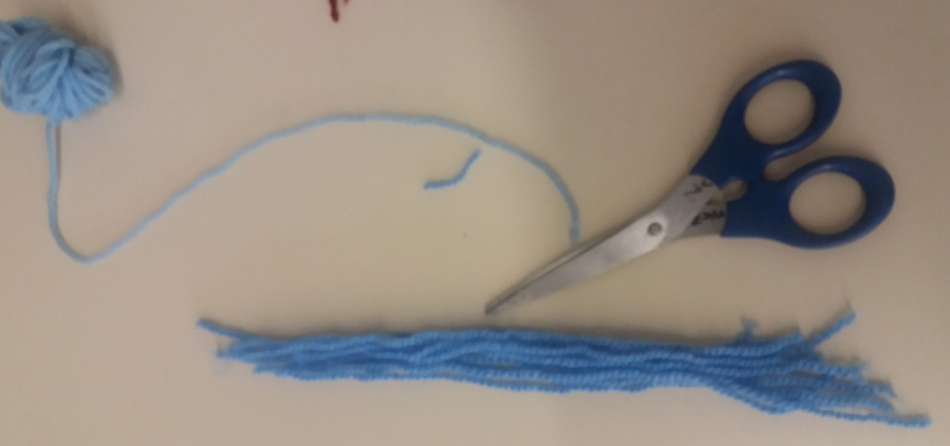
You need: wool leftovers, toilet rolls and scissors. We cut the rolls in 1,5 cm wide circles and wool in 15 cm long strips.

Slide 4
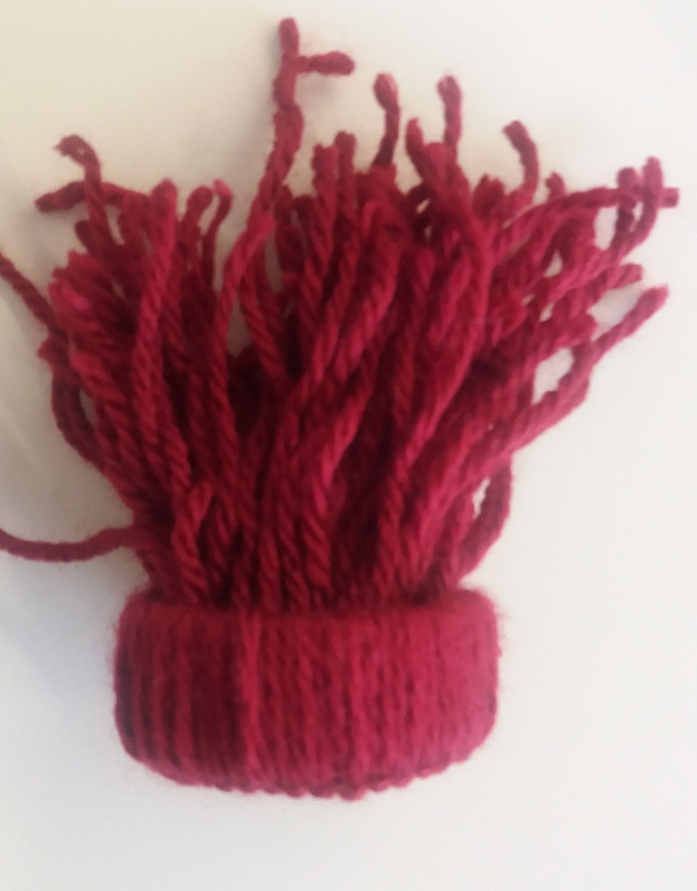
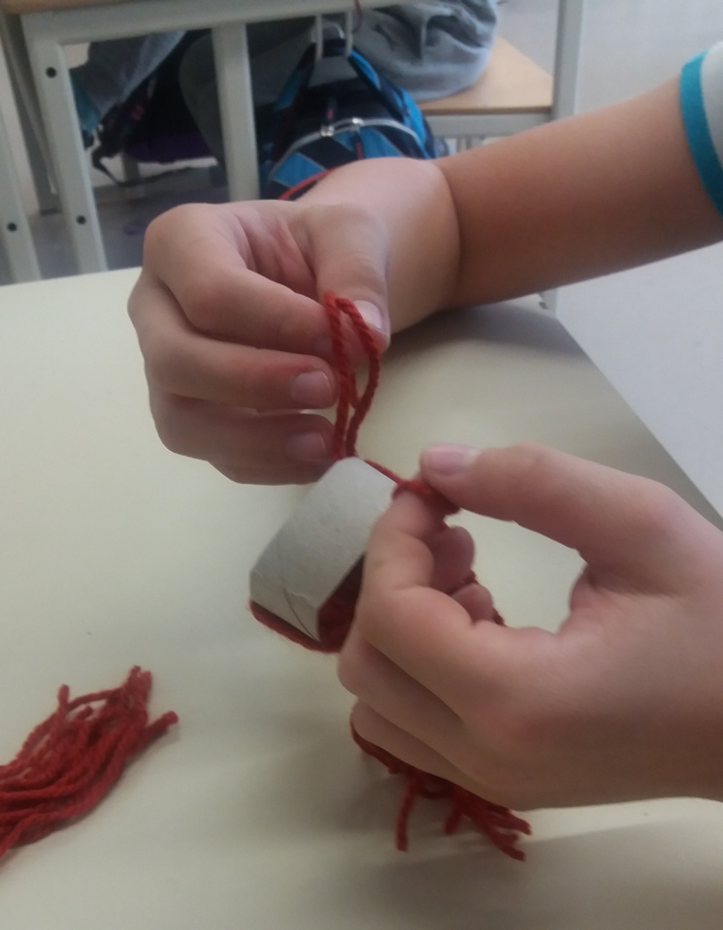
Tie the woll tightly around the rolls.

Slide 5
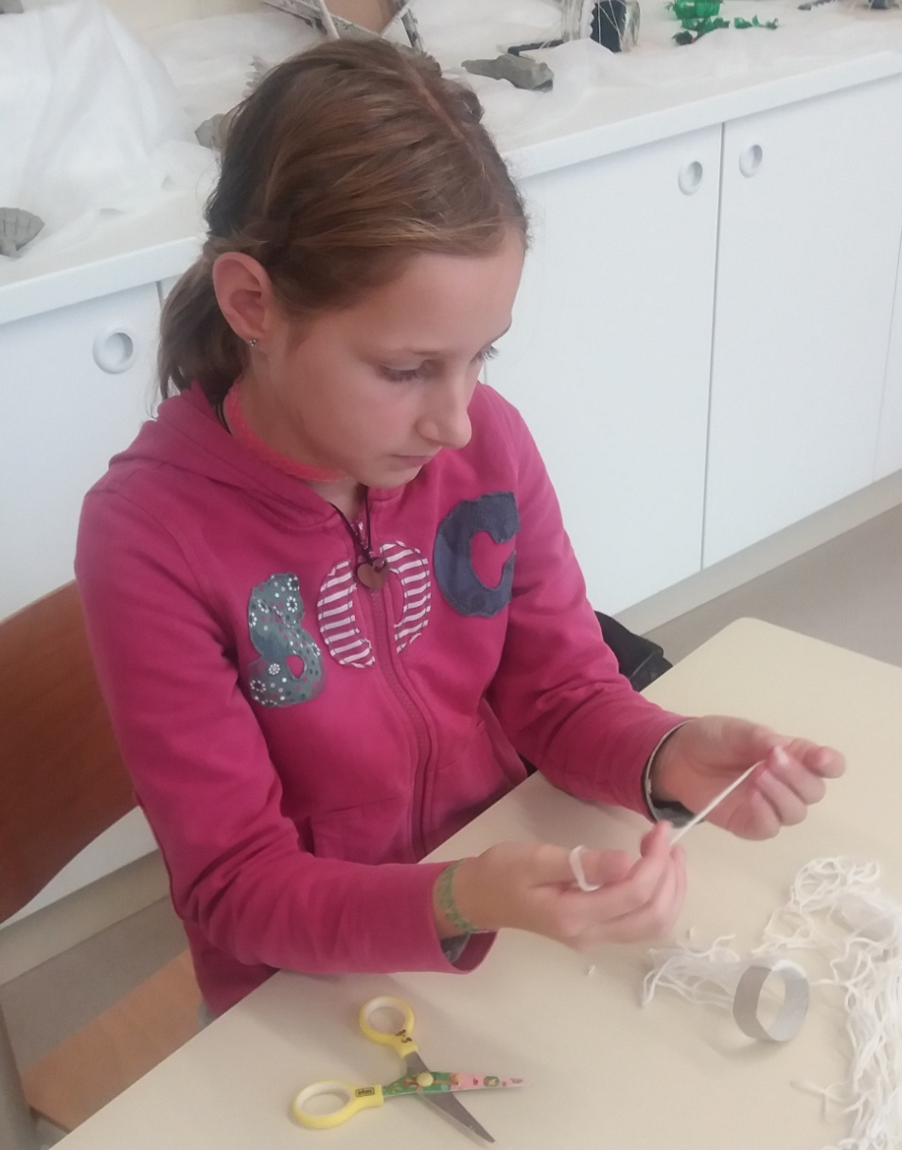
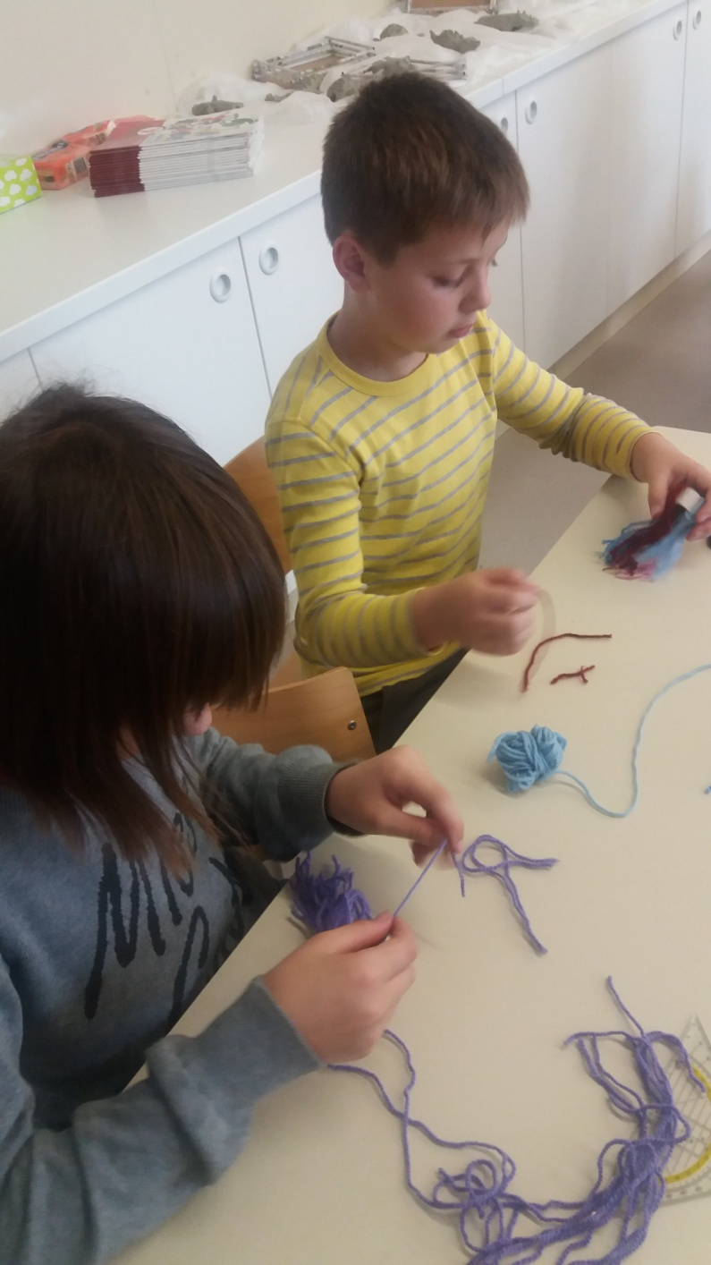

Slide 6
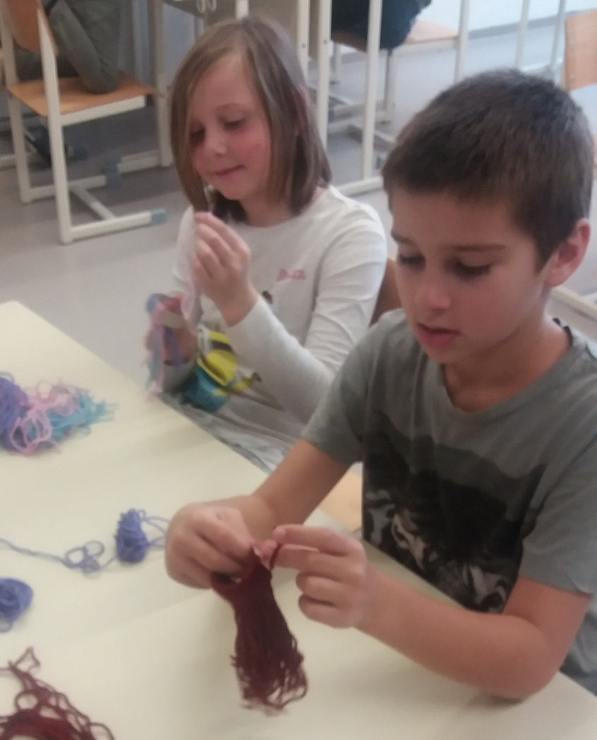
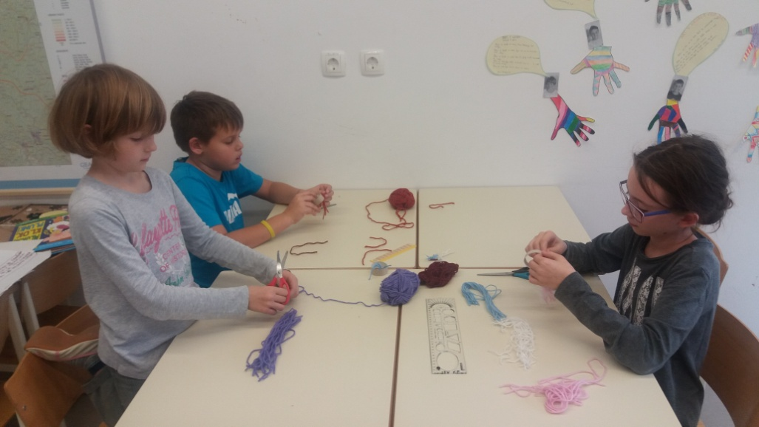

Slide 7
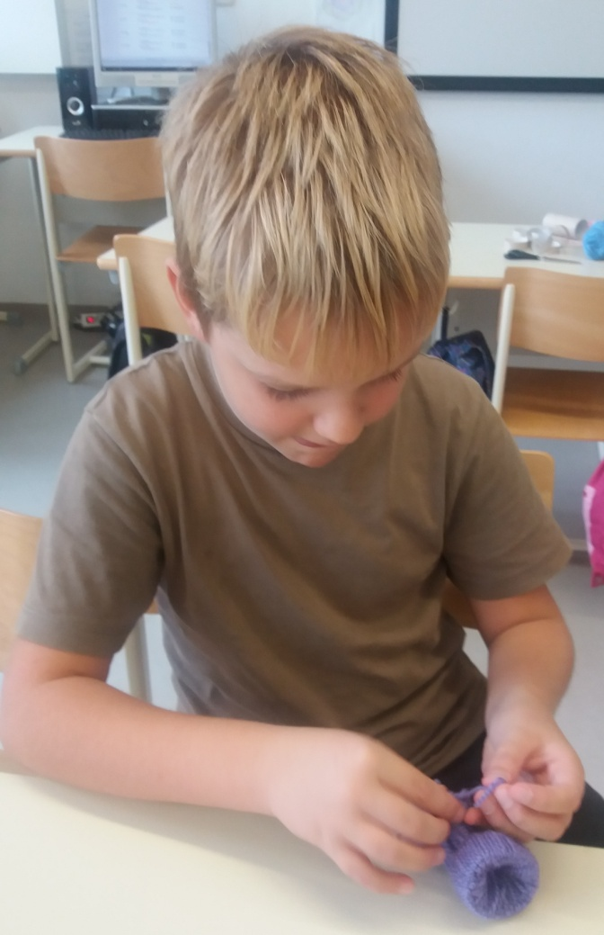
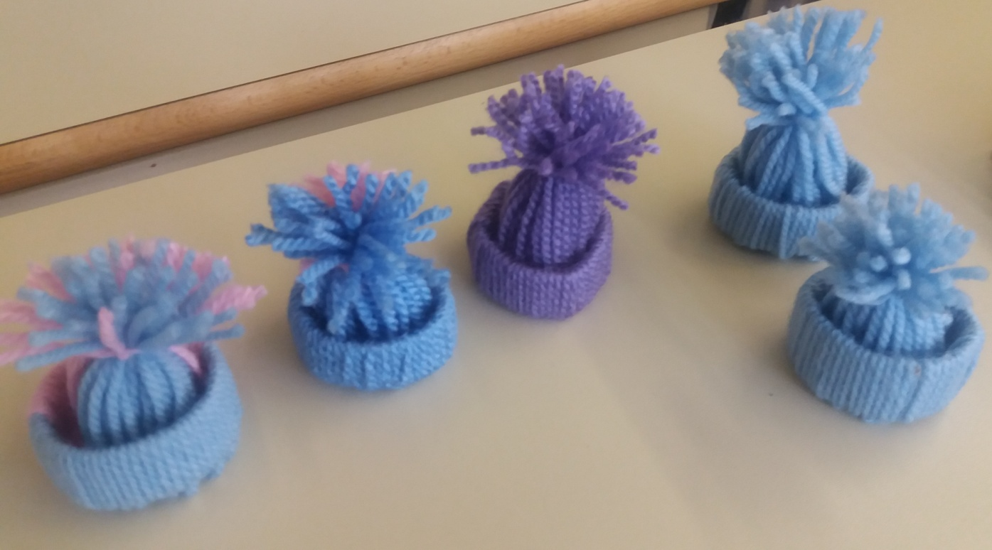
Tie the strips together to make a tassel.

Slide 8
