Slide 1
Creating with Grandparents
Tone Pavček Primary School Mirna Peč, Slovenia Class 4. b

Slide 2
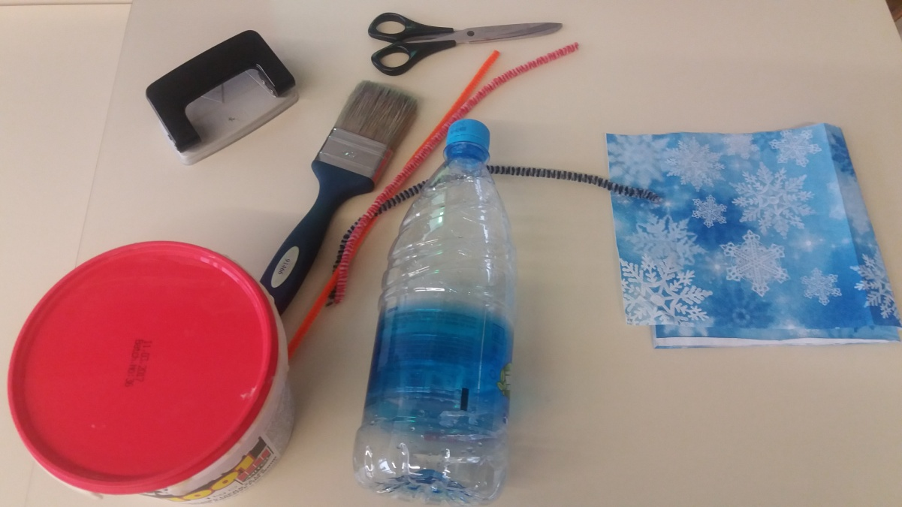
We invited our grandparents to help us create using scrap material. We made candle holders made out of water bottles.
We used:
- an empty water bottle,
- scissors,
- some glue,
a napkin,
chenille wire,
a brush,
hole puncher

Slide 3
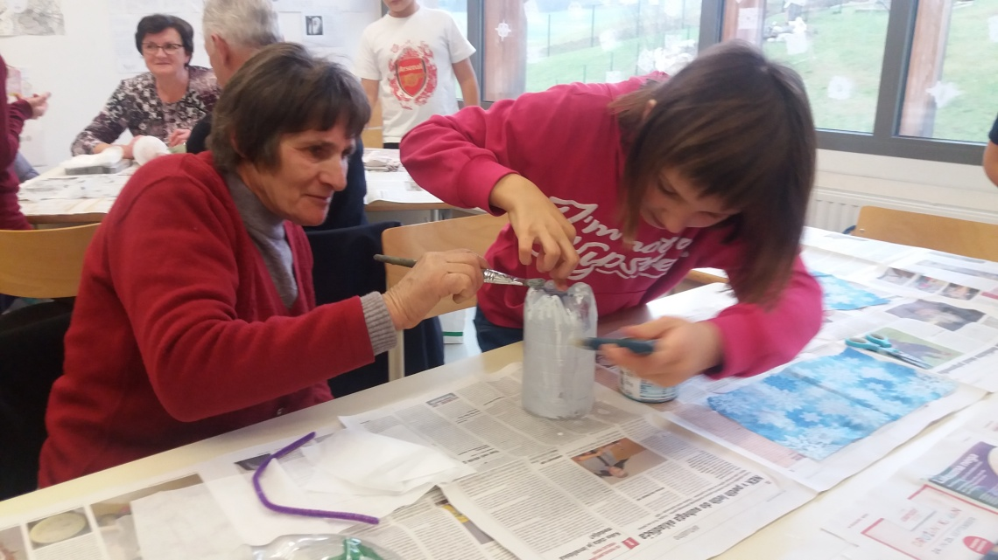
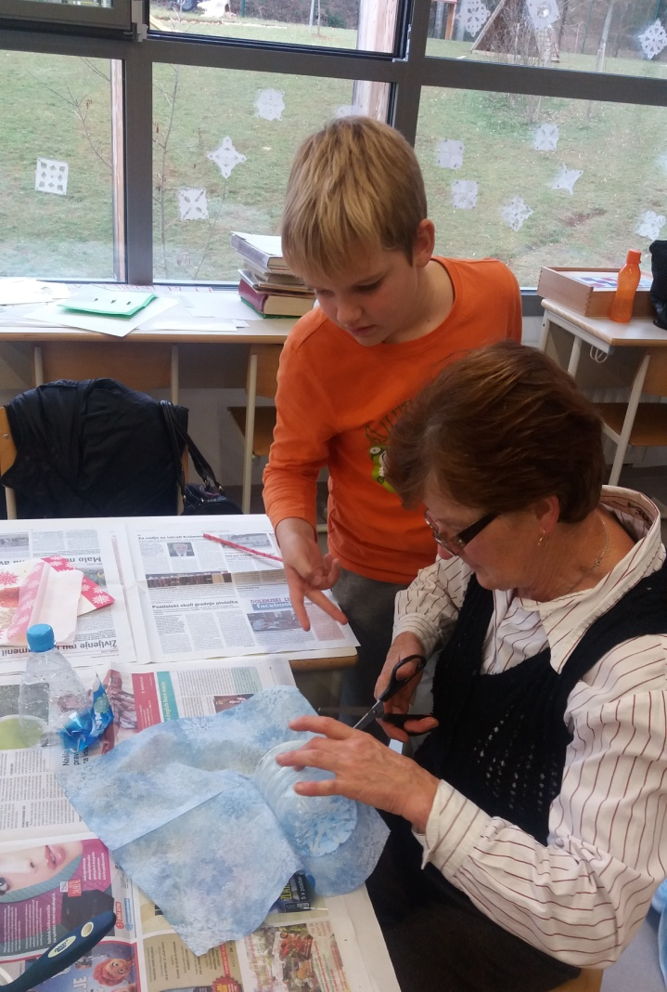
Cut off the bottle‘s bottom (about 10 cm high). Apply glue all over the bottom part using a brush. Stick the napkin on it (best if it‘s Christmas themed).

Slide 4
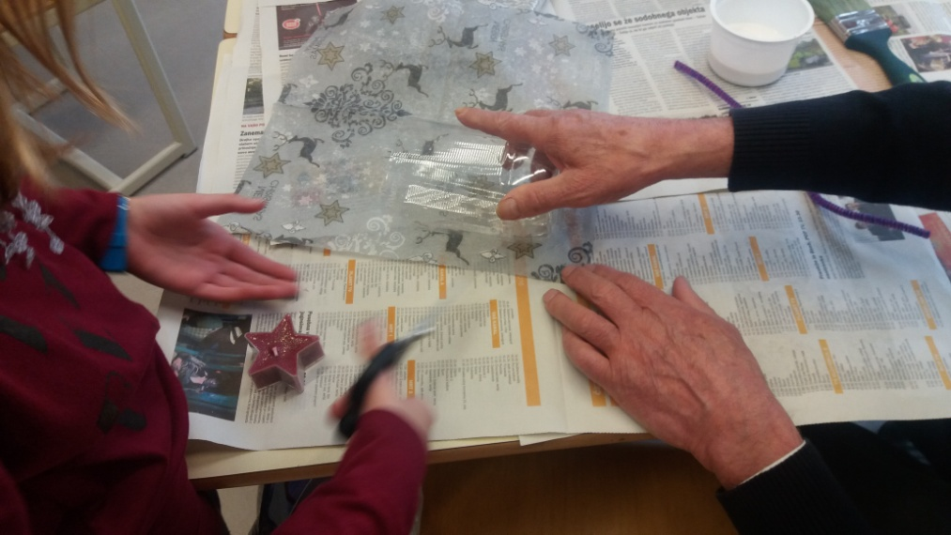
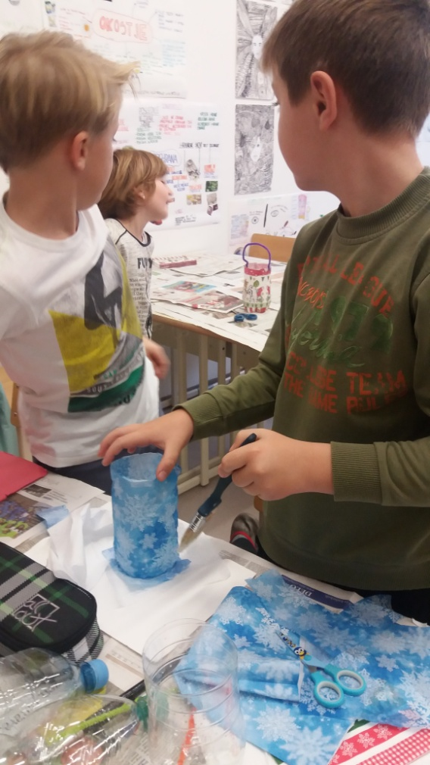
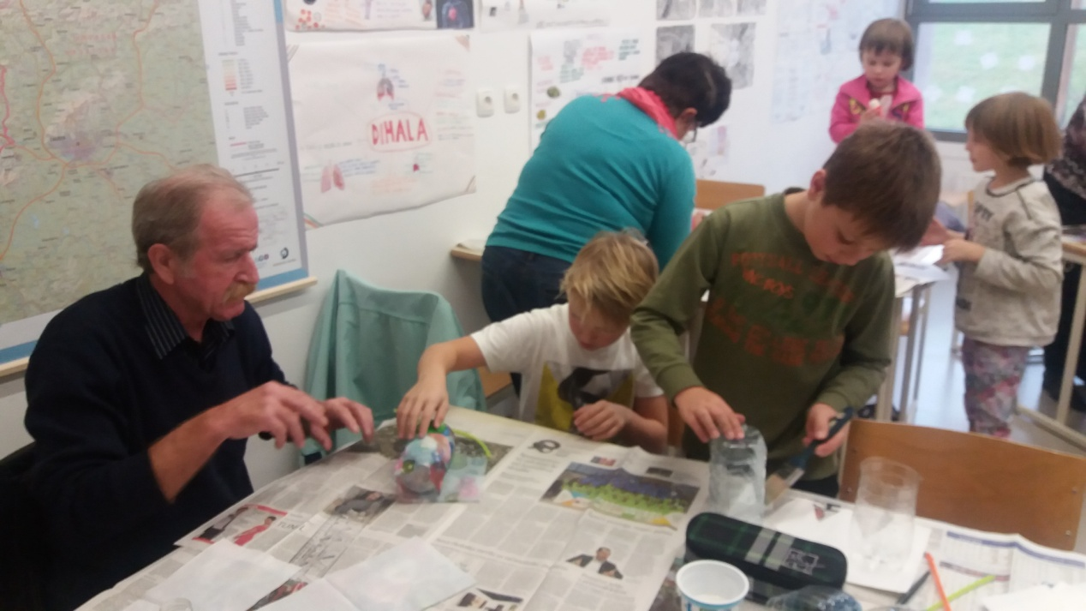

Slide 5
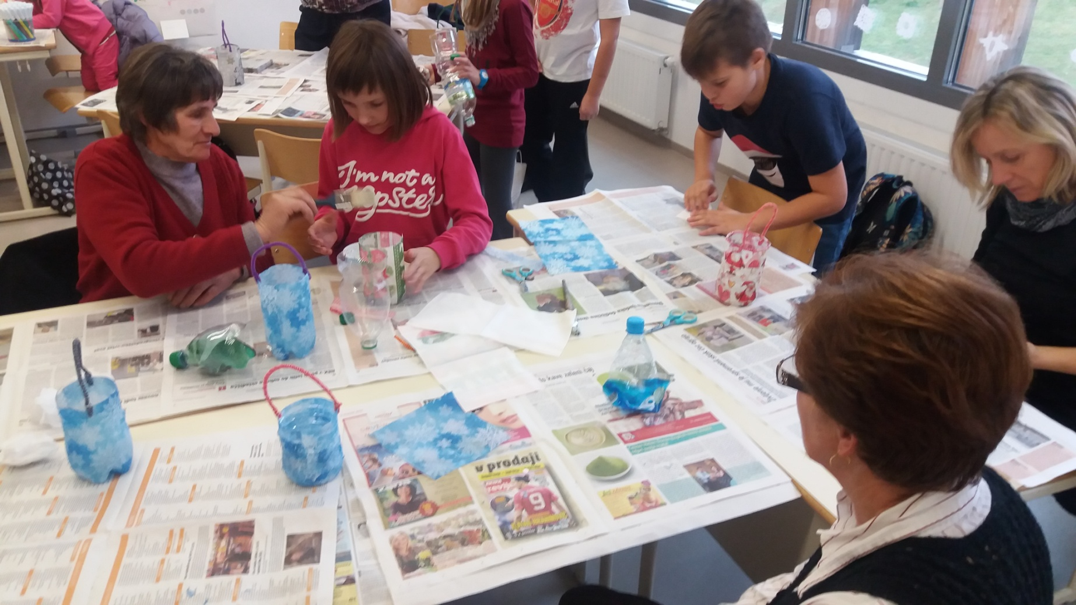

Slide 6
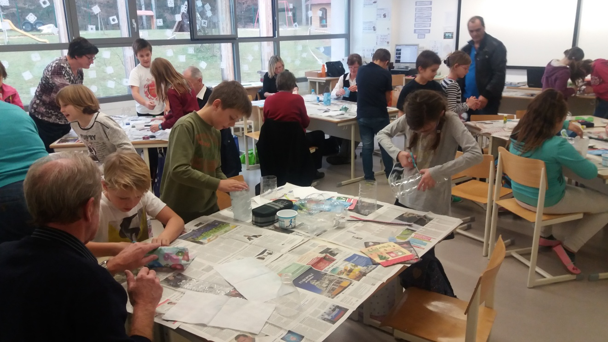
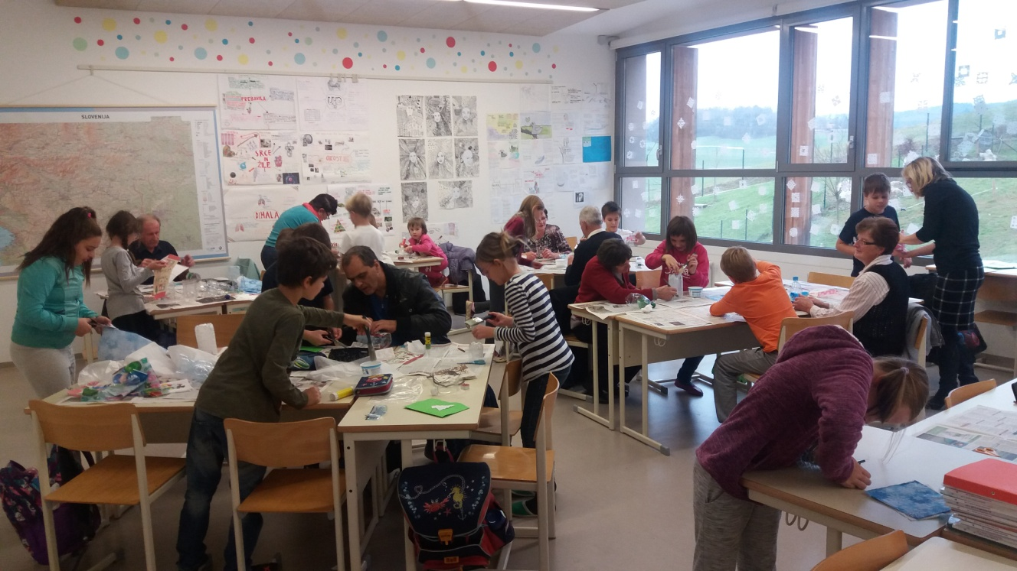

Slide 7
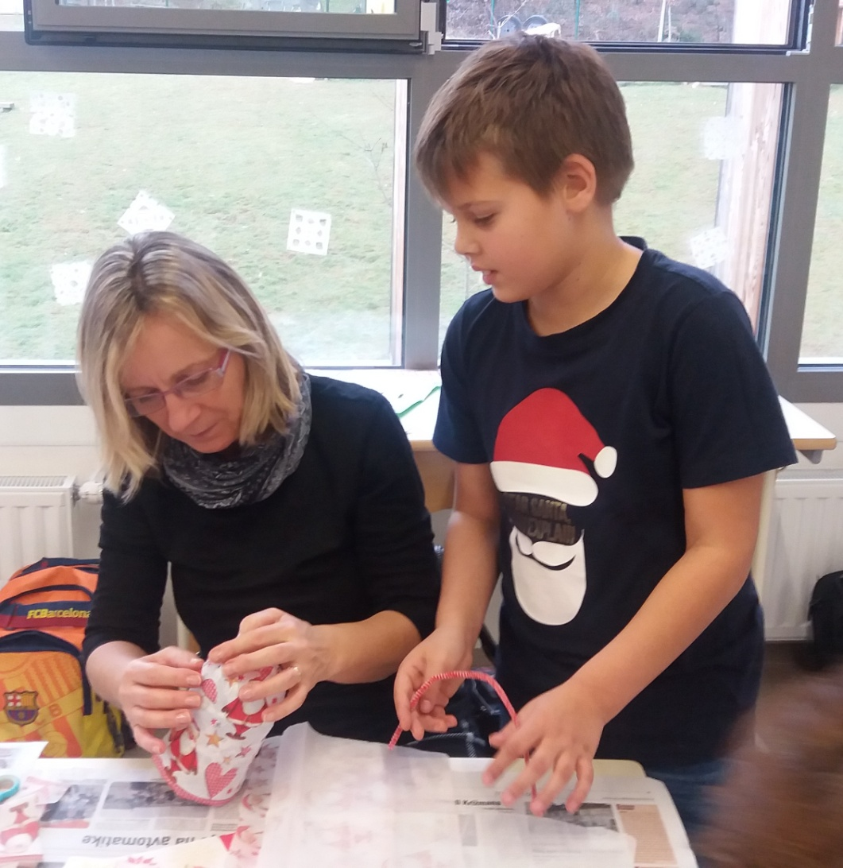
Use a hole puncher to make two holes on the upper border, through which you put chenille wire (used as a handle). Last, put a candle in the candle holder.

Slide 8
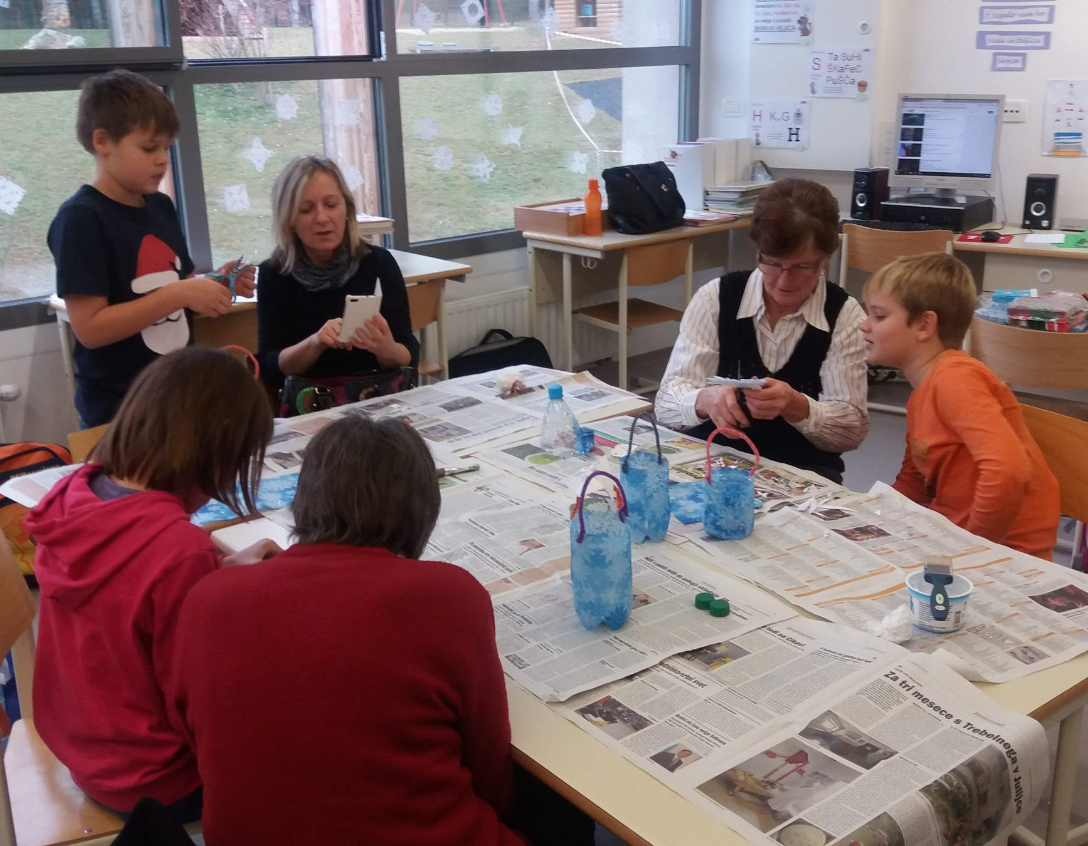

Slide 9
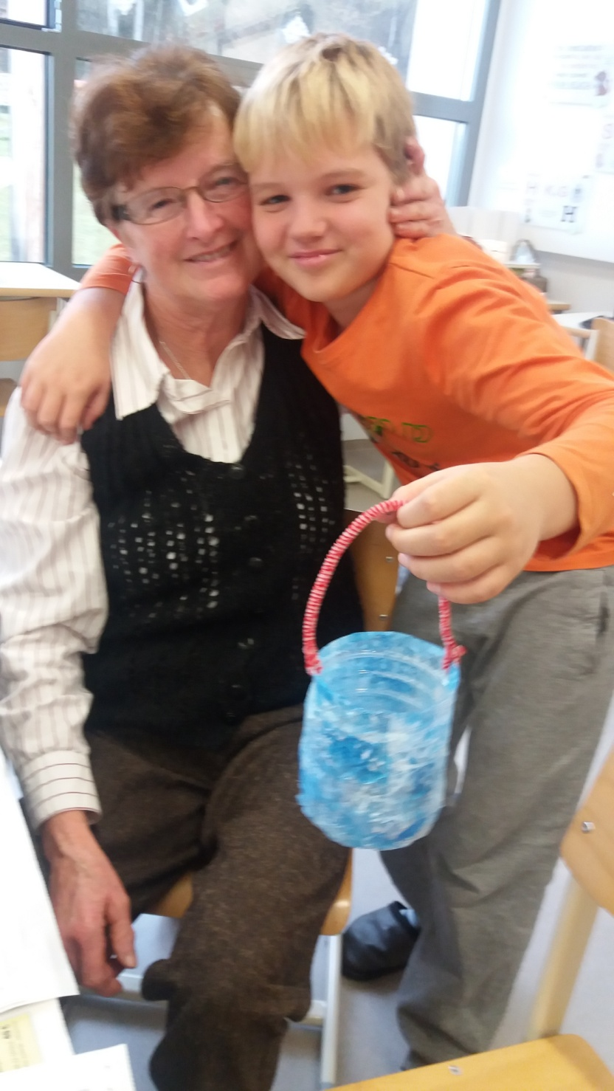
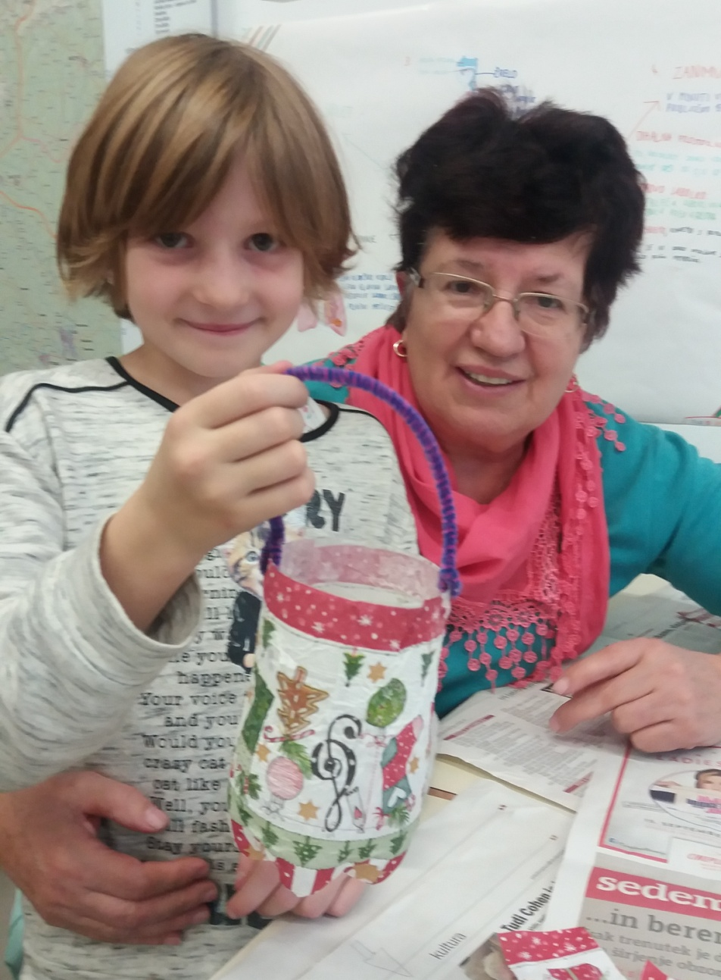

Slide 10
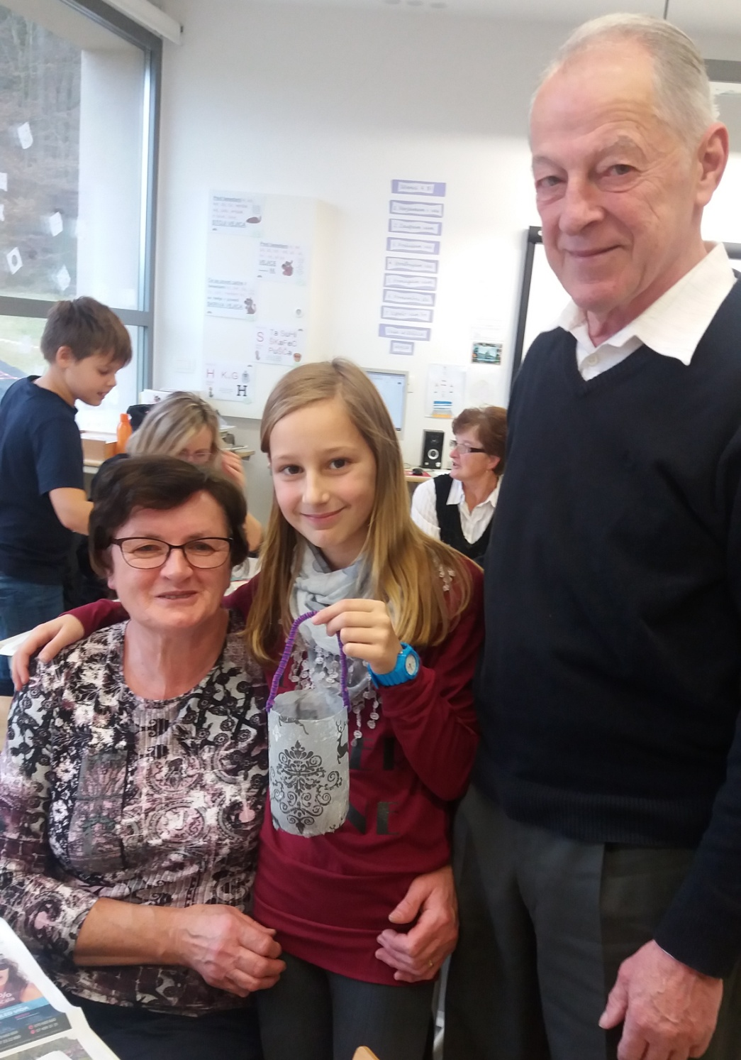
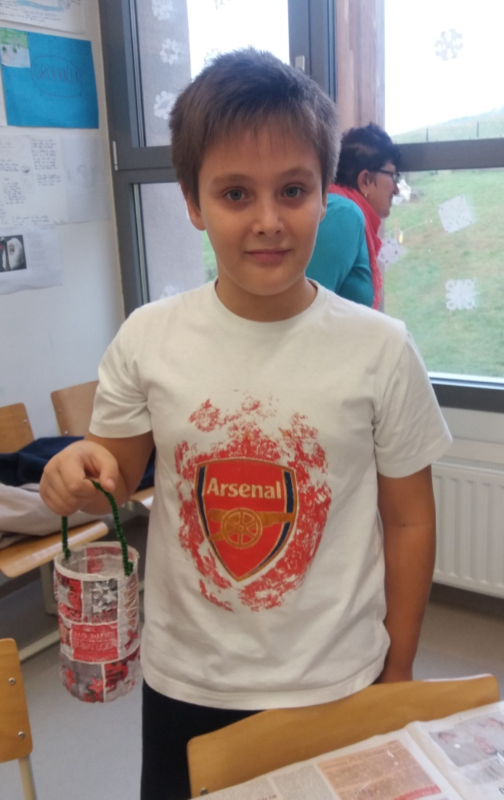

Slide 11
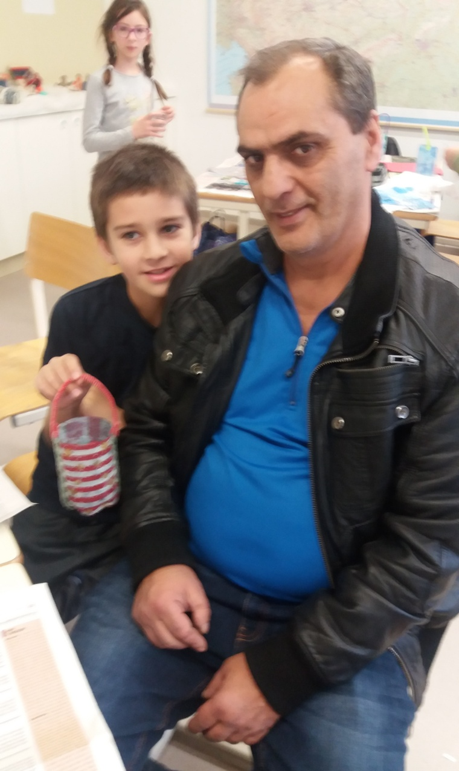
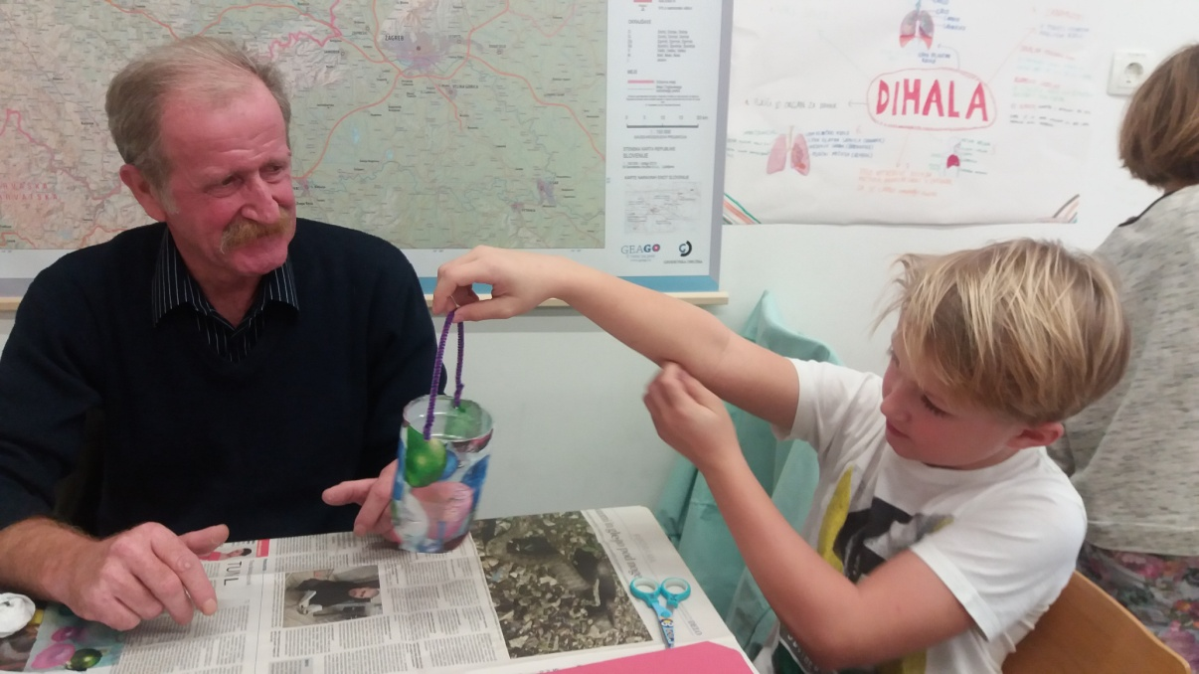

Slide 12
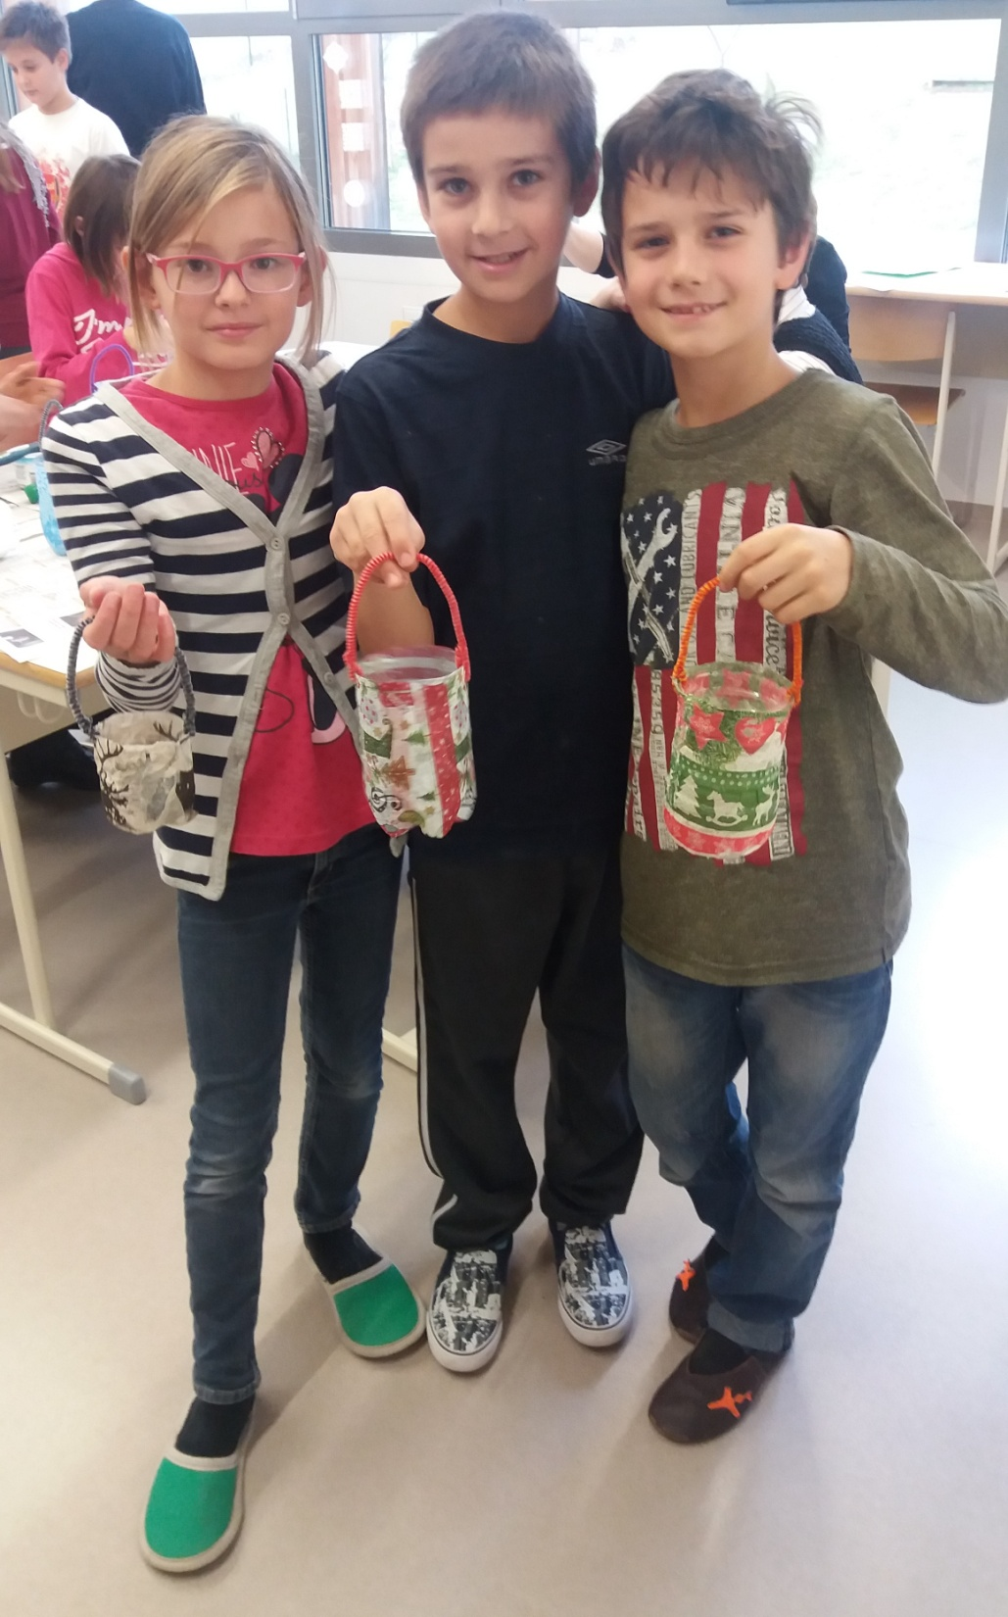

Slide 13
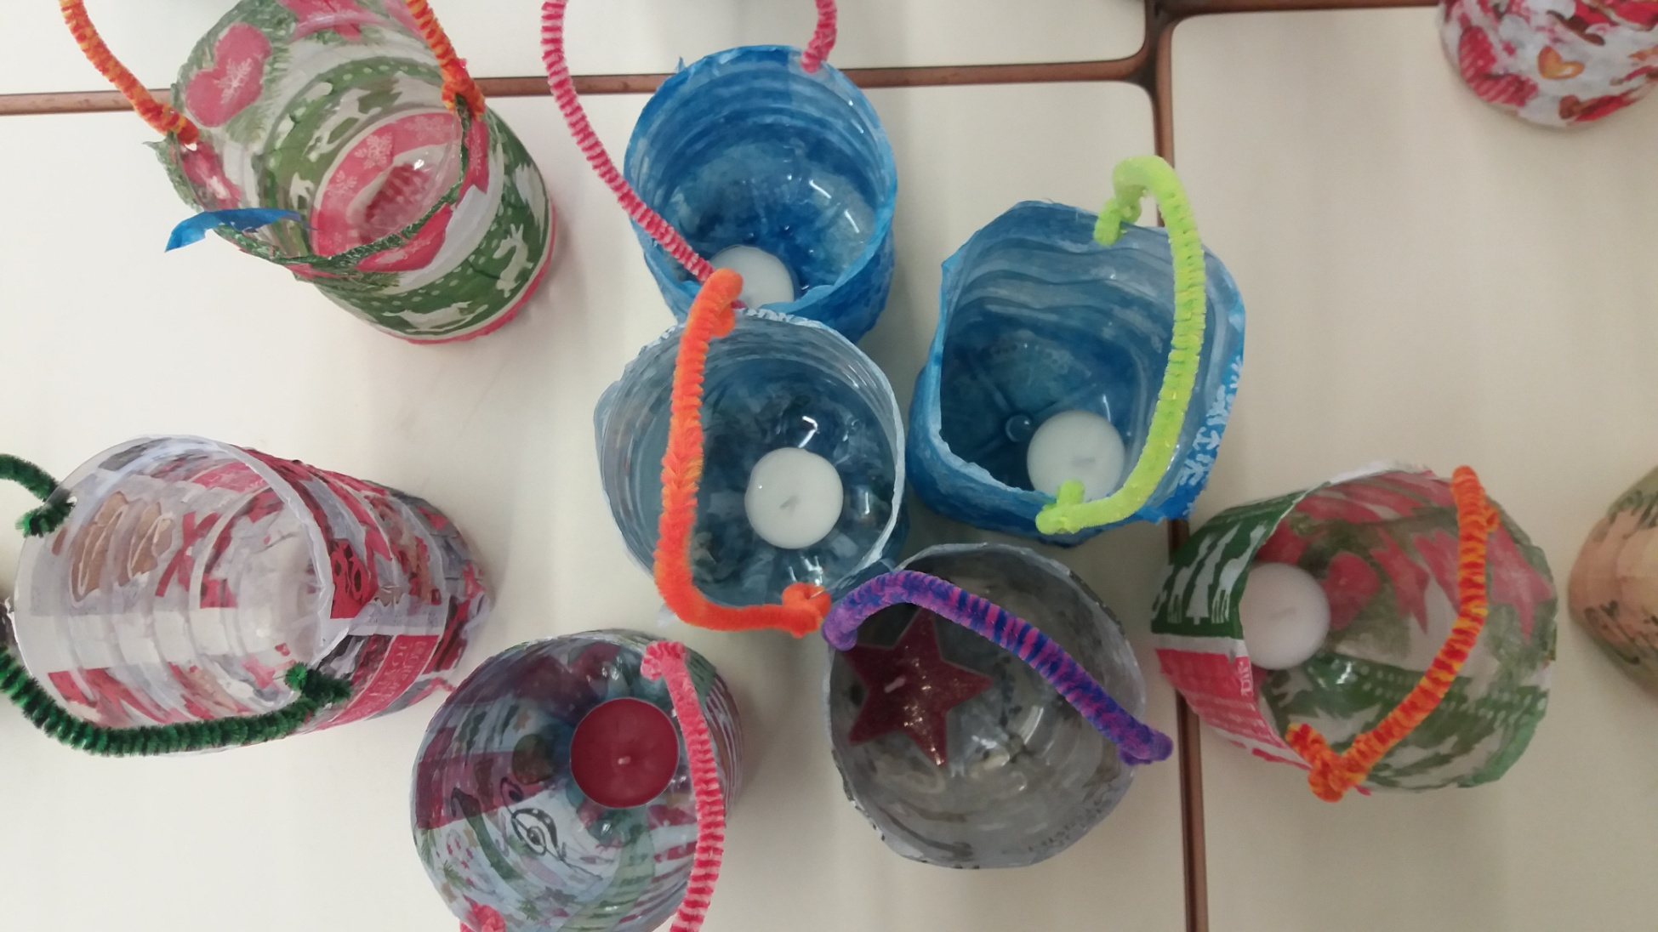

Slide 14
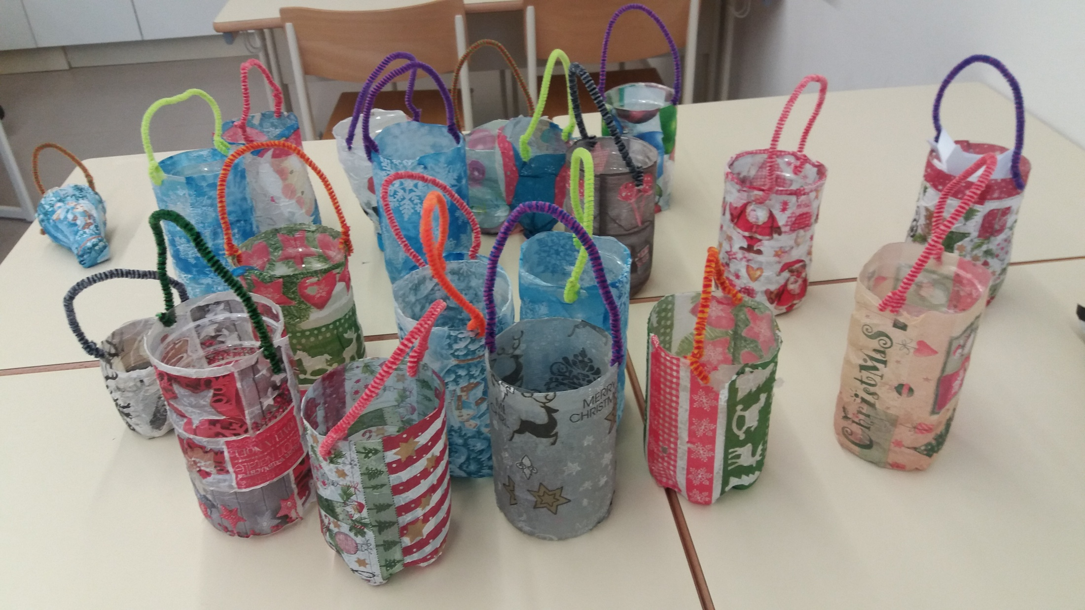

Slide 15
