Slide 1
Bracelets made of old jeans
Tone Pavček Primary School Mirna Peč, Slovenia Recycling Club

Slide 2
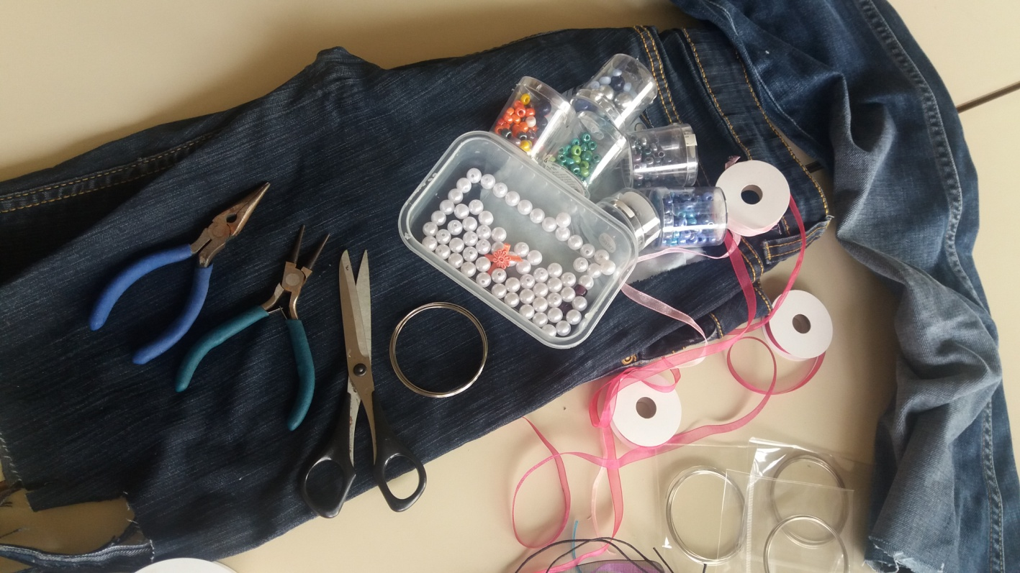
Materials:
old jeans,
scissors,
memory wire
pliers for jewellery making
lace, beads, organza ribbon…

Slide 3
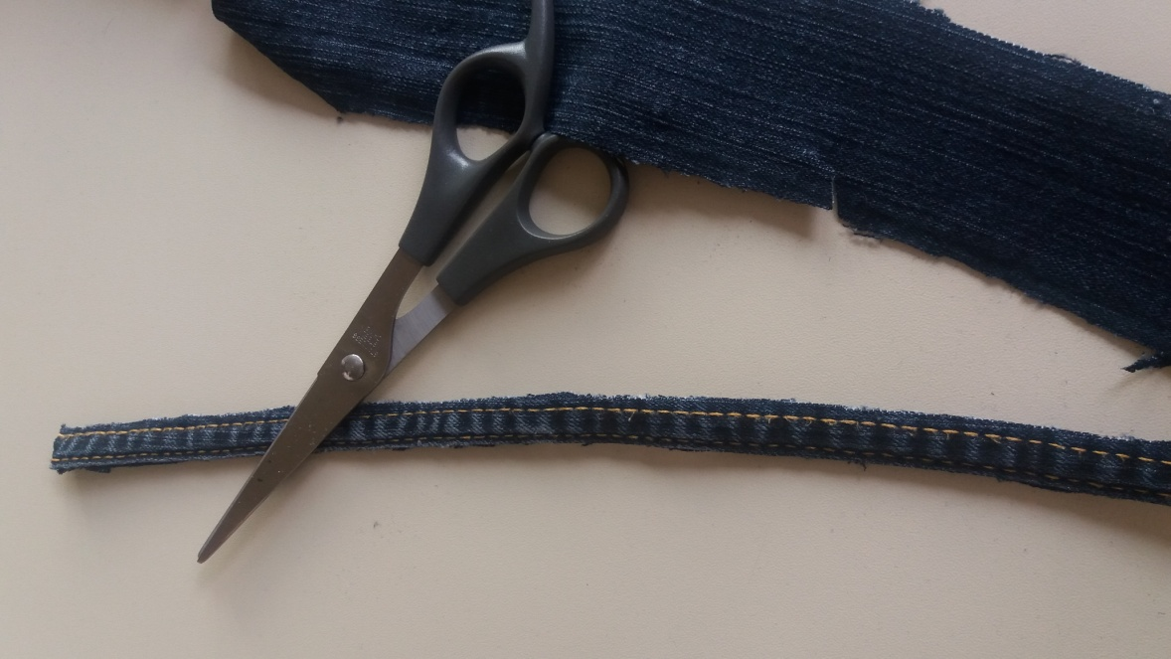
Cut about 15 cm of the jeans' trim.

Slide 4
Use pliers for jewelry making to cut memory wire in the size of your wrist.

Slide 5
Put the wire through the trim.

Slide 6
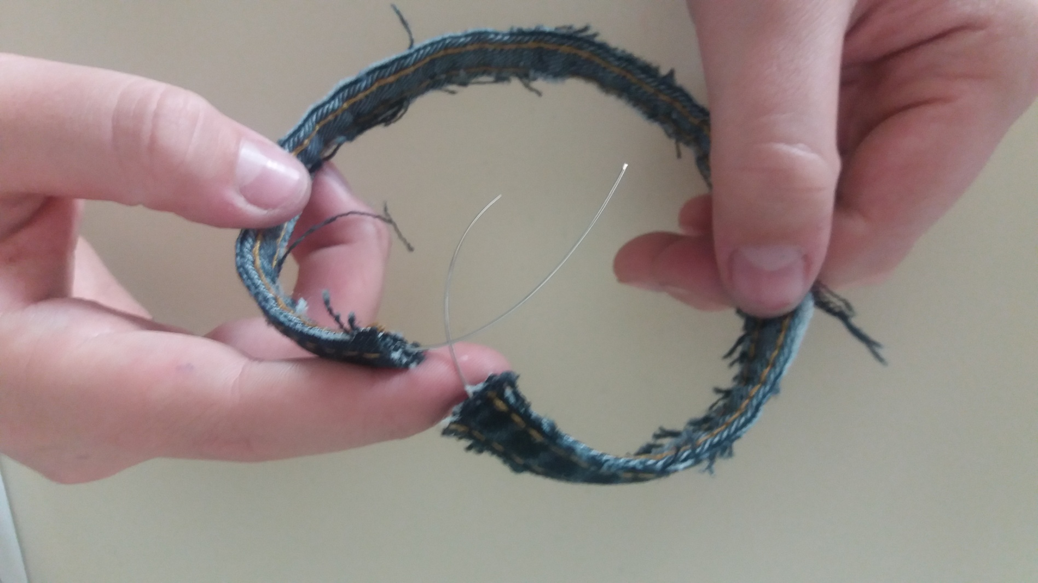

Slide 7
String beads on both ends of the wire. Use pliers to make a semicircular closure.

Slide 8
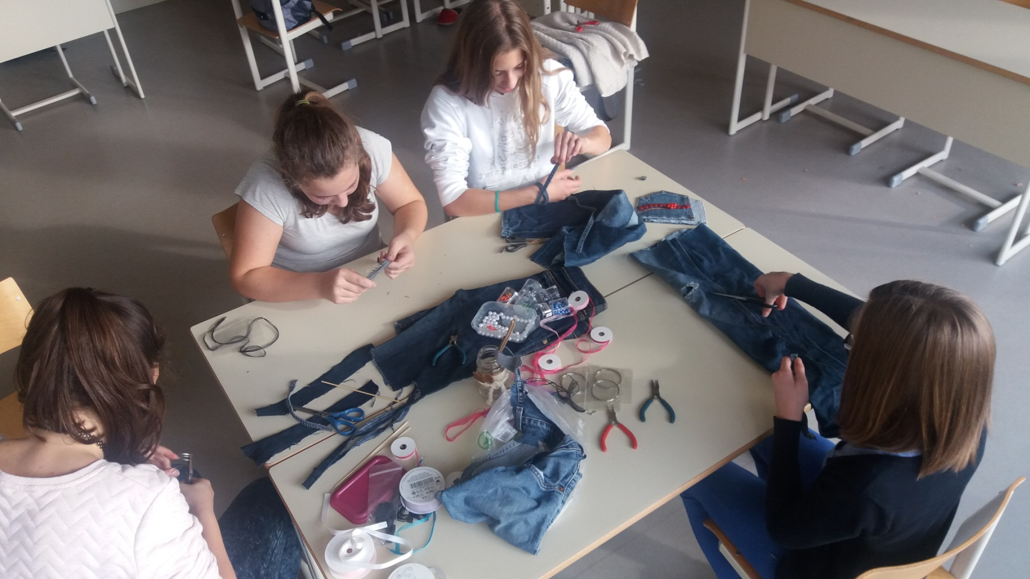

Slide 9
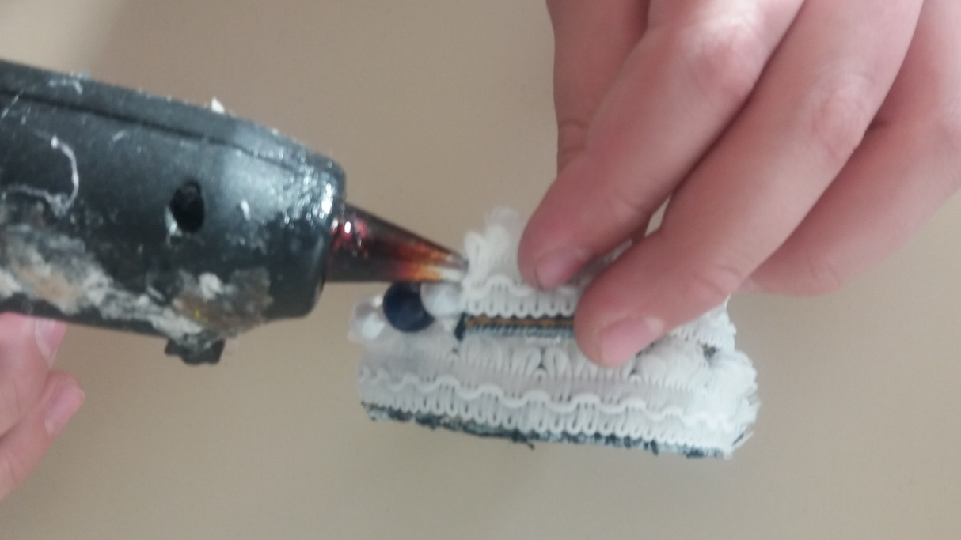
Optional: glue lace on the bracelet.

Slide 11
You can also make the bracelet by tying 10 cm long and 1 cm wide strips from old jeans onto the memory wire, which you can then decorate with beads or organza ribbon.

Slide 12
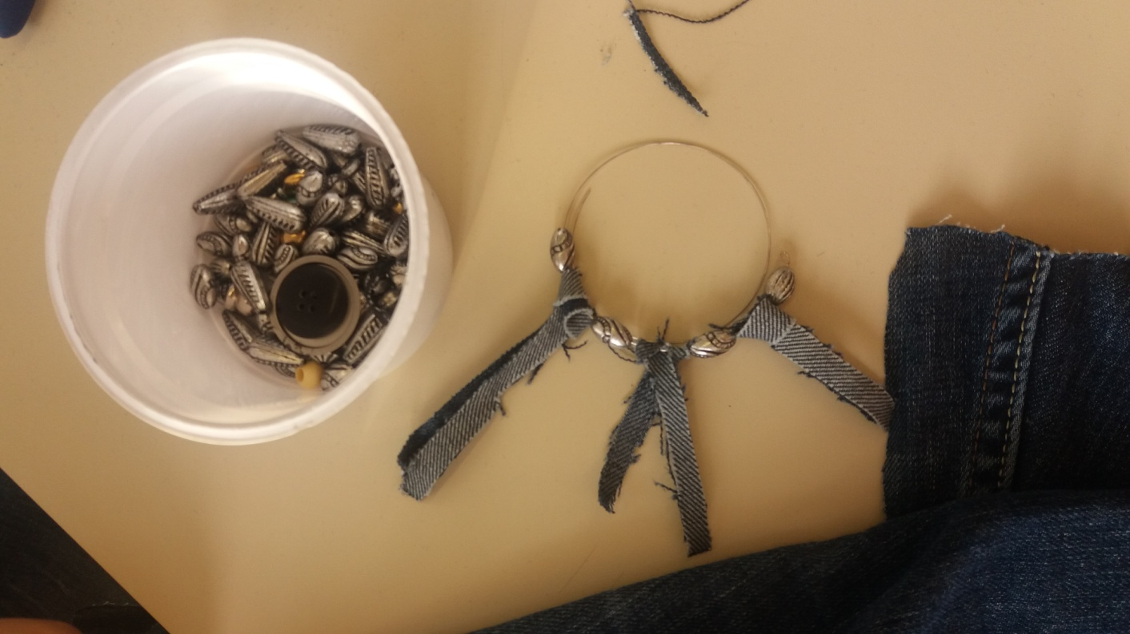

Slide 13
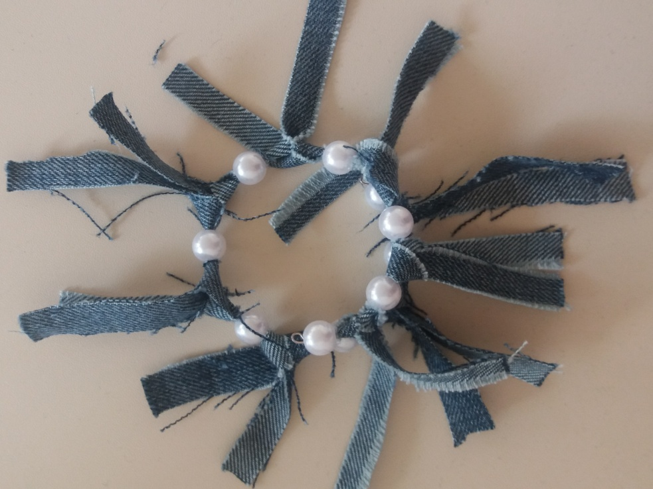
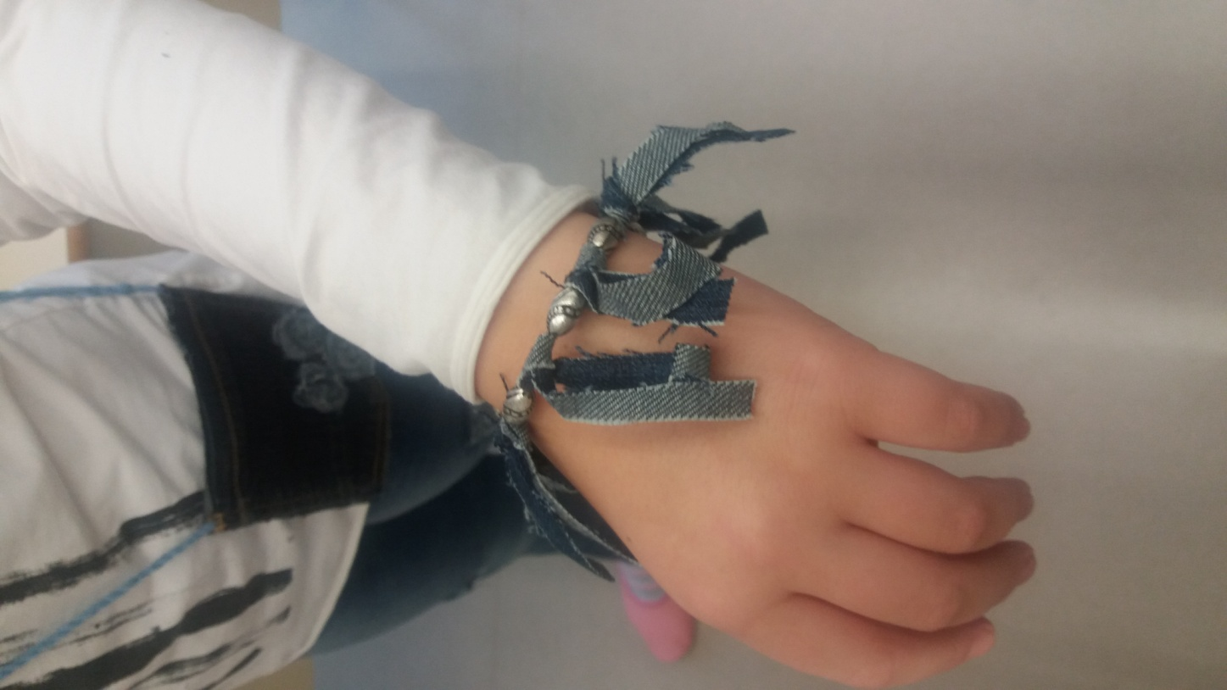

Slide 14
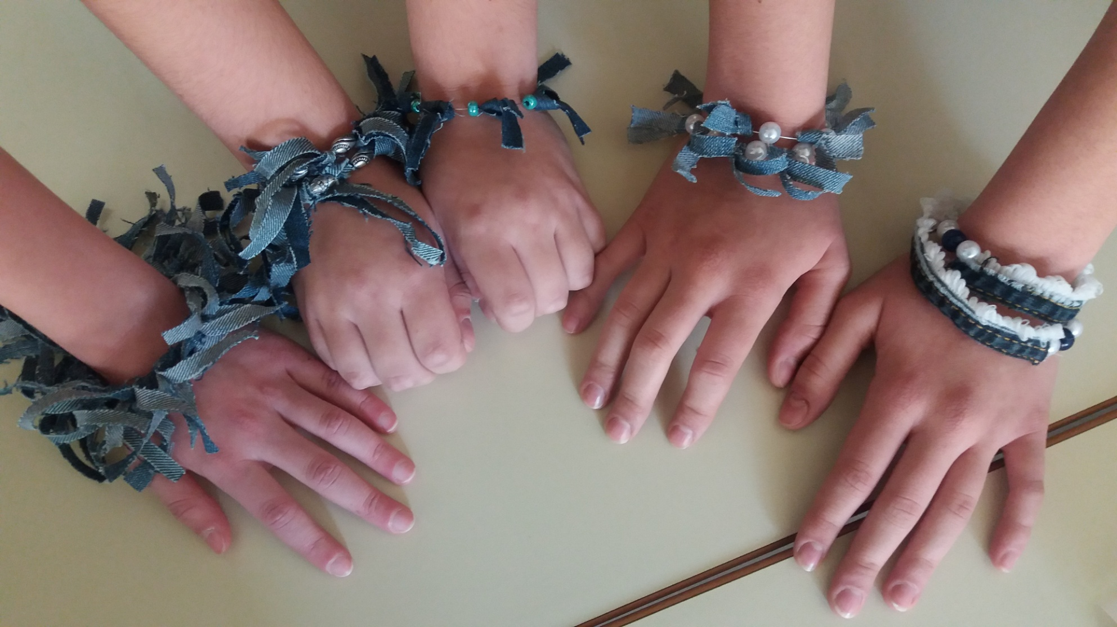

Slide 15
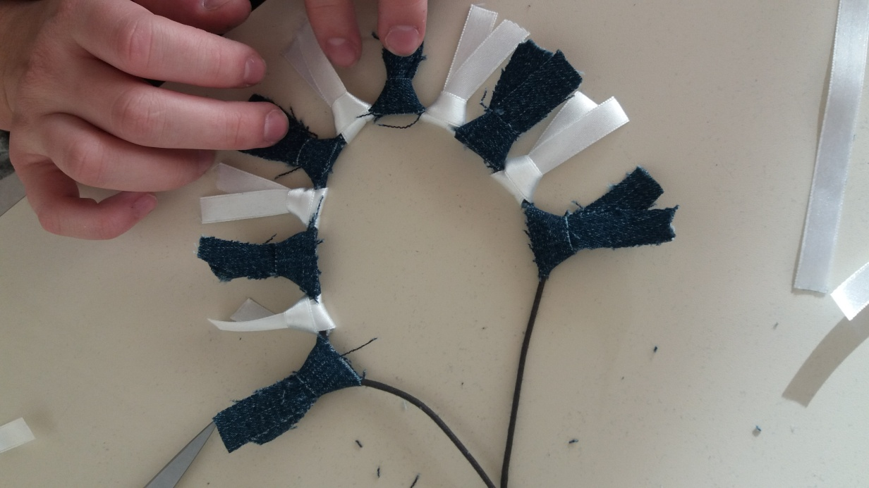
The process also works for necklaces.

