Slide 1
Pictures made of old jeans and fabric leftovers

Slide 2
You need:

Slide 3
Draw the wanted motive on the jeans and cut it out.

Slide 4
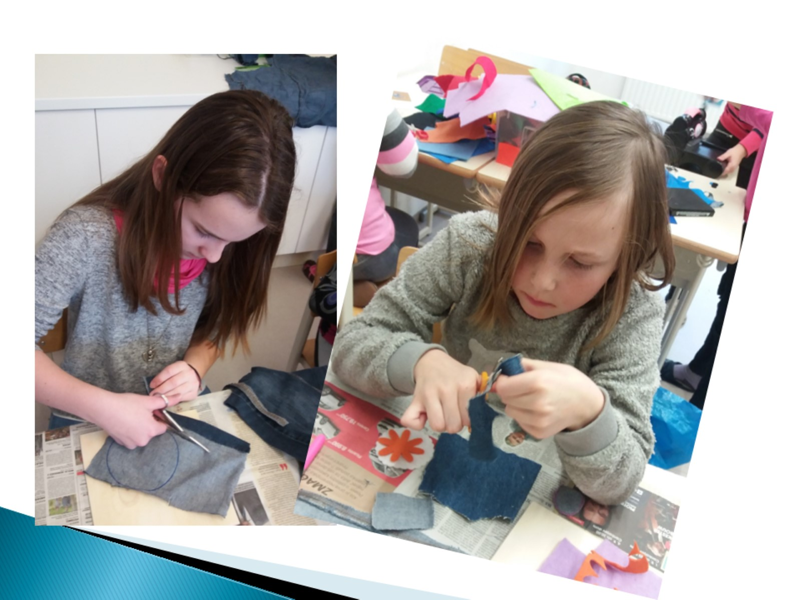

Slide 5
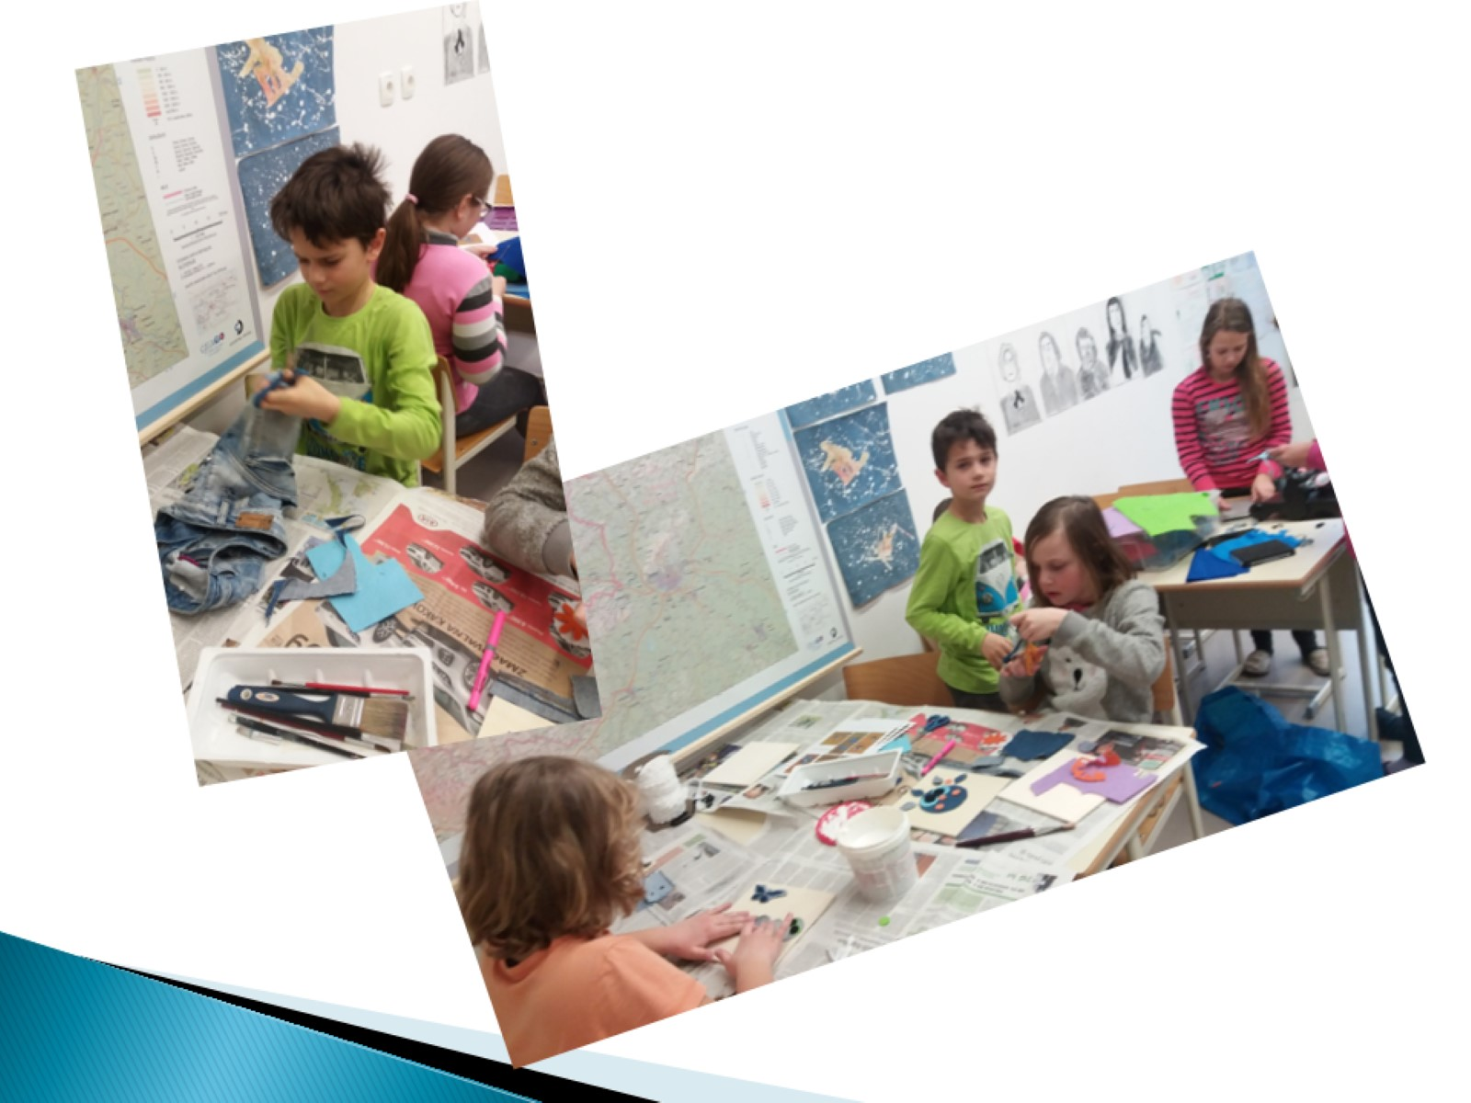

Slide 6
Stick the fabric on the wooden board.

Slide 9
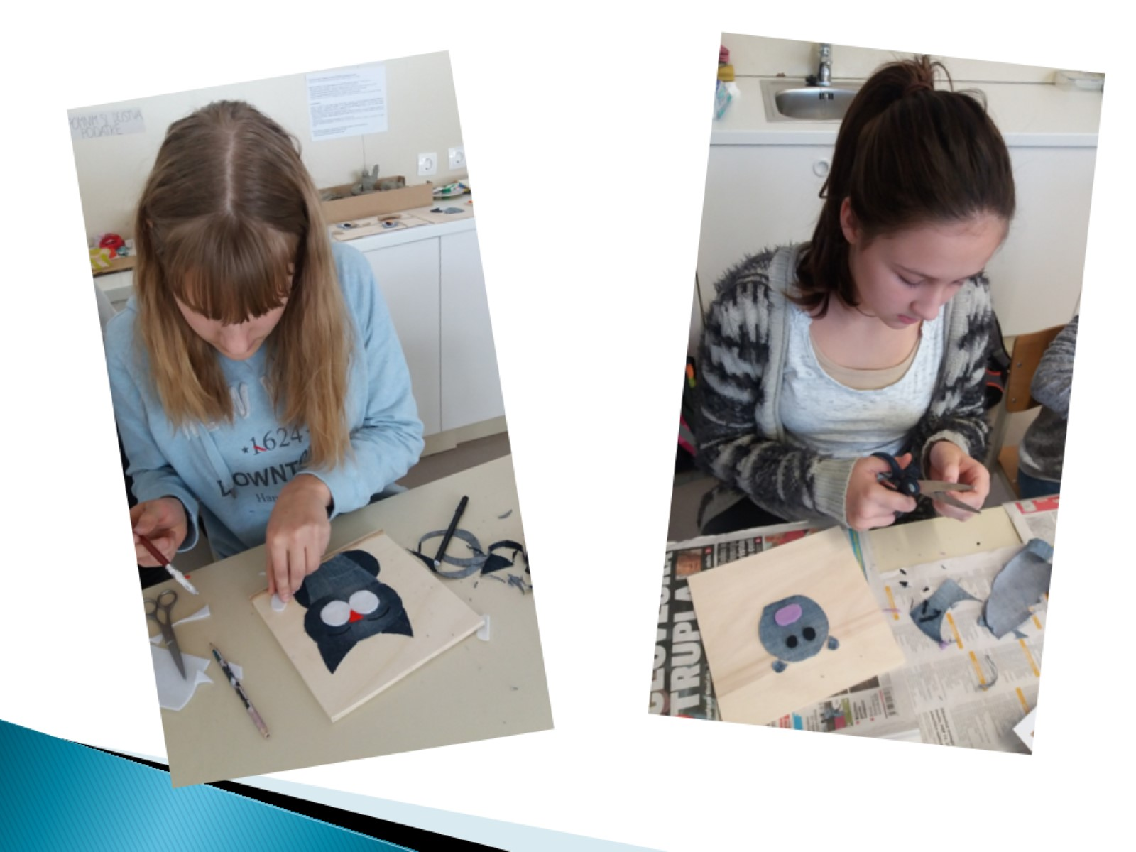

Slide 10
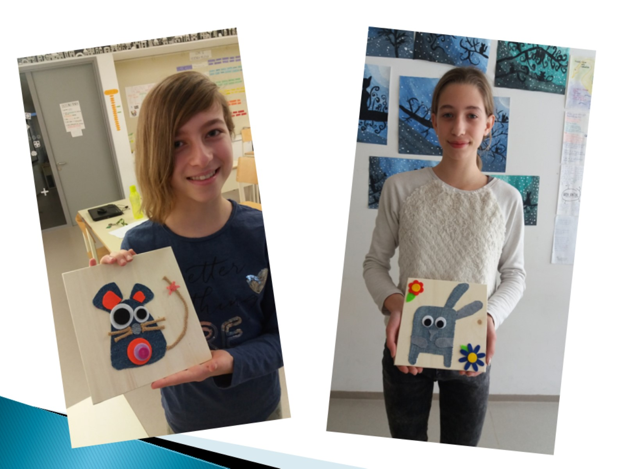

Slide 11
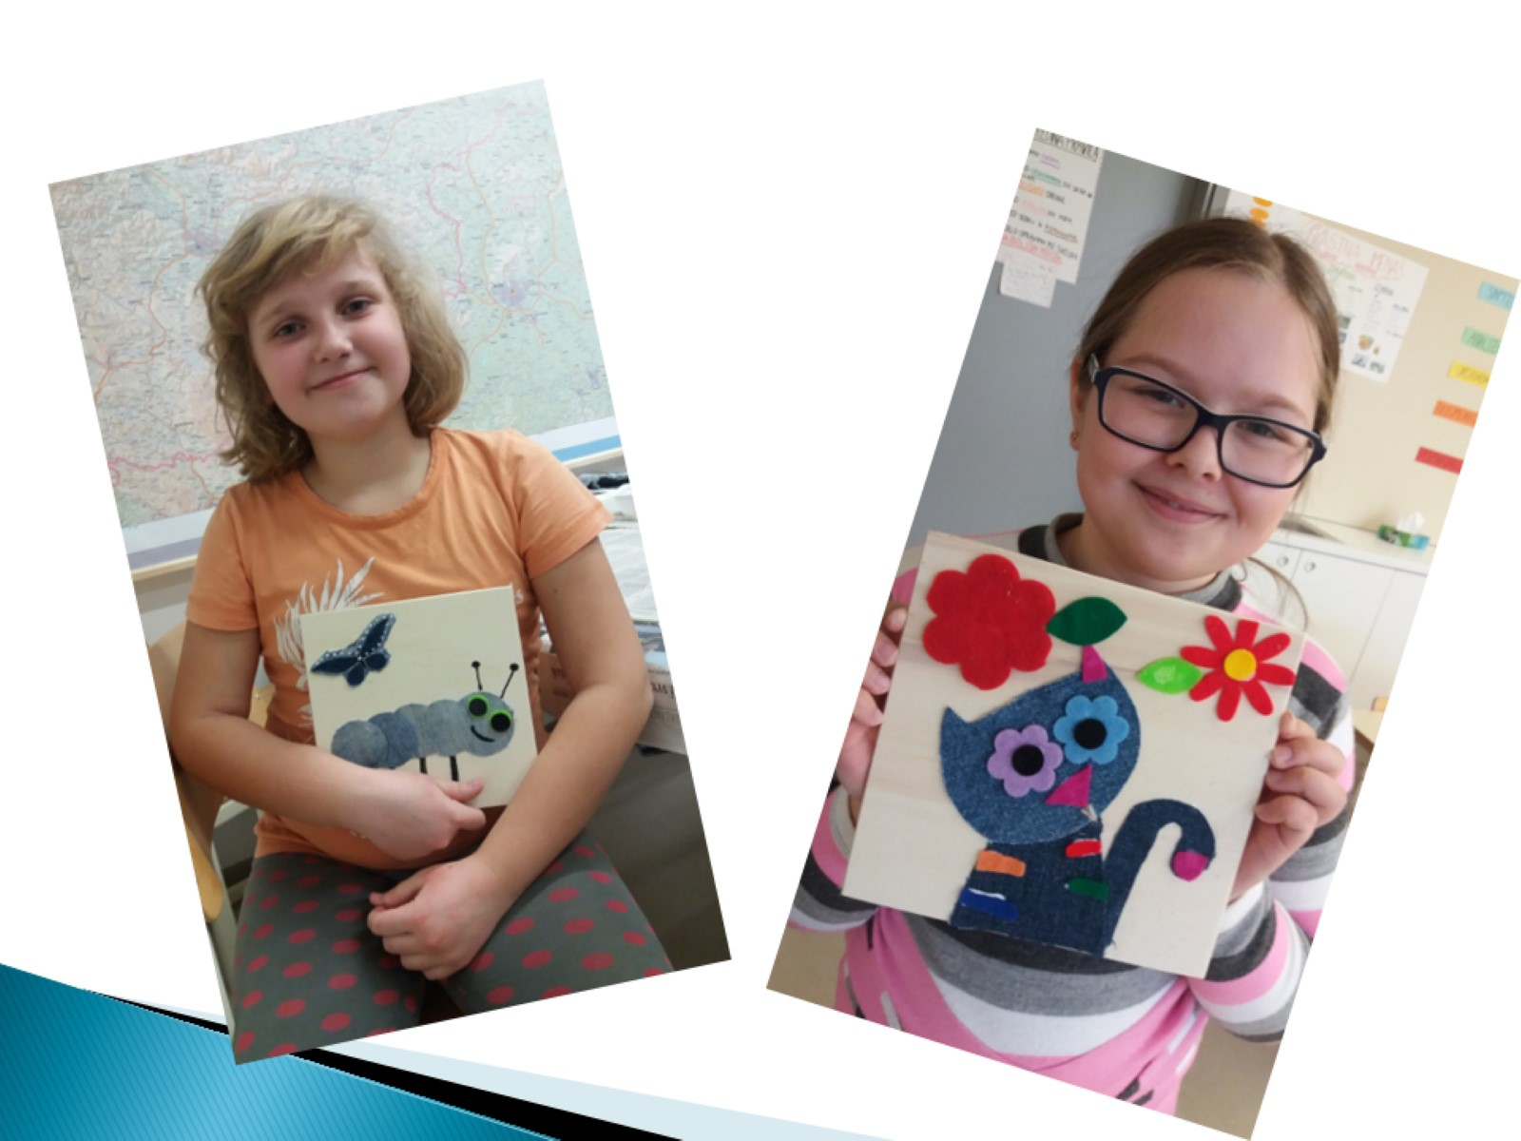

Slide 13
You can hang the pictures on your wall.

