Slide 1
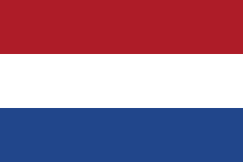
Water presentation the netherlands
Sluice, deltaworks and dikes

Slide 2
Old locks how are locks together? New sluice old en new

Slide 3
why we have sluices?
There are different types of sluices with each their own function. What all the sluices mean in common is that they hold water. The most famous type of lock is the sluice. This works like a kind of lift. On one side of the sluice-gate the water is always higher than on the other side of the sluice. A boat that sail into the sluice can be dropped by running water out of the sluice. Or they let the boat rise by running water into the sluice. When the boat comes out of the sluice, he can go on again.

Slide 4
We make a lot of use in the Netherlands of inland waterway transport by ships. To ensure that transportation is as smooth as possible, we use channels and sluices.

Slide 5
look this is the sluice closed to use It is 5 kilometers from us, Boxmeer

Slide 6
how do sluice work
The locking doors open so that the ship can enter.
The locking doors close behind the ship.
The baffles, which are in the front doors or the locking walls, open themselves.
The water runs in or out of the sluice due to the difference in pressure on the different sides of the sluice doors.
When the water level is equal, the front doors open and the ship can continue his way

Slide 7
The delta works
The delta works are a defense system, in the Netherlands, to protect the country against high tide of the sea, especially the province of Zeeland, The south of southern Holland and north brabant.
The Delta works have been built a long time ago. The project started in 1957 and was completed by the completion of the oosterscheldekering (1986), the maaslandering (in 1997) and after the completion of the increase of all dikes to delta height the Haarlingse Keerdam, in August 2010.
The original plan for the construction of the Delta works contained The works in Zeeland, South of South Holland and North Brabant. This part of the Delta works, especially the Oosterscheldekering and the Meuse Landing, still attracts international attention.

Slide 8
Delta works in the south-west of the Netherlands

Slide 9
Reason for the delta works
Although the Deltaplan was thought by John van Veen before the Water Disaster Disaster in 1953, this event gave rise to shortening the Dutch coast by about 700 kilometers by constructing closed and permeable dams between the South Holland and Zeeland Islands. In this way only the dikes to the west of the country had to be increased and strengthened, and could remain intact inland

Slide 10
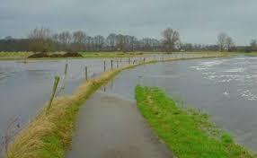
Water safety
About 60% of the netherlands is so low, below sea level, that it is vulnerable to floods
nine milion people live in areas that can be flood by the great rivers or large by the sea
Flood in 1995 in Boxmeer

Slide 11
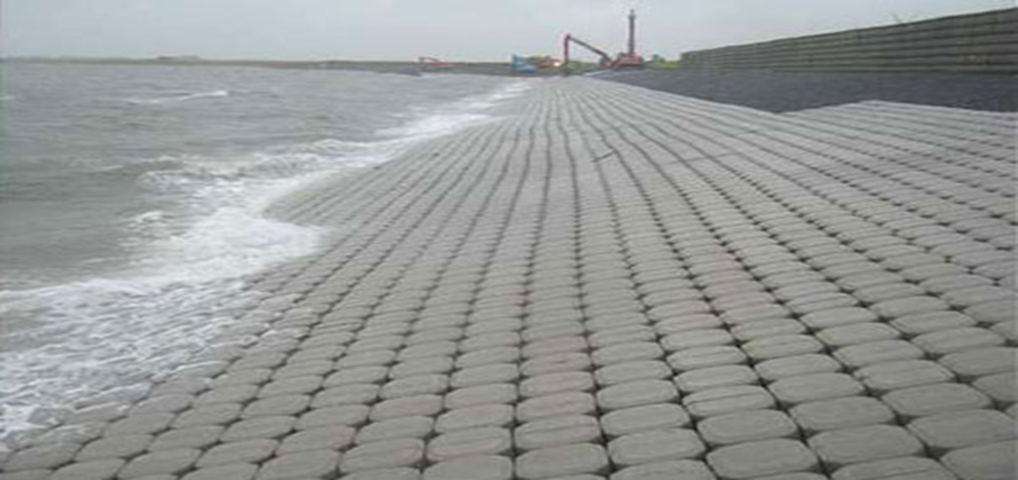
dike depression
For dykes the lining must be replaced over time depending on the type of lining and the load that the denses will wear when the liner is damaged too much easier water can flow

Slide 12
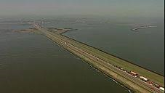
Netherlands editing
About 1000 years ago the coast of the netherlands and belgium was covered from a wide row of dunes. here and there seawater behind the dune row created a swamp landscape consisting of wet clay

Slide 13
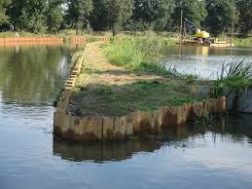
Sheet walls
Dikes can be re-inforced by a sheet pile which makes them more waterproof
the dam walls also make the dike more stable

Slide 14
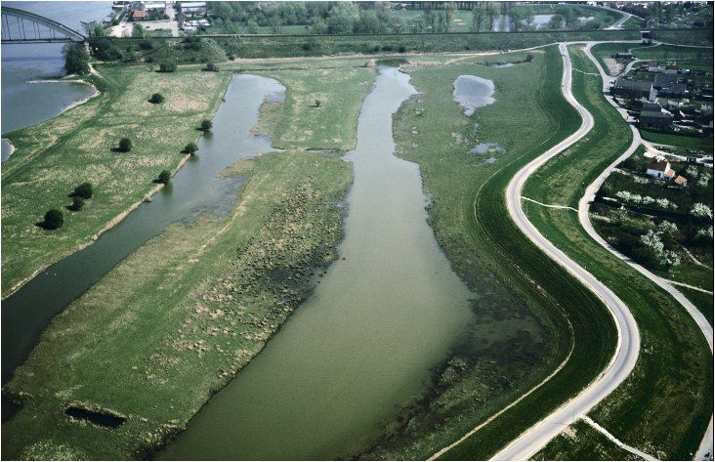
Landscape
Due to the construction of dikes there are special landscapes
Water is often seen as characteristic and cultural history important landscape element

Slide 15
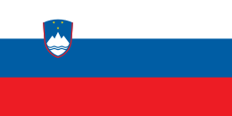
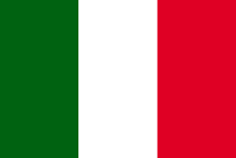
the end ,konec fine ,beigas ,koniec ,einde

