Slide 1

Handicraft
ECO ACTIV

Slide 2
Materials

Slide 3
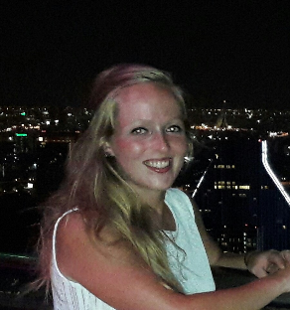
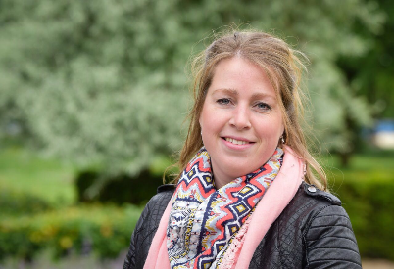
Introduction of the teachers
Imke Kosman
Maaike Simons

Slide 4
Welcome
Hello students,
Today we are going to make flowers free materials. We wish you all a lot of fun.
If you have any questions ask us for help.

Slide 5
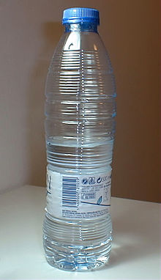
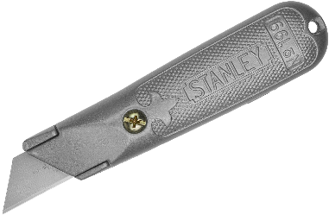
Explanation
Step 1
cutting out the bottle gently in half.

Slide 6
Explanation
Step 2
2. Make the half bottle onto the cardboard.

Slide 7
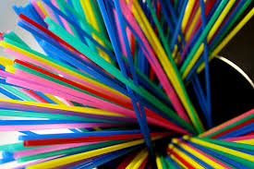
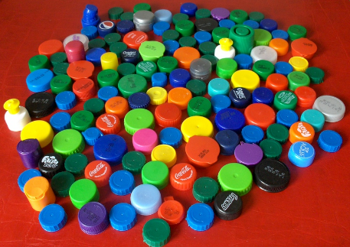
Explanation
Step 3
3. Make the straws and plastic caps flowers.

Slide 8
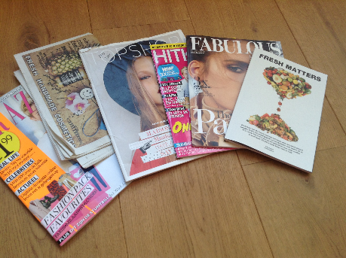
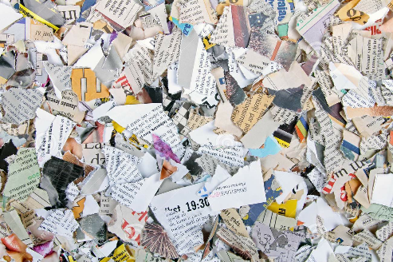
Explanation
Step 4
4. Tear magazines into pieces. Take leaves from here.

Slide 9
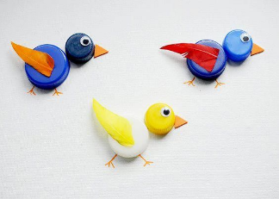
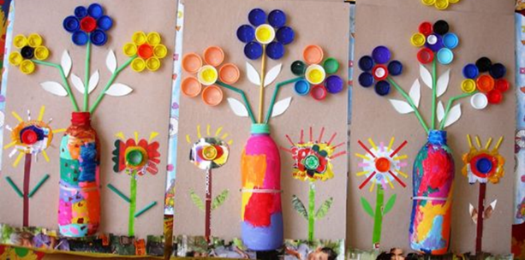
Result

