Slide 1
Healthy lifestyle
By: Oliwia Bielec 6e
Enjoy!

Slide 2
Why it is so important?
Healthy lifestyle is very important for our body, because this makes we feel great and have lots of energy.

Slide 3
Rules of healthy eating
Drink about 1,5 l. of water, becouse our body need it for correct existence.
1,5 l.

Slide 4
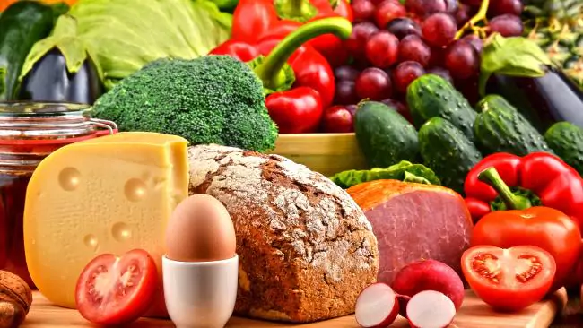
Rules of healthy eating
Eat 5 little meals for a day, then digestion is better.
Cut down on fatty food

Slide 5
Rules of healthy life
Do the sports.
Jogging
Swimming
Going for a walk
Riding a bike
Going to the gym
Hiking

Slide 6
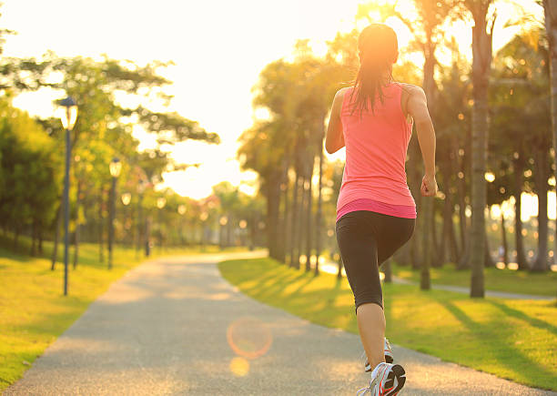
Jogging

Slide 7
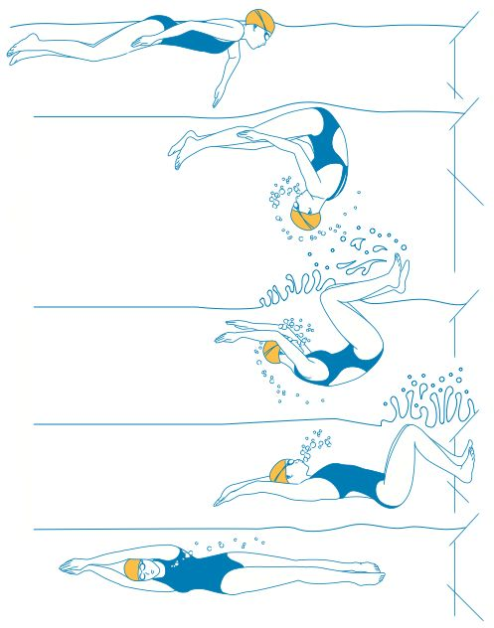
Swimming

Slide 8
GOING For a walk

Slide 9
Riding a bike

Slide 10
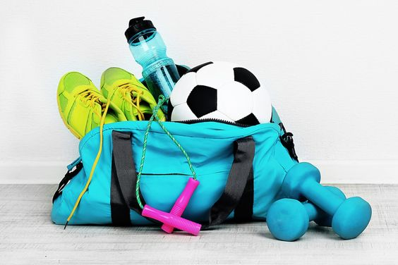
Going to the gym

Slide 11
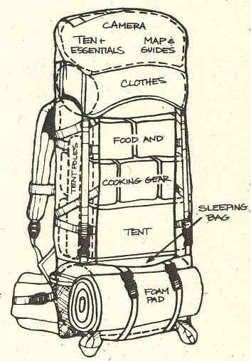
Hiking

Slide 12
And now…
Eat Healthy doesn’t mean only small… It means, you shuld eat vitamins and balanced meals:
Vegetables
Fish
Meat
Eggs
And More…

Slide 13
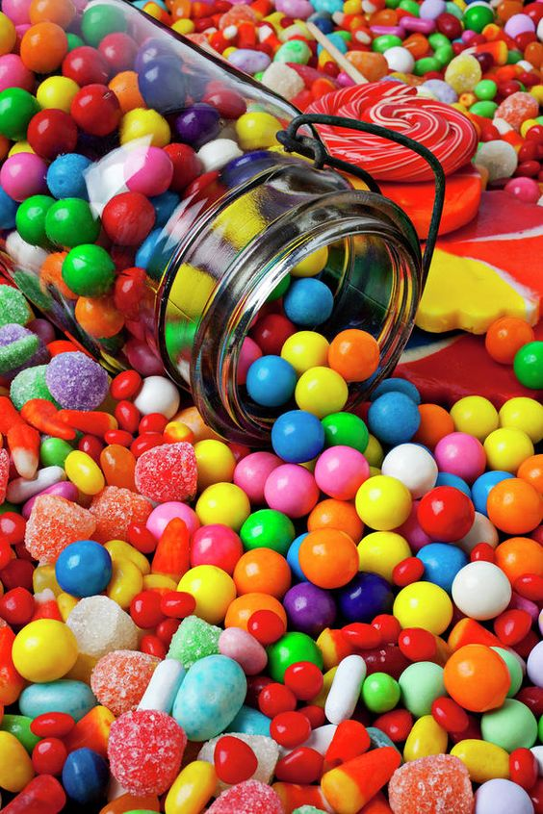
Sugar
Our organism needs sugar, but not to much! Reduce calories. We shouldn’t it a lot of sweets, becouse it puts on weight and destroys our teeth!!!

Slide 14
And what about eyes?
In statistic people every day watch television about 3-4 hours a day.
They us theire mobile phones to often, they can get canser.
To long playing computer games destroy our eyesight.

