Slide 1
Tone Pavček Primary School, Mirna Peč Recycling Club
JEWELRY MADE OF PLASTIC BOTTLES

Slide 2
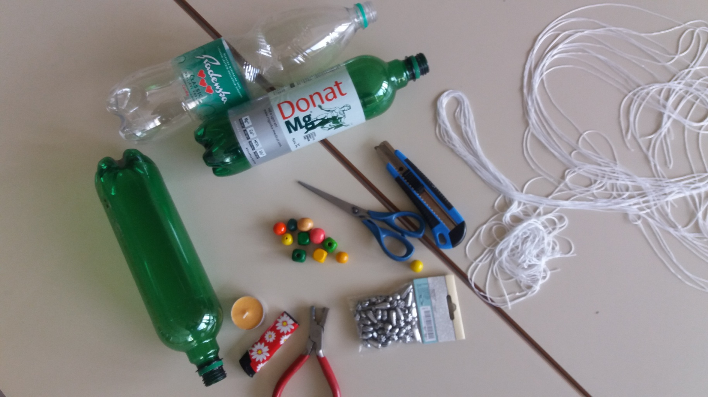
You need: plastic bottles, scissors, a candle, a hole puncher, some thread, beads.

Slide 3
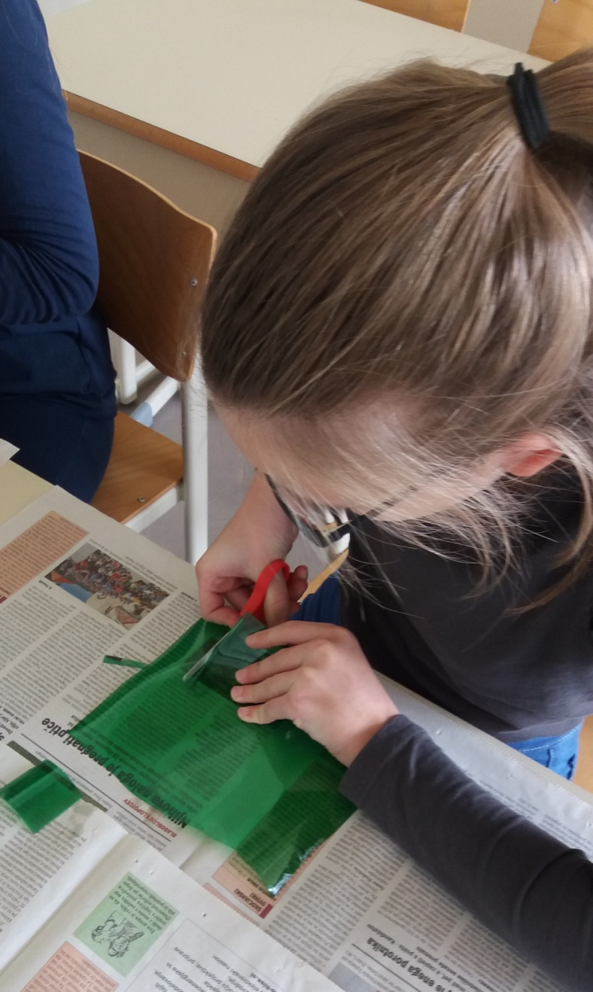
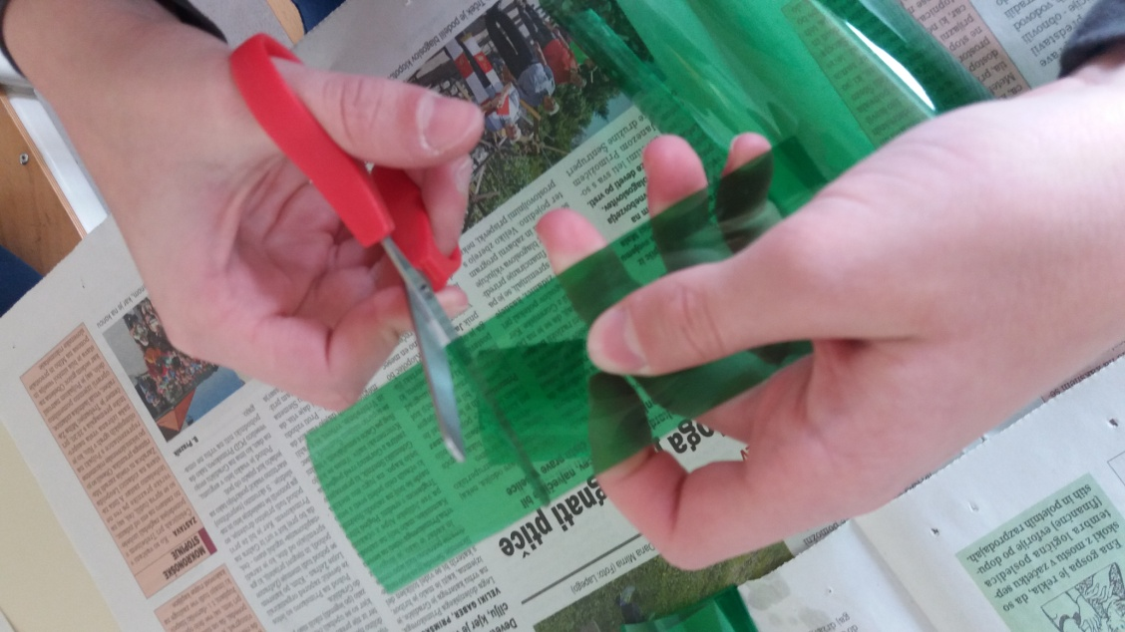
Cut the bottom and the top off the bottle. Cut the middle part in 3 cm wide strips.

Slide 4
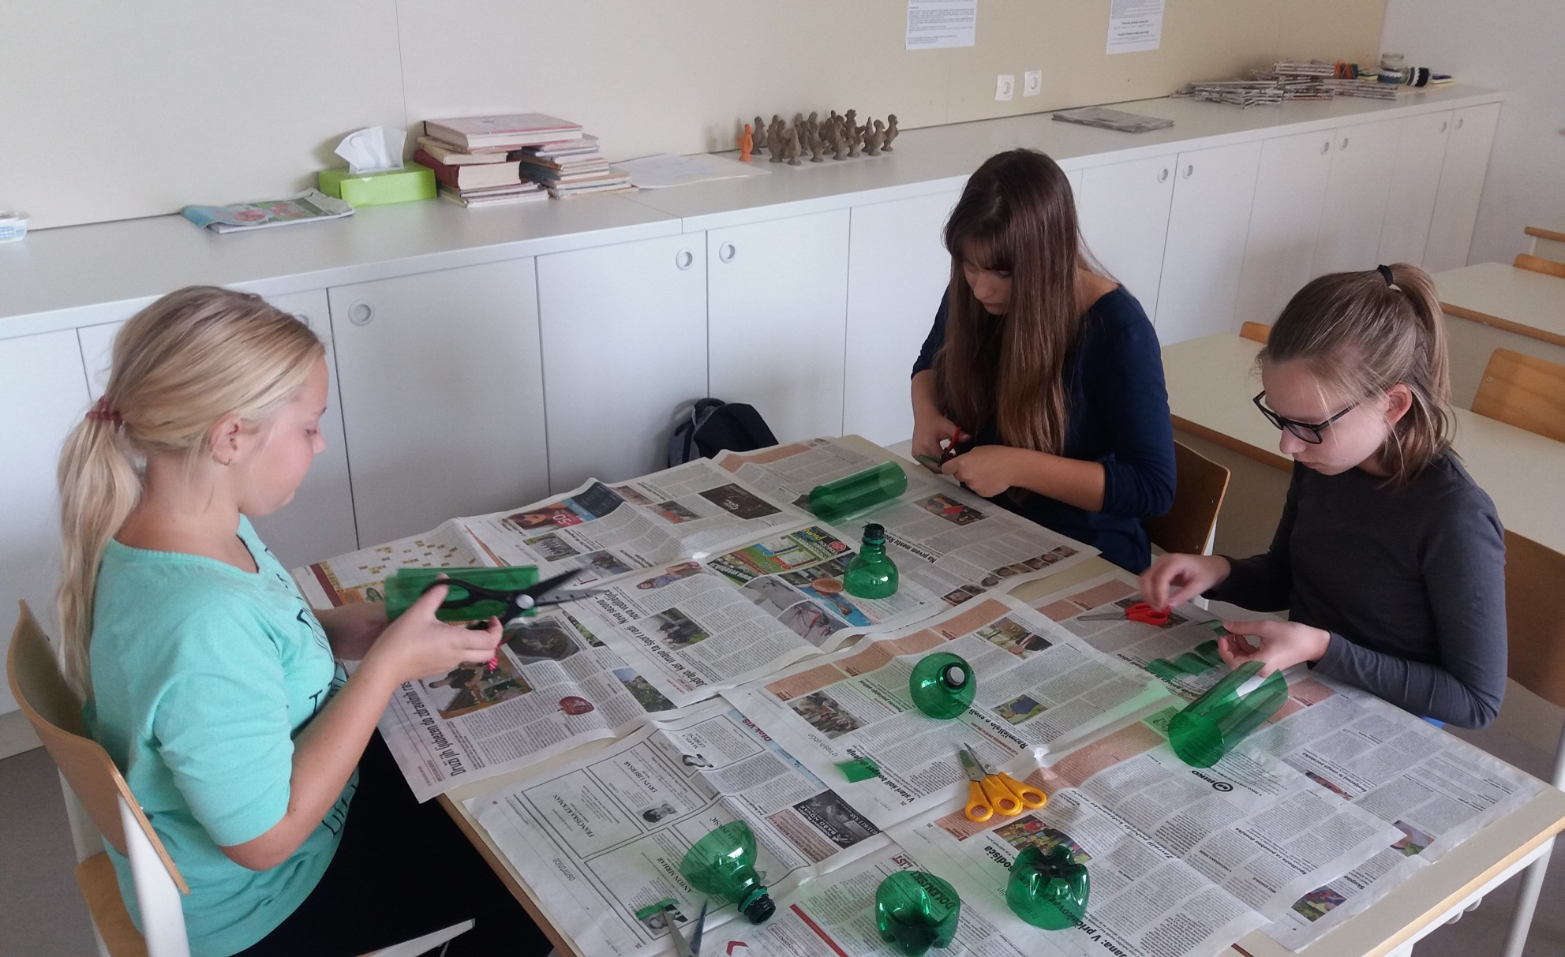

Slide 5
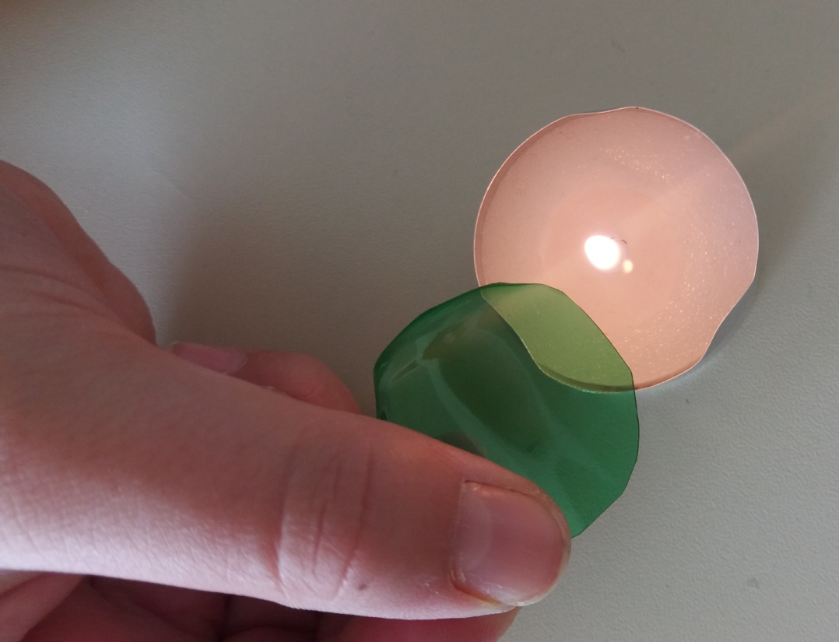
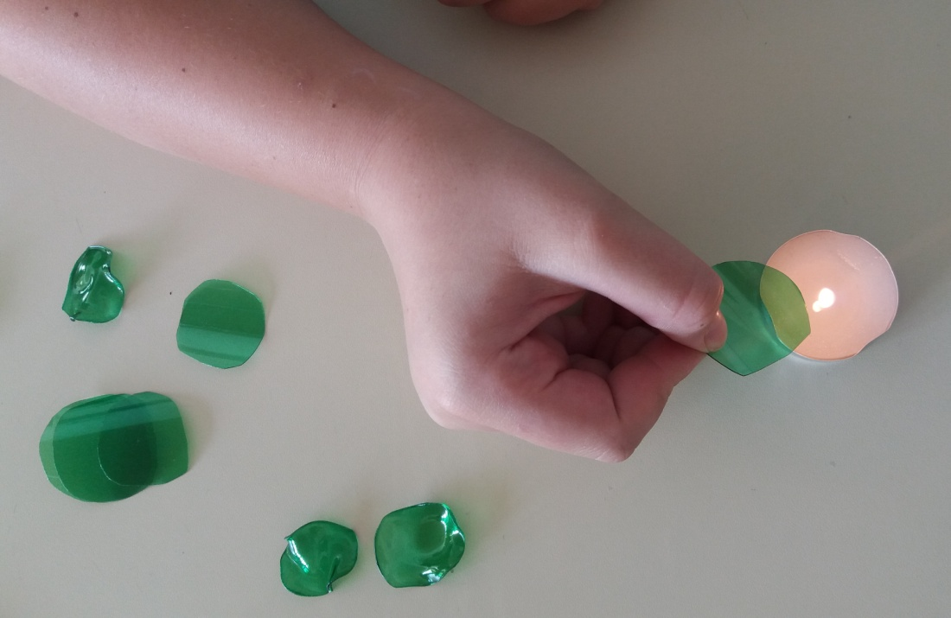
Cut the strips into squares, which you shape into circles. Light the candle and soften the edges. If you want to bend the cirlcle, hold it above the flame for a second.

Slide 6
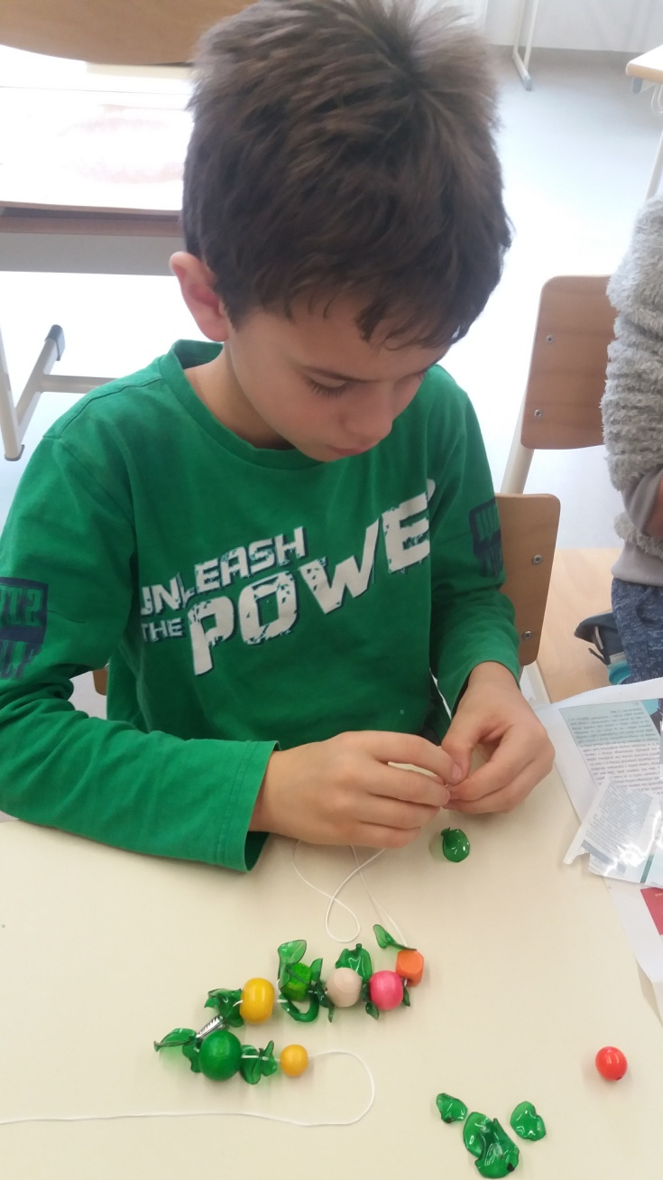
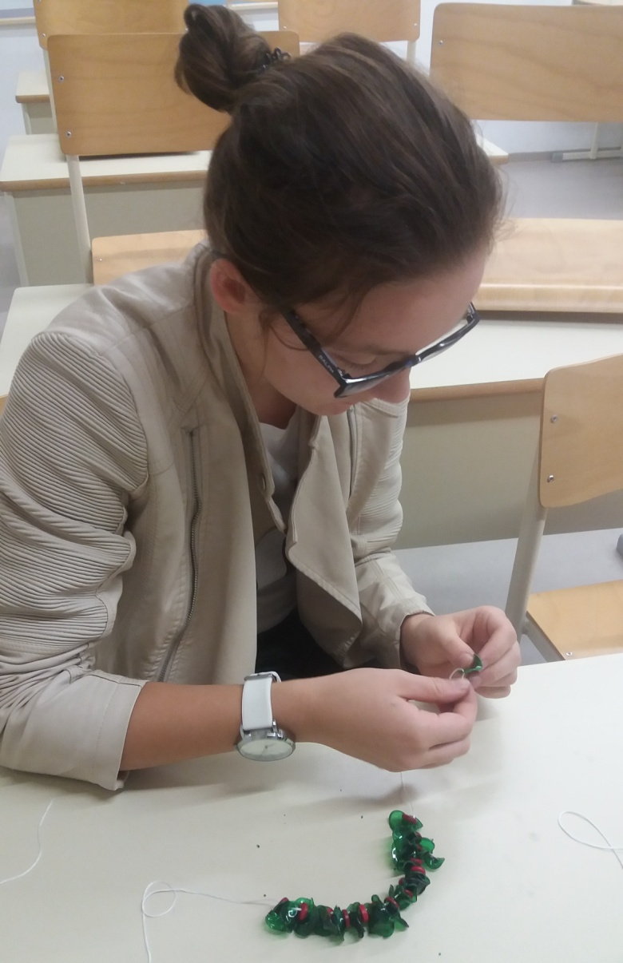
Punch the circles with the hole puncher, then string them and the beads on a thread.

Slide 7
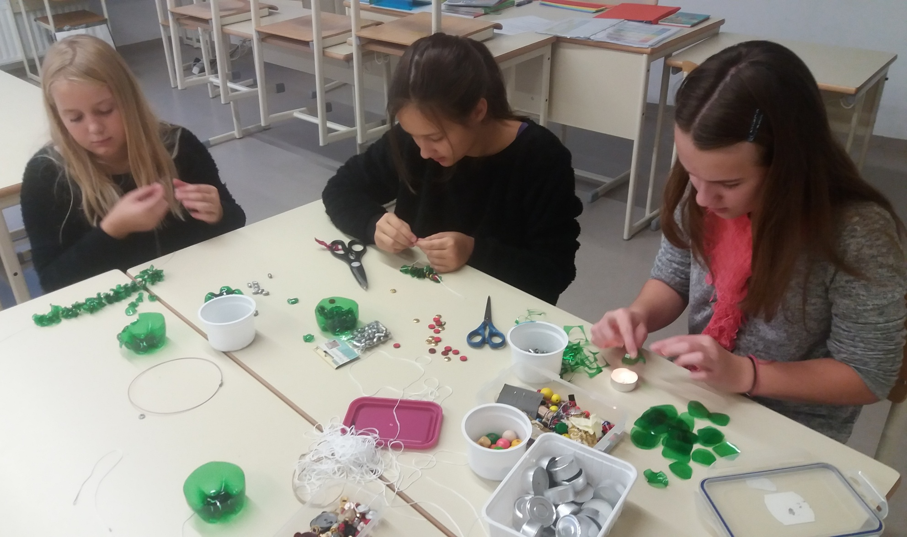

Slide 8
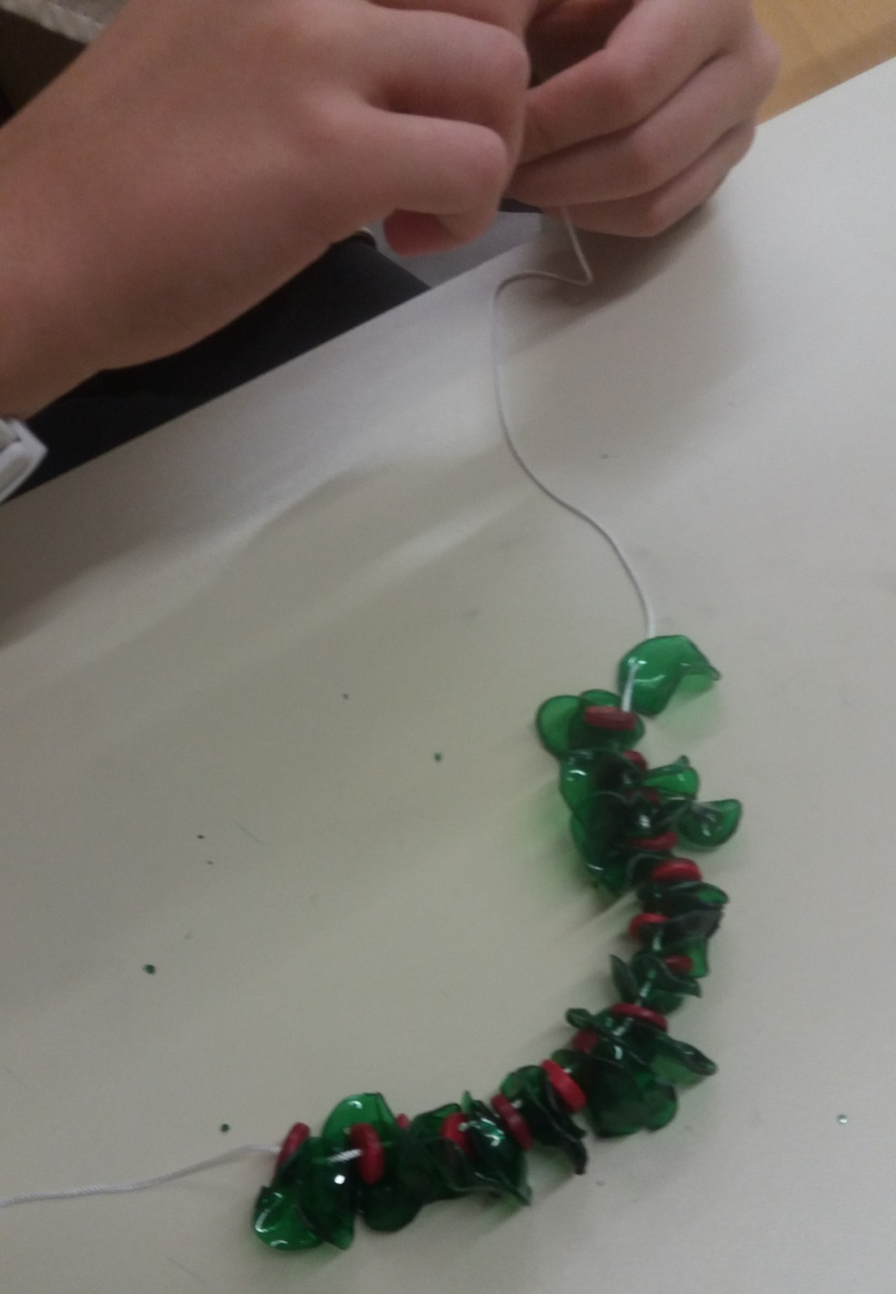
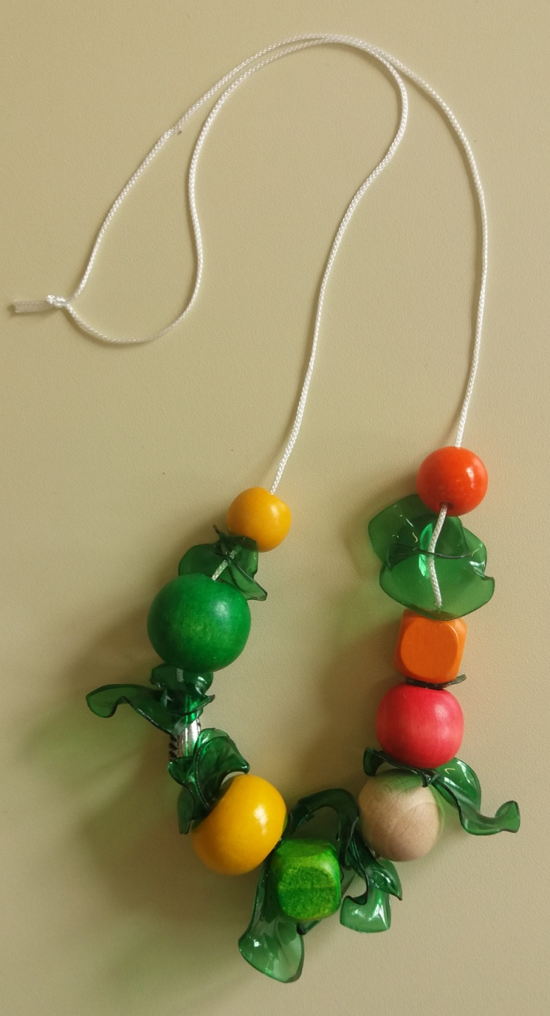

Slide 9
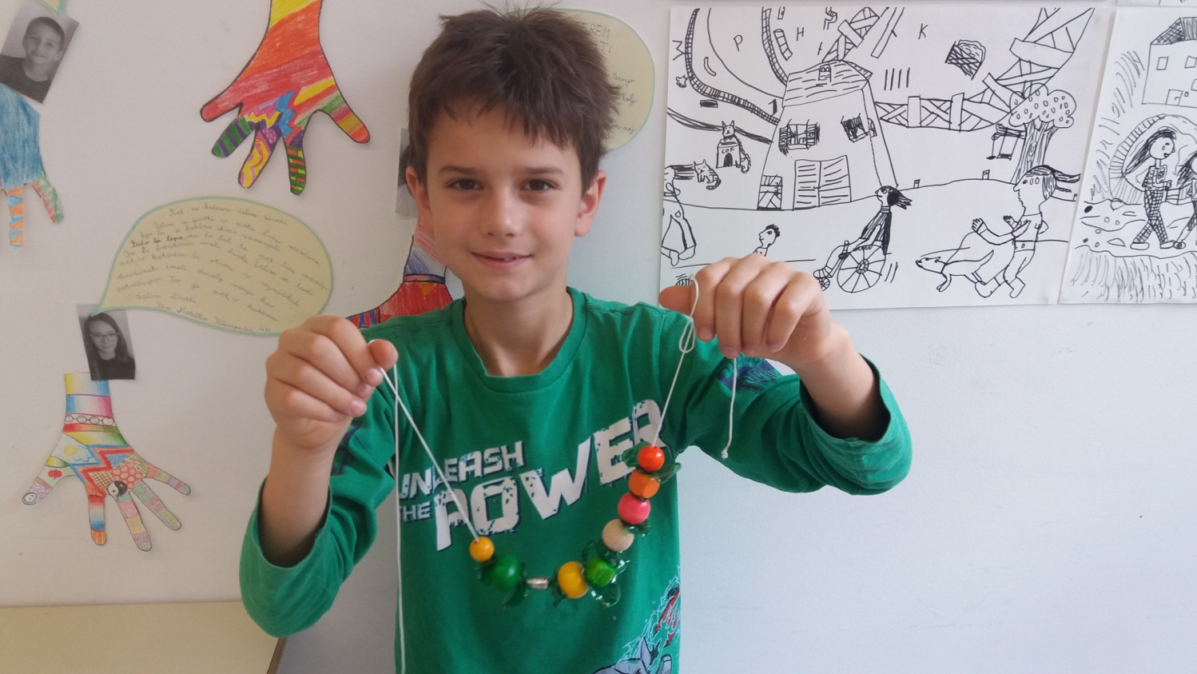

Slide 10
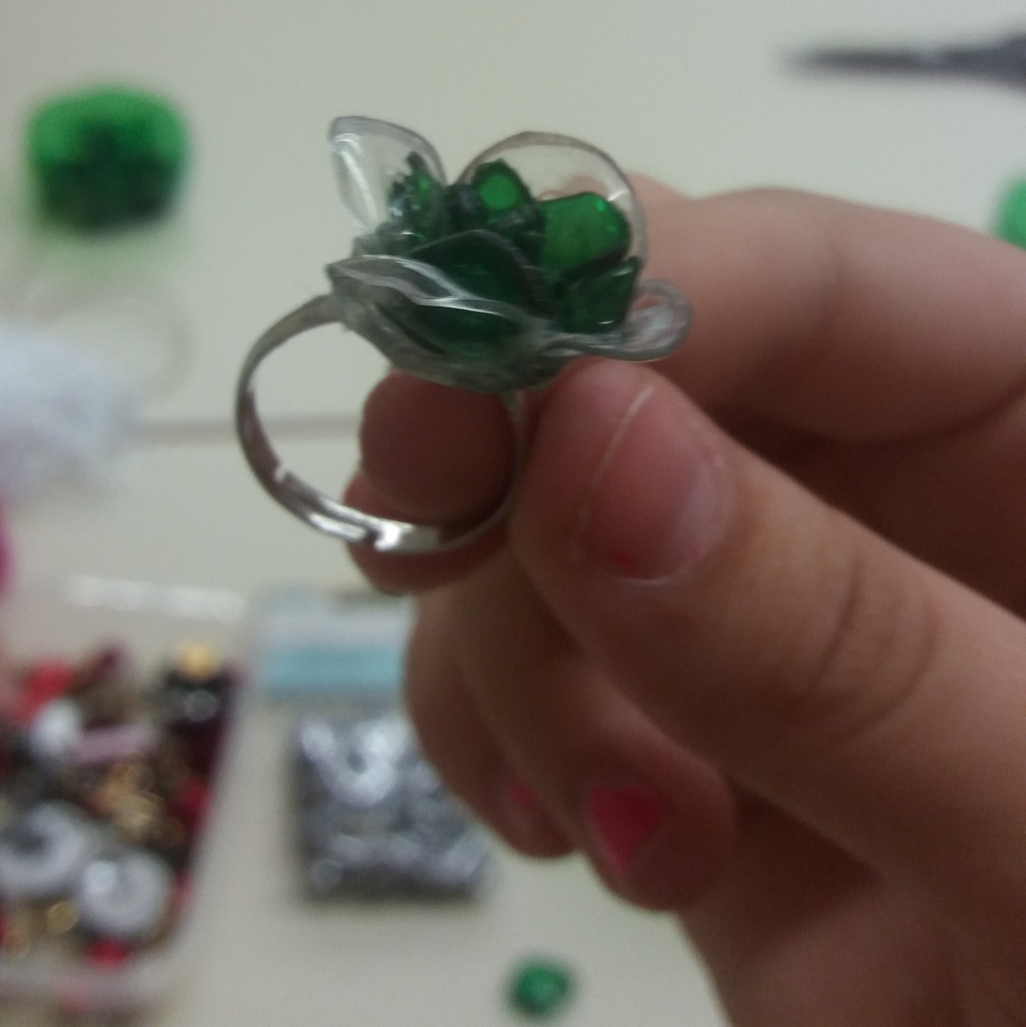
You can also design a ring.

Slide 11
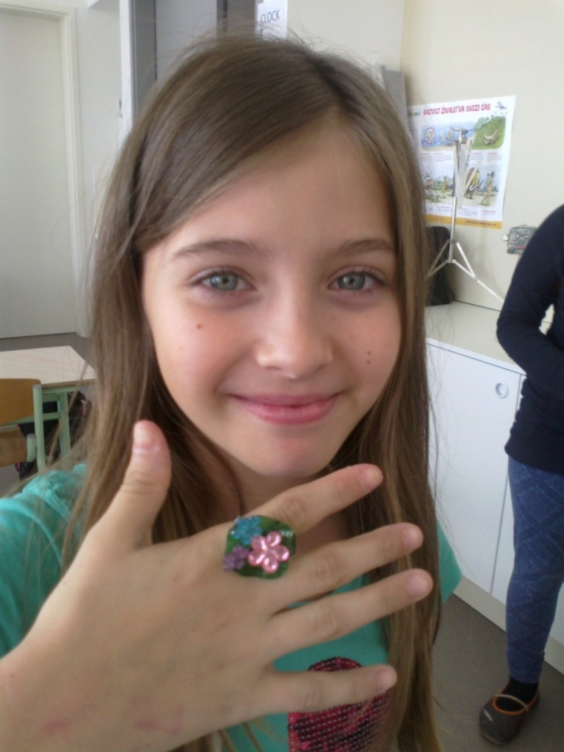
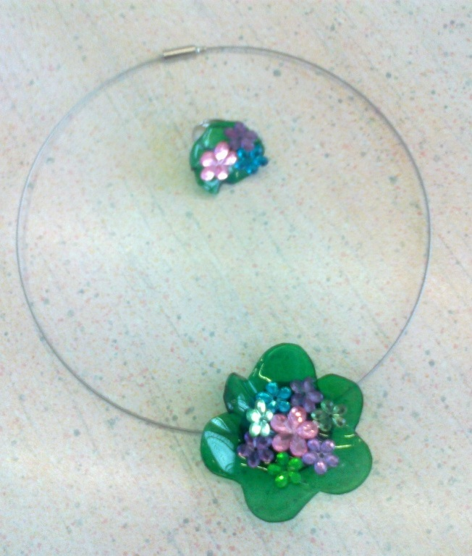

Slide 12
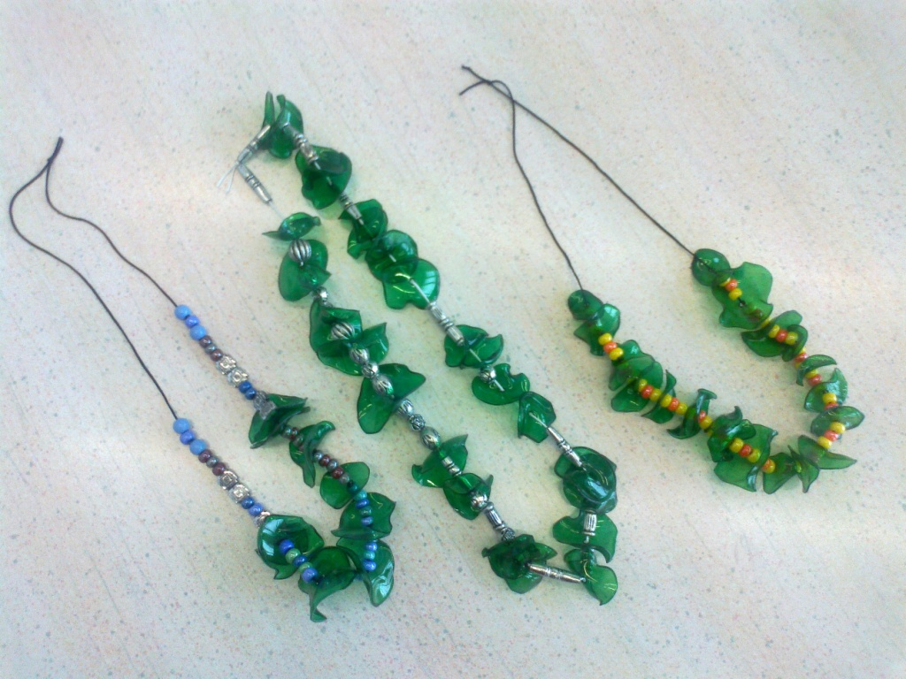

Slide 13
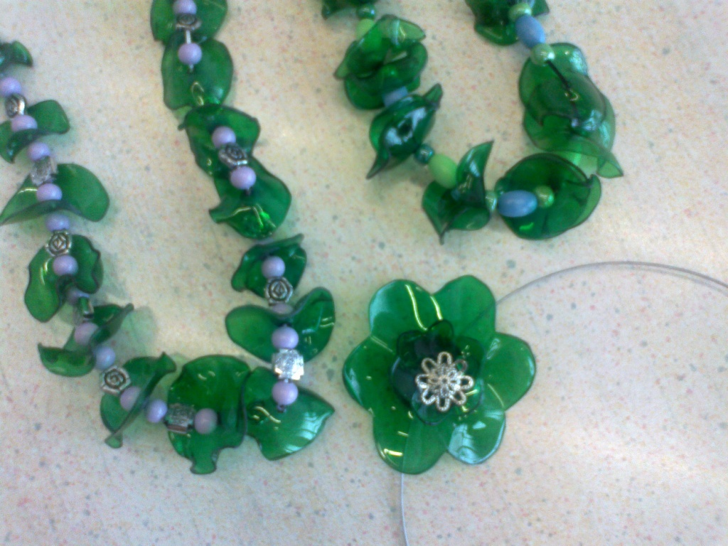

Slide 14
