Slide 1
Tone Pavček Primary School, Mirna Peč, Slovenia Recycling Club
A CANDLE HOLDER
MADE OF
PLASTIC BOTTLES

Slide 2
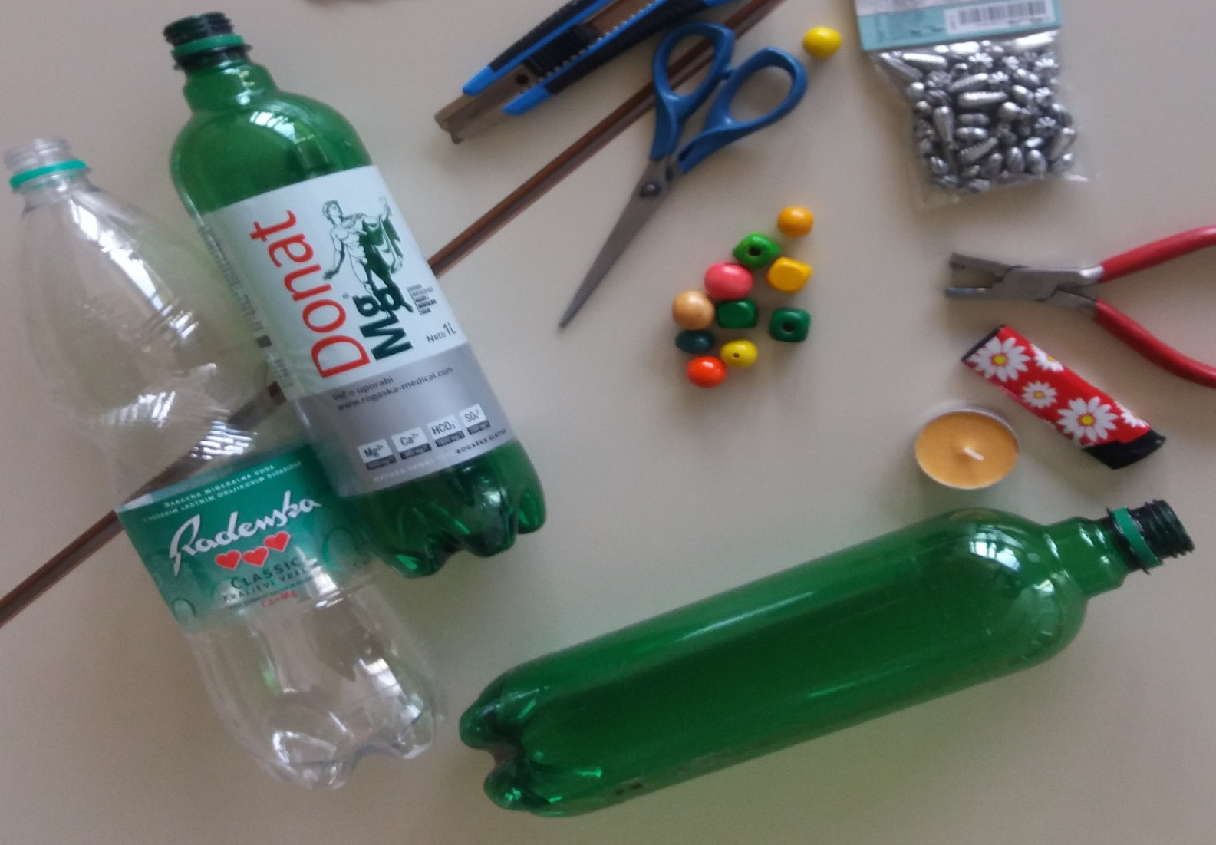
You need: a plastic bottle, an utility knife, scissors, a candle, a lighter

Slide 3
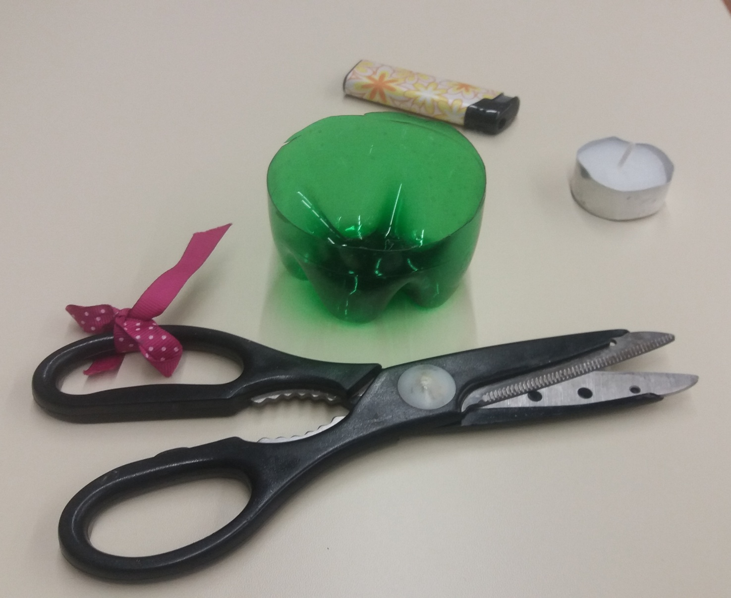
Cut the bottom off the plastic bottle.

Slide 4
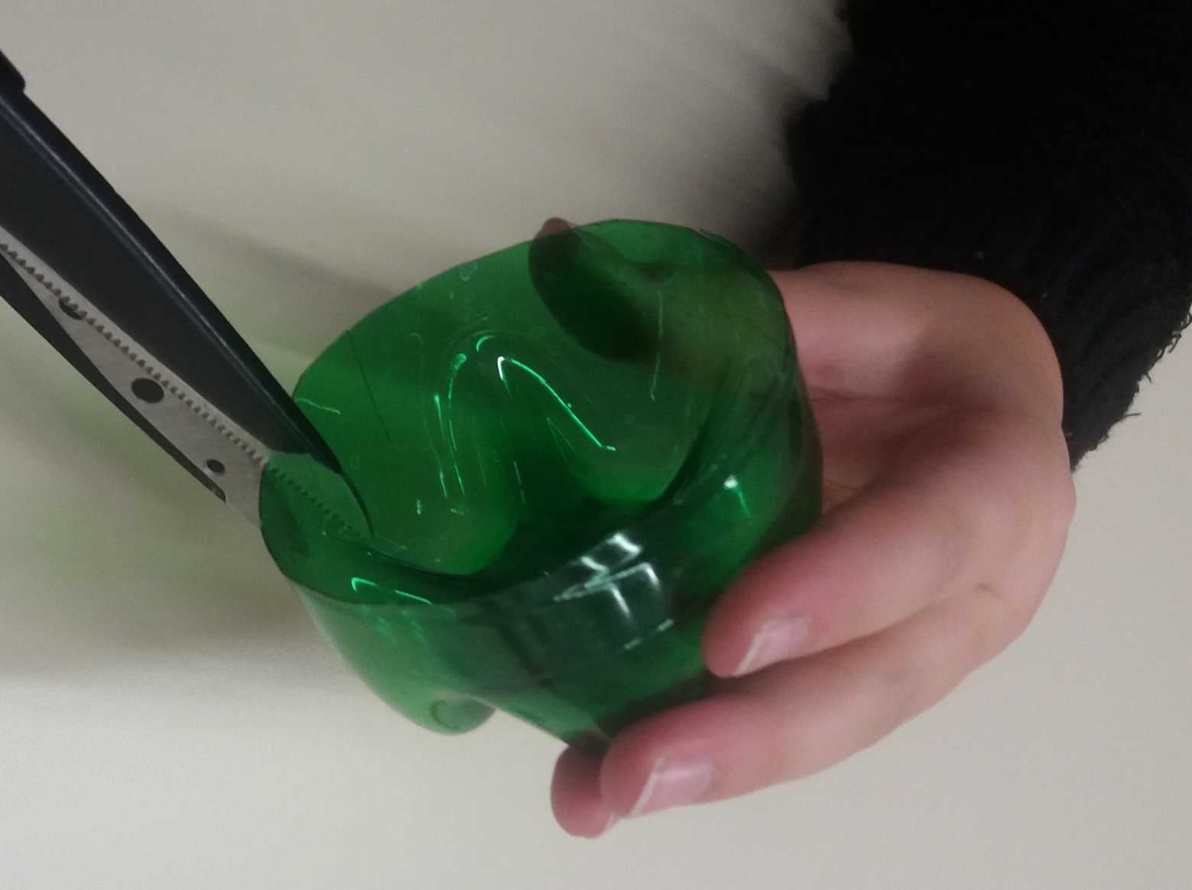
Cut about 2 cm deep and 0,5 cm wide strips into the bottle.

Slide 5
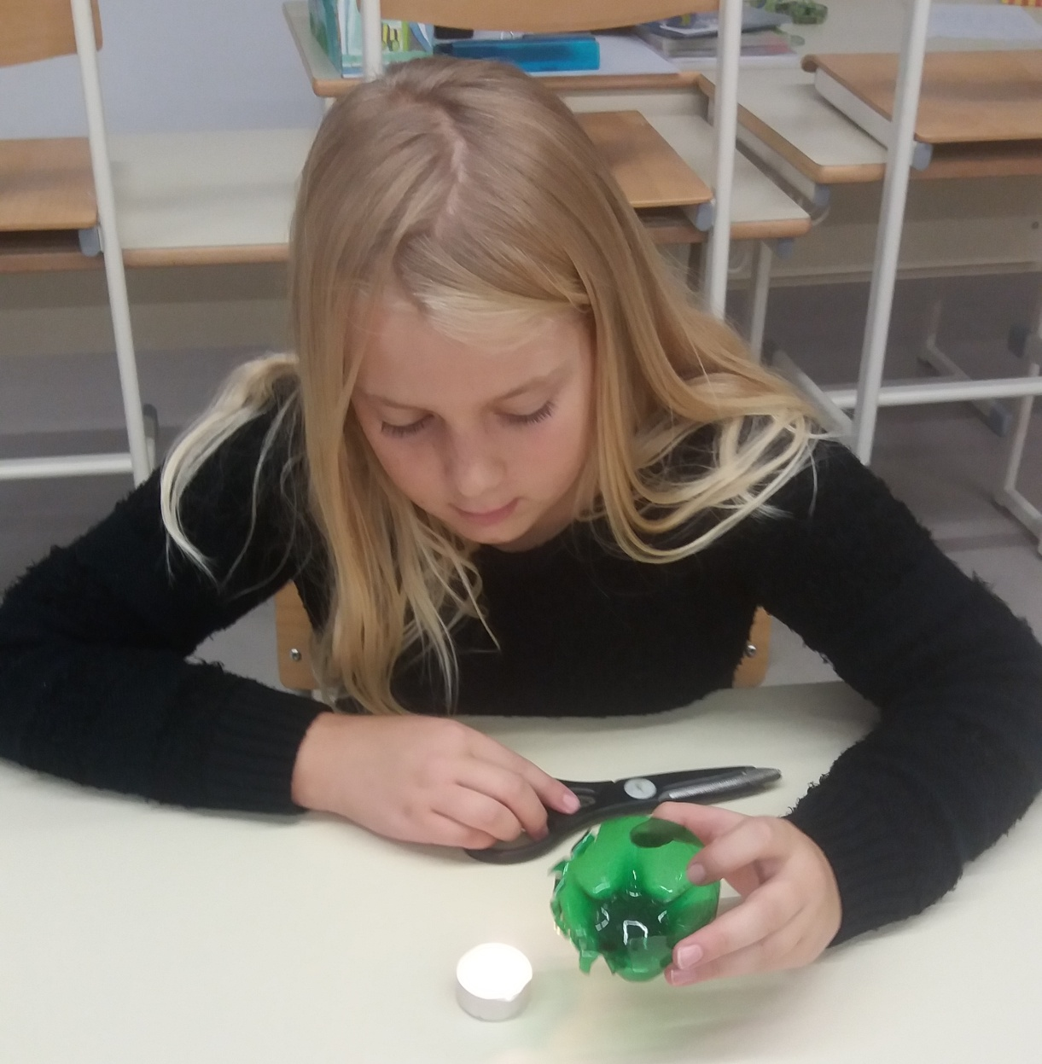
Light the candle and move the bottle (only the strips) closer. Plastic bends because of the heat.

Slide 6
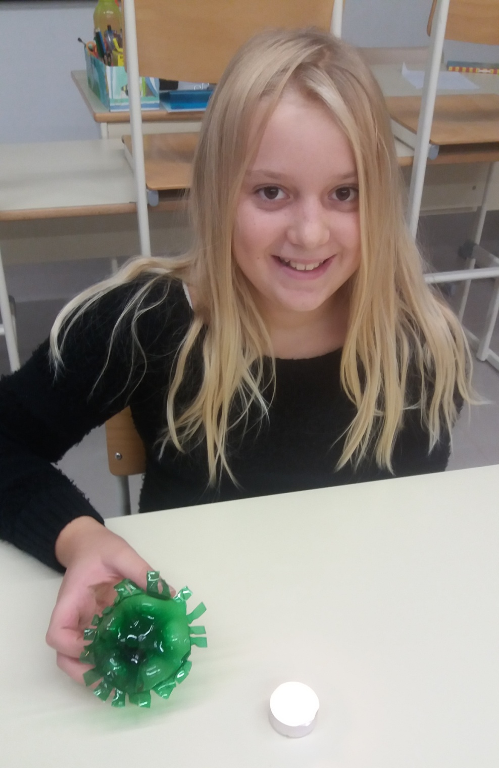
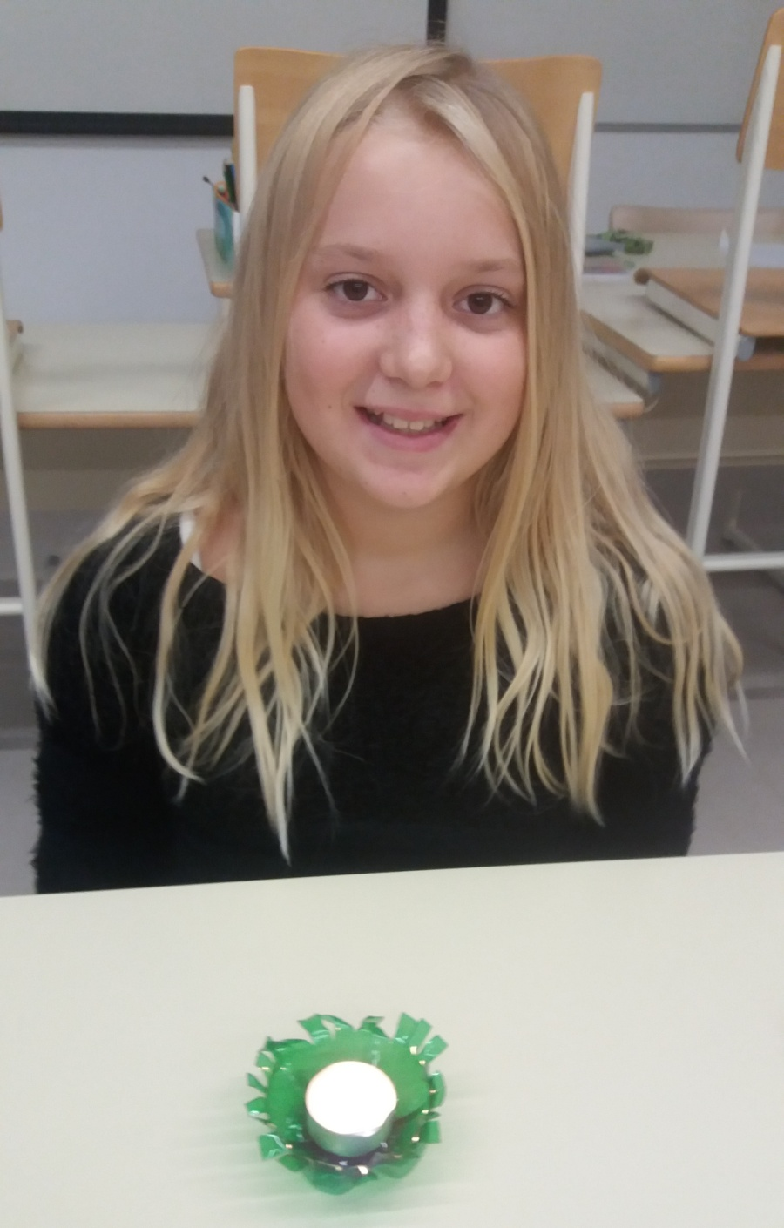

Slide 7
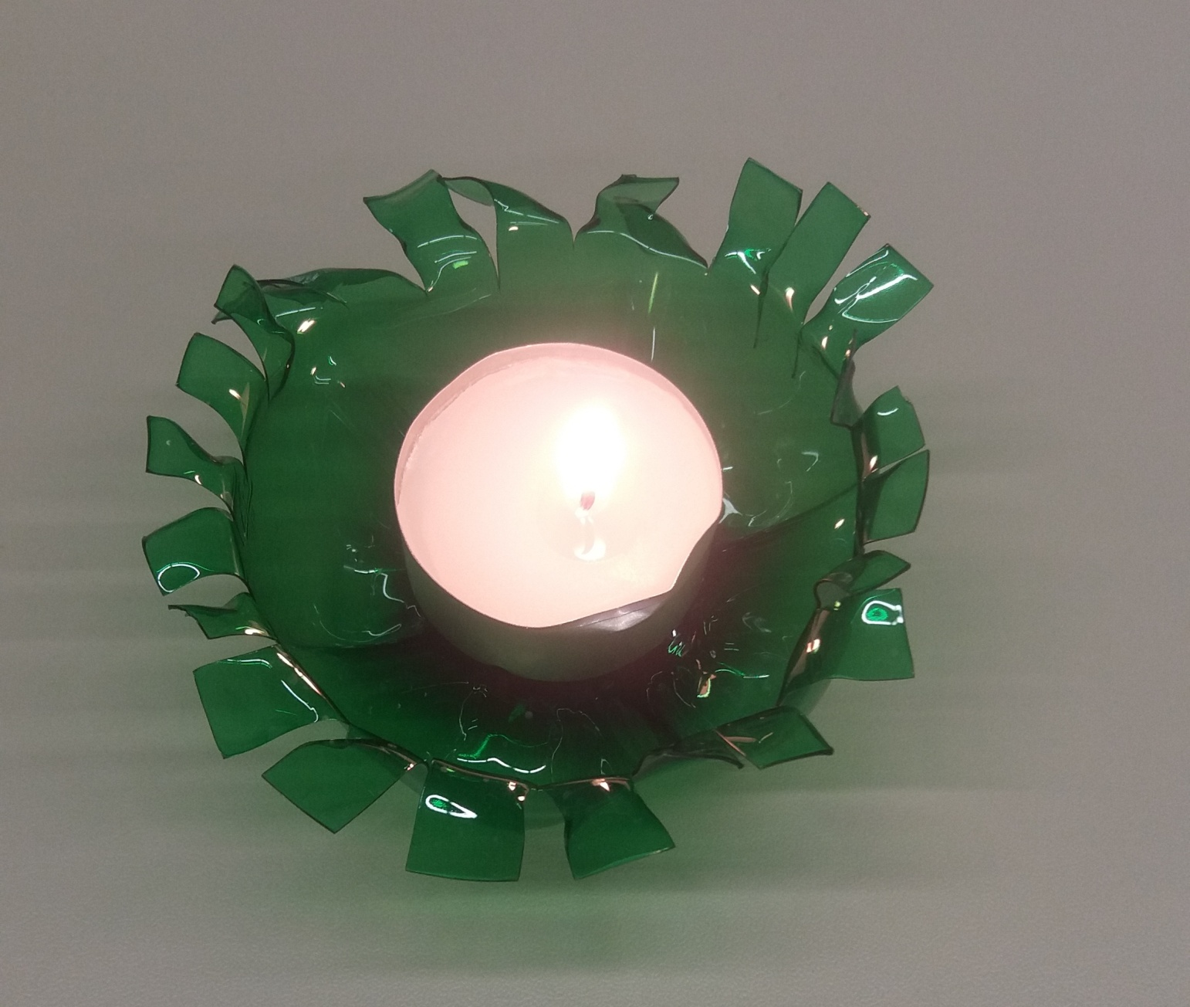
Put a candle inside of it and enjoy the pleasant atmosphere ☺

Slide 8
