Slide 1
CATAPULTS MADE OF SCRAP MATERIAL
Tone Pavček Primary School, Mirna Peč, Slovenia
Recycling Club

Slide 2
We ate a lot of ice cream in the summer and saved the sticks to make the catapult. Material: ice cream sticks, felt-tip pens, rubber bands, a cap from a bottle, a gluegun

Slide 3
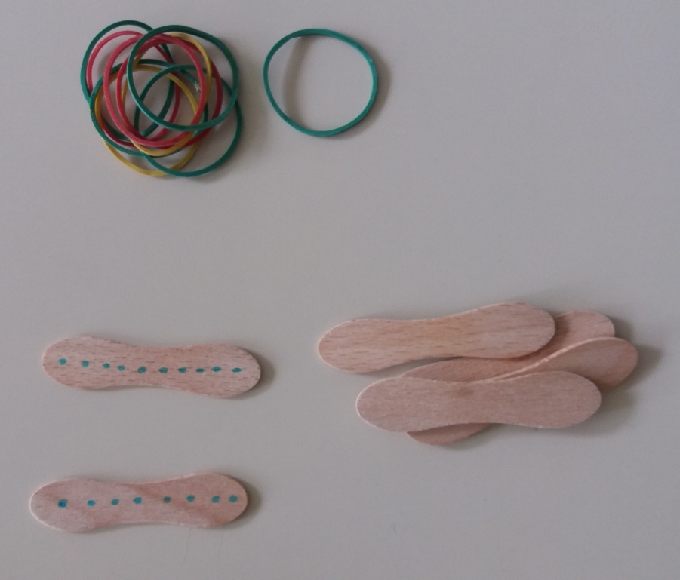
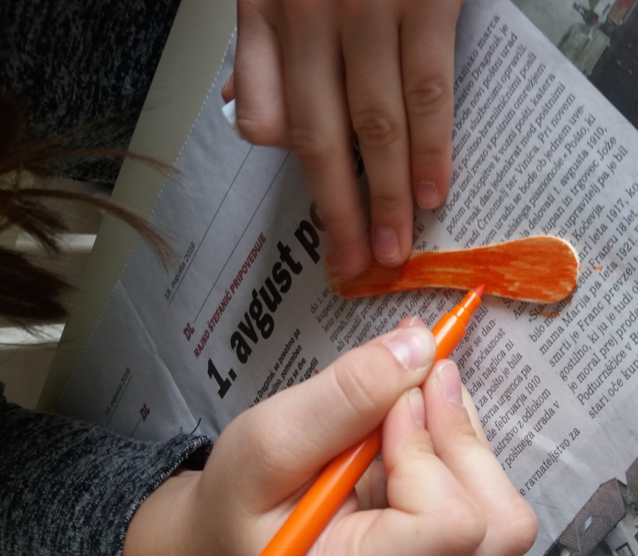
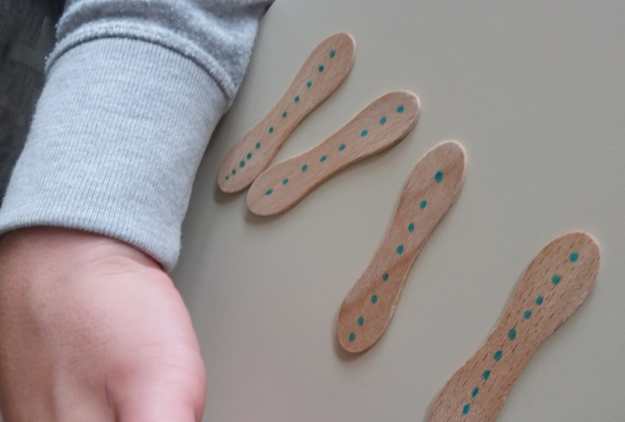
Decorate the ice cream sticks.

Slide 4
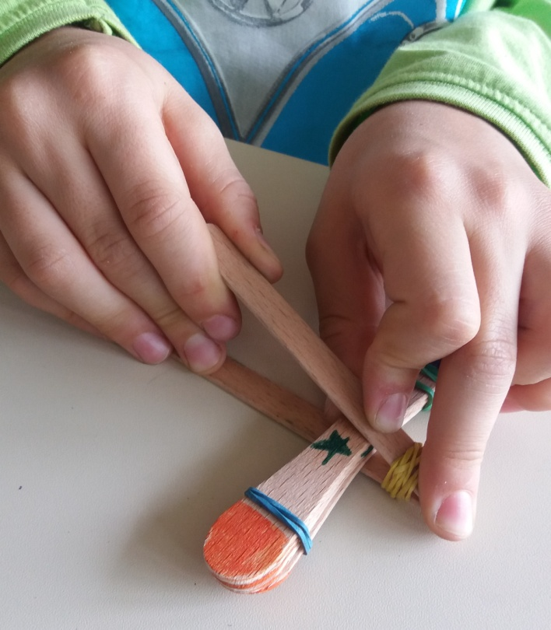
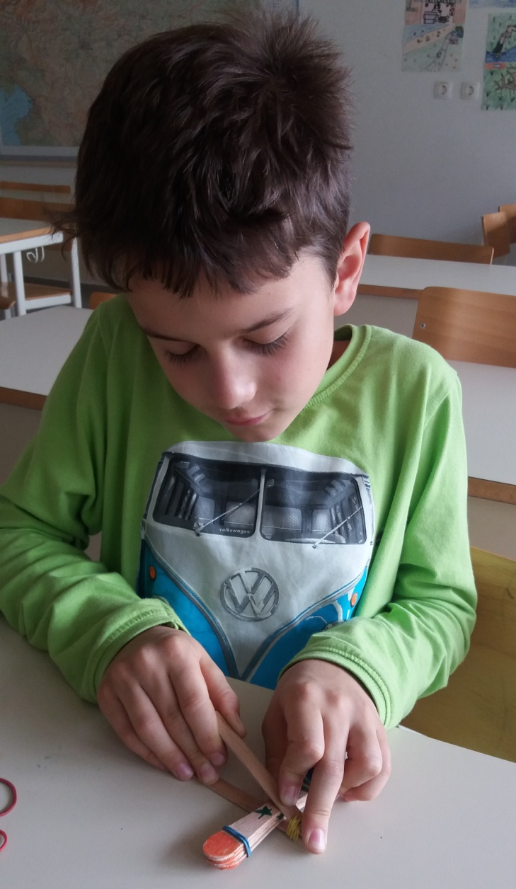
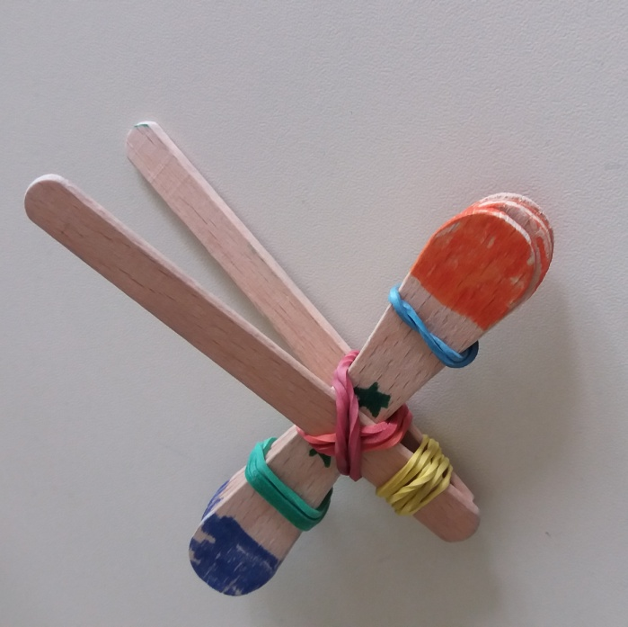
Stack two decorated sticks together, then wrap a rubber band tightly on both ends. Take two more sticks and do the same, but wrap the band on one side only. Put the sticks that have rubber bands on both ends in the middle between the ones with just one rubber band. Tighty wrap another rubber band around the middle part, where the sticks cross.

Slide 5
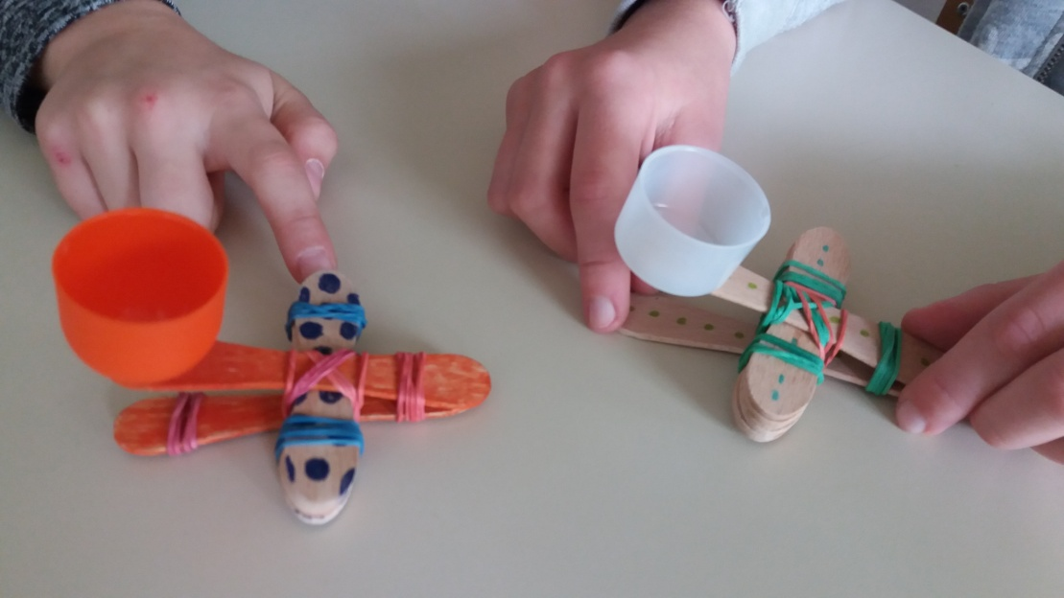
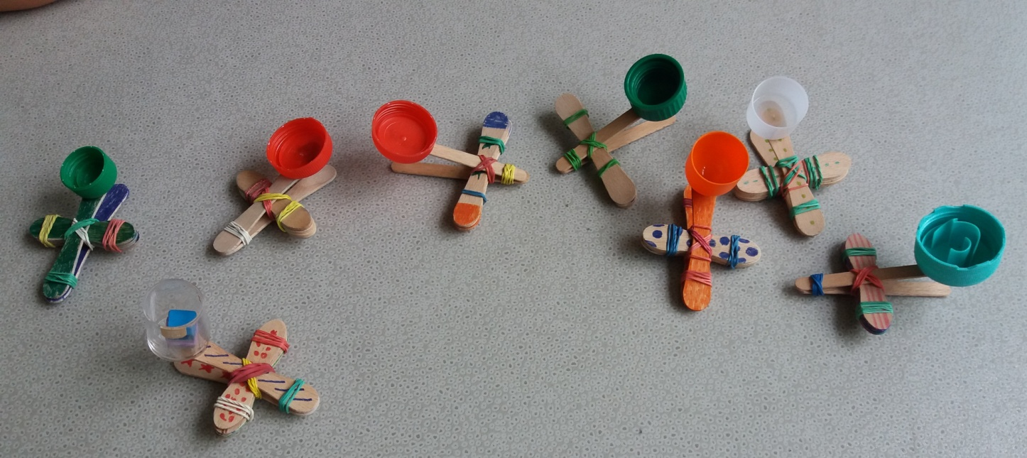
Use a gluegun to glue the cap onto the sticks and the catapult is ready to shoot.

Slide 6
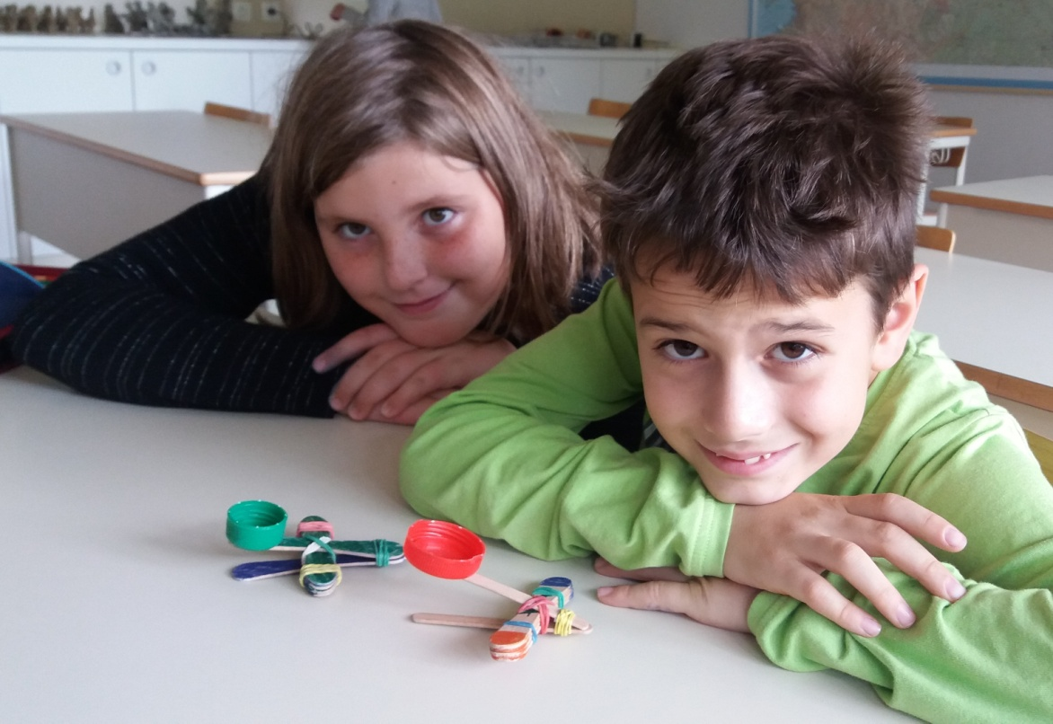
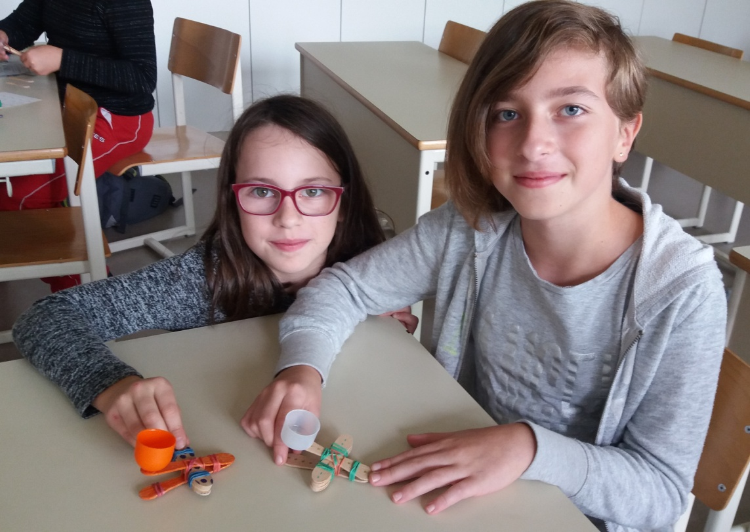

Slide 7
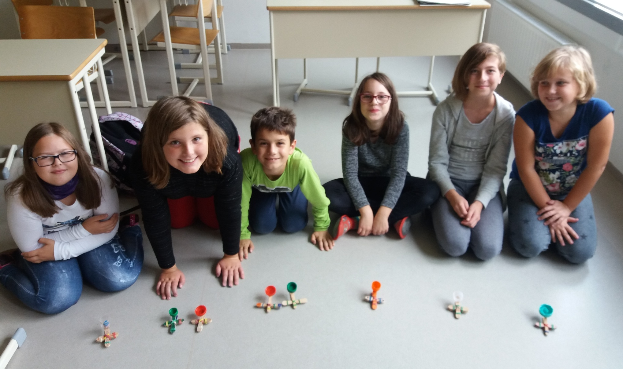

Slide 8
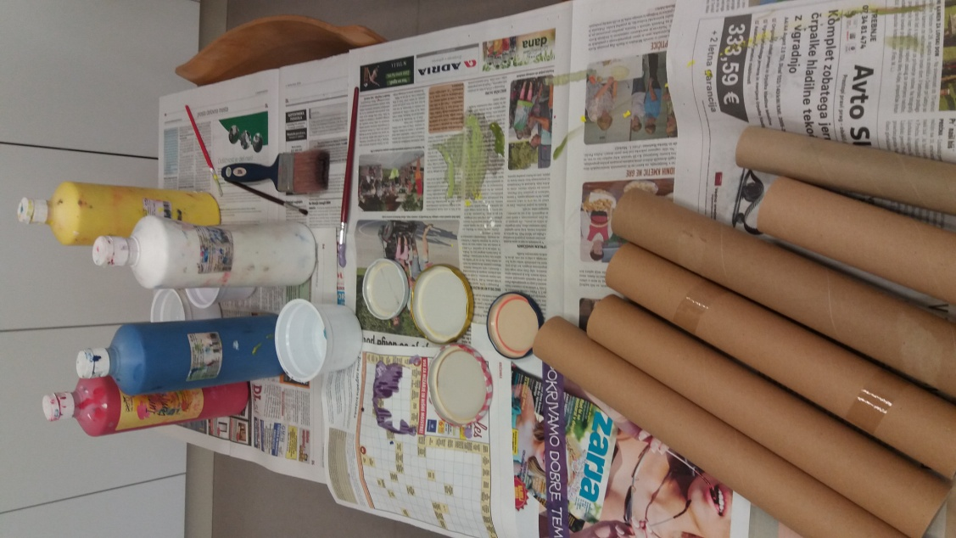
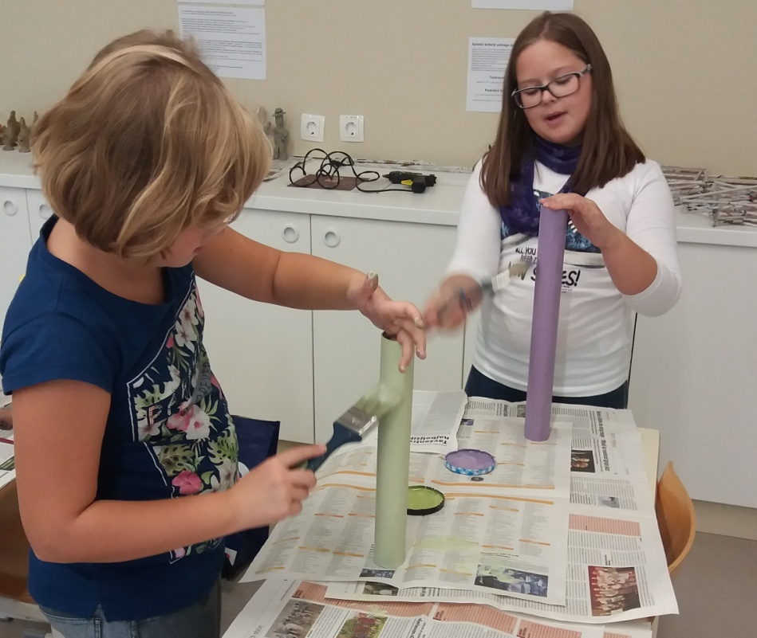
You can also make catapults from a tube from paper towels. The procedure it the same, you just use paint instead of felt-tip pens.

Slide 9
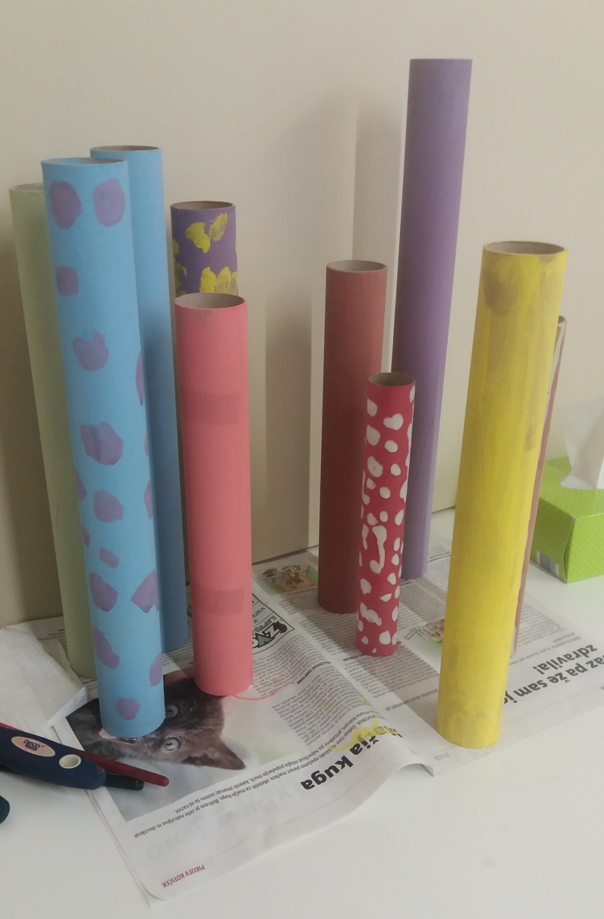

Slide 10
