Slide 1
Bracelets made of plastic bottles and wool
Tone Pavček Primary School Mirna Peč, Slovenia Recycling Club

Slide 2
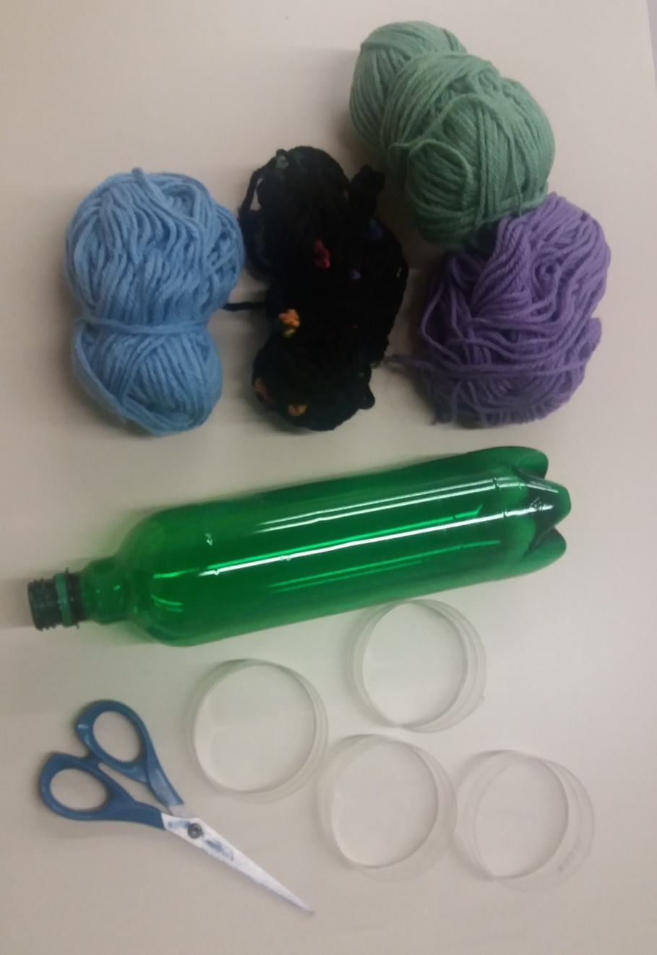
You need:
a plastic bottle,
scissors,
thread or wool

Slide 3
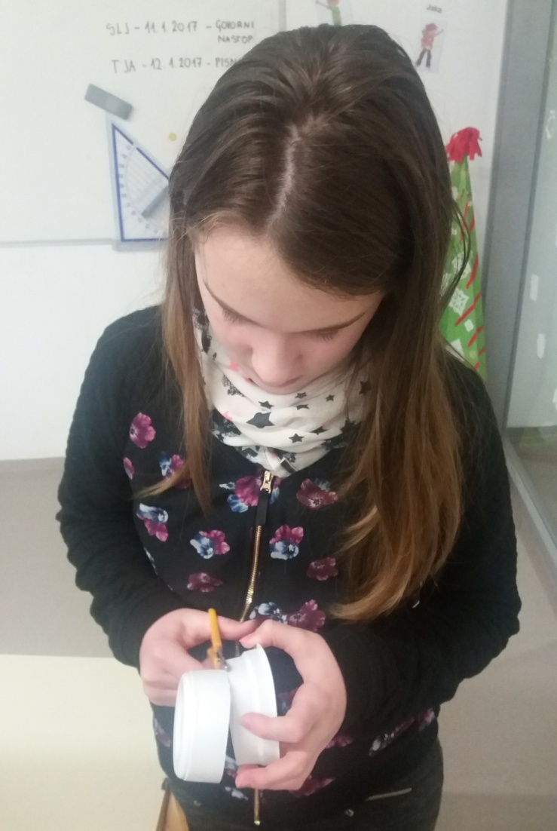
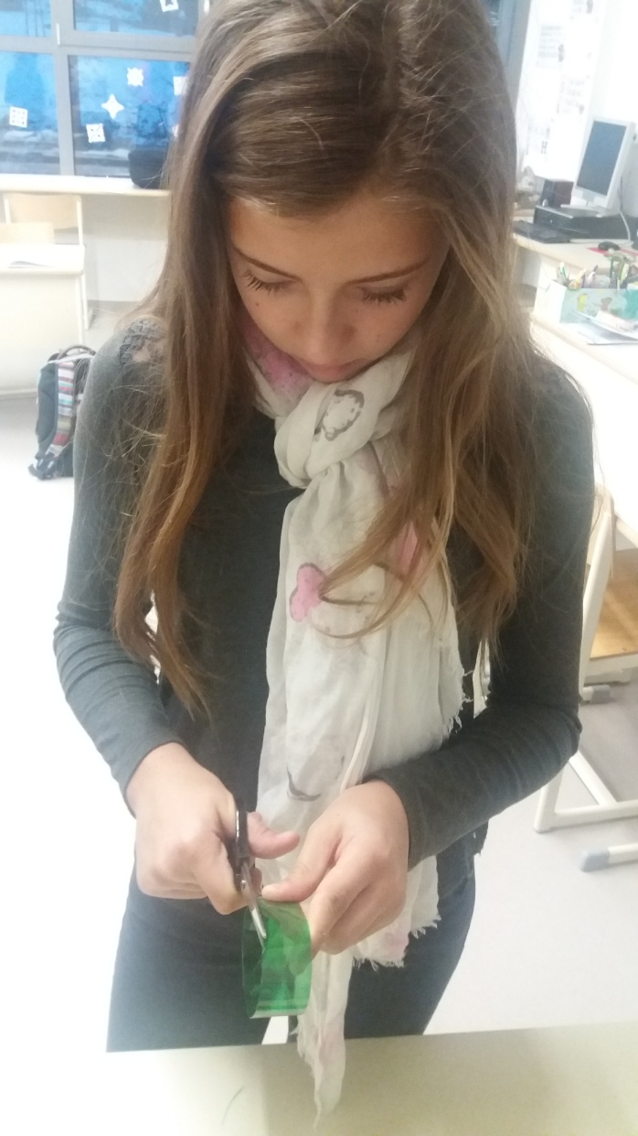
Carefully cut a 2 cm wide circle out of the bottle using scissors.

Slide 4
Wrap the wool around the circle.

Slide 5
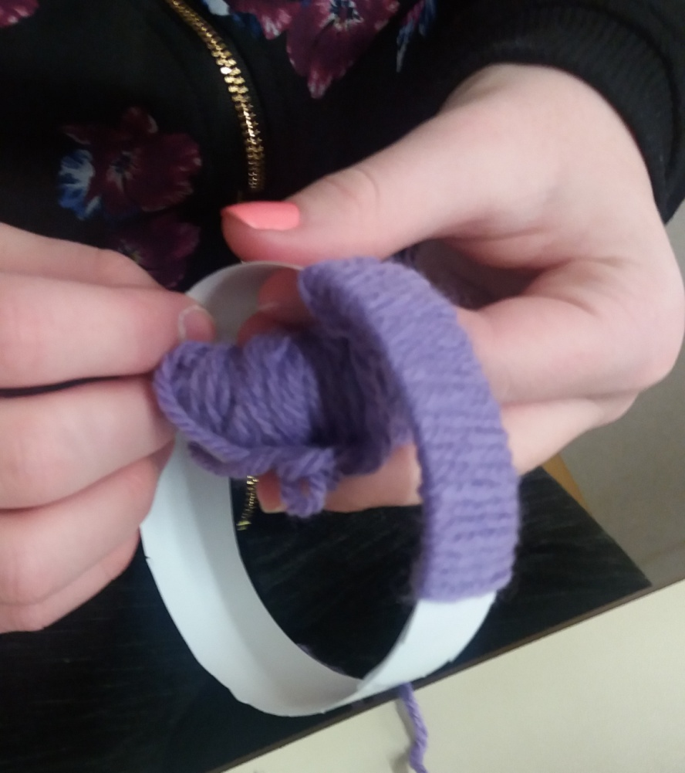
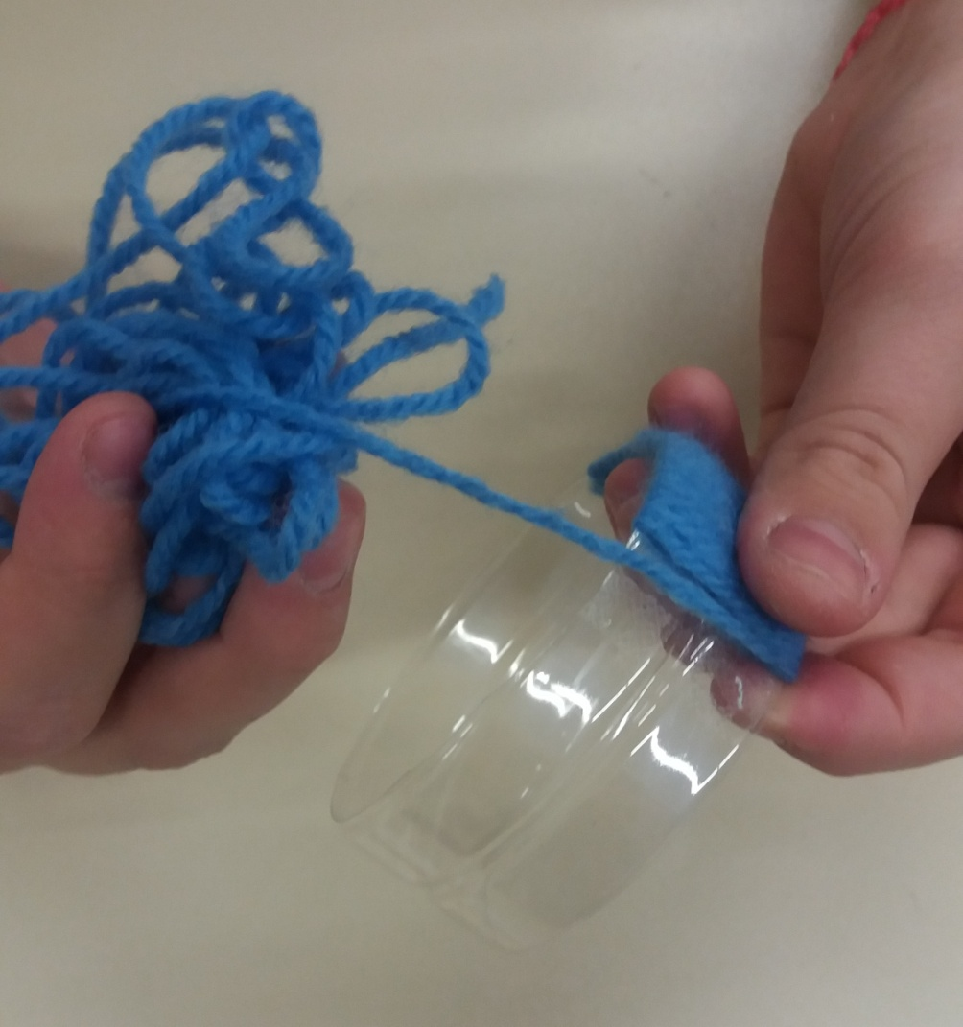

Slide 6
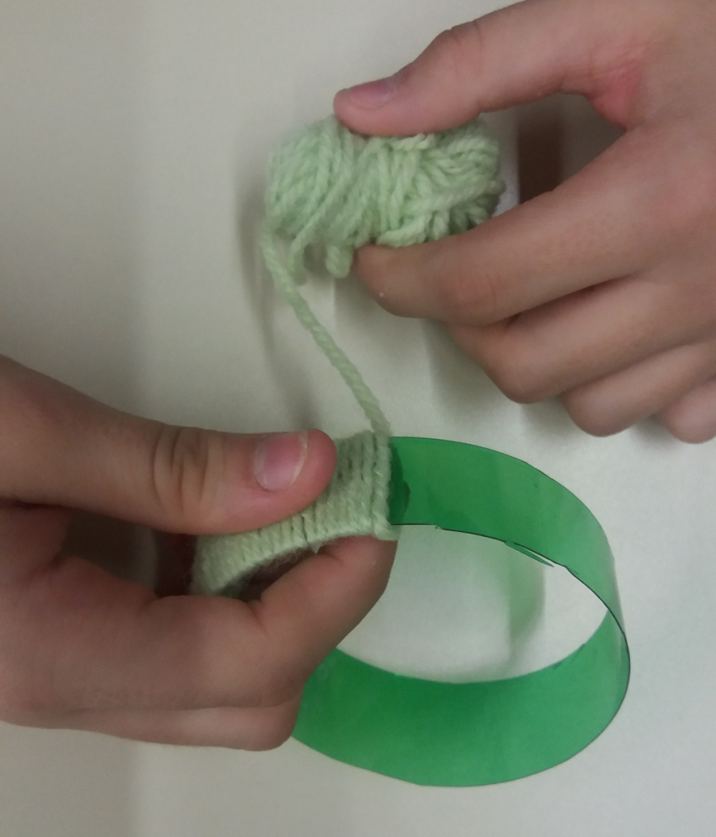
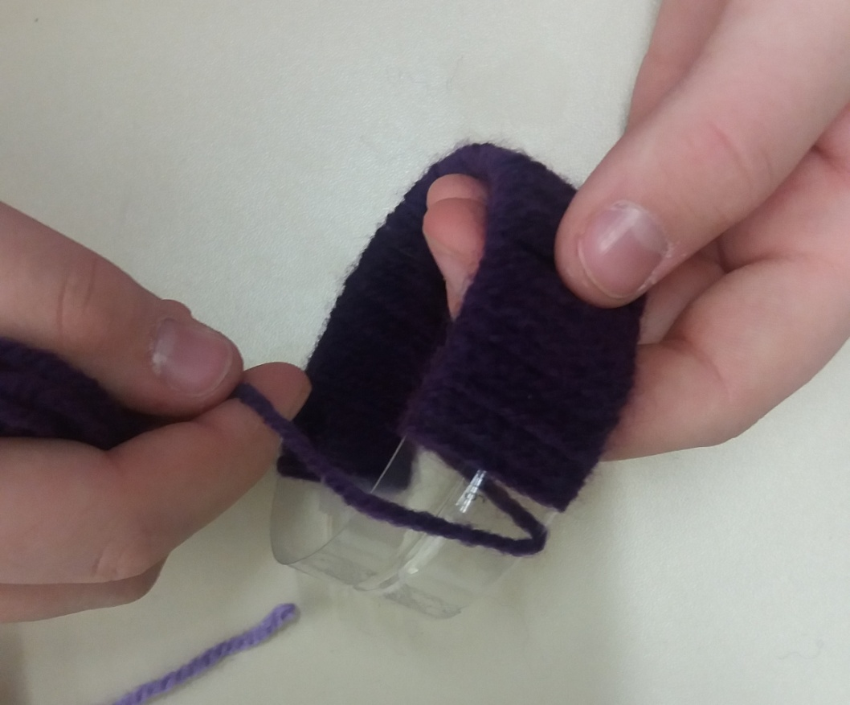

Slide 7
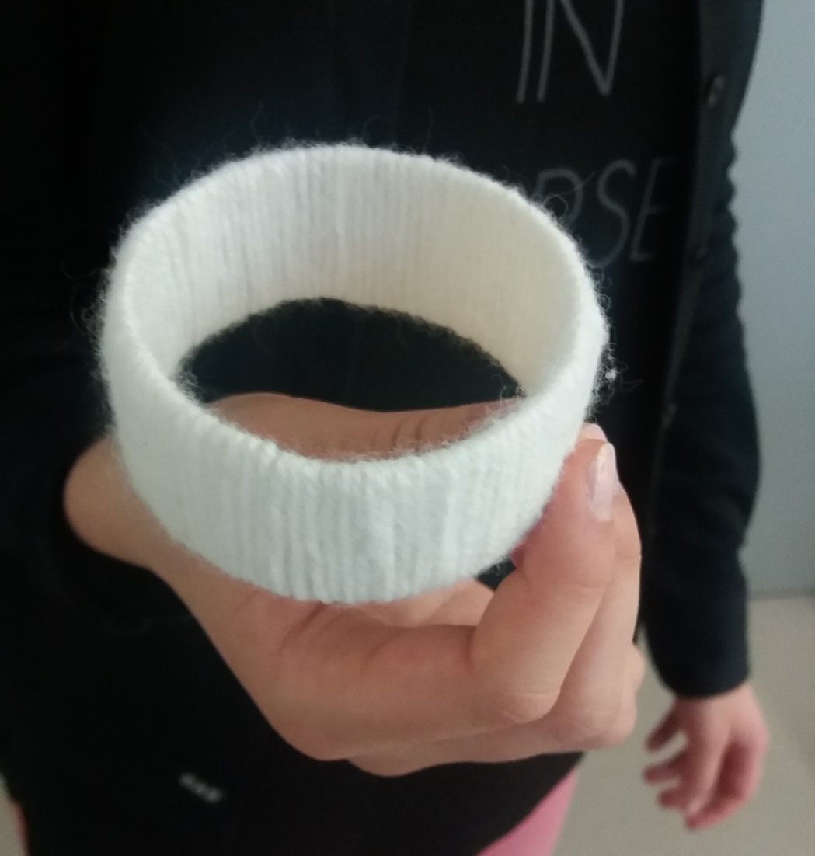
Last, tie the wool or glue it on the circle with a glue gun.

Slide 8
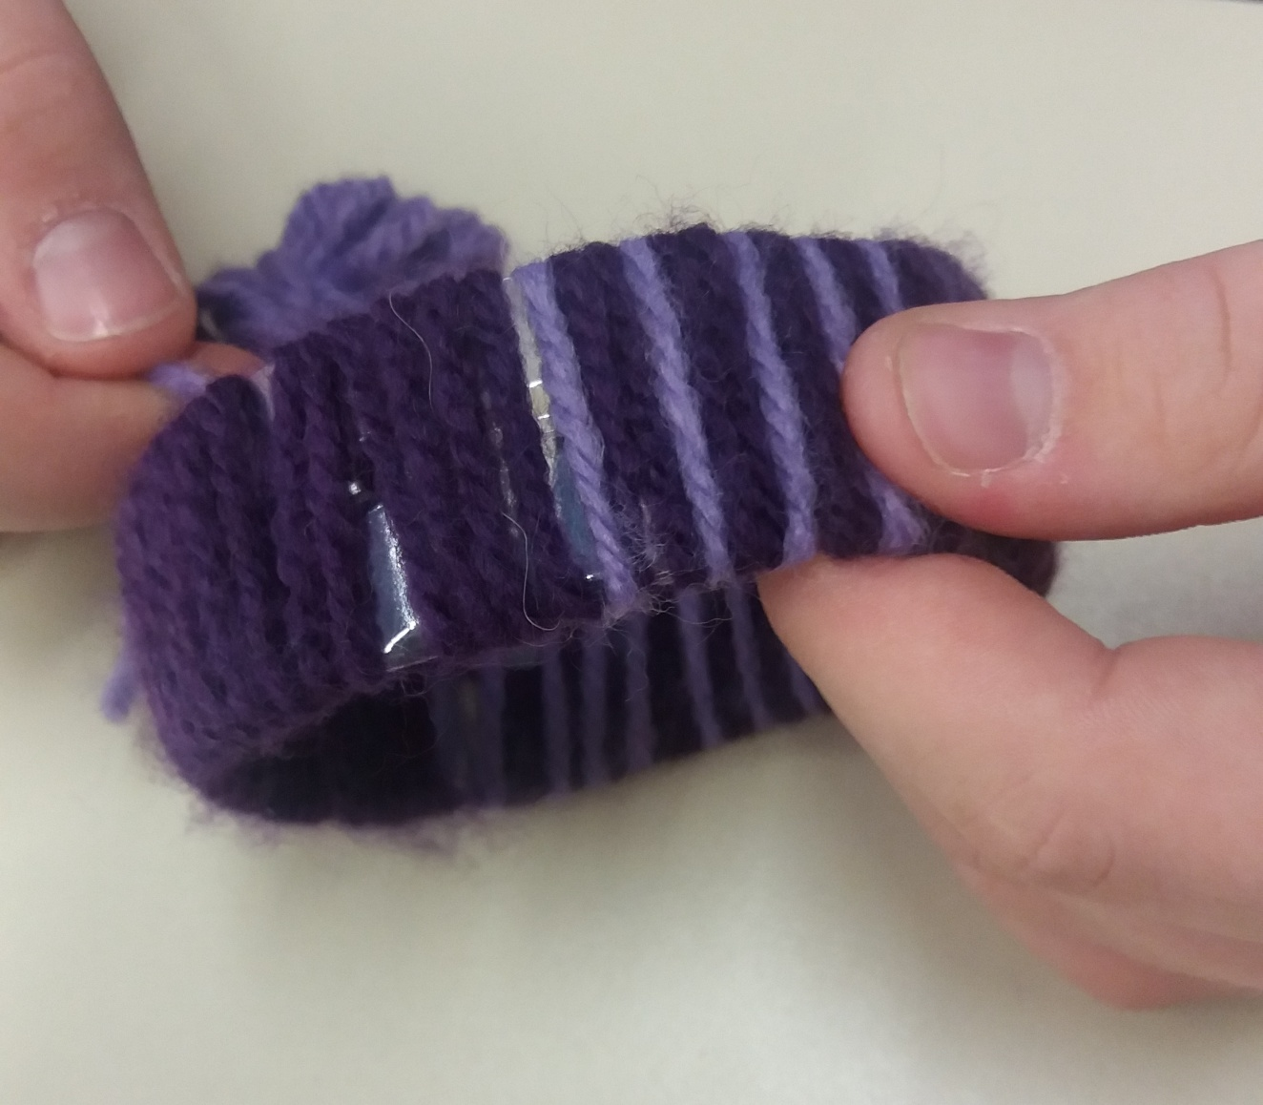
You can use wool in more colours to make it more fun if you want.

Slide 9
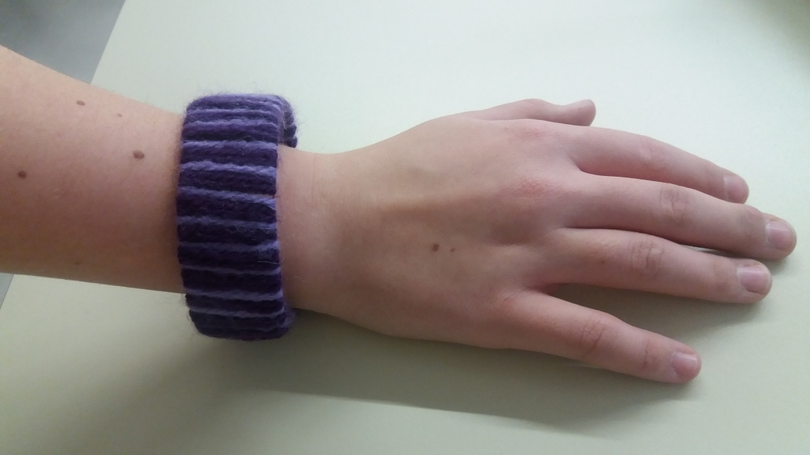
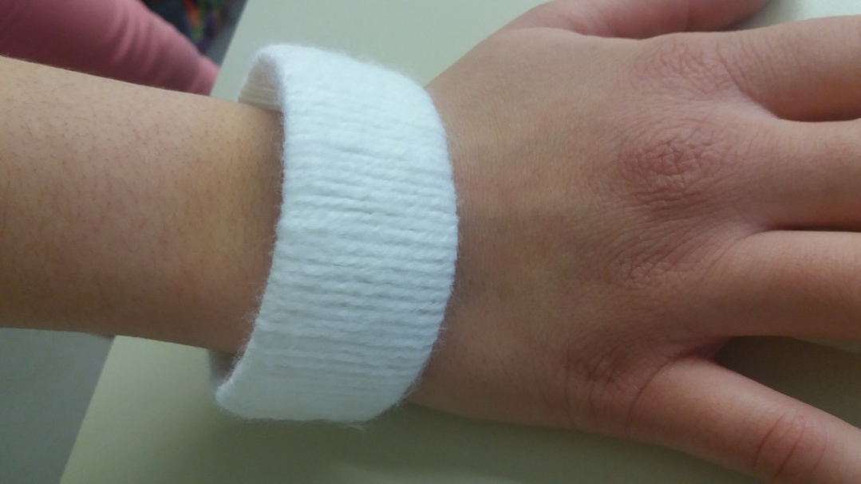
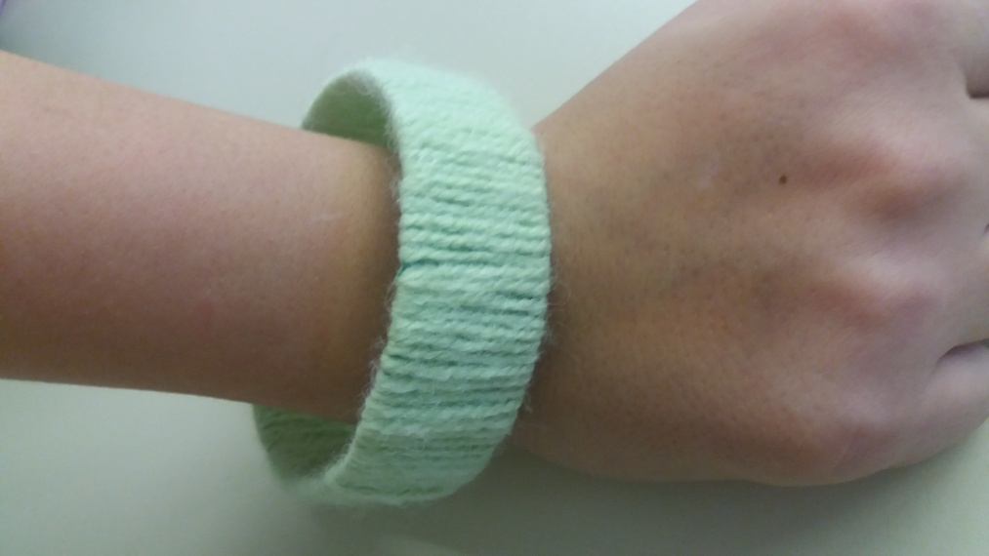

Slide 10
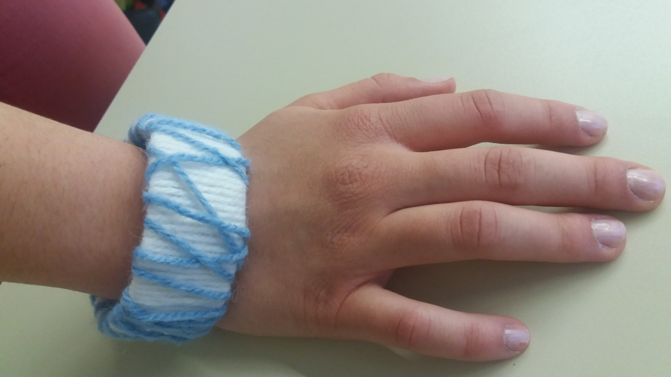
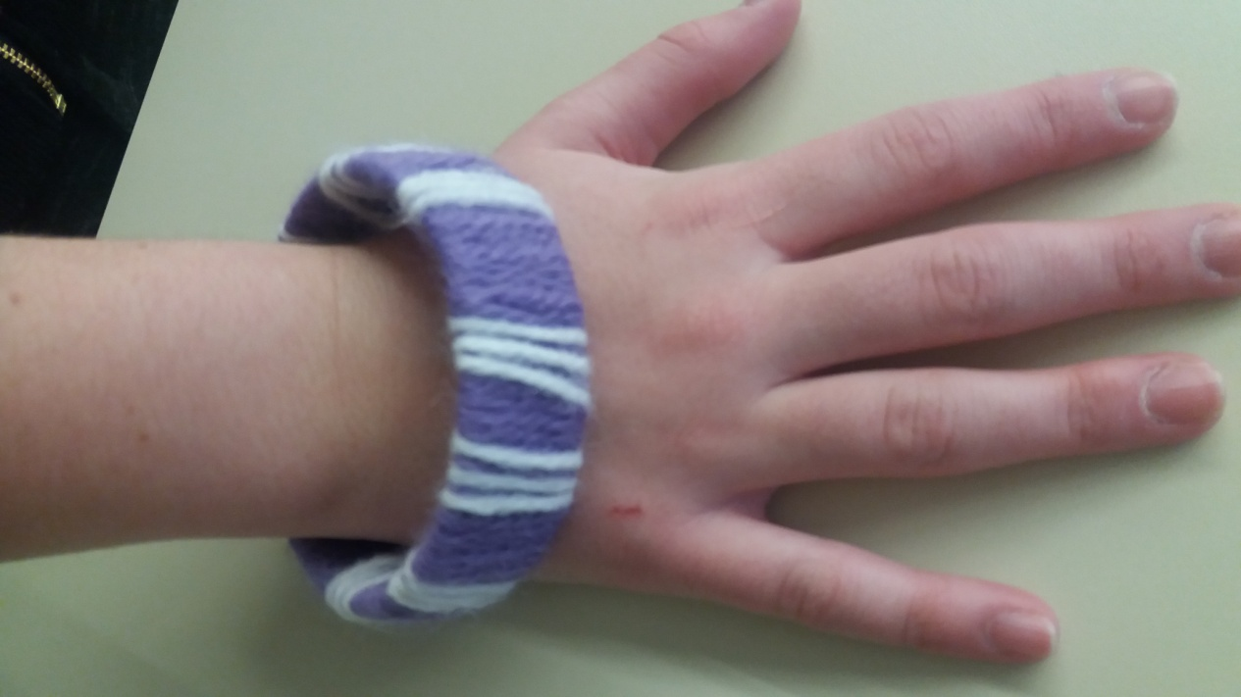

Slide 11
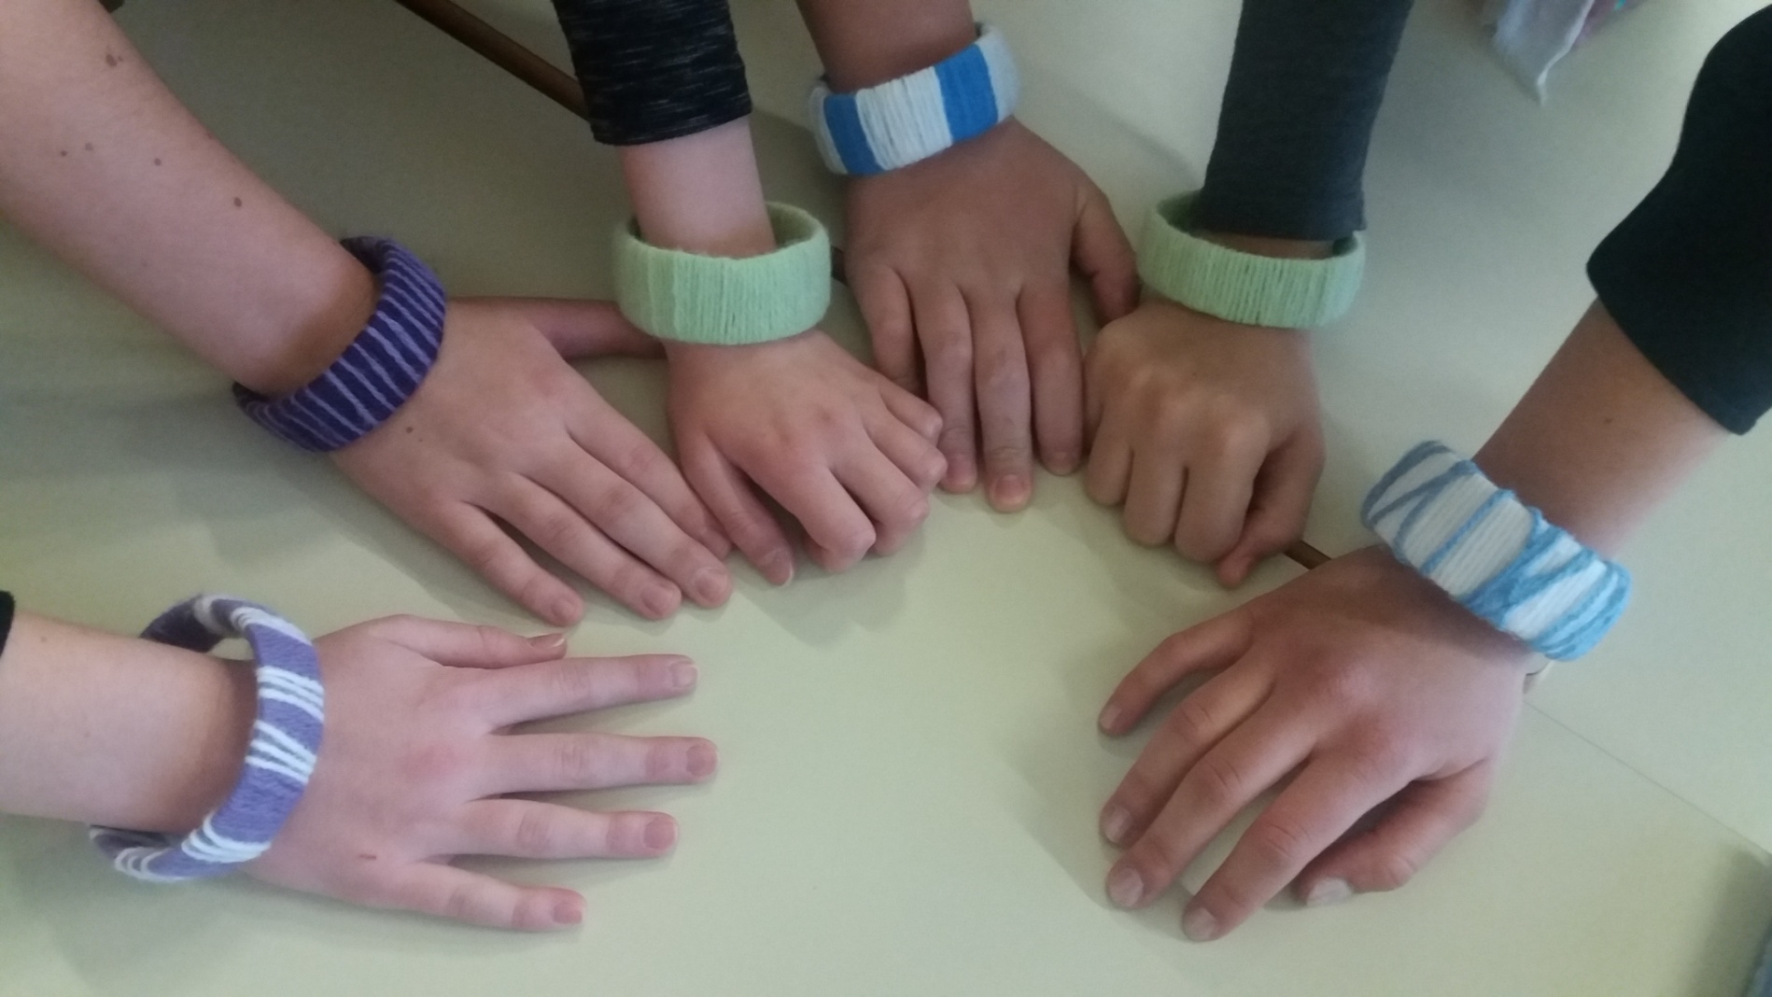

Slide 12
