Slide 1
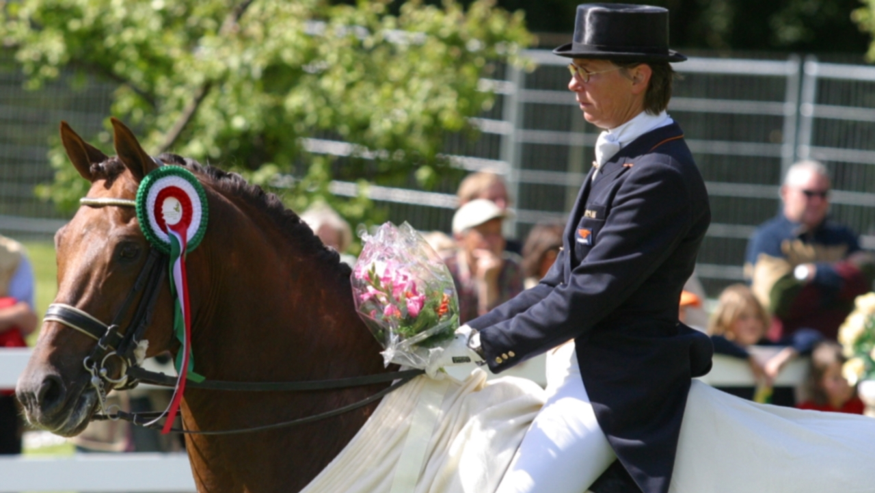
Tineke Bartels
My hero

Slide 2
About Tineke Bartels
Martina Maria Anna Antonia Tineke Bartels de Vries (born: Tineke de Vries) (Eindhoven, 6 February 1951) is a Dutch rider. She took part in the Olympic Games four times and won a total of two silver medals
Klikken om tekst toe te voegen

Slide 3
This Olympic dressage rider started her career in show jumping and military sport. It wasn't until the age of 31 that Tineke made the switch from eventing to dressage. She took home the silver medal at her first World Championship in Toronto in 1980. At the Olympics that followed, she won a silver team medal in Barcelona and Atlanta.

