Slide 1
My bestfriends

Slide 2
contents
The names
How old they are
their biography

Slide 3
The names
Amy
Marieke
Lieke
Eva
chloë

Slide 4
How old they are
Marieke is 11 years old
Amy is 11 years old
Lieke is 12 years old
Eva is 10 years old
chloë is 12 years old

Slide 5
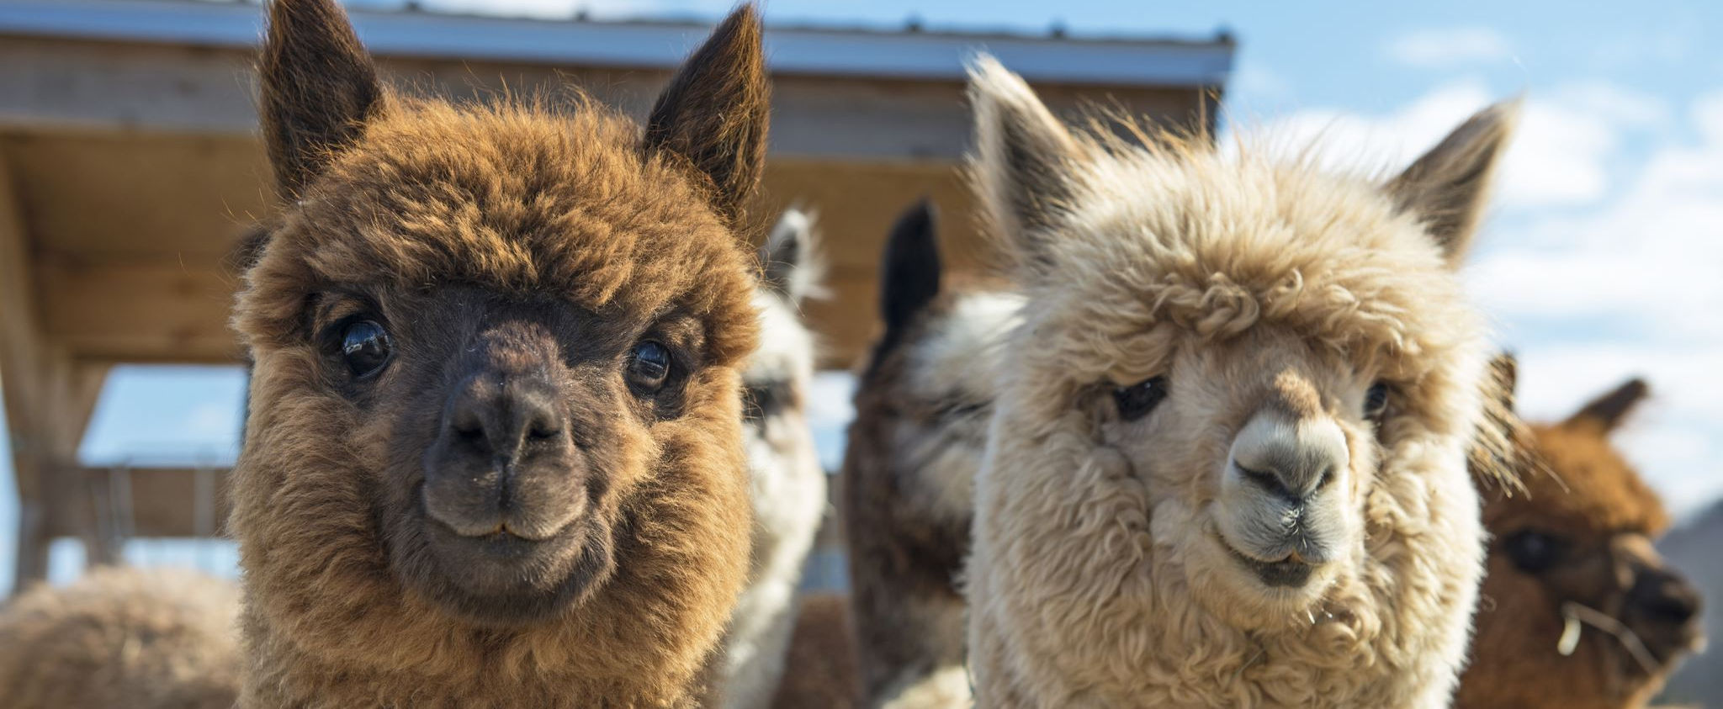
Their biography from Marieke
she has 17 animals 2 brothers height 163 favorite animal alpaca/ llama born on 2010 august 20th

Slide 6
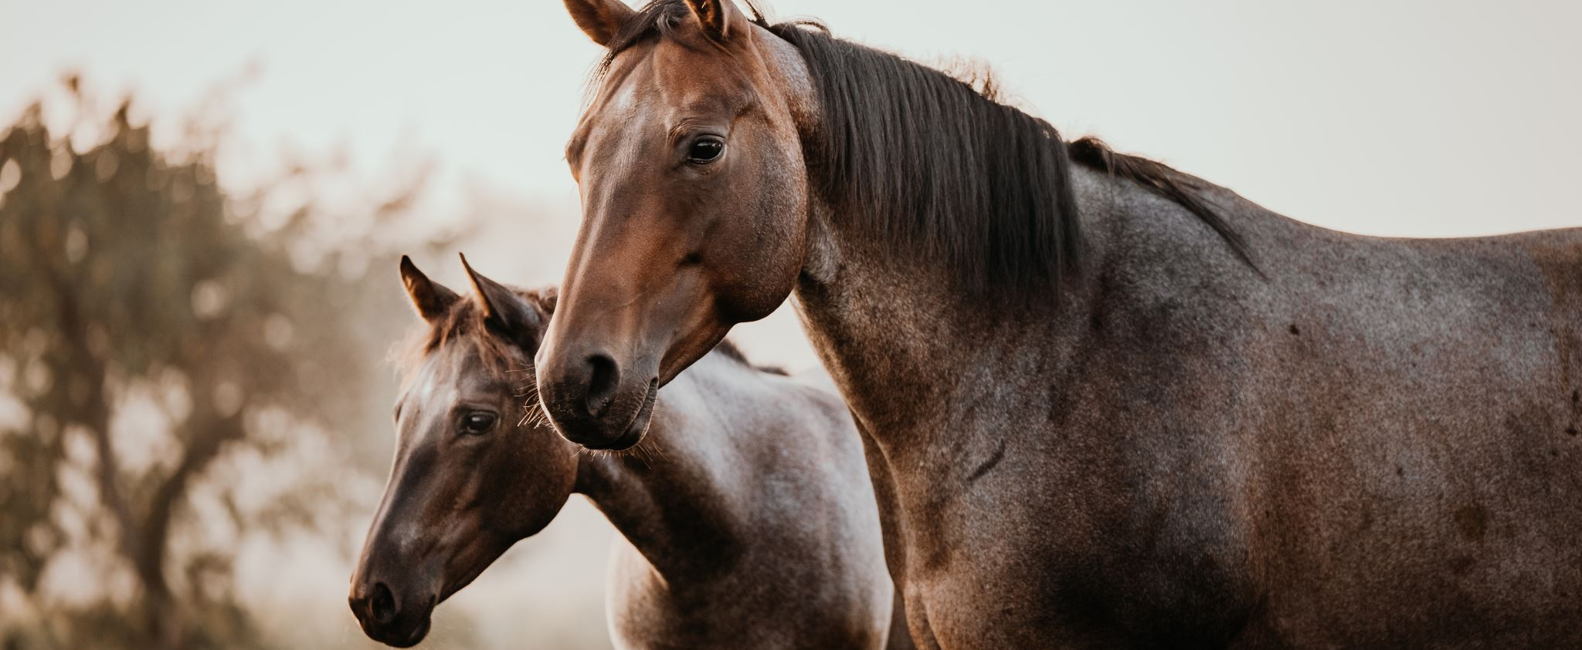
Their biography from Eva
she has 5 animals 1 sister length 150 favorite animal is a horse born on 2011 may 29th

Slide 7
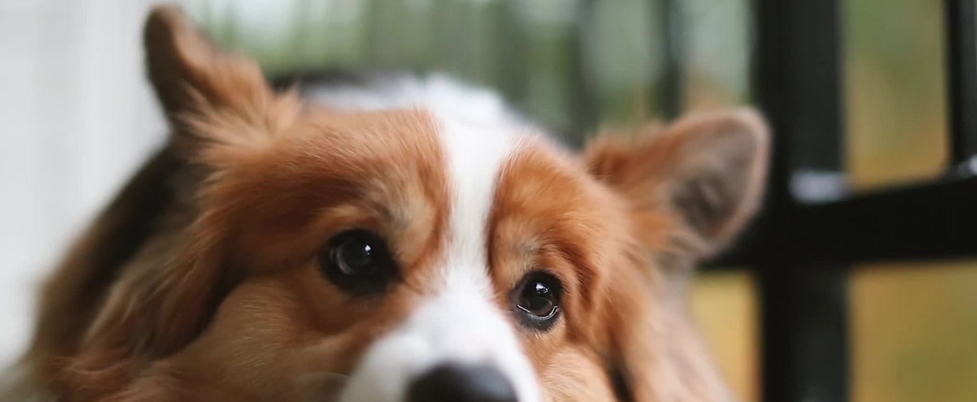
Their biography from amy
she has 4 animals 1 sister length is 145 favorite animal is a dog was born on 2010 August 18

Slide 8
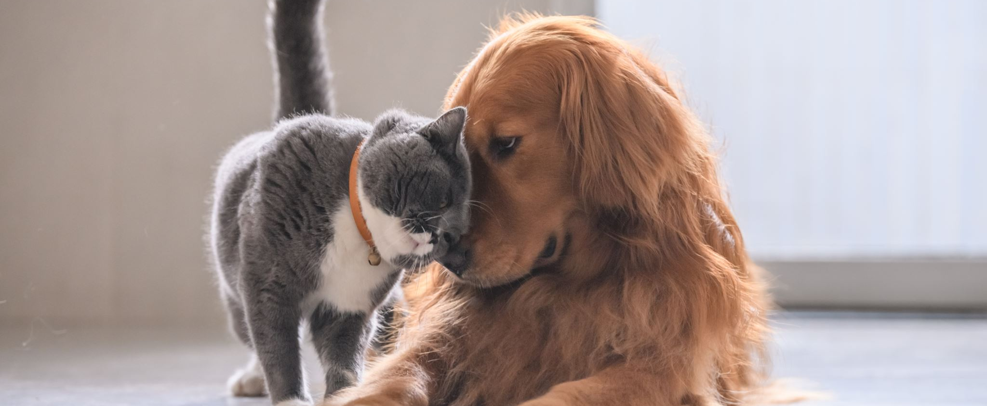
Their biography from lieke
she has 2 animals 1 sister length 162 favorite animals are cat dog horse and hamster.

Slide 9
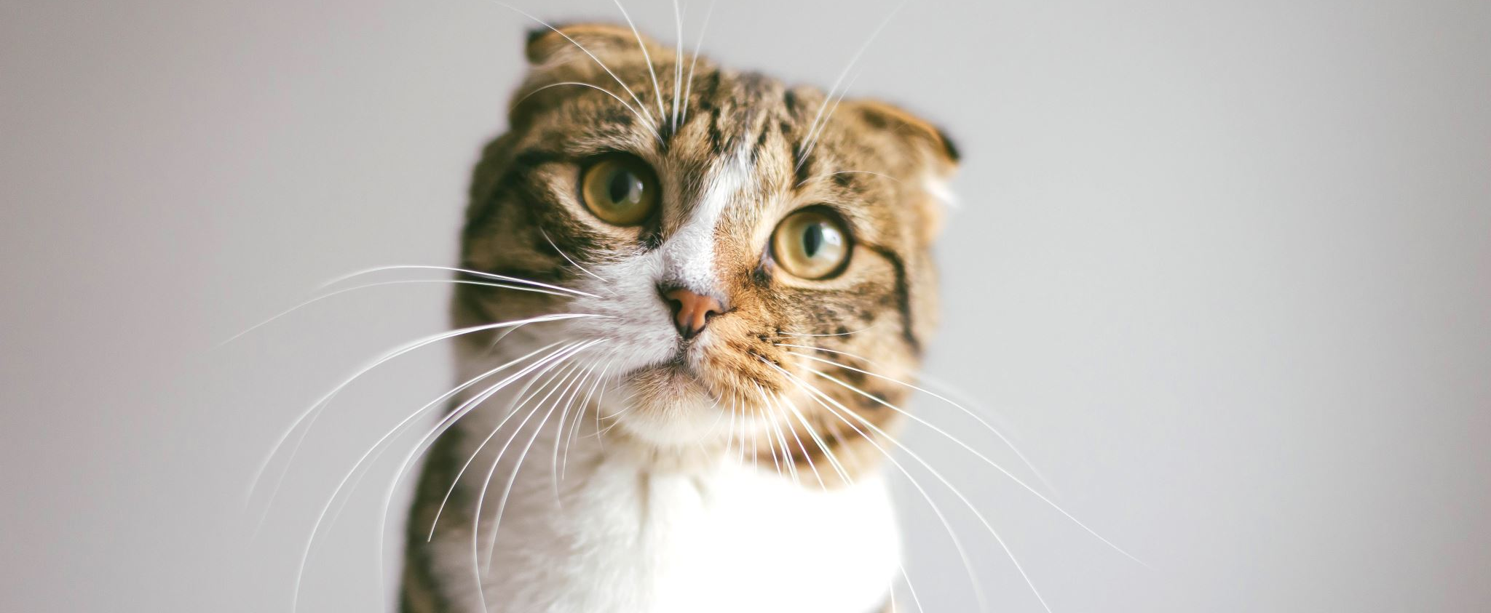
Their biography from Chloë
she has no animals has 1 brother length is 155 favorite animal cat that I think.

