Slide 1
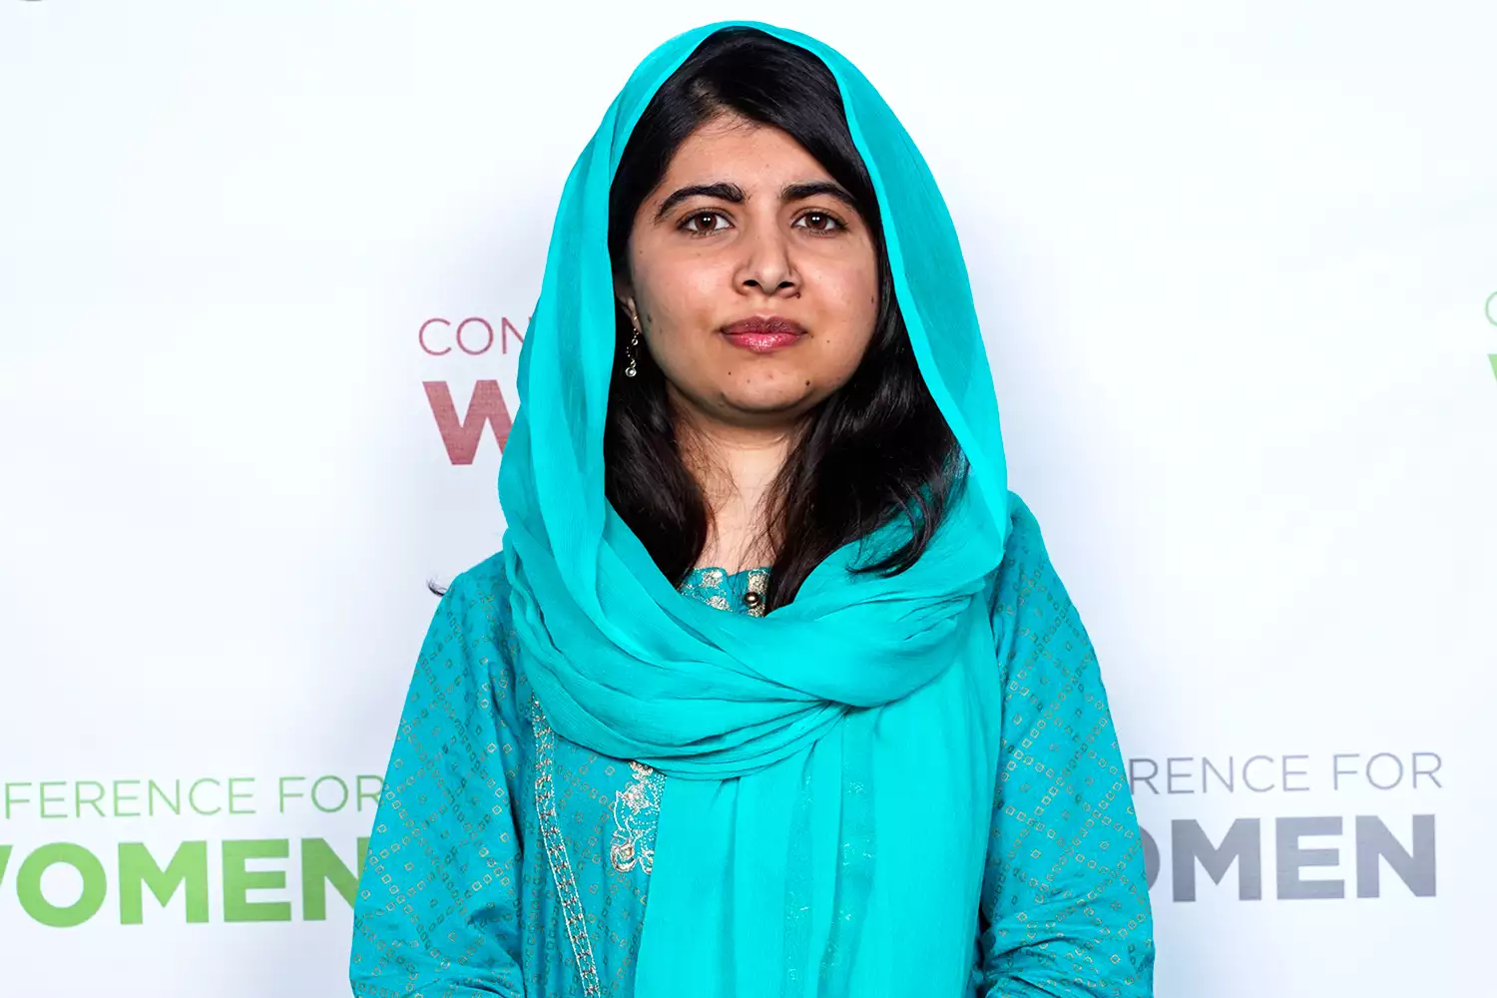
Malala Yousafzai

Slide 2
About Malala
Malala Yousafzai, daughter of a teacher, has become known for her struggle for girls in particular to be allowed to go to school. She rose to fame in 2009 at the age of 11 when she blogged on the BBC website under the pseudonym Gul Makai. In the form of a diary she wrote about the acts of violence perpetrated by the Taliban in the Swat Valley, where girls have been excluded from school and many other human rights violations since the Taliban took power in 2007. Thats why she got selected for the Nobel Peace Price.

Slide 3
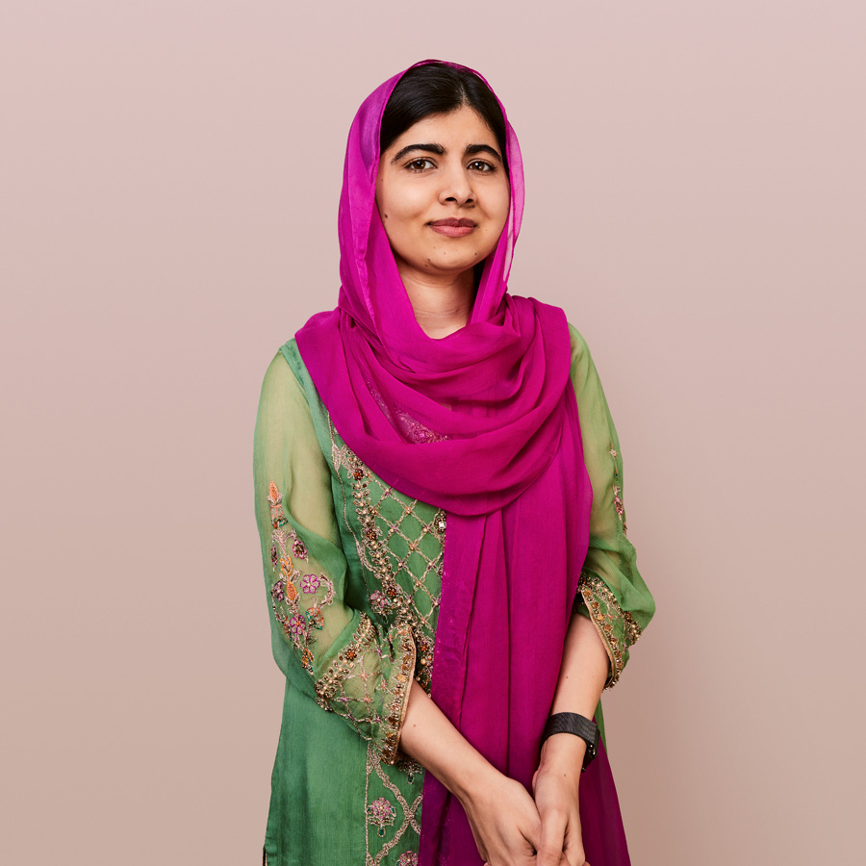
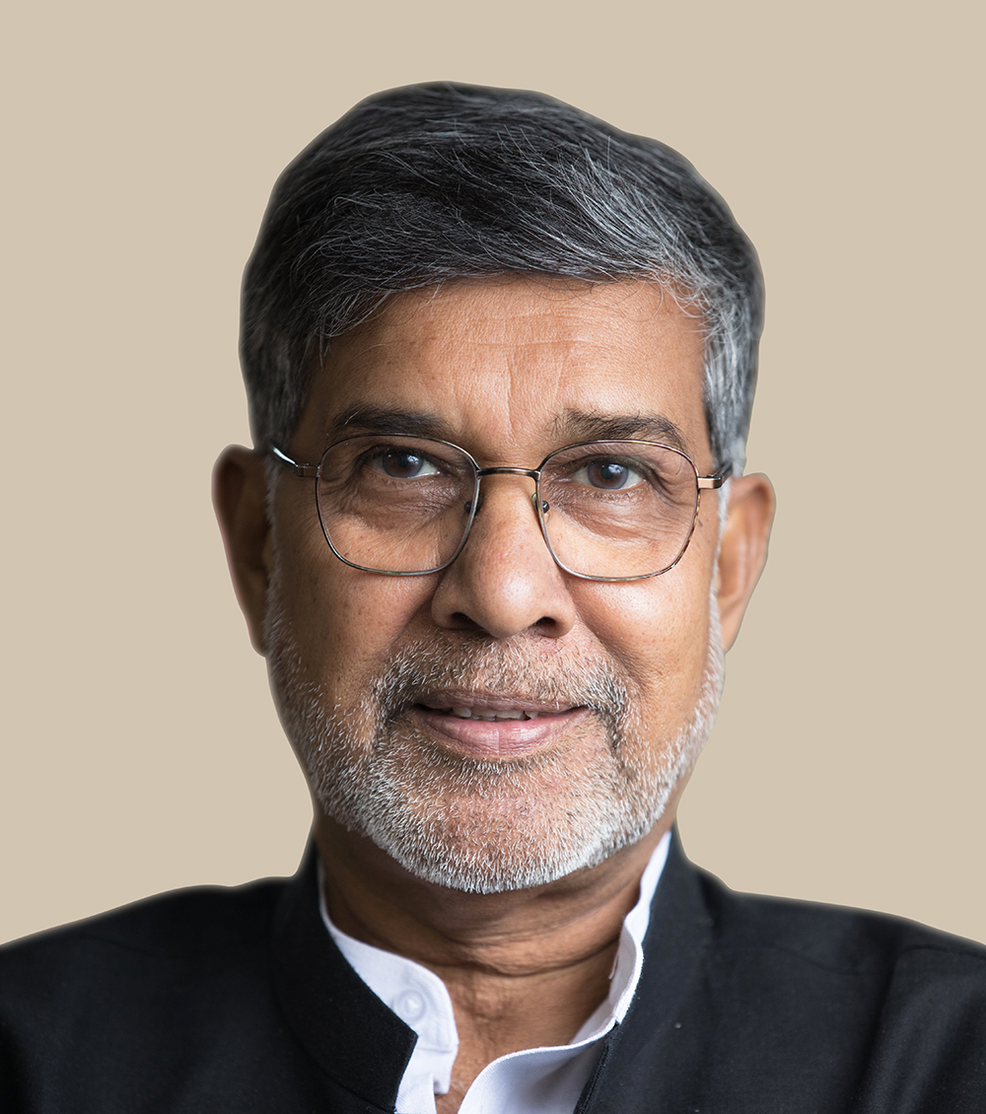
About Malala
Malala is born in Mignora on 12 july 1997. She is a Pakistani children´s rights activist. In 2014 she was awarded the Nobel Peace Prize, along with Kailash Satyarthi.

Slide 5
quizzzzzzzzzzzzzzzzzzzzzzzzzzzzzz
Question 1
When did Malala got the Nobel Peace Price
A 2012
B 2014
C 2013

